Slide 1
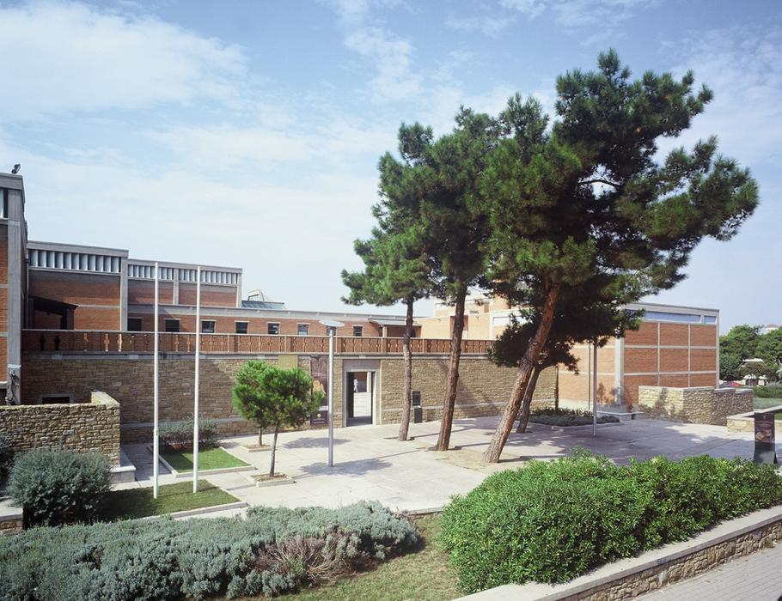
Nea Herakleia Reliquary
Museum of Byzantine Culture, Thessaloniki

Slide 2
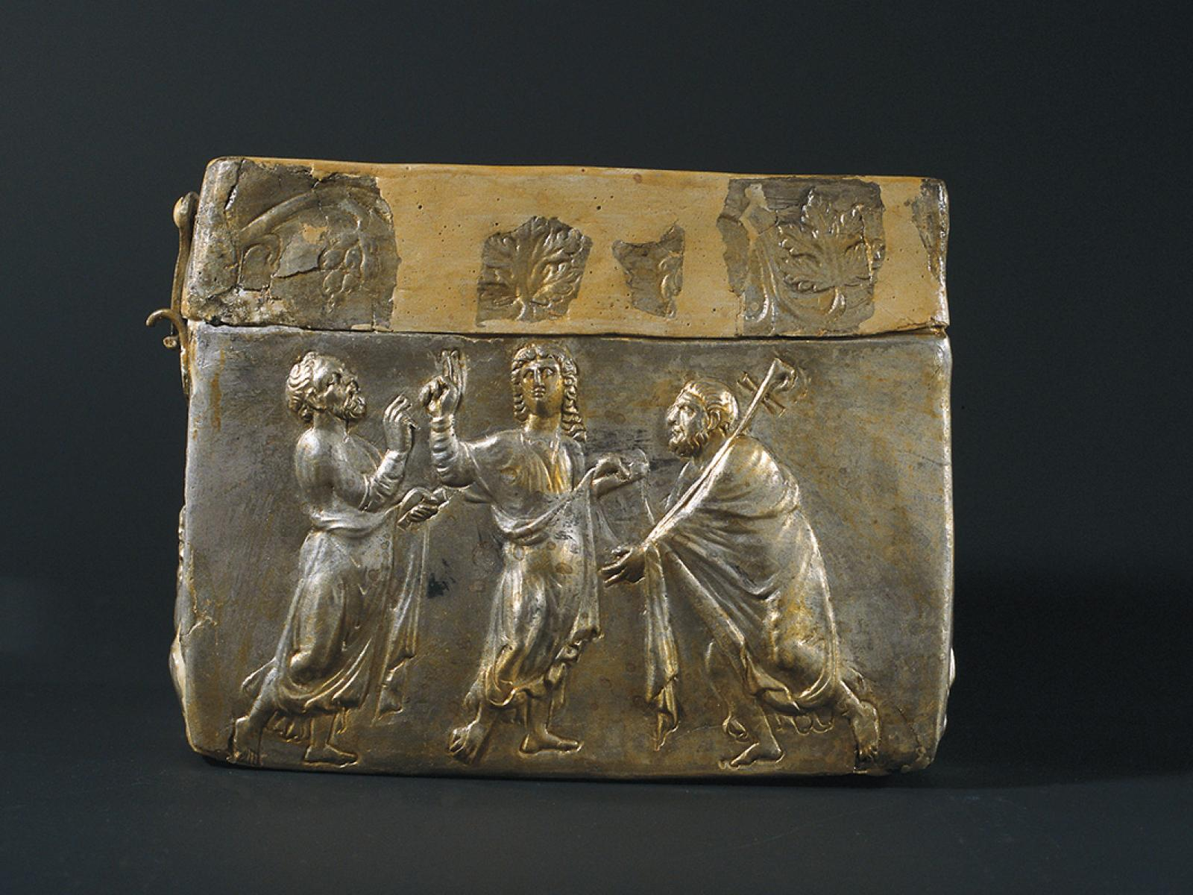
Nea Herakleia Reliquary, 4th century, silver, 9.5 x 12 x 9.5 cm, Museum of Byzantine Culture, Thessaloniki

Slide 3
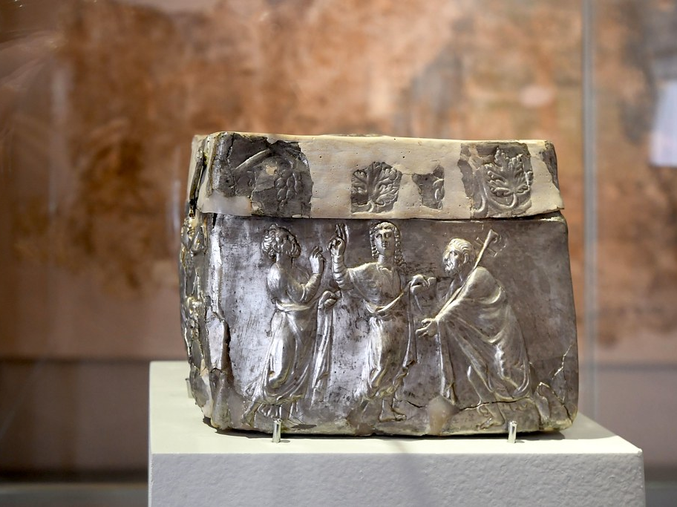

Slide 4
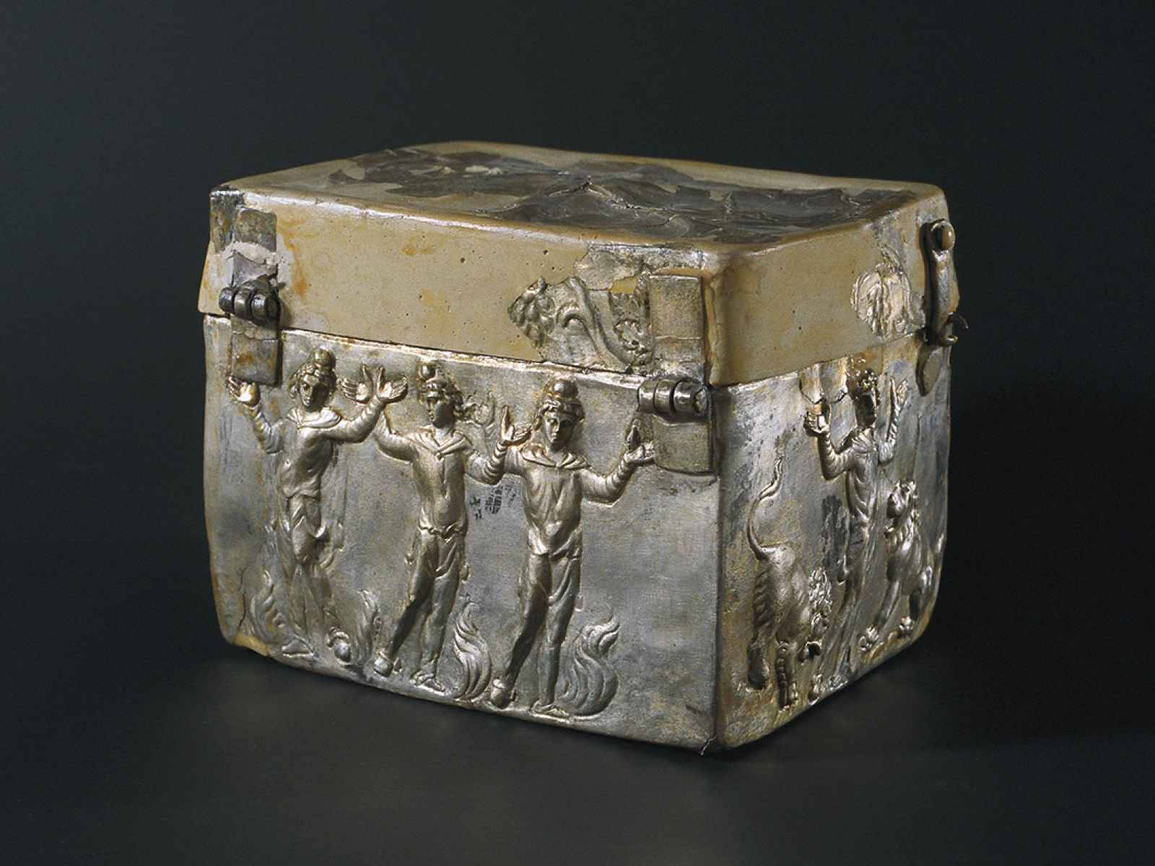

Slide 5
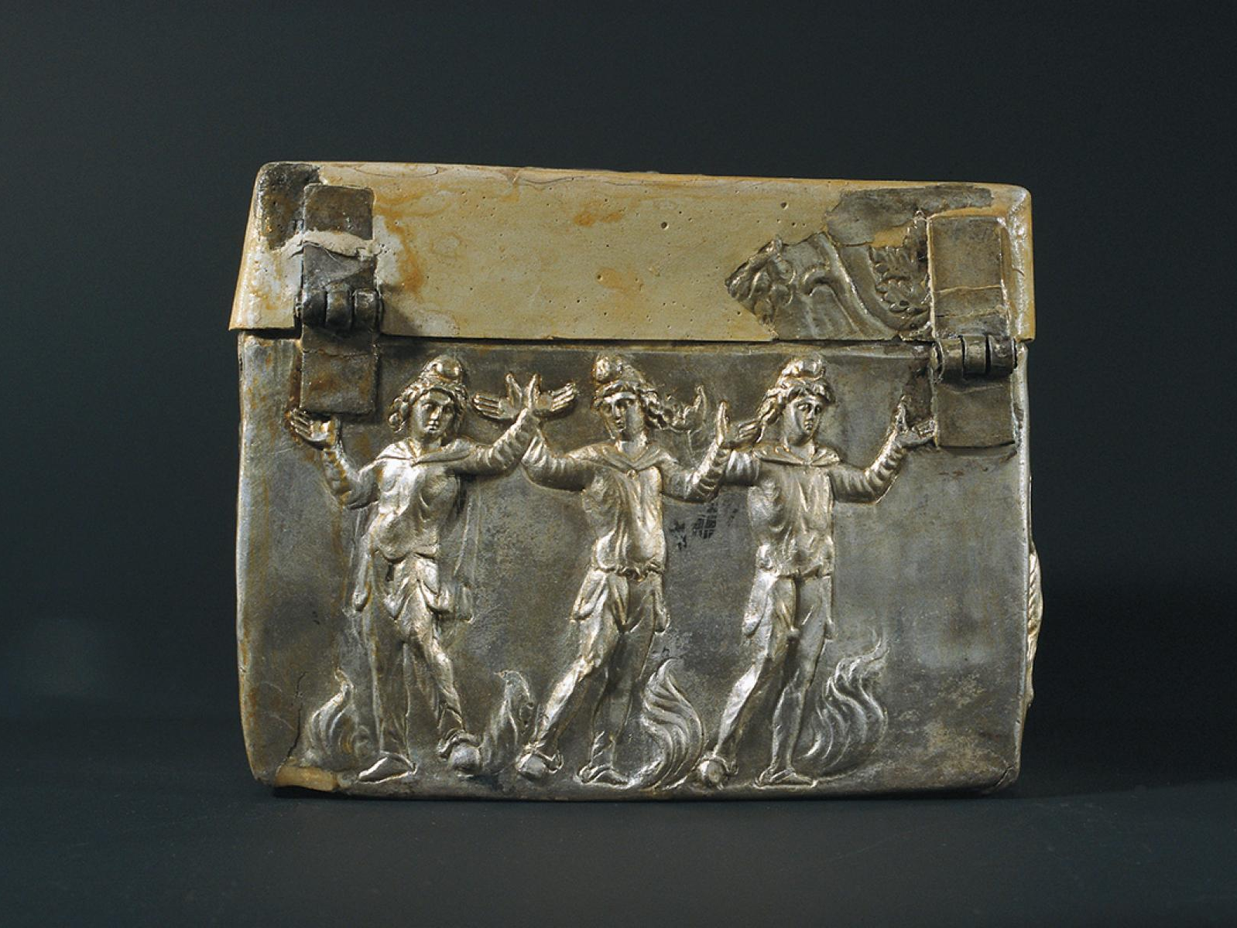

Slide 6
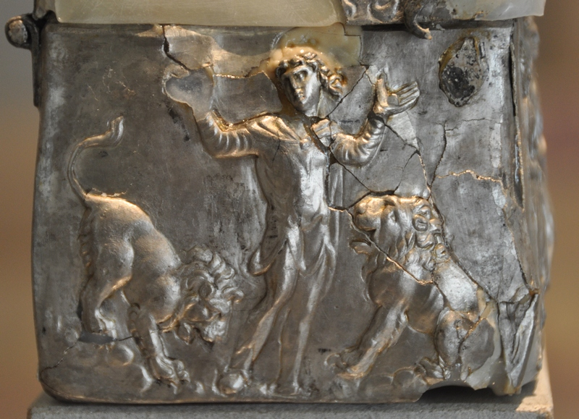

Slide 7
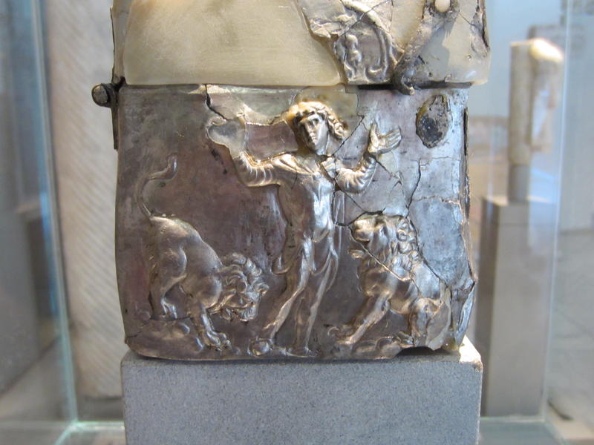

Slide 8
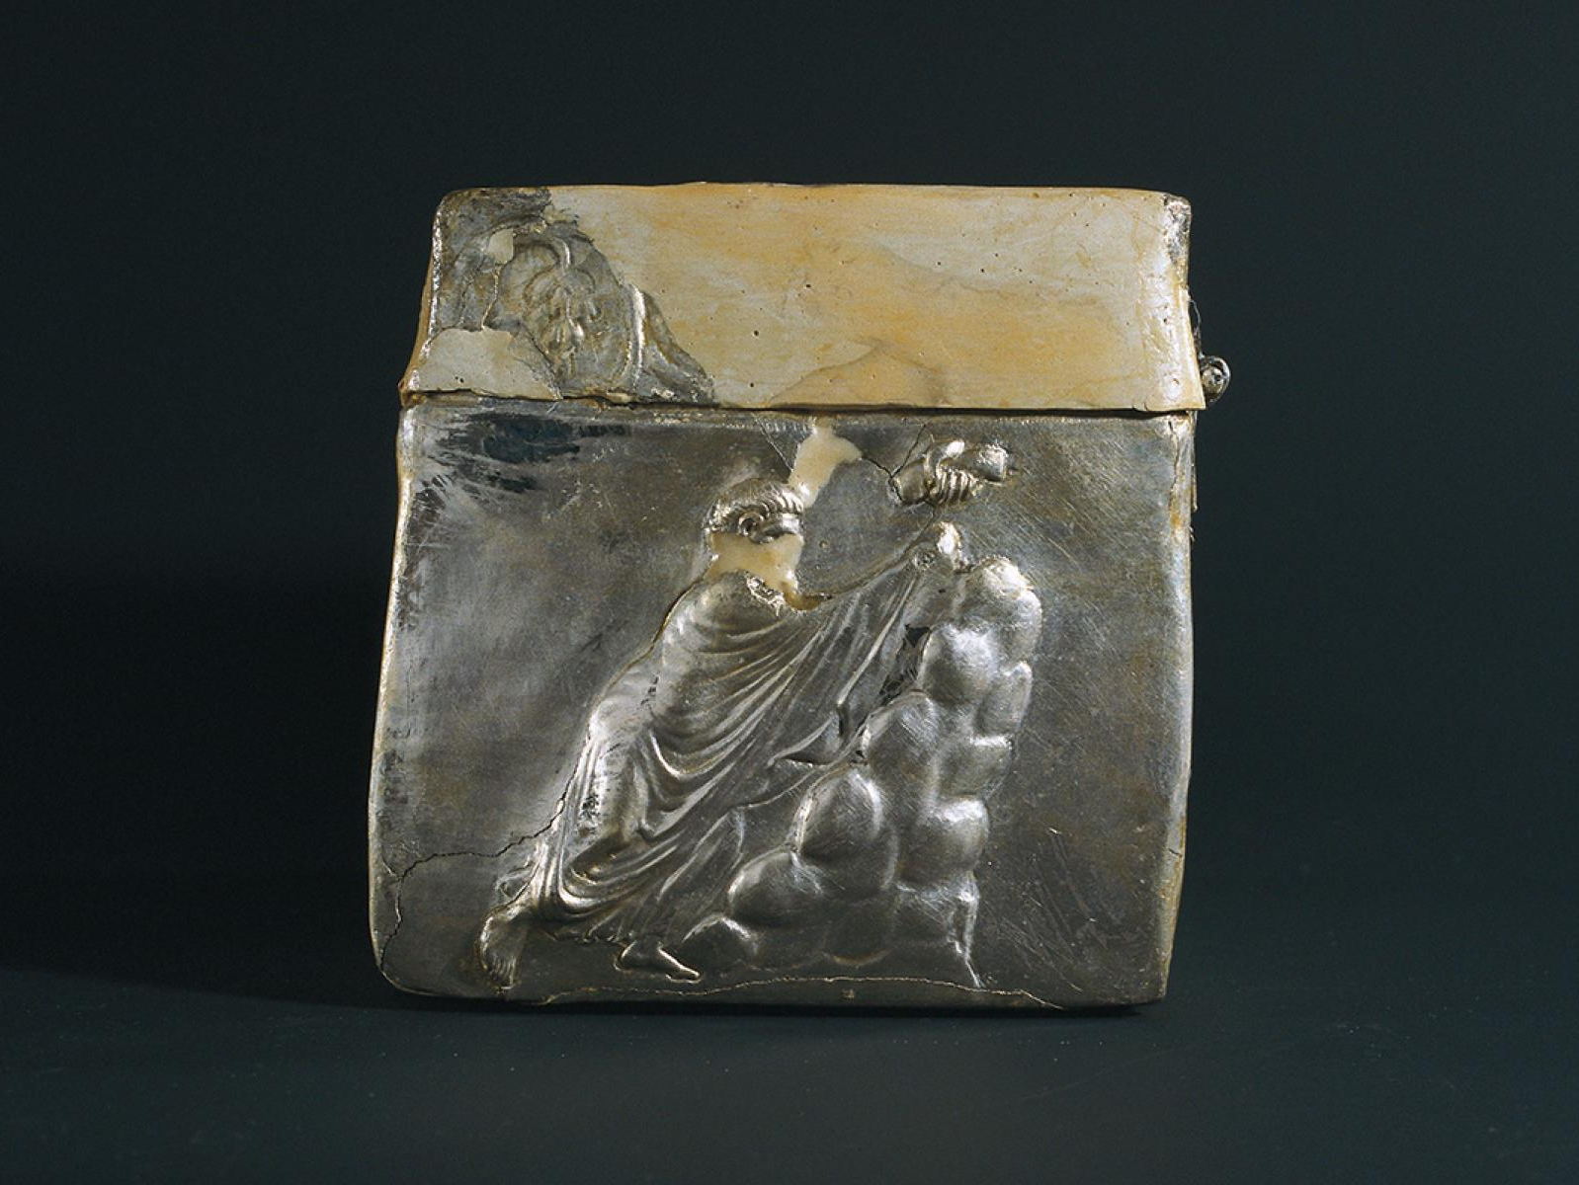

Slide 9
