Slide 1
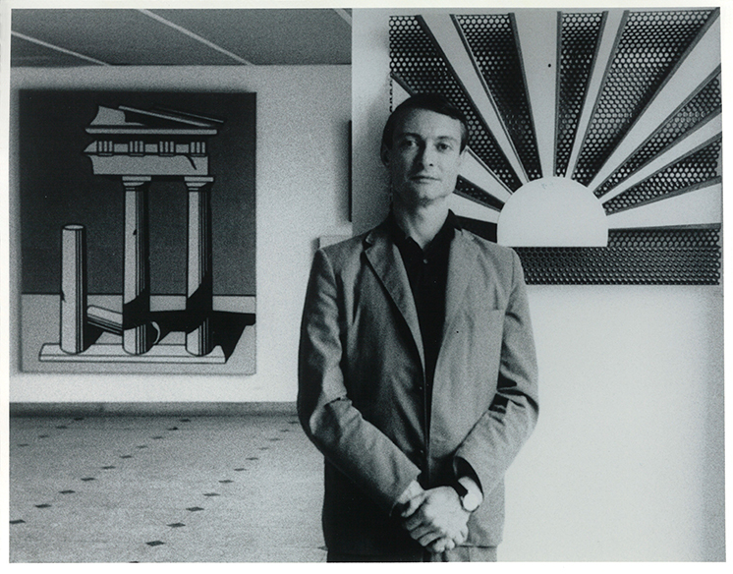
Roy Lichtenstein, 1923 – 1997
Exhibition at Galerie Ileana Sonnabend, Paris, 1965.
Shunk-Kender © Roy Lichtenstein Foundation

Slide 2
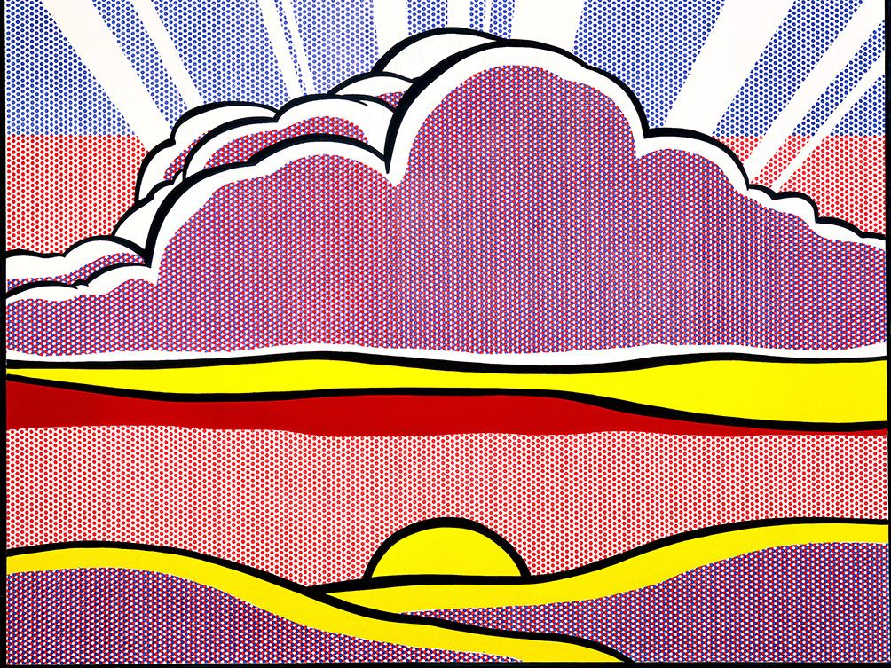
Sinking Sun, 1964, oil and magna on canvas
68 x 80 in. 172.7 x 203.2 cm, private collection

Slide 3
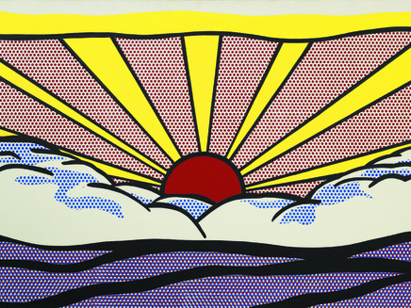
Sunrise, 1965, oil on canvas, 91,4 × 172,7 cm, Estate of Roy Lichtenstein New York

Slide 4
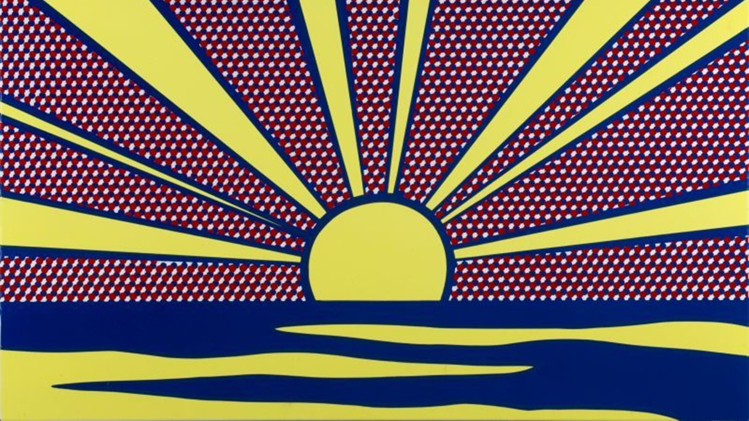
Sunrise, 1965, Enamel on steel, One from an edition of five, 57.5 × 91.5 cm, Basil & Elise Goulandris Foundation, Athens

Slide 5
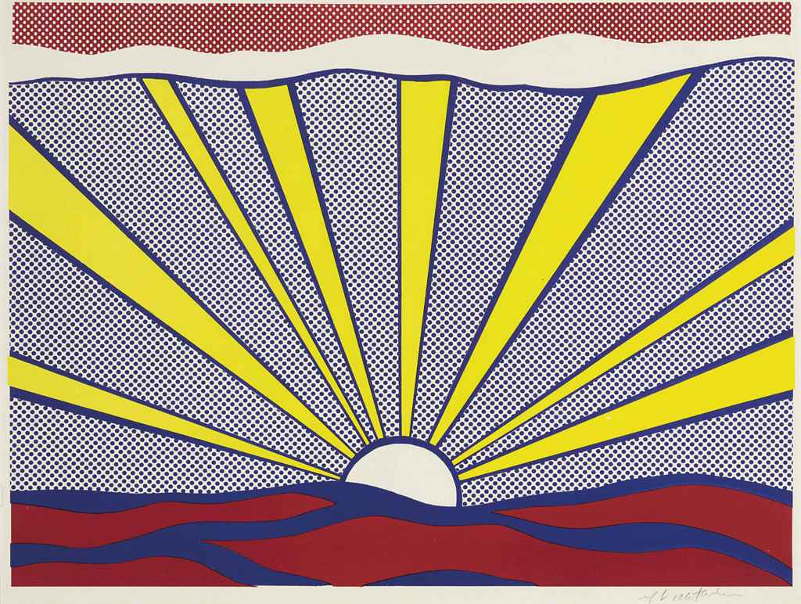
Sunrise, 1965, Offset Lithograph, 18 x 24 cm, private collection

Slide 6
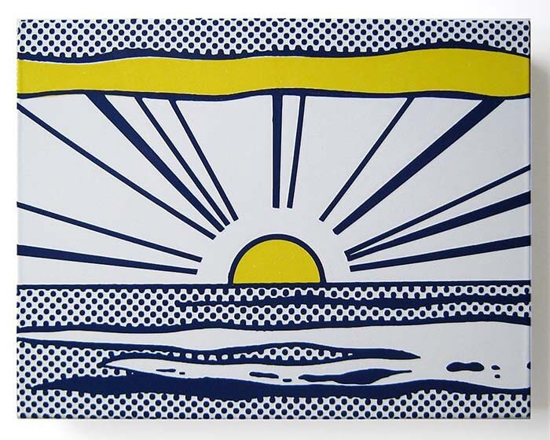
Sunrise, from Seven Objects in a Box, 1965, baked enamel on metal multiple, 216 x 279 x 25 mm, private collection

Slide 7
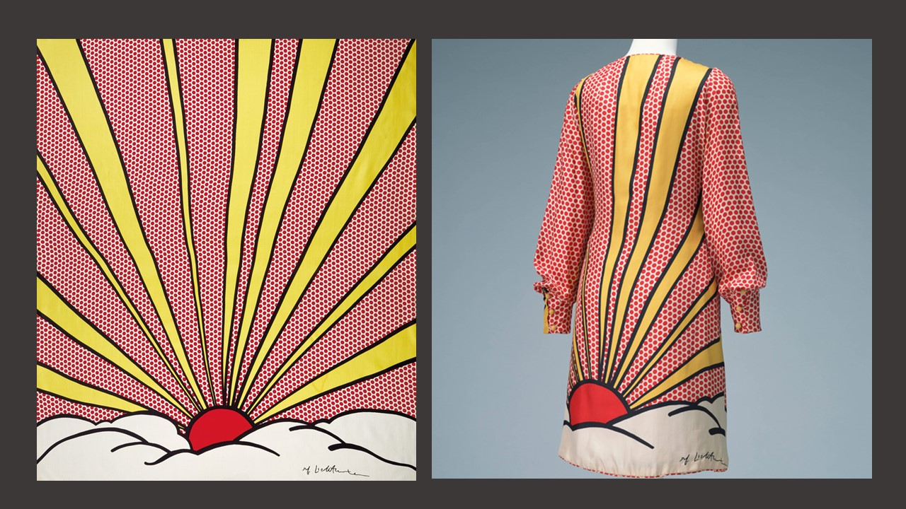
White satin one-piece dress, silk-screen printed by Roy Lichtenstein. Dotted in red all over and the rising sun and clouds on the back. Front and left side opening. Ivory silk satin coat with left side front opening by buttons, The Kyoto Costume Institute

