Slide 1
An Unexpected Comparison!
Roger van der Weyden’s Portrait of a Lady, NGA, Washingon, D.C.
and
A Shrine Head by an unknown Ife (Nigeria) artist, MIA, MN

Slide 2
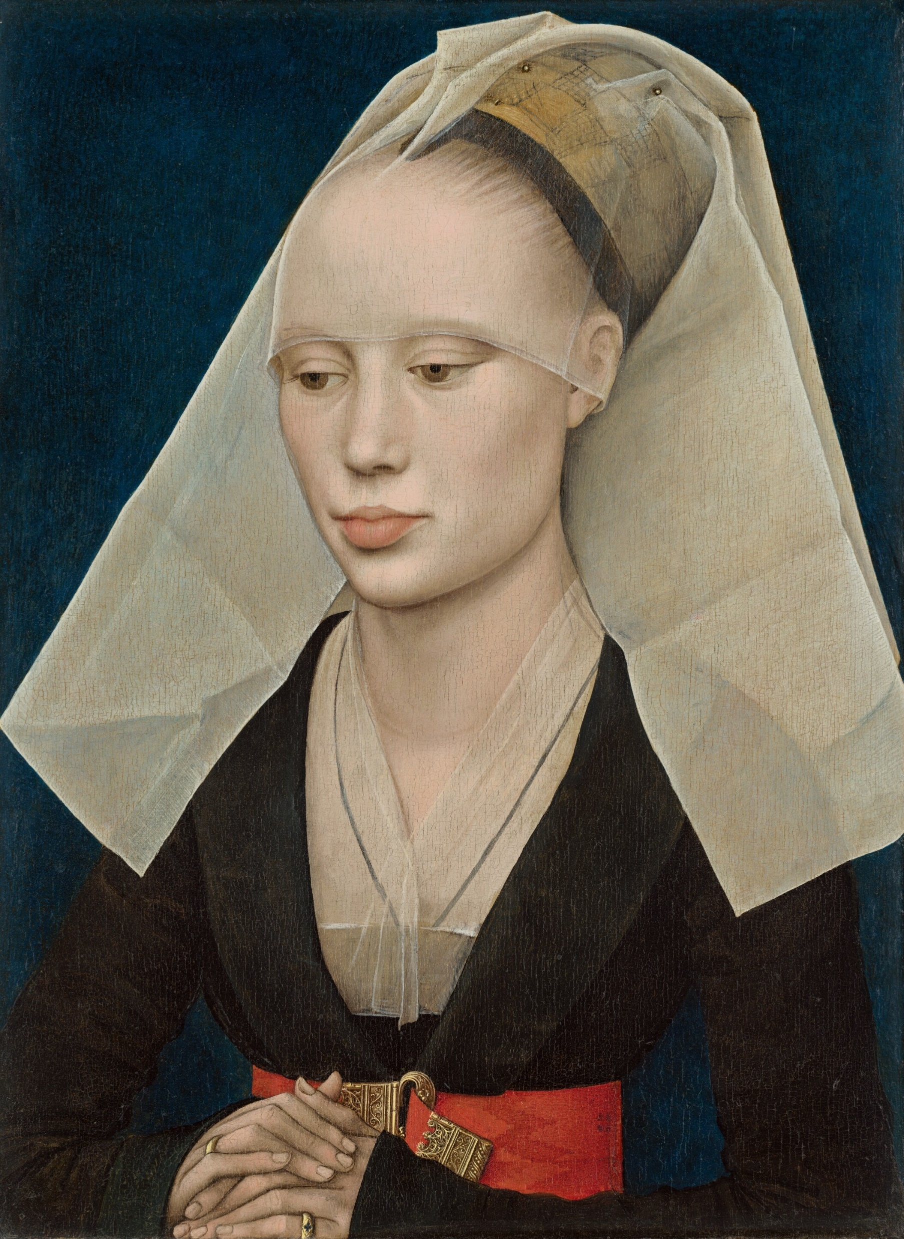
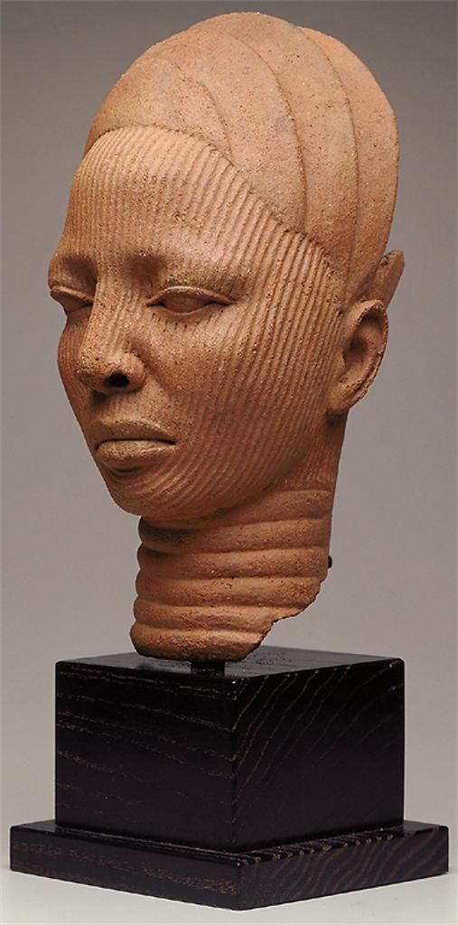

Slide 3
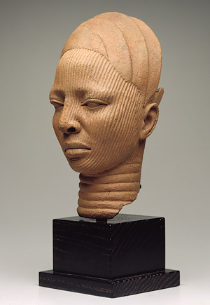
Shrine Head, Ife,
2th-14th century, Terracotta,
31.1 x 14.6 x 18.4 cm
Africa, Nigeria
Minneapolis
Institute of Arts https://gr.pinterest.com/pin/234327986836542117/?lp=true

Slide 4
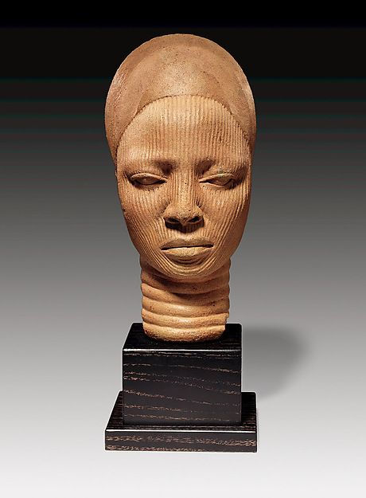
https://www.pinterest.fr/pin/545568942338828499/

Slide 5

Roger van der Weyden,
Portrait of a Lady, c. 1460, oil on oak panel,
34 × 25.5 cm, National Gallery of Art, Washington, D.C.
Credit: https://commons.wikimedia.org/wiki/File:Rogier_van_der_Weyden_Portrait_of_A_lady_C1460.jpg

Slide 6
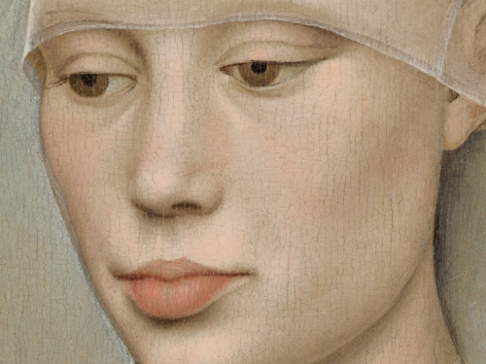

Slide 7
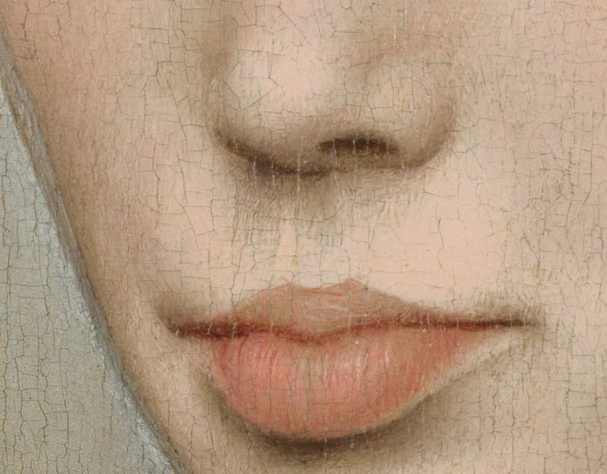

Slide 8
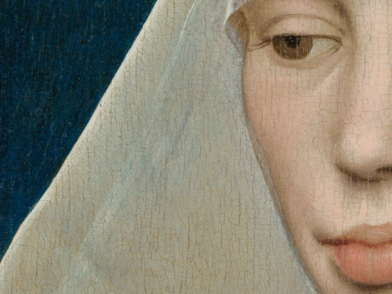

Slide 9
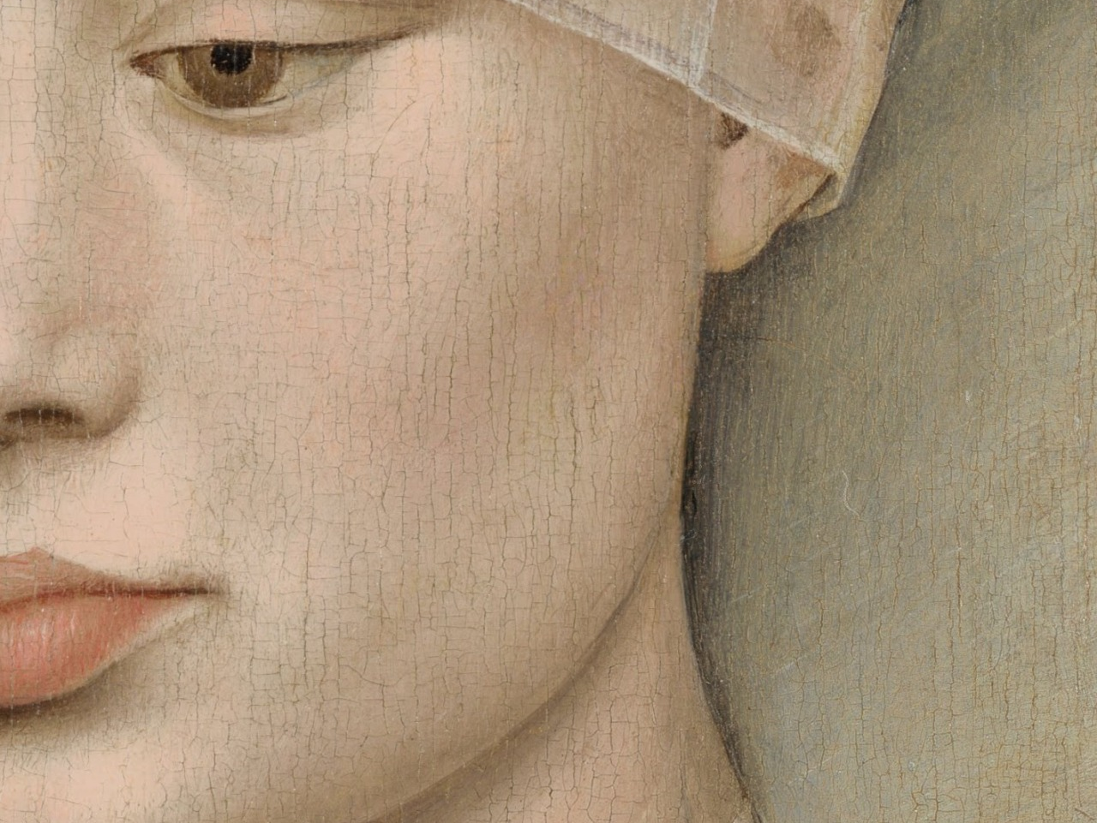
https://artdetails.tumblr.com/post/108224300875/rogier-van-der-weyden-portrait-of-a

