Slide 1
Church of the Holy Saviour in Chora
The Nativity Mosaic
in the Outer Narthex,
14th century

Slide 2
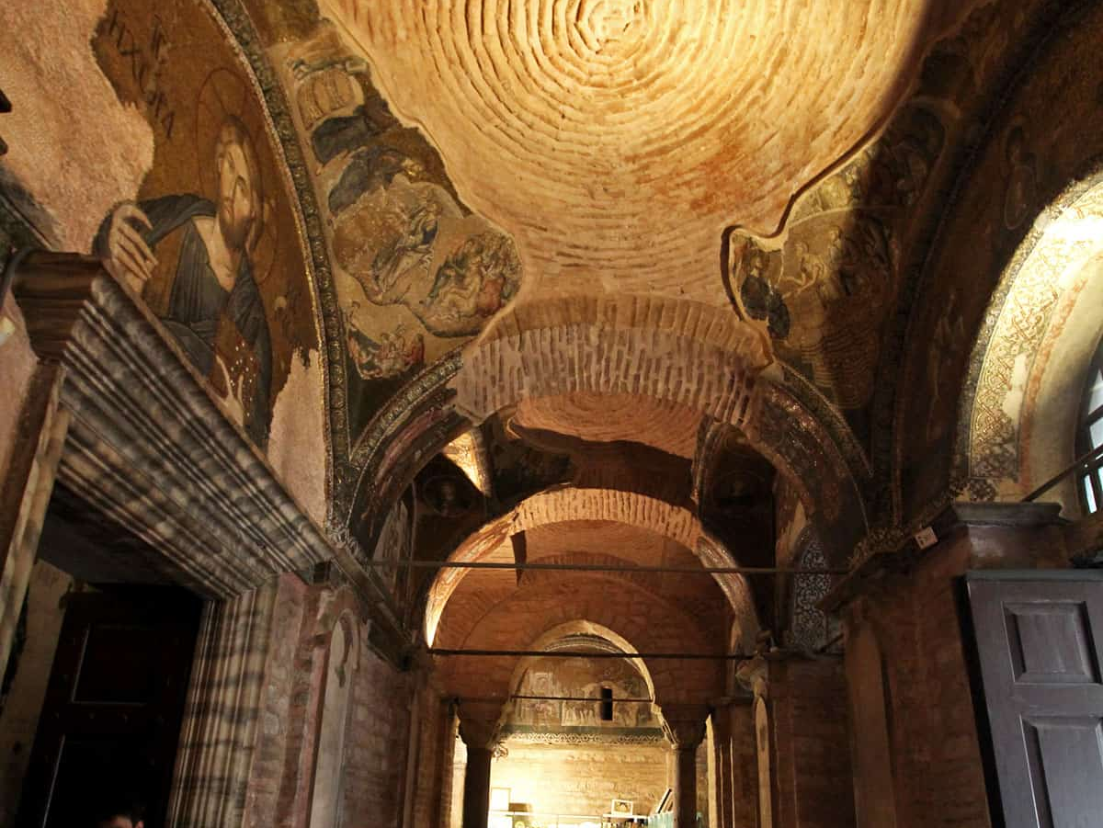

Slide 3
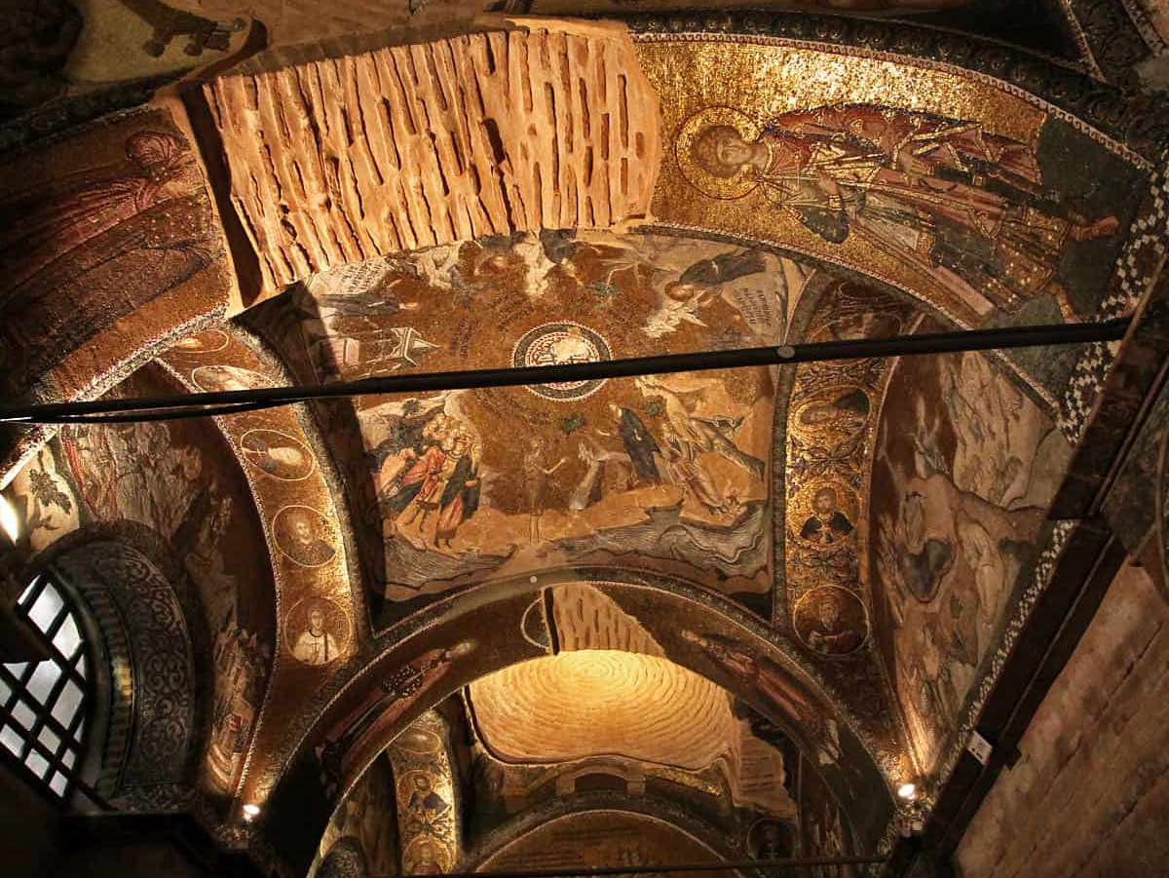

Slide 4
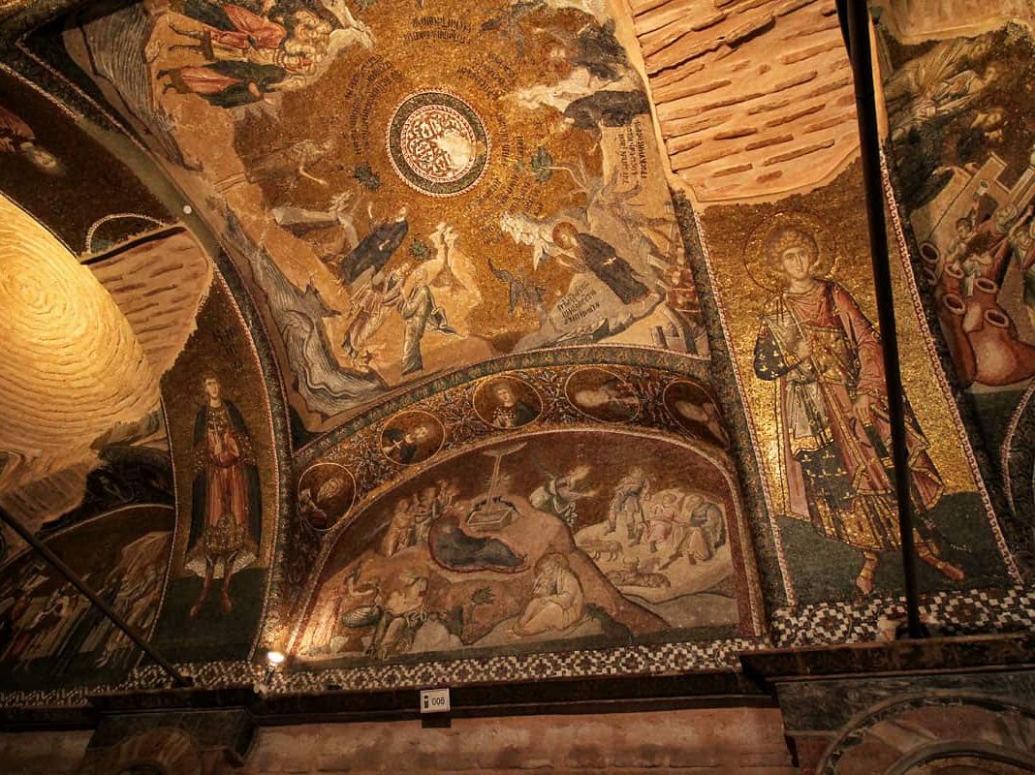

Slide 5
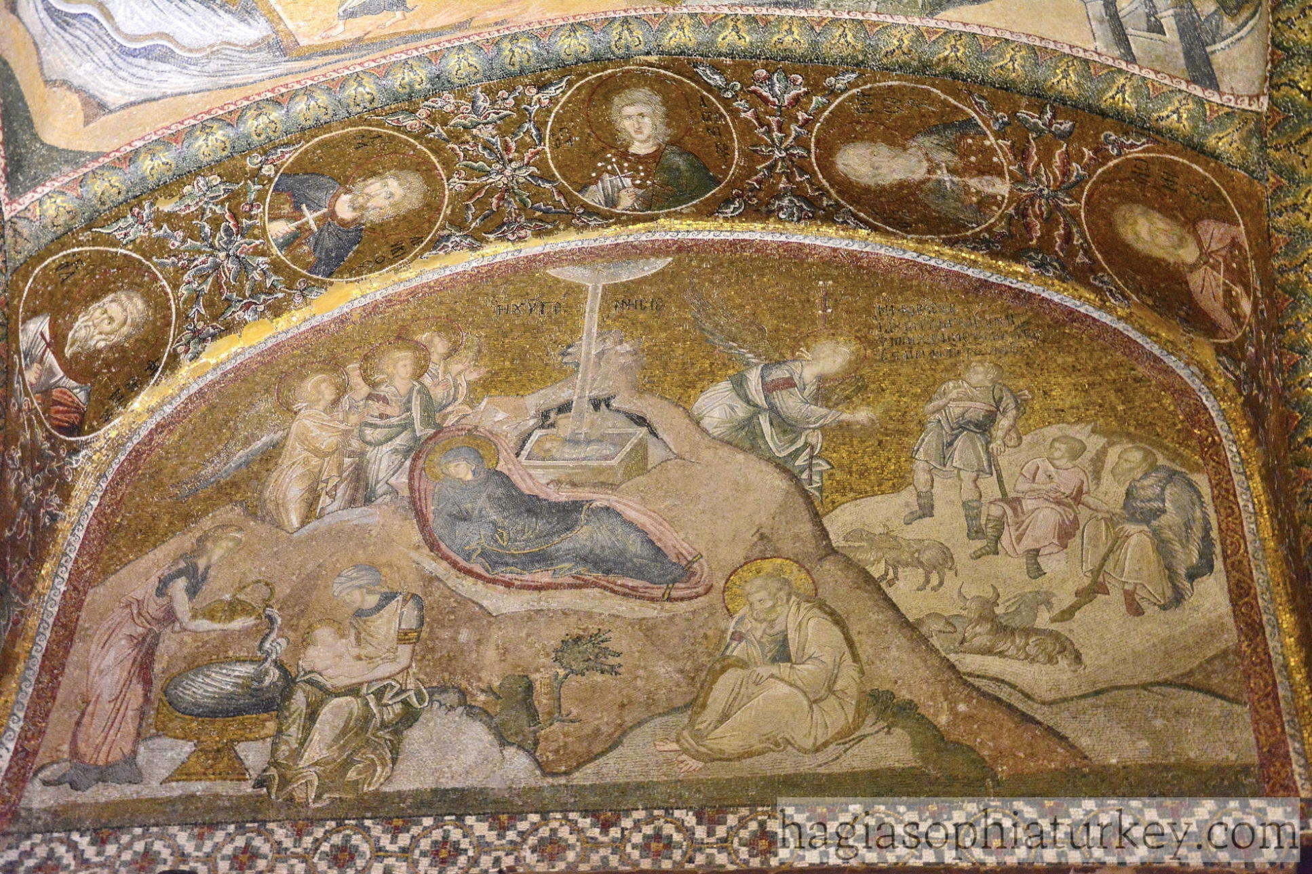

Slide 6
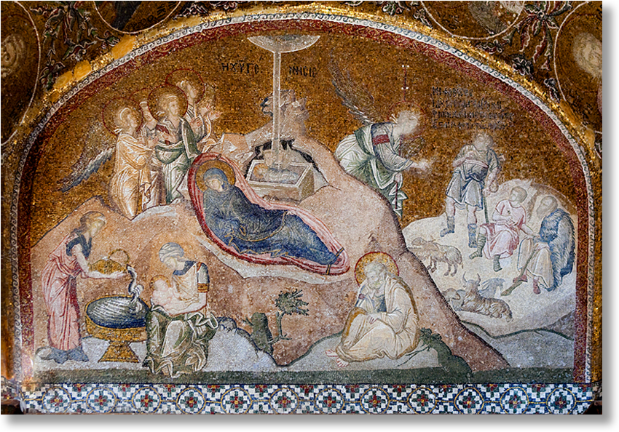

Slide 7
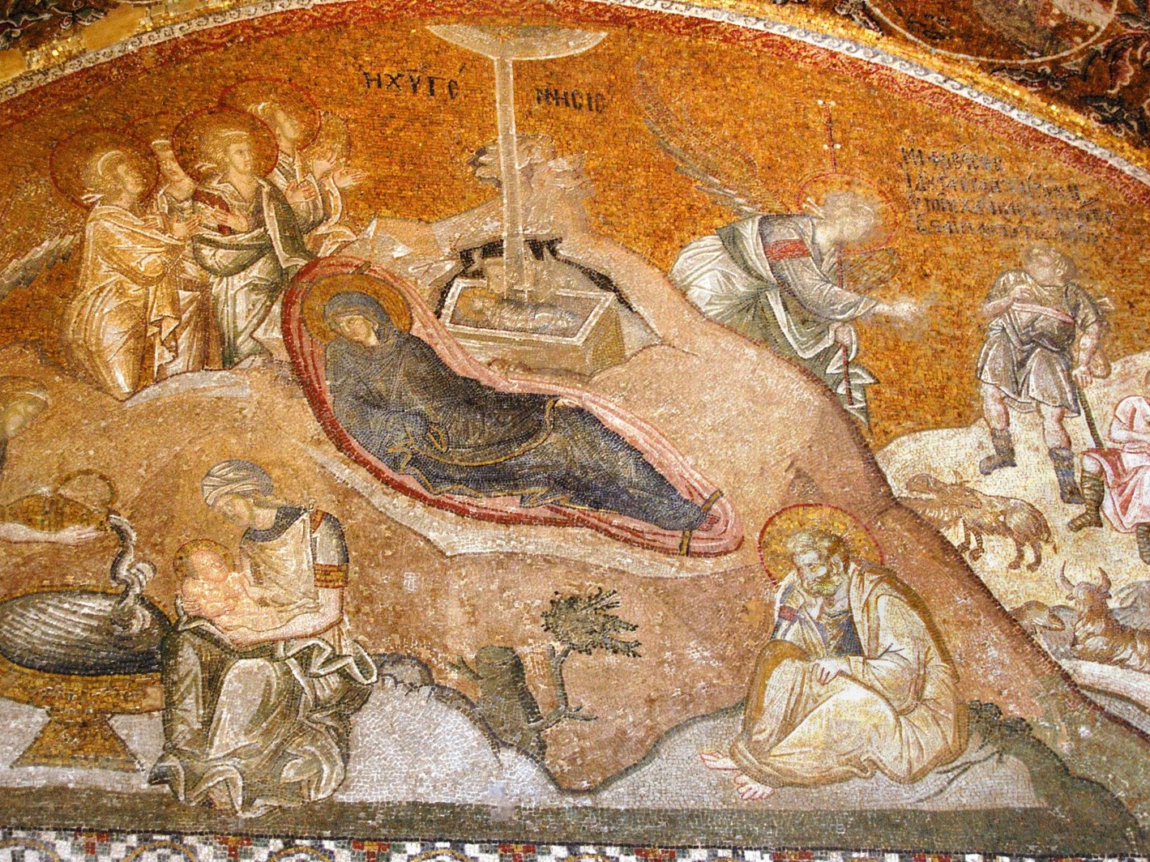

Slide 8
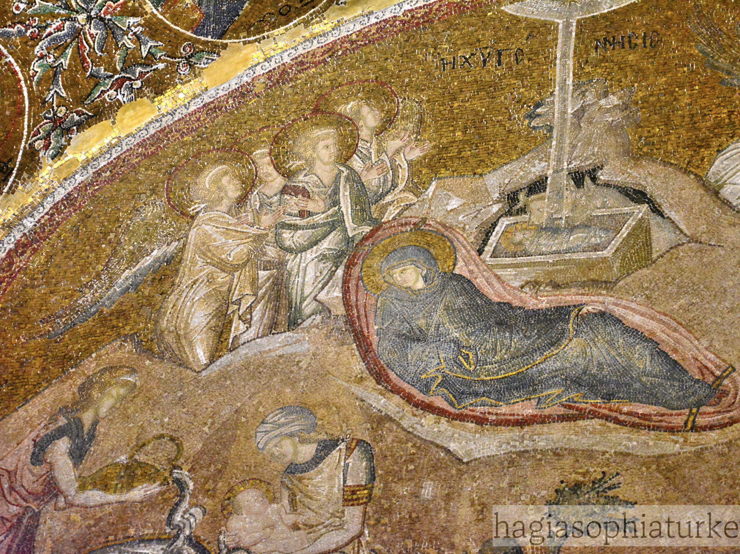

Slide 9
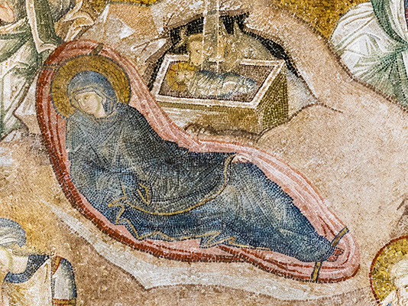

Slide 10
Credits for the Photographs used, go to: https://hagiasophiaturkey.com/outer-narthex-mosaics-chora/ https://www.willflyforfood.net/2016/02/22/chora-church-kariye-museum-home-to-the-most-beautiful-mosaics-in-istanbul-turkey/ http://www.churchofchora.com/chora-outer-narthex-mosaics.html https://www.thebyzantinelegacy.com/chora

