Slide 1
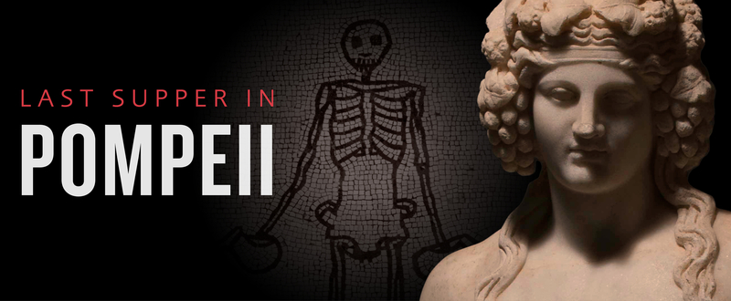

Slide 2
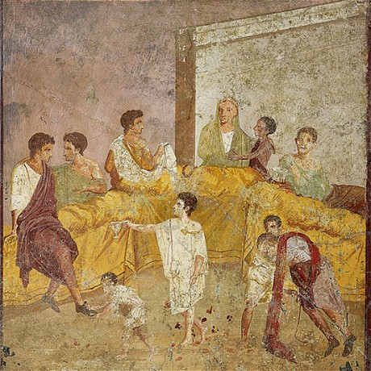
Fresco of a Family Feast, 40-60 AD, from the House of Triclinium,
© Museo Archeologico Nazionale di Napoli

Slide 3
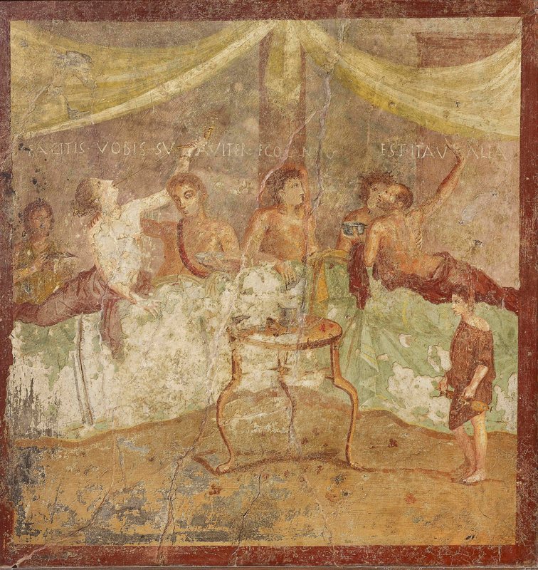
Fresco wall panel showing a dinner party with painted messages: FACITE VOBIS SUAVITER EGO CANTO and EST ITA VALEAS (make yourselves comfortable; I am singing; go for it!), AD 40–79, Pompeii, House of the Triclinium, 68 x 72 cm © Museo Archeologico Nazionale di Napoli

Slide 4
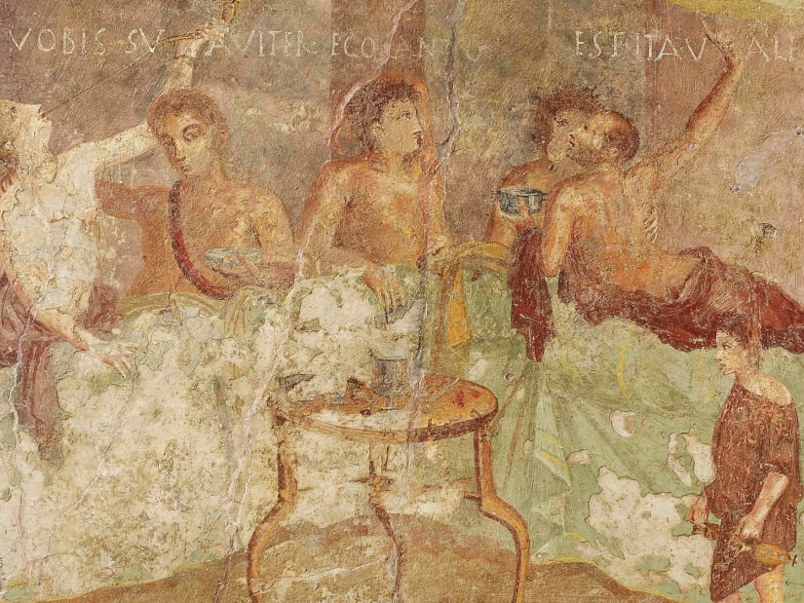

Slide 5
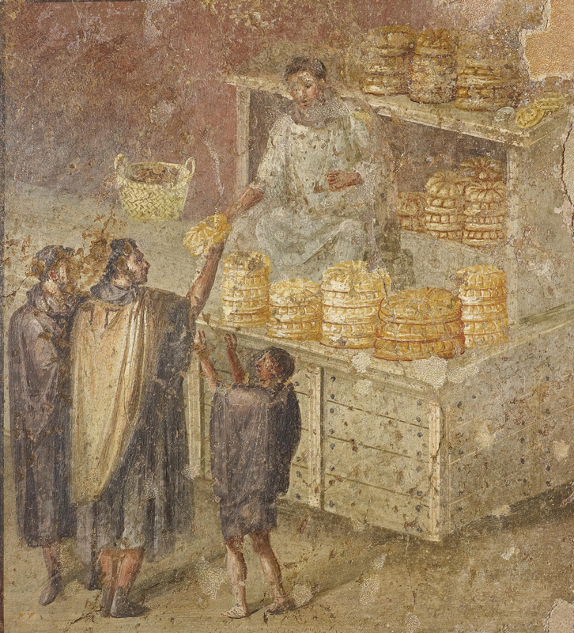
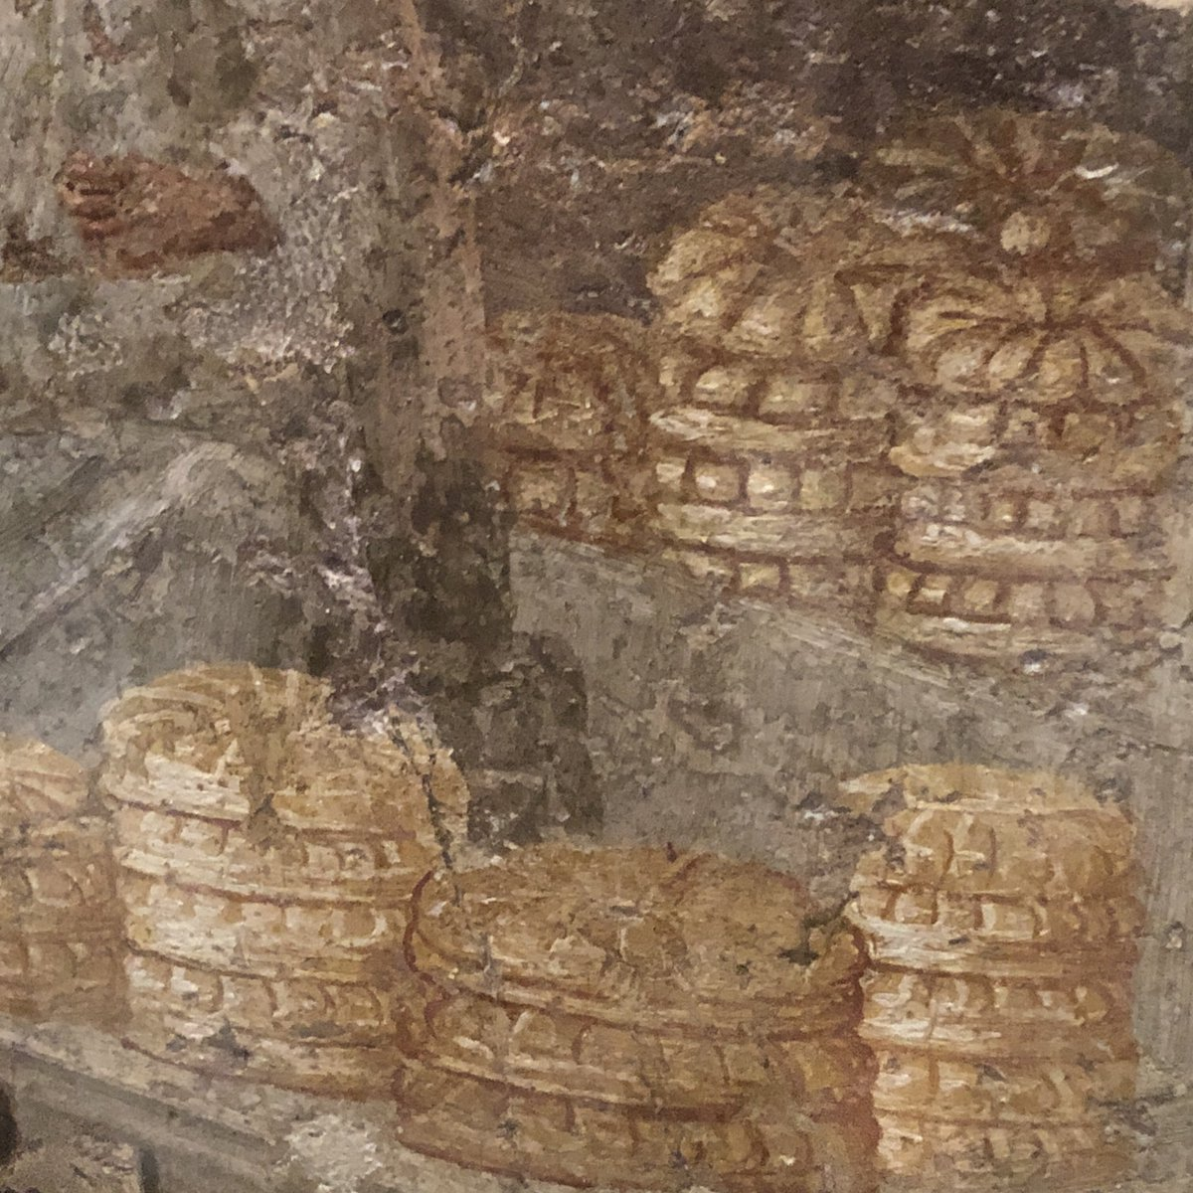
Fresco wall panel showing the Distribution of Bread, AD 40–79, Pompeii, House of the Baker, 69 x 60 cm © Museo Archeologico Nazionale di Napoli

Slide 6
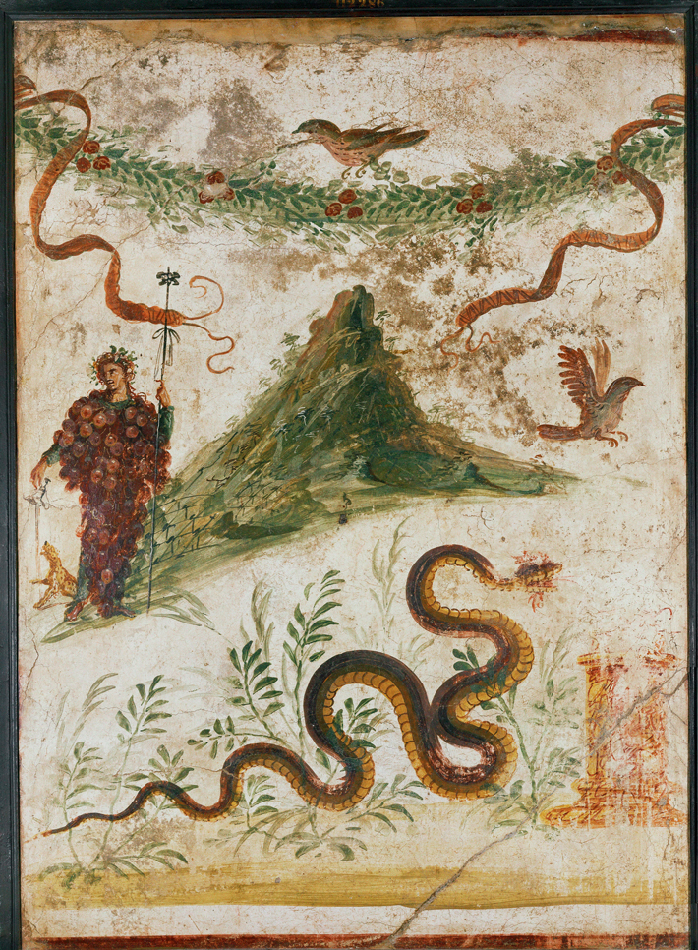
Fresco from a Lararium showing Bacchus covered with grapes next to Mount Vesuvius, AD 60-79, © Museo Archeologico Nazionale di Napoli

Slide 7
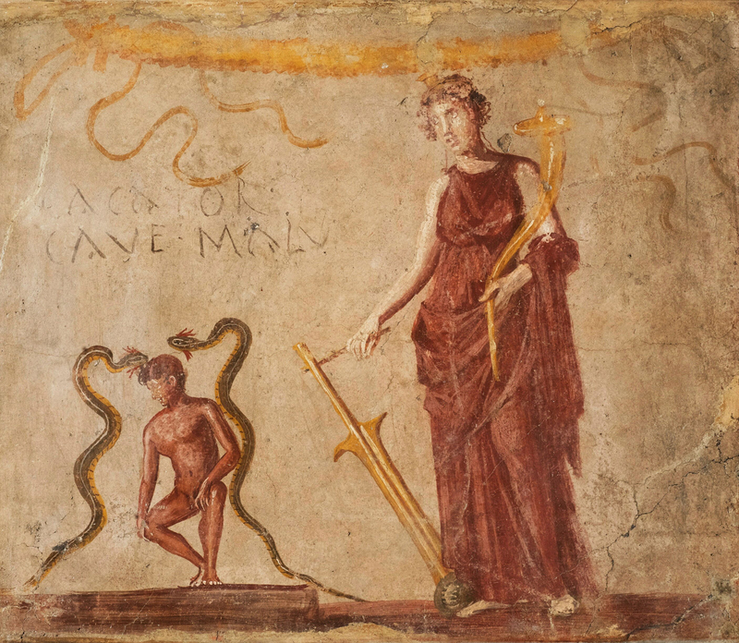
Fresco wall panel showing Isis Fortuna protecting a man flanked by the agathodaemones (protective serpents), with painted message: CACATOR CAVE MALU[m] (‘shitter beware the evil [eye]’), AD 40–79, Pompeii, 68.7 x 80.3 cm © Museo Archeologico Nazionale di Napoli

Slide 8
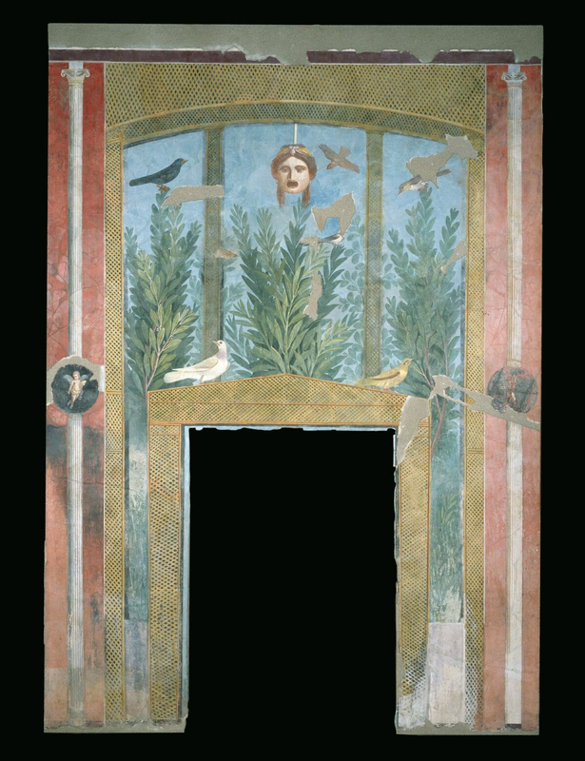
Garden-themed fresco wall from the House of the Golden Bracelet, Pompeii, AD 1–50, 278 x 178 cm © Parco Archeologico di Pompeii

Slide 9
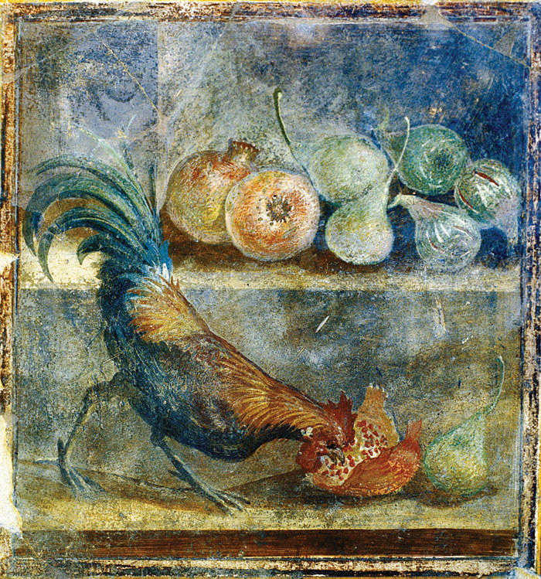
A cockerel pecking at pomegranates, figs, and pears on a shelf, AD 45-79, still-life wall panel from the House of the Chaste Lovers depicts, © Parco Archeologico di Pompeii

Slide 10
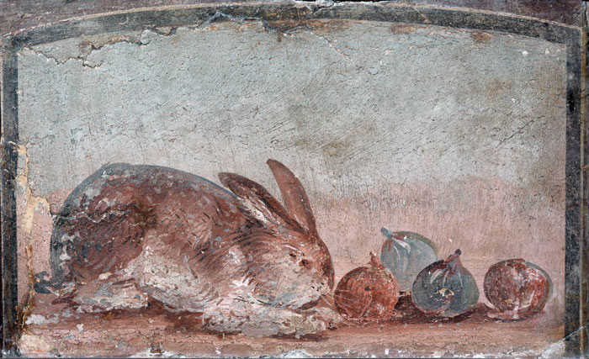
Still life wall panel fresco showing a rabbit nibbling at figs, AD 40–79, Pompeii, 35 x 42 cm © Museo Archeologico Nazionale di Napoli

Slide 11
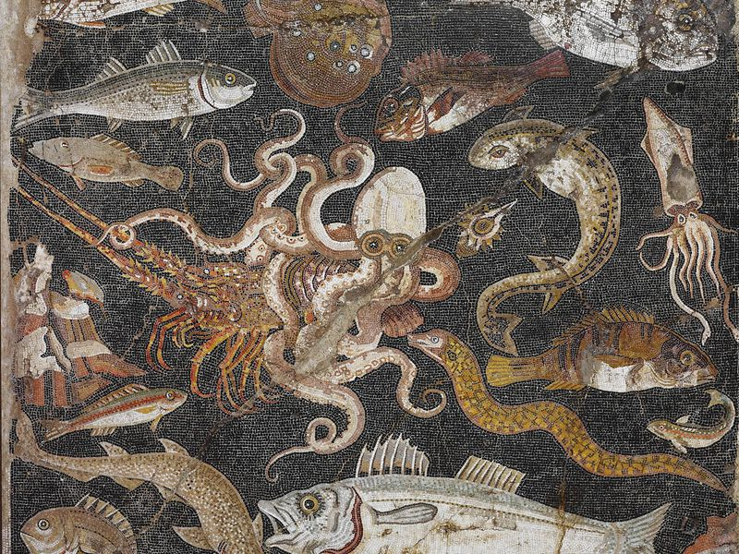
Polychrome mosaic emblema (panel) showing fish and sea creatures, Pompeii, House of the Geometric Mosaics, © Museo Archeologico Nazionale di Napoli

Slide 12
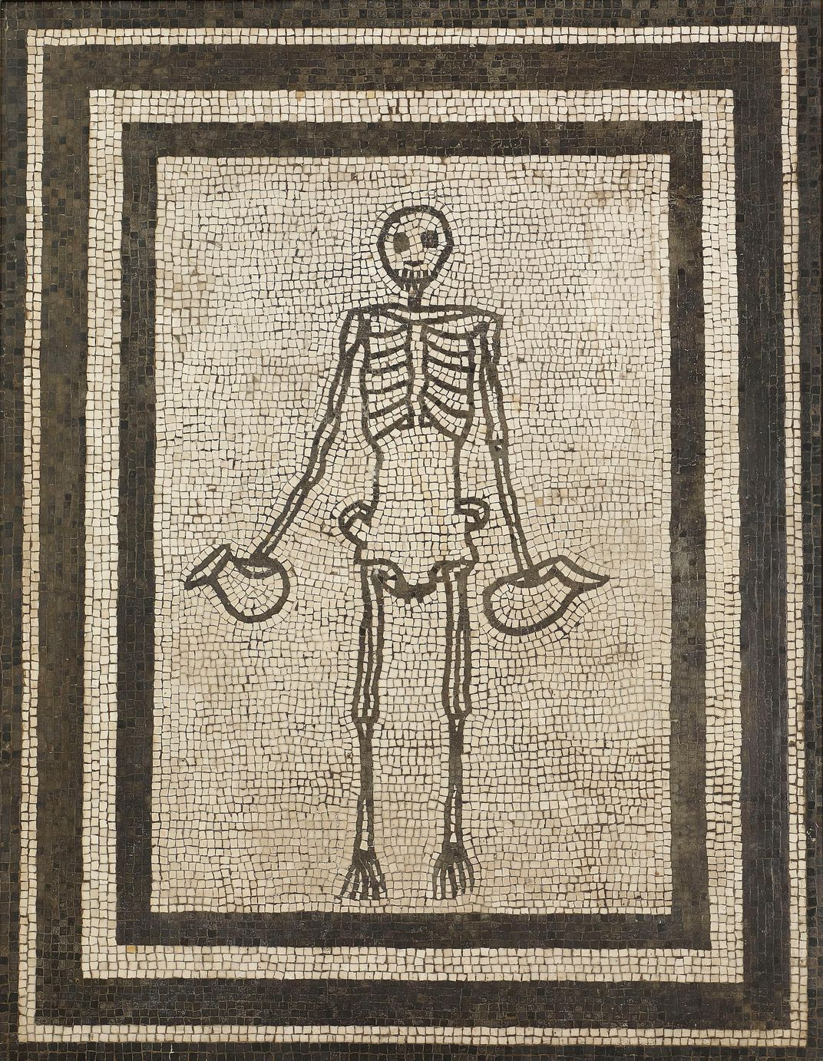
Floor mosaic of a skeleton holding jugs of wine, 1-50 A.D., Pompeii, House of the Vestals, cm © Museo Archeologico Nazionale di Napoli, © Museo Archeologico Nazionale di Napoli

Slide 13
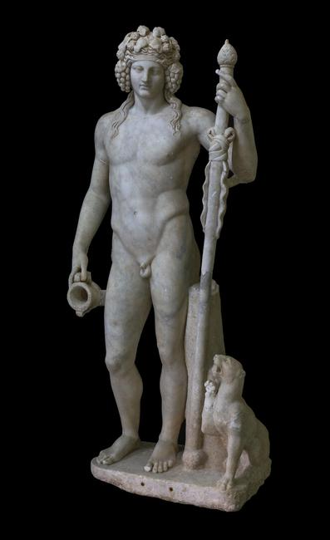
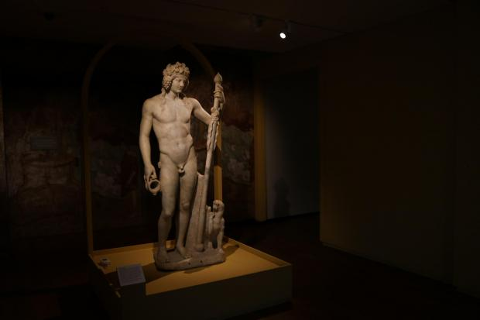
Marble statue of Bacchus with a panther, AD 50–150.
From the ruins of a temple in Piacenza, Emilia-Romagna, 180 x 64 x 38 cm,
© Museo Archeologico Nazionale di Napoli

Slide 14
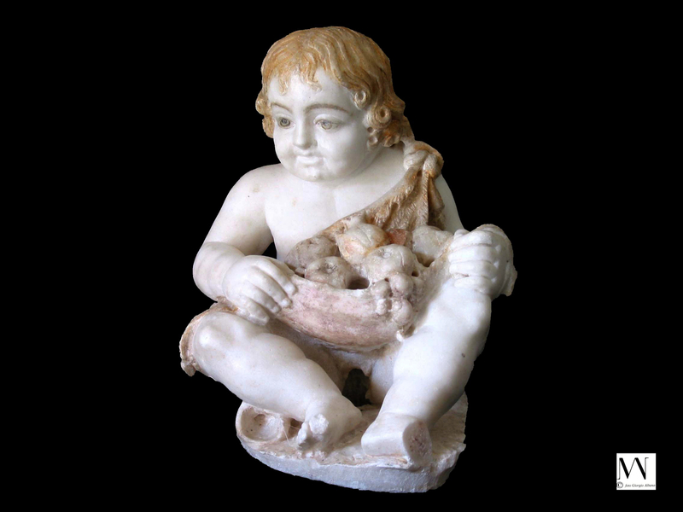
Marble fountain figure of a seated cupid wearing an animal skin filled with fruit, with traces of polychromy surviving, 50 BC–AD 50, Pompeii, 26 x 21 cm © Parco Archeologico di Pompeii

Slide 15
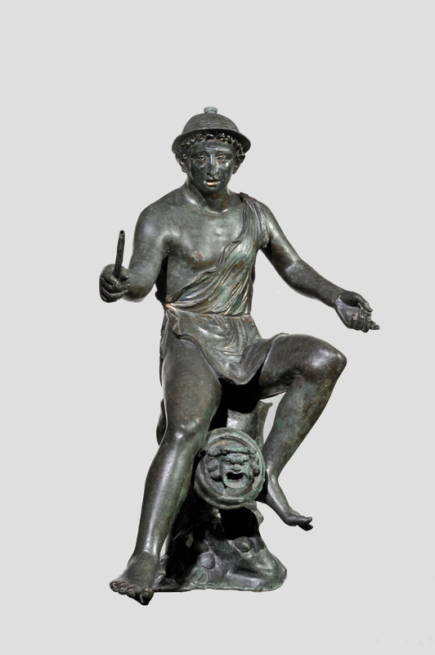
Bronze fountain spout in the form of a seated fisherman holding a fishing rod, 50 BC–AD 50, Pompeii, House of the Small Fountain, 54 cm high © Museo Archeologico Nazionale di Napoli

Slide 16
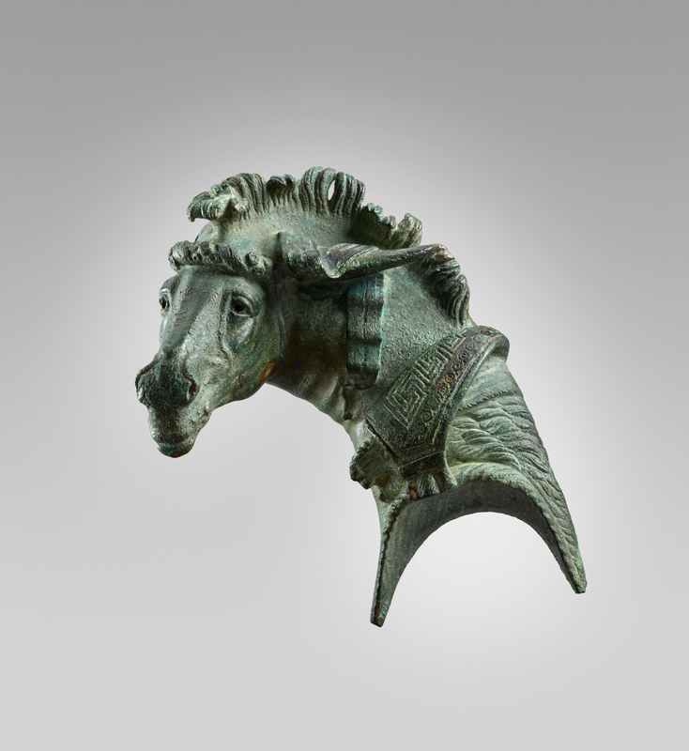
Bronze fulcrum (couch end) in the form of a horse’s head, AD 50–100, Origin unknown, Bronze with silver inlay highlights, 15 cm high © Ashmolean Museum, University of Oxford

Slide 17
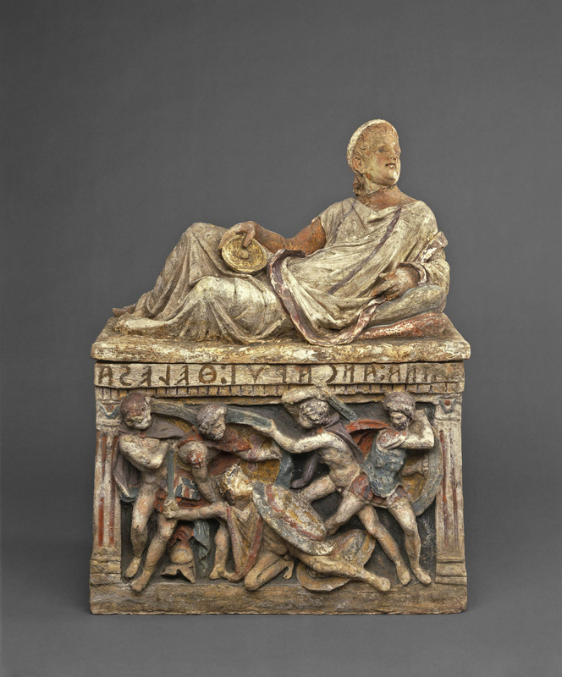
Painted Etruscan funerary urn and lid, Terracotta urn with heroic battle scene and Etruscan inscription: Thana Ancarui Helesa. (Thana Ancarui, wife of Hele), Lid (which does not belong to urn) in the form of a reclining young man, Chiusi, Tuscany, 150–100 BC, 75.5 x 58.3 cm © British Museum, London

Slide 18
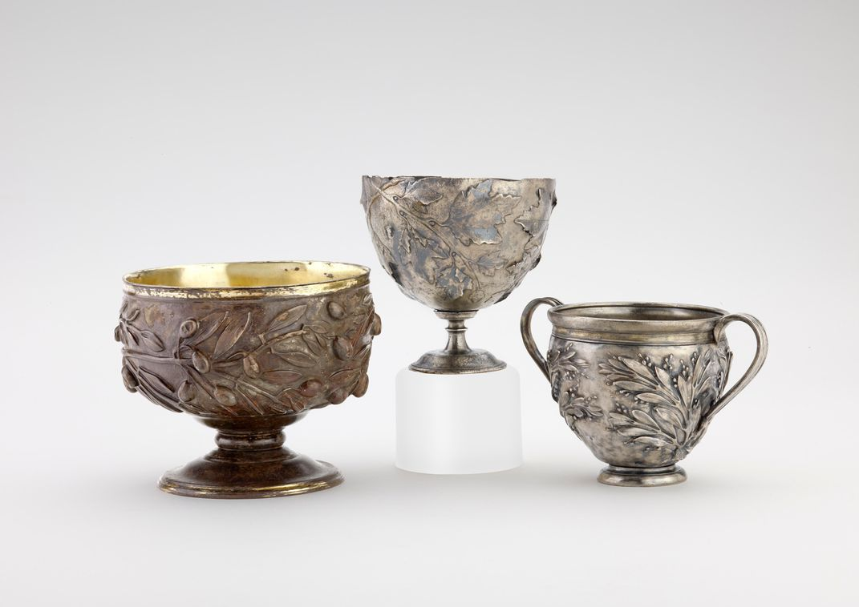
Gilded silver cups decorated with repoussé olive, vine and myrtle sprays (left to right), 50 BC–AD 150, © Ashmolean Museum, University of Oxford

Slide 19
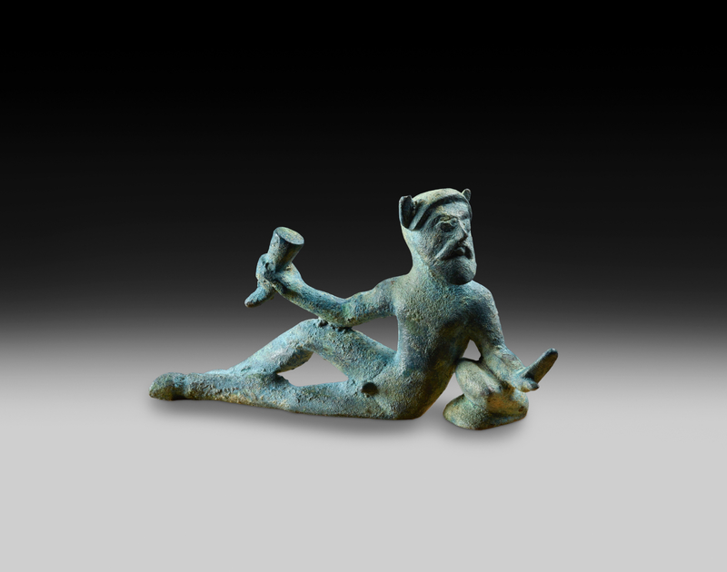
Bronze reclining satyr from the rim of a vessel, 500–400 BC, Possibly from Chiusi, Tuscany, 4.5 x 6.8 cm © Ashmolean Museum, University of Oxford

Slide 20
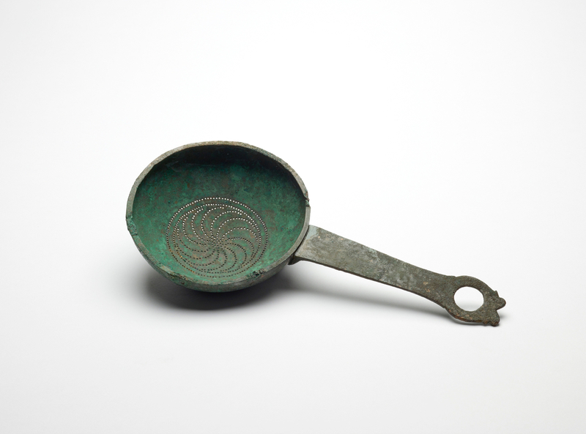
Bronze strainer, 500–300 BC, 25.5 cm long, diameter 12.5 cm, Findspot unknown © Ashmolean Museum, University of Oxford

Slide 21
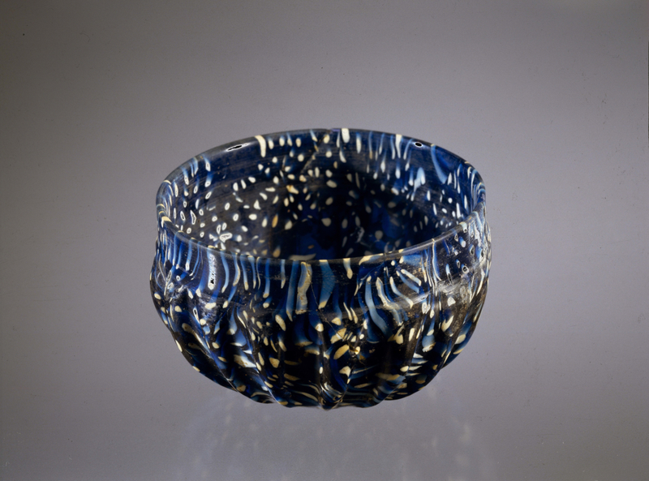
Blue glass cup with white speckles, 50 BC–AD 50, Pompeii, 6.2 x 9.4 cm diameter © Parco Archeologico di Pompeii

Slide 22
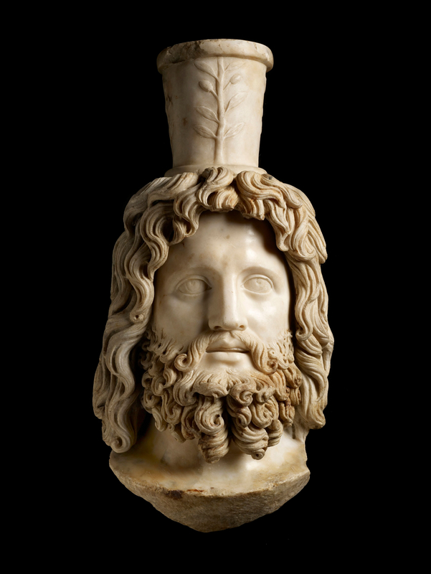
Marble head of Serapis wearing a modius (grain measure), AD 180–200, 43 x 22 cm, Walbrook Mithraeum, London © Museum of London

Slide 23
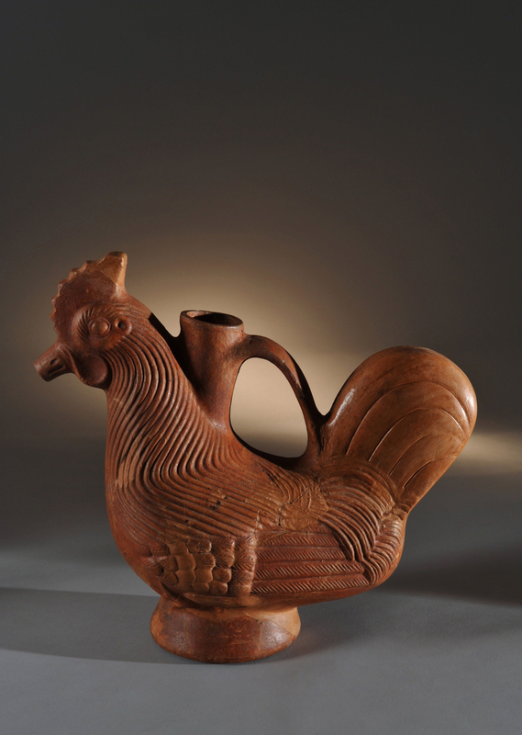
Rhyton (drinking or pouring vessel) in the form of a cockerel, AD 1–79, Pompeii, House of the Venus in a bikini, 31.5 x 34.5 cm © Parco Archeologico di Pompeii

Slide 24
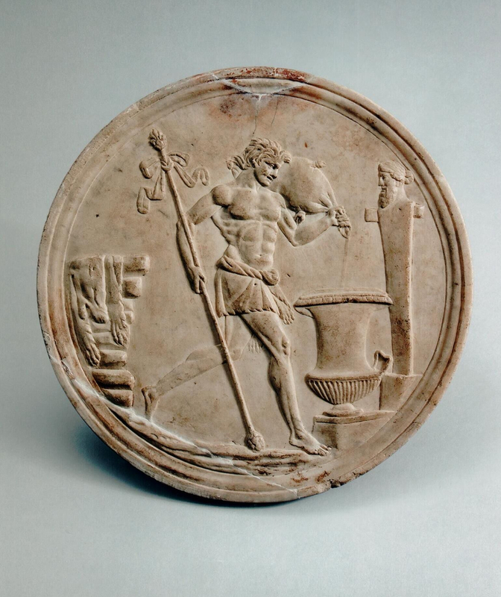
Marble oscillum (circular relief) showing a satyr pouring wine into a calyx krater (vessel for mixing wine and water), 50 BC–AD 50, Findspot unknown, Diameter 35.9 cm, Private collection

Slide 25
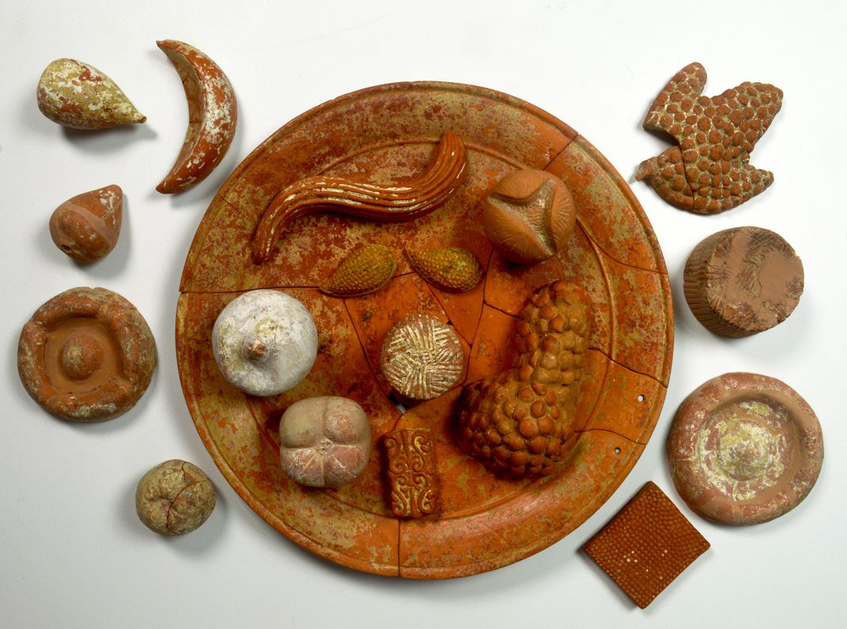
A plate of terracotta votive food (including open and closed pomegranates, grapes, figs, honeycombs, cheeses, and breads), found in a 360 BC tomb in Paestum
Image: Parco Archeologico di Paestum

Slide 26
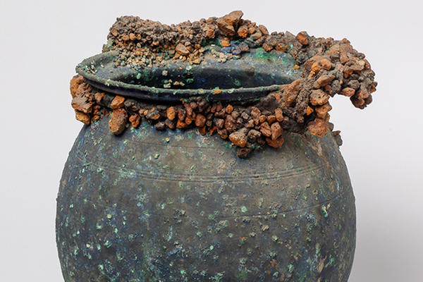
Olla – Cooking Jar with Lapili, AD 79, Parco Archeologico di Pompeii

Slide 27
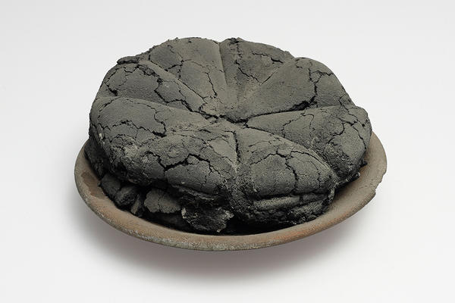
Carbonised Bread, AD 79, © Parco Archeologico di Pompeii

Slide 28
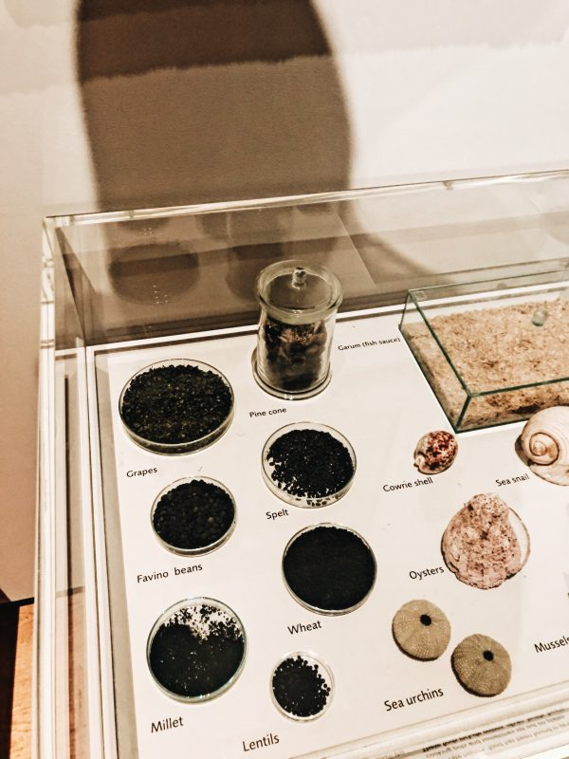
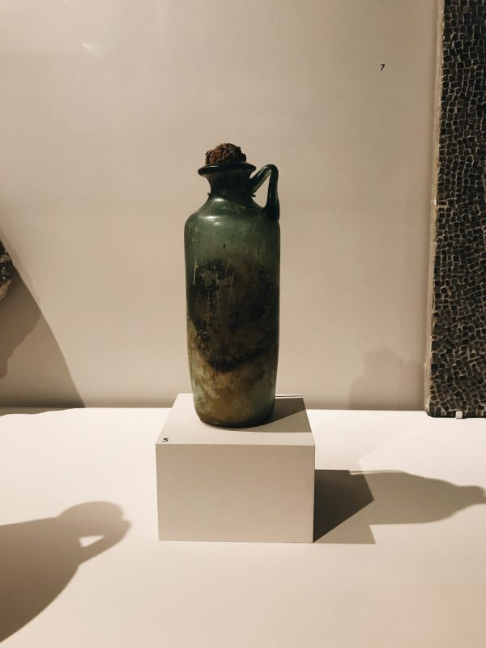
Carbonised food from Pompeii
Bottle of olive oil from Pompeii. The condiment is still intact but solid.

Slide 29
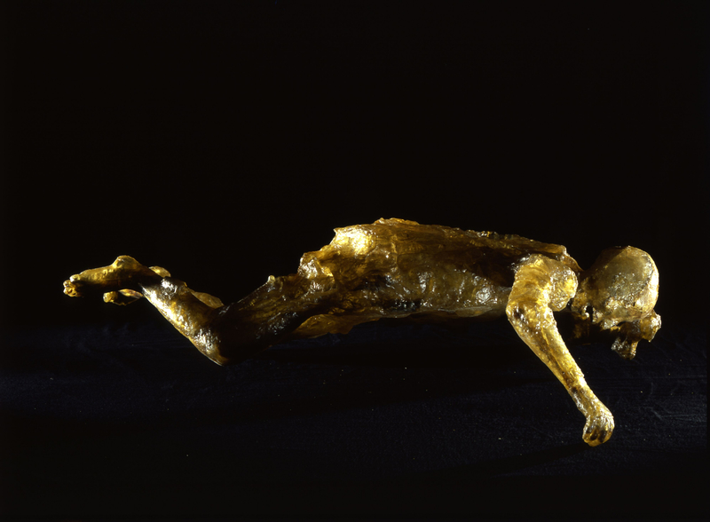
The body of a woman in her early-30s, preserved in transparent epoxy resin. AD 79, 190 x 120 cm max. Villa B, Oplontis © Parco Archeologico di Pompeii

