Slide 2
Georges Braque, 1882-1963
BIRDS

Slide 3
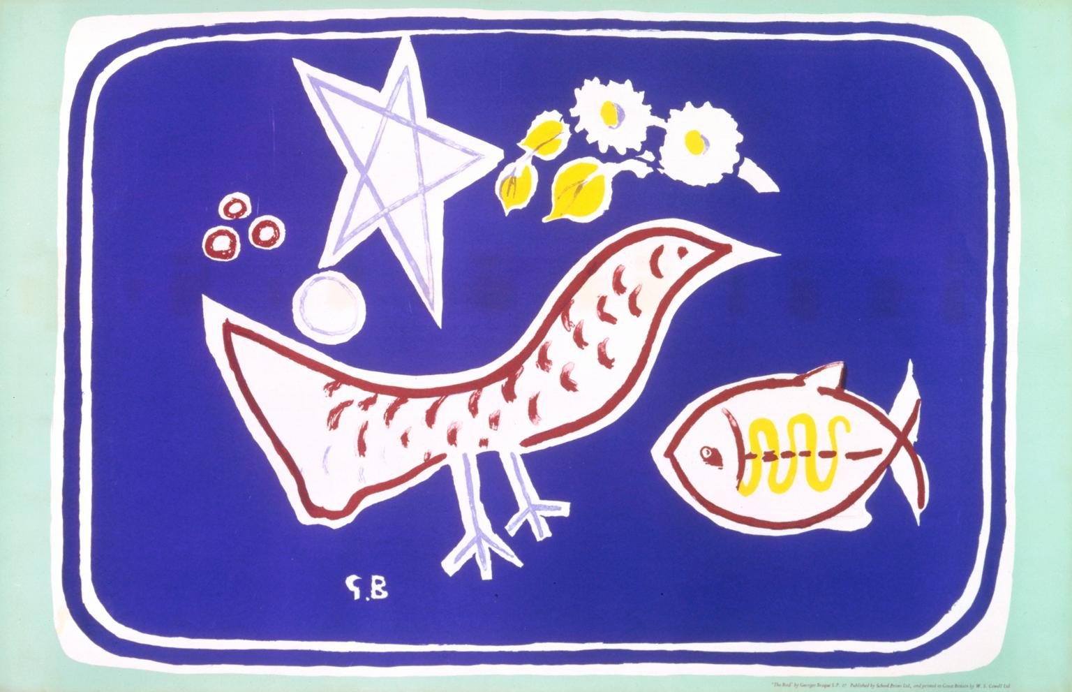
L'Oiseau, 1949, Lithograph on Paper, 498 x 762 mm, Tate, London

Slide 4
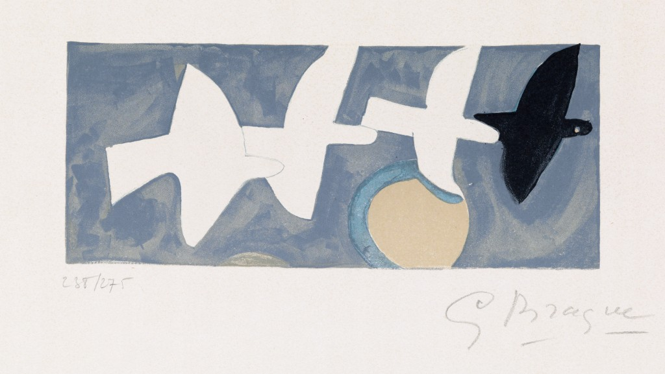
Quatre oiseaux, circa 1950, color lithograph, private collection

Slide 5
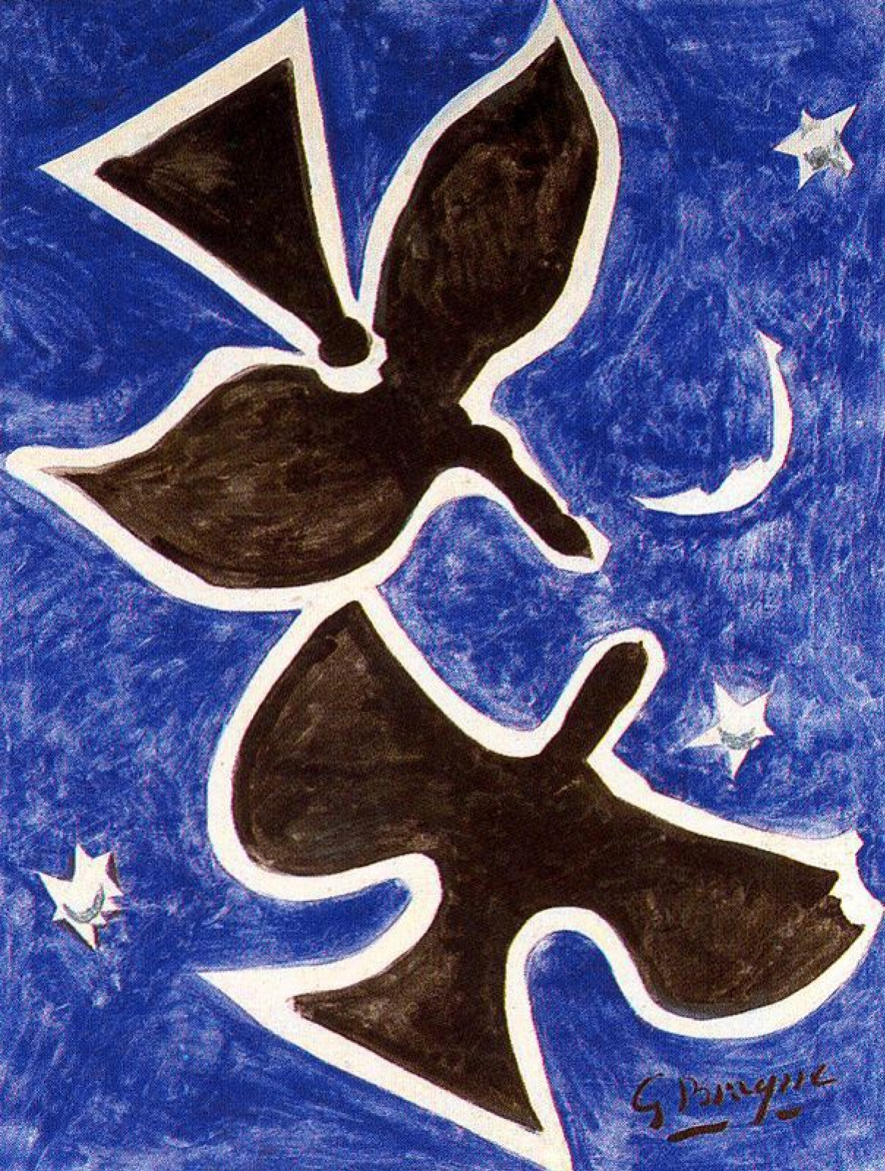
Birds, 1953, oil on canvas, 501×347 cm, private collection

Slide 6
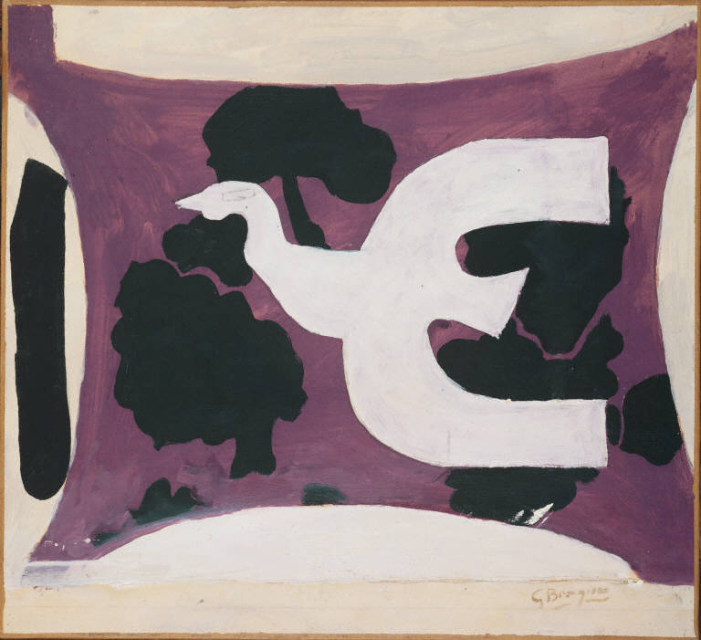
Bird, 1956, oil on canvas, 45.72 x 49.53 cm, The Phillips Collection

Slide 7
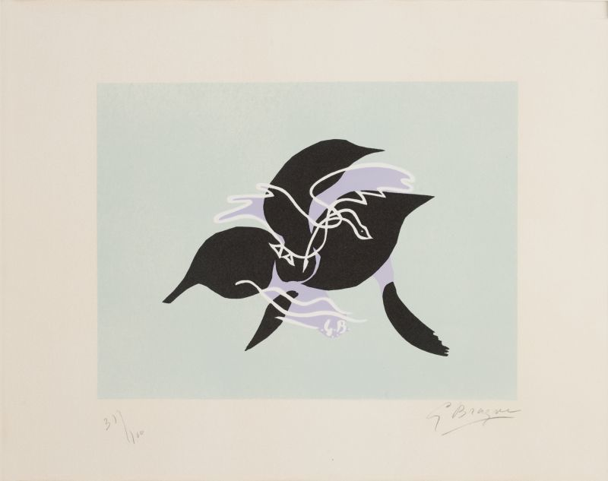
Essor (The Flight) I, 1961, Coloured lithograph on Arches paper, 31/100, 48 × 65.5 cm, Published by Adrien Maeght, Paris, Basil & Elise Goulandris Foundation, Athens

Slide 8
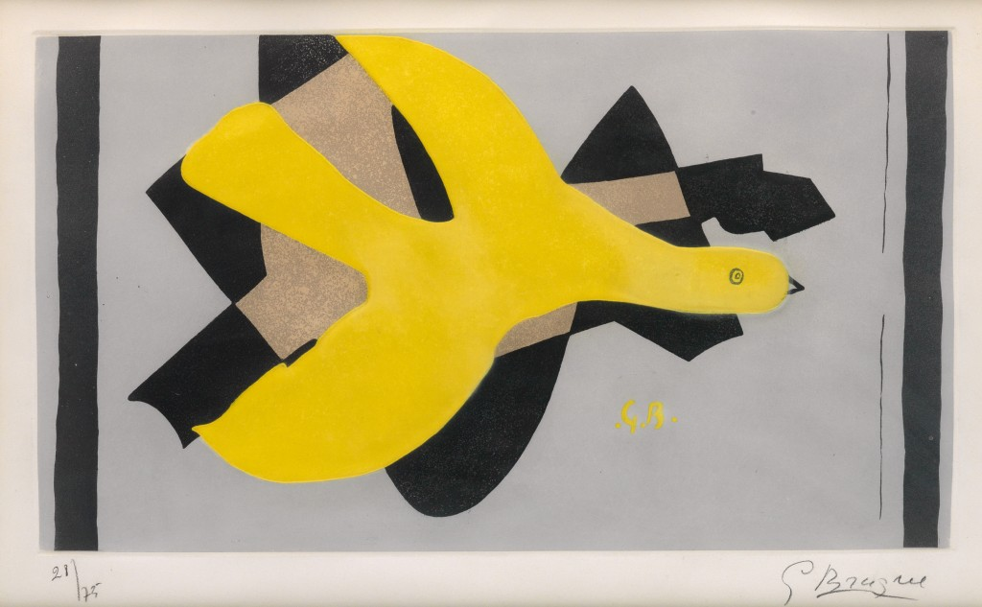
L’Oiseau et son ombre III, 1961, color aquatint and etching, private collection

Slide 9
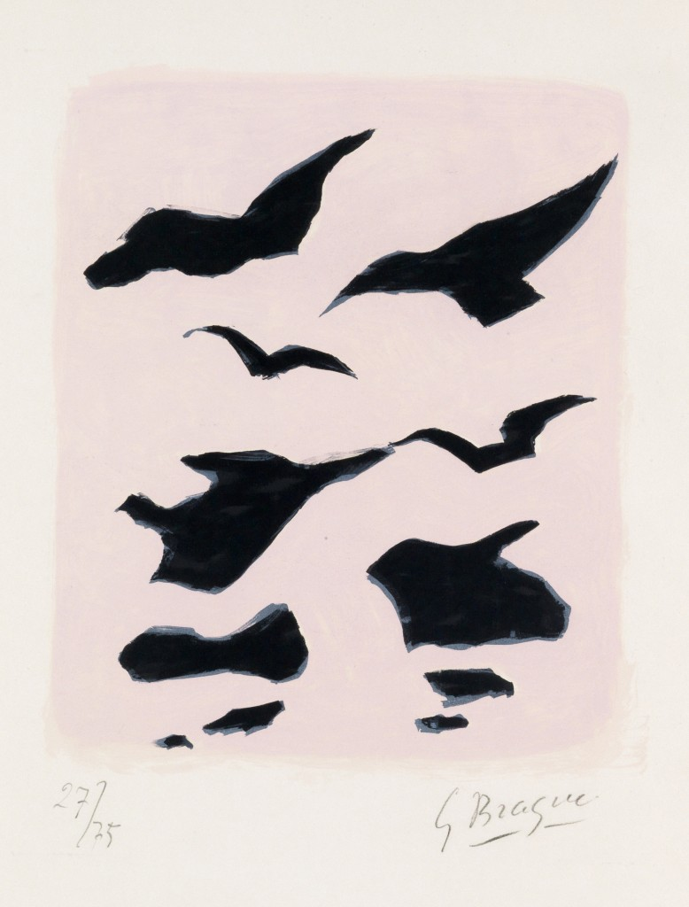
Oiseaux, 1962, color lithograph, private collection

Slide 10
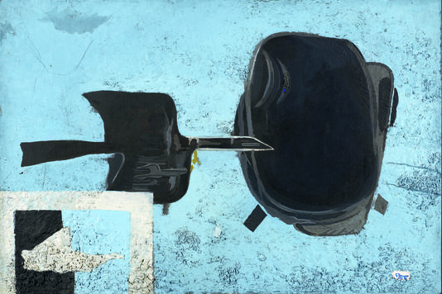
Bird Returning to Its Nest, 1956-61, oil and sand on canvas, 114 x 170,5 cm, Cetre Pompidou

Slide 11
