Slide 1
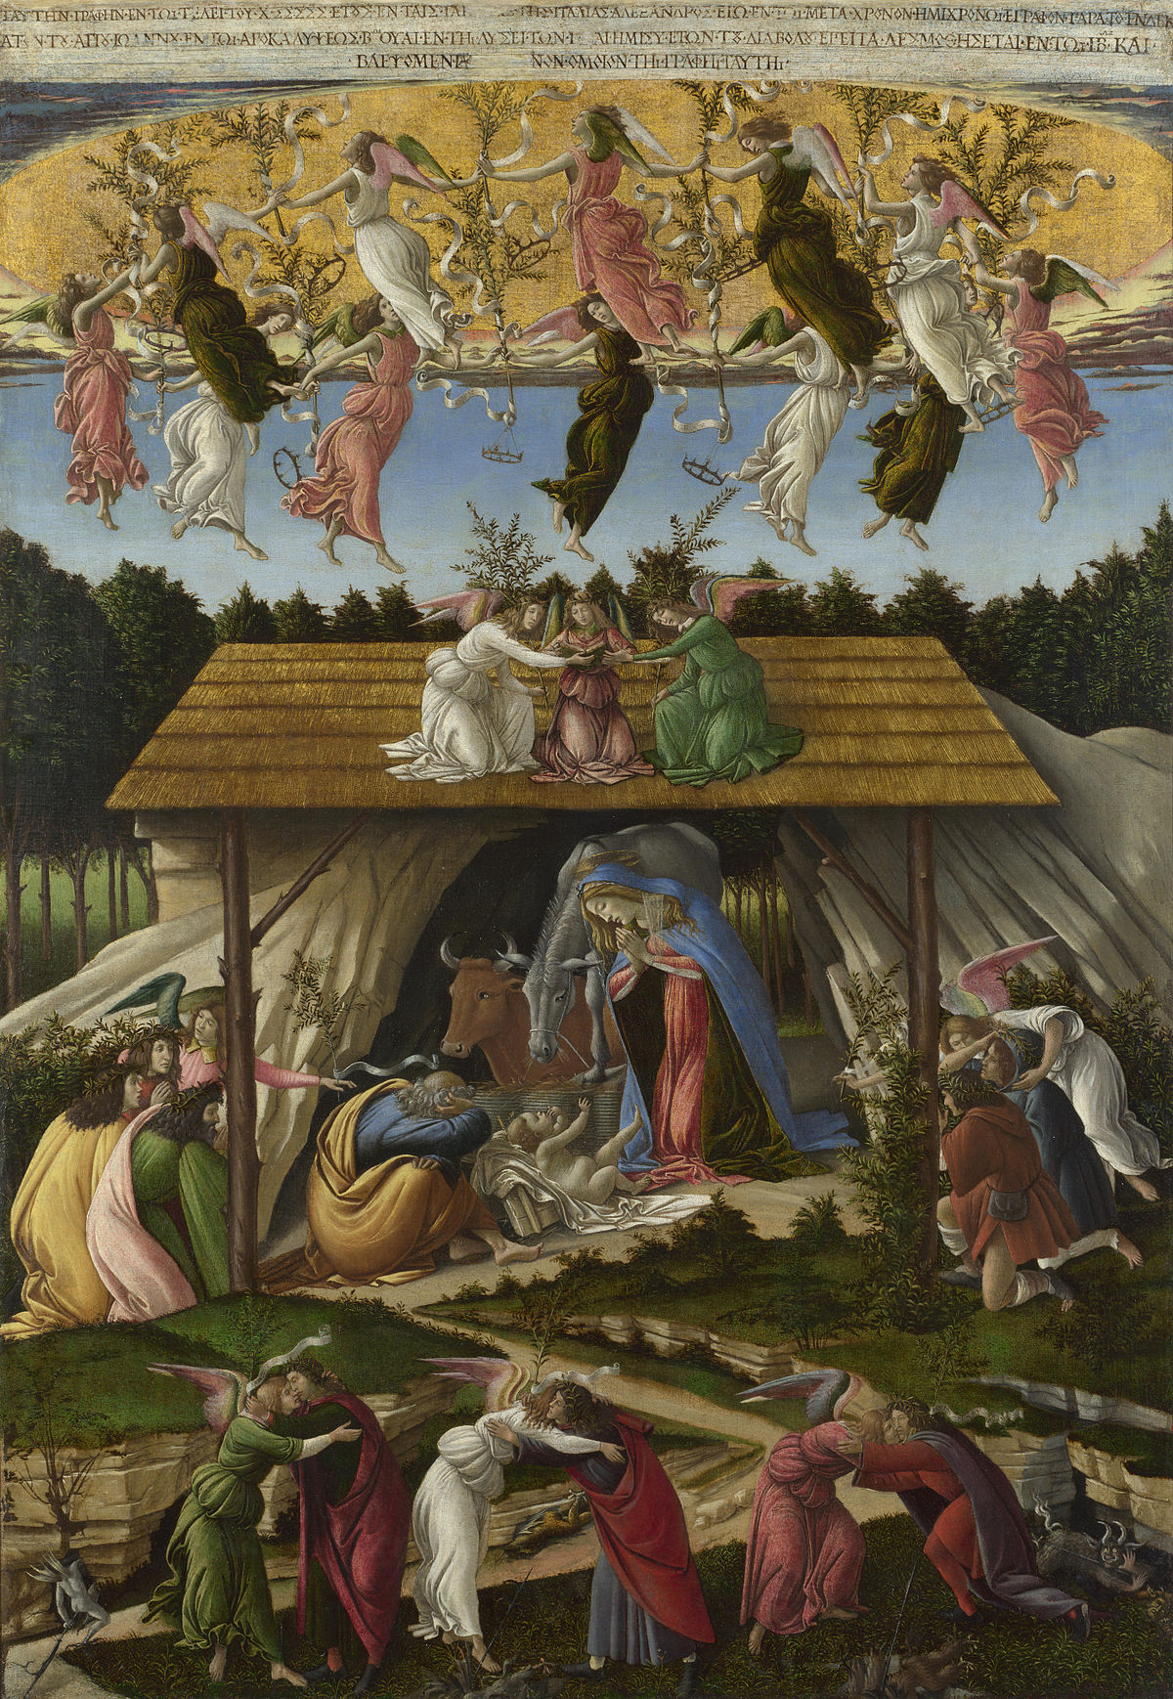
S
Sandro Botticelli, about 1445 - 1510
Mystical Nativity, about 1501, tempera on canvas,
108.6 x 74.9 cm, National Gallery, London

Slide 2
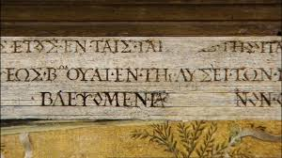
Translated from Greek, the inscription at the top of the painting, reads 'I Sandro made this picture at the conclusion of the year 1500 in the troubles of Italy in the half time after the time according to the 11th chapter of Saint John in the second woe of the Apocalypse during the loosing of the devil for three and a half years then he will be chained in the 12th chapter and we shall see [...] as in this picture.’
The inscription is believed to refer to the Italian War of 1494–1498 and reflect upon the teachings of Girolamo Savonarola. “After the political turbulence of the previous decade and the death of his spiritual and moral guide, Botticelli in this picture looks forward to the fulfilment of peace and to man’s reconciliation with
God, as initiated by the Incarnation and expected to be achieved fully, according to the
Book of Revelation, with Christ’s return.

Slide 3
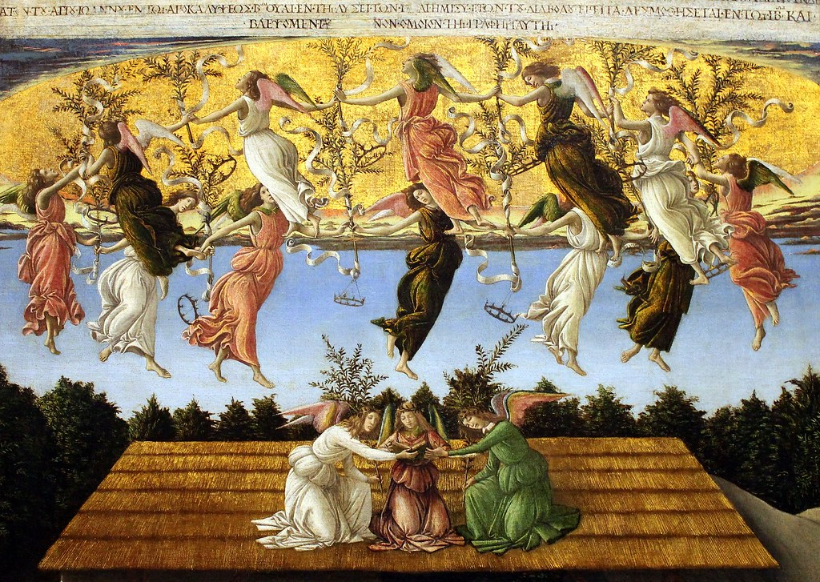

Slide 4
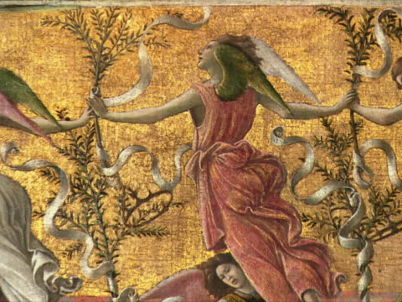

Slide 5
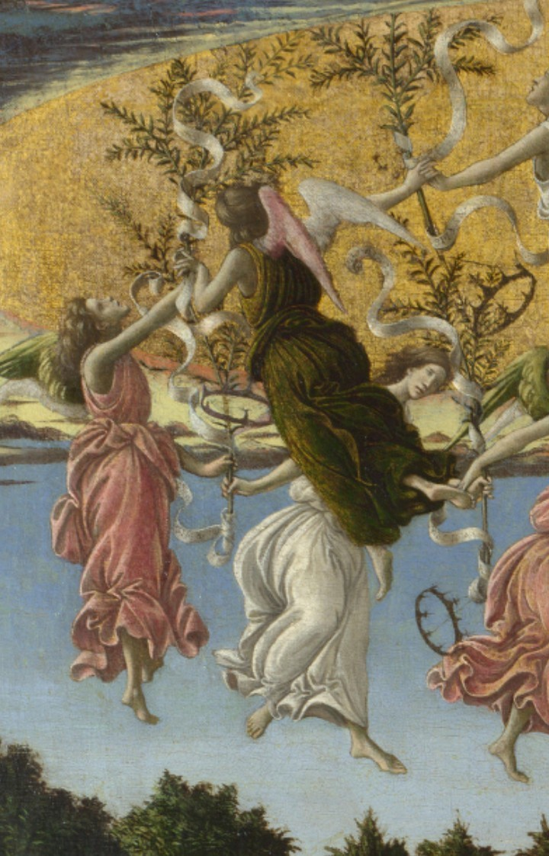
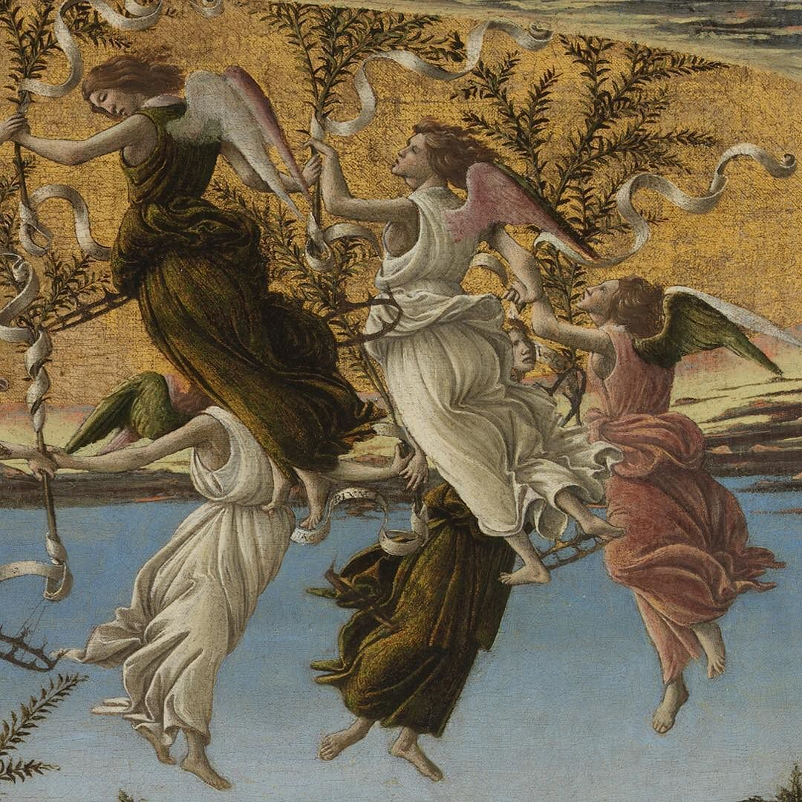
“The golden dome of heaven has opened up and become visible from earth; it is circled by 12 angels holding olive branches entwined with scrolls and hung with crowns which swing as they dance.”

Slide 6
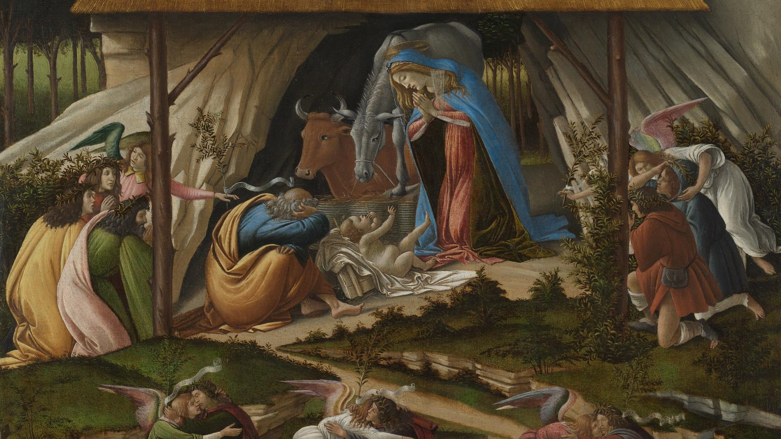
The Nativity scene “takes place in a glade within a forest; the stable where, according to the Gospel writers, Christ was born, is represented imaginatively as a thatched roof pitched over the opening of a rocky cavern. The infant Christ reaches up towards the Virgin Mary, oblivious of his visitors – the Three Kings on the left and the shepherds on the right, who have been ushered towards him by angels.”

Slide 7
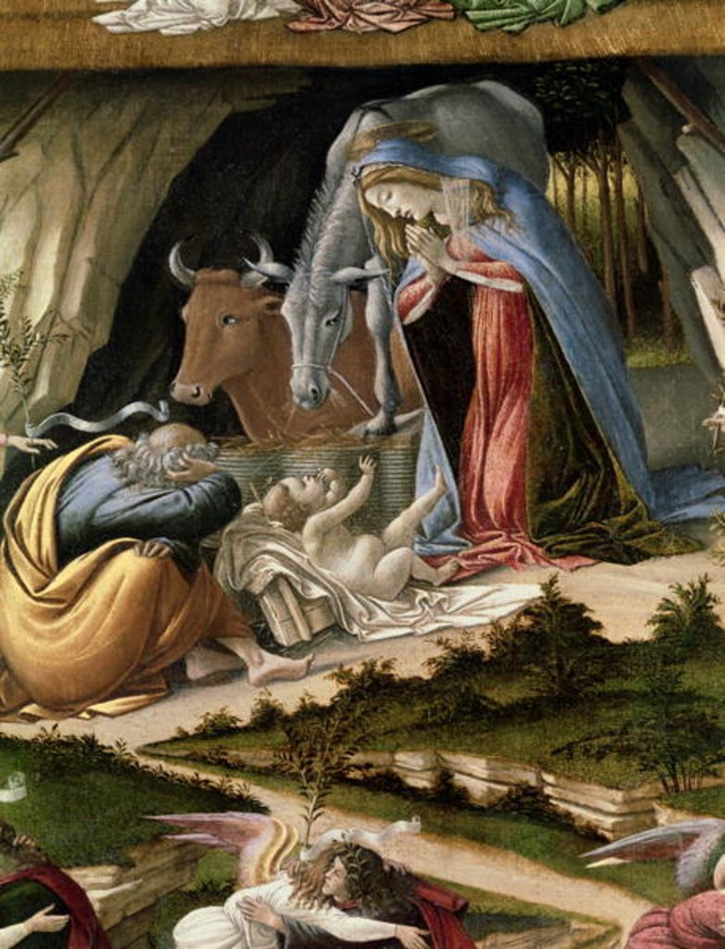
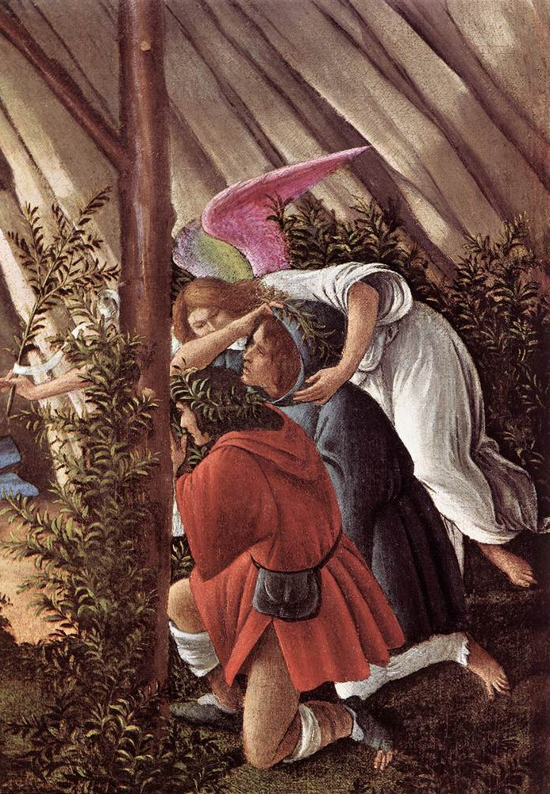

Slide 8
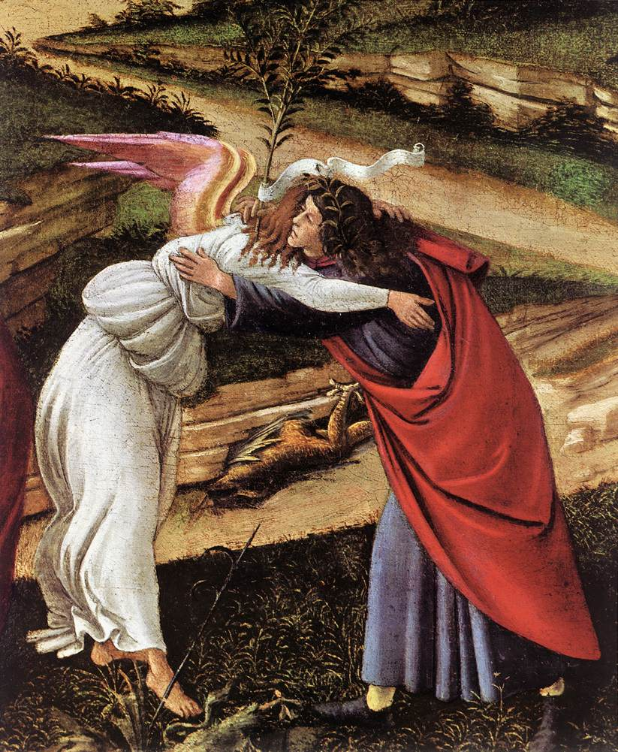
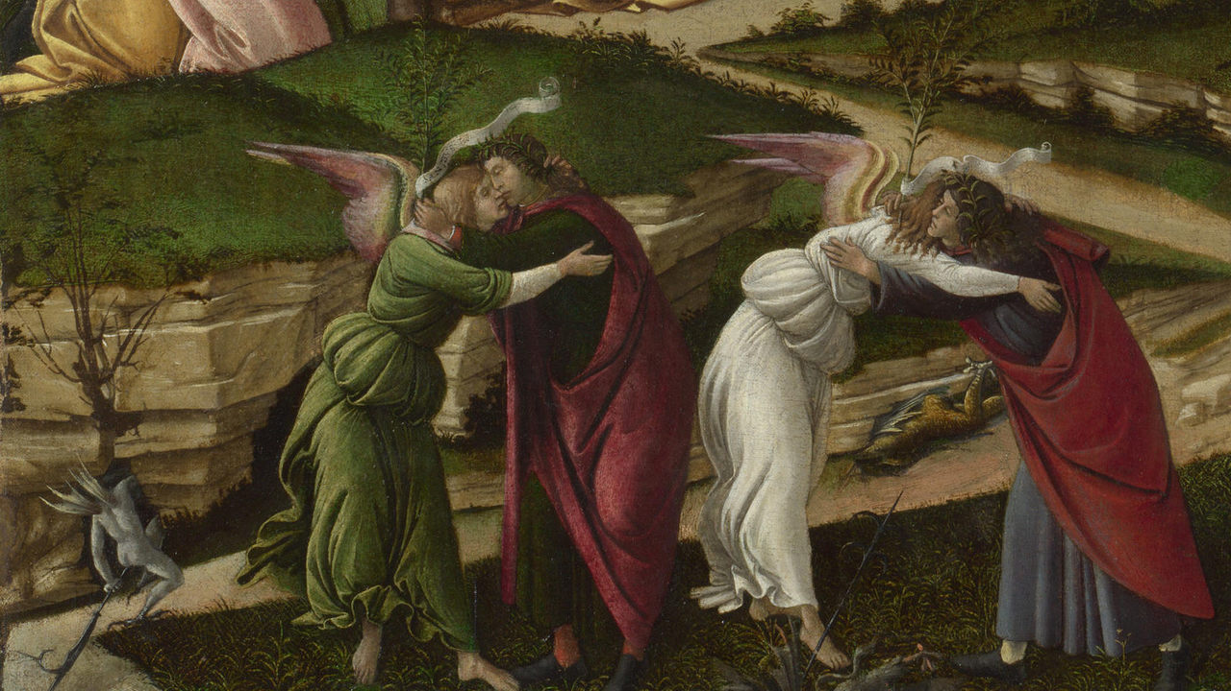
“The meeting of the divine and the human in the newborn Christ is shown symbolically in the dance-like embrace of three pairs of angels and men who form a rhythmic frieze in the foreground.”

Slide 9
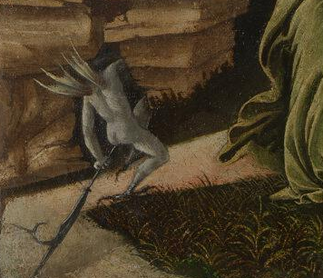
“Among their feet, winged demons and horned little devils scuttle for shelter in the underworld through cracks in the rocks. …an unusual sight in a nativity scene but key to the understanding of Botticelli’s mystical creation…”

Slide 10
S
Sandro Botticelli, about 1445 - 1510
Mystical Nativity, about 1501, tempera on canvas,
108.6 x 74.9 cm, National Gallery, London
All quotations in the PowerPoint are credited to the National Gallery presentation: https://www.nationalgallery.org.uk/paintings/sandro-botticelli-mystic-nativity

