Slide 1
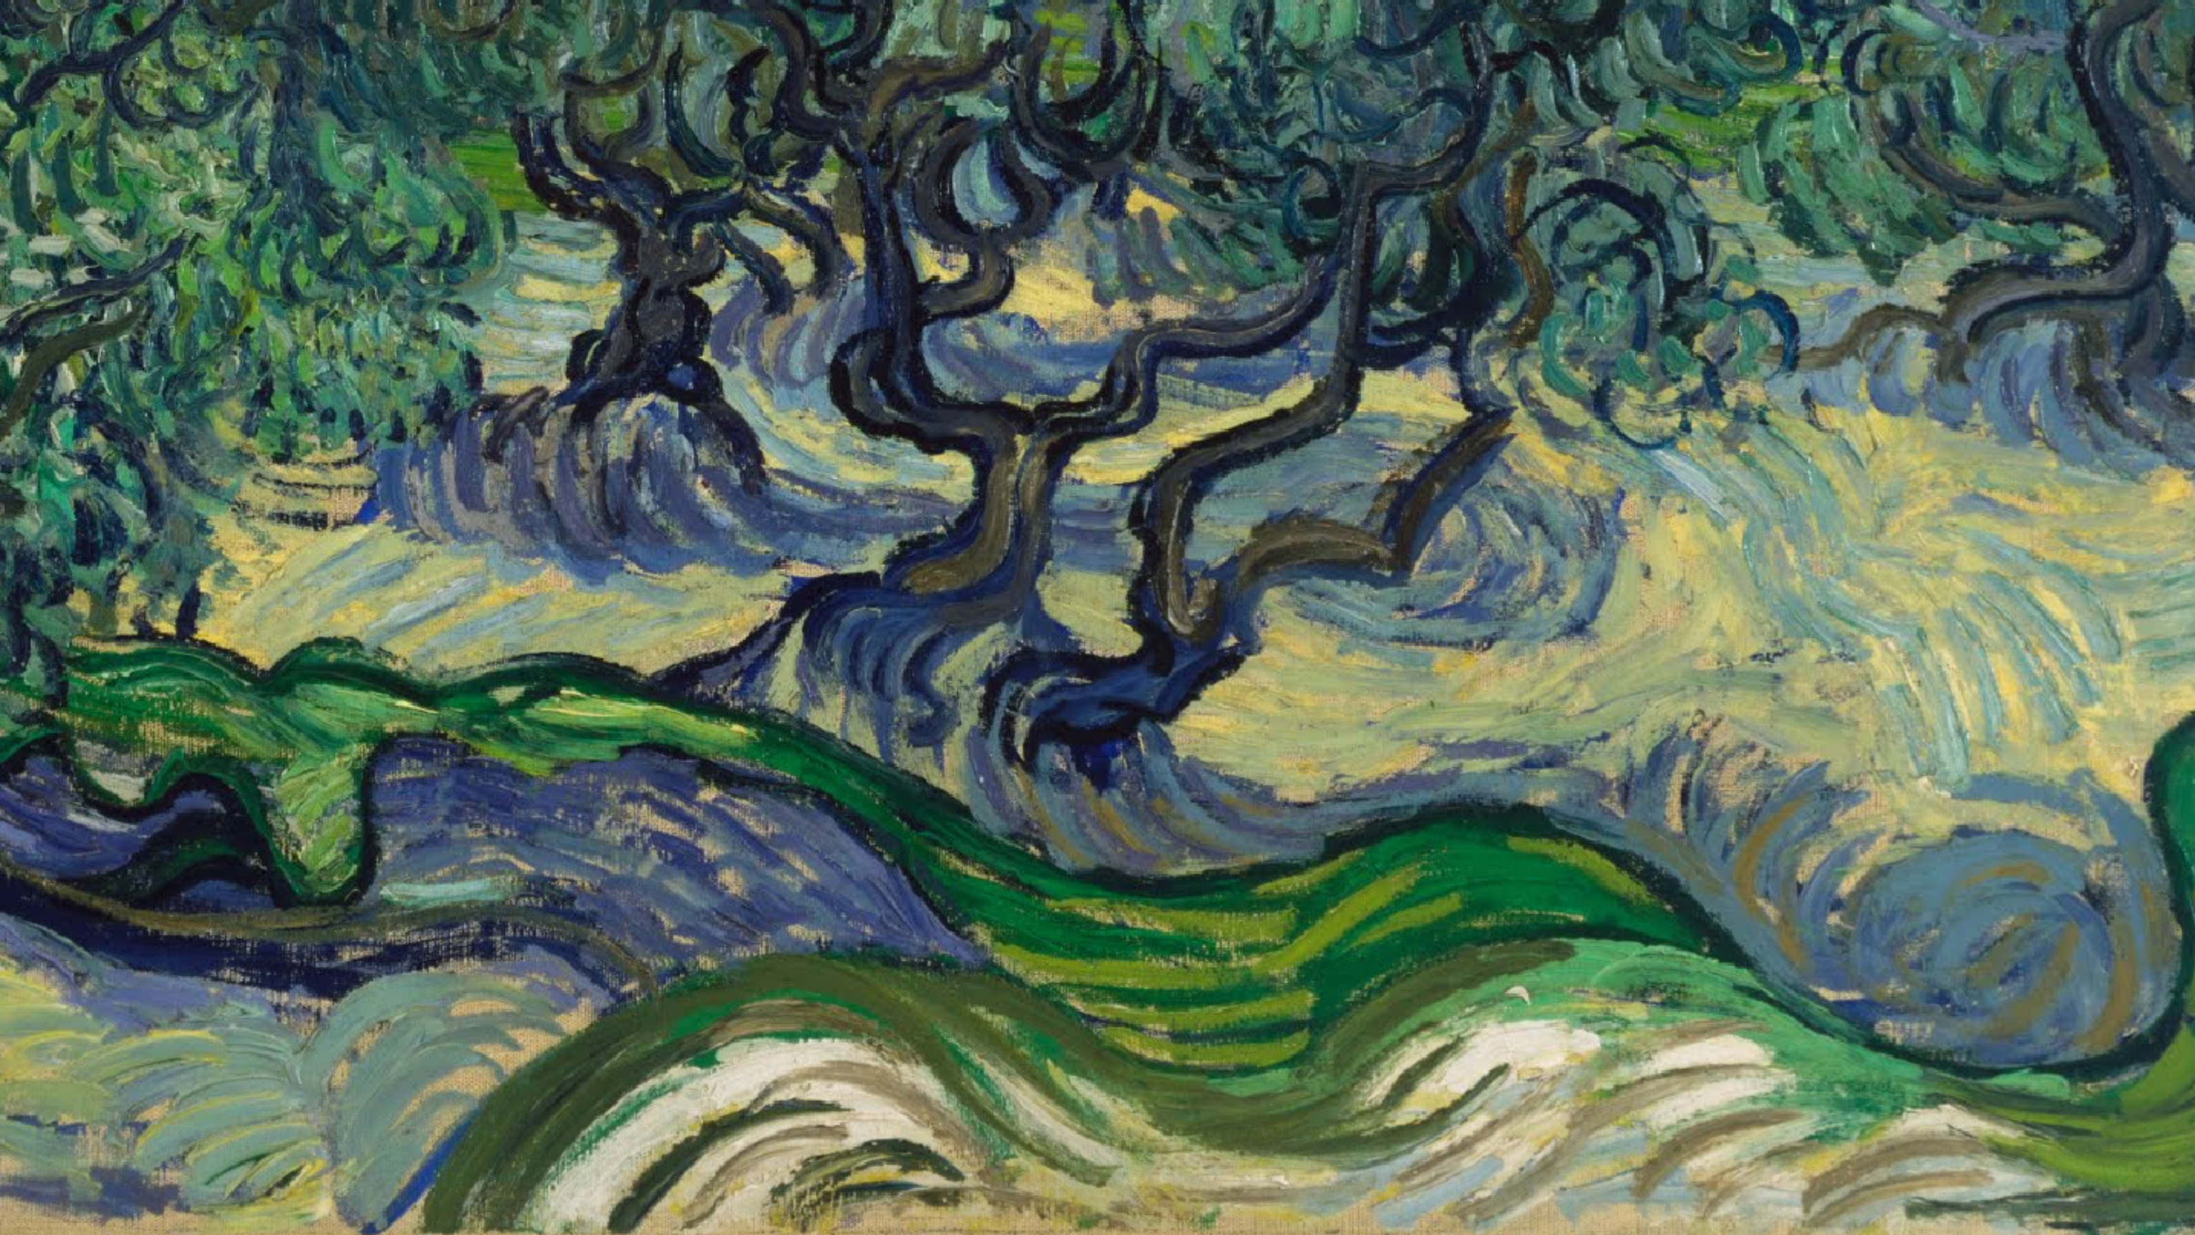
Vincent Van Gogh, the Olive Tree and Olive Picking

Slide 2
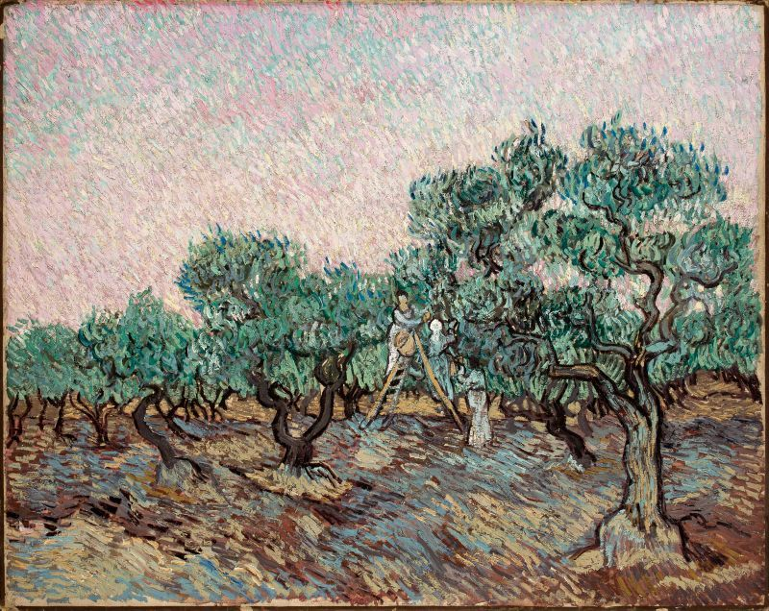
Olive Picking. 1889, oil on canvas, 73.5 × 92.5 cm, Basil & Elise Goulandris Foundation, Athens

Slide 3
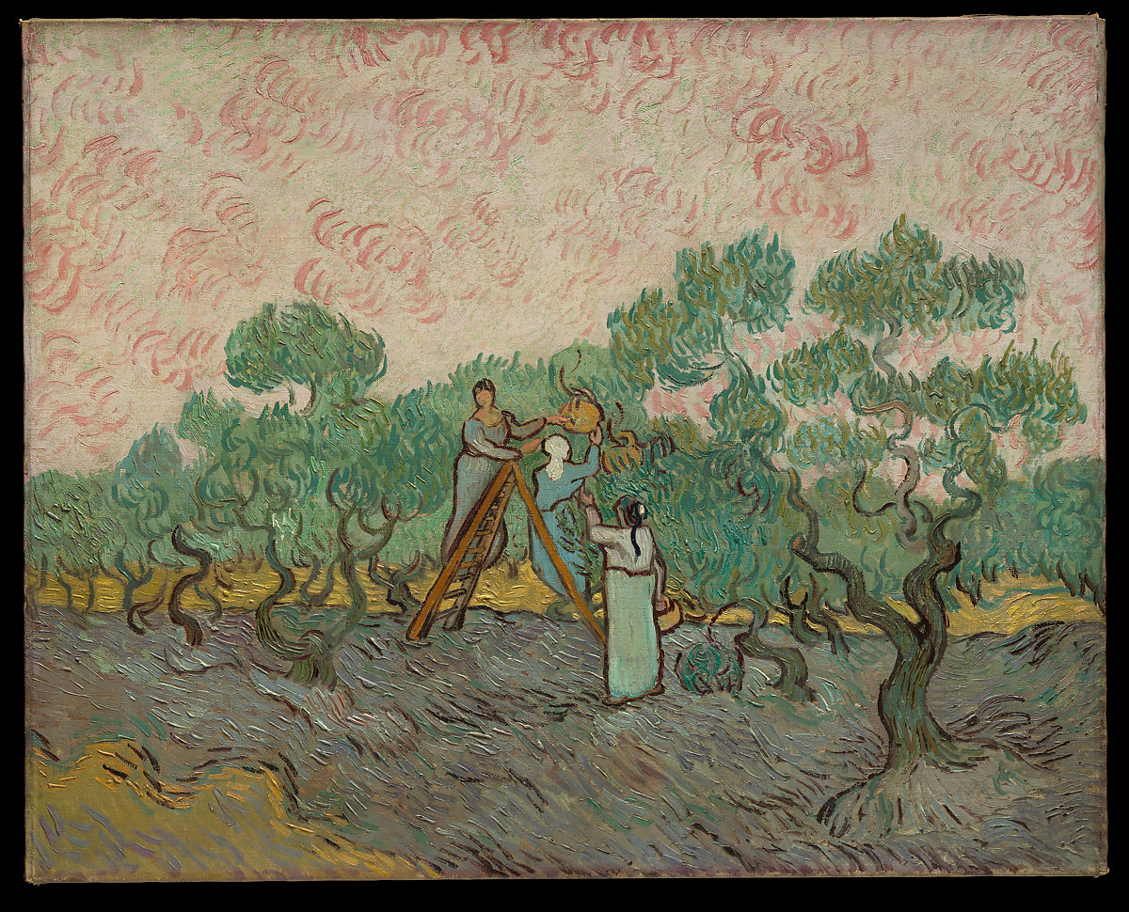
Women Picking Olives, 1889, oil on canvas,
72.7 x 91.4 cm, the MET, NY

Slide 4
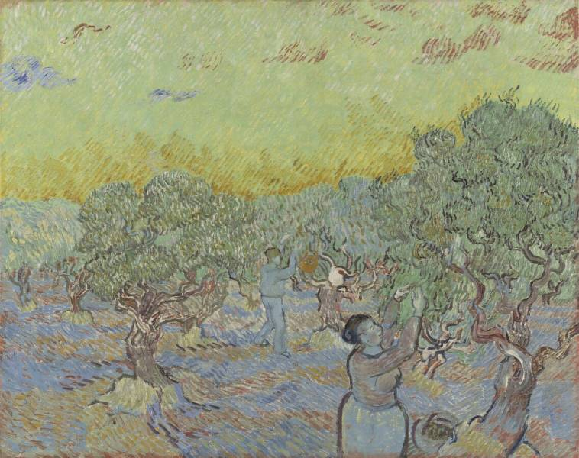
Olive Grove with Two Pickers, 1889, oil on canvas, 73,3 x 92,2 cm, Kroller-Muller Museum, Otterlo, Netherlands

Slide 5
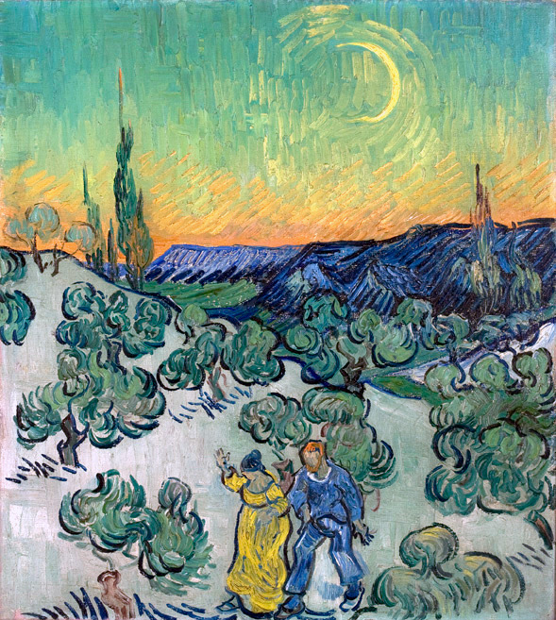
Couple Walking among Olive Trees in a Mountainous Landscape with Crescent Moon, May 1890, 49.5 x 45 cm, Museu de Arte de São Paulo, São Paulo, Brazil

Slide 6
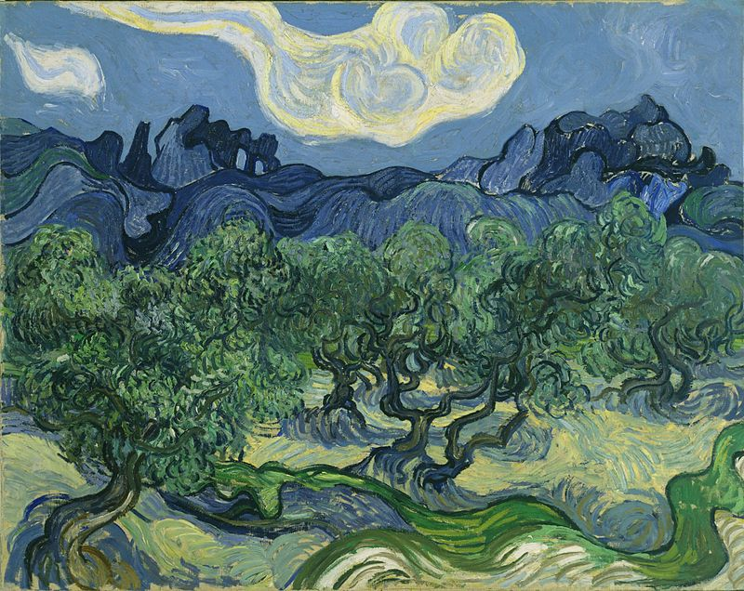
Olive Trees in a Mountainous Landscape, 1889, oil on canvas,
72.6 x 91.4 cm,
MOMA, NY

Slide 7
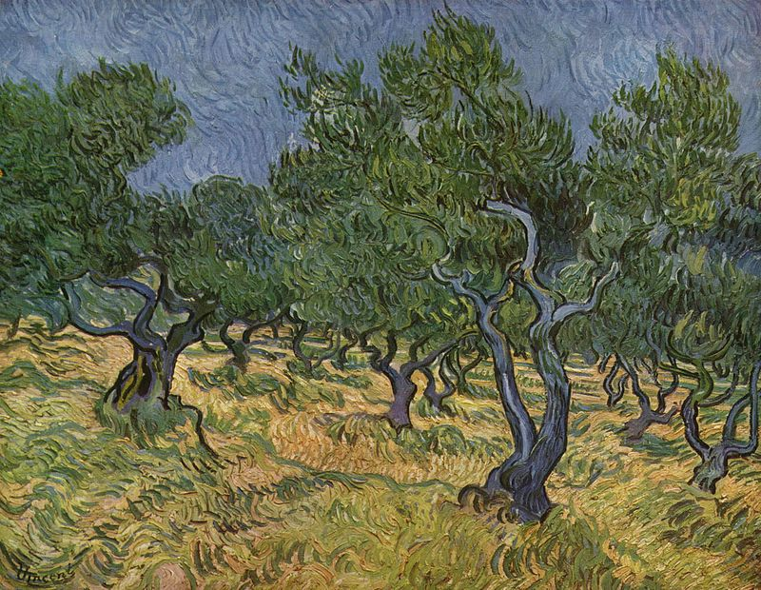
Olive Orchard, mid-June 1889, 72 x 92 cm, Kröller-Müller Museum, Otterlo, Netherlands

Slide 8
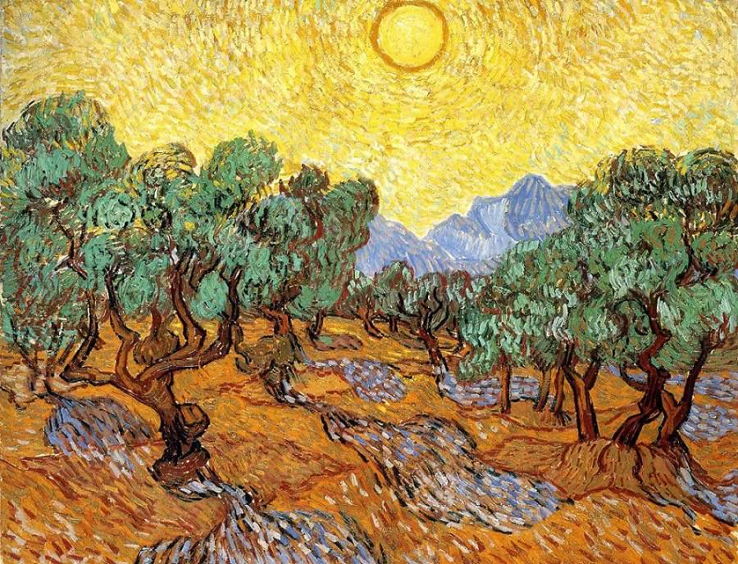
Olive Trees with Yellow Sky and Sun,
1889, oil on canvas, 73.66 x 92.71 cm, Minneapolis Institute of Arts

Slide 9
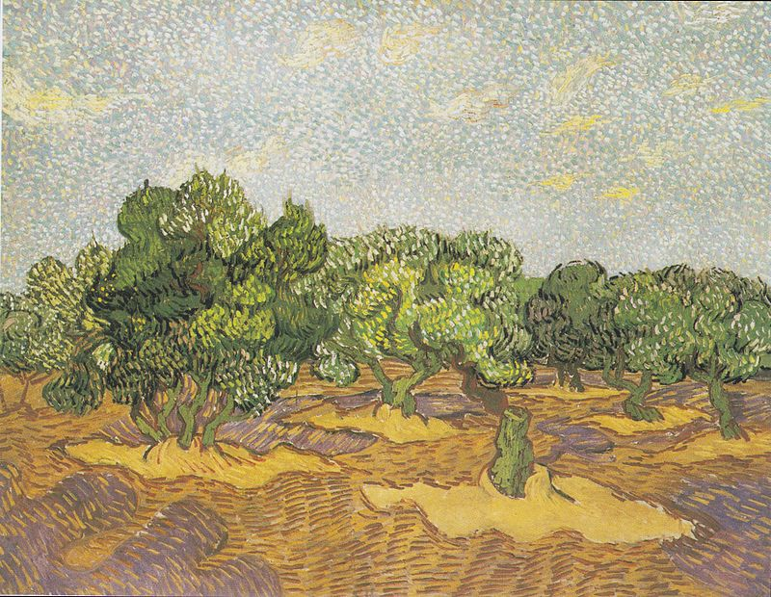
Olive Orchard,
November 1889,
72.7 x 92.1 cm, the MET, NY

Slide 10
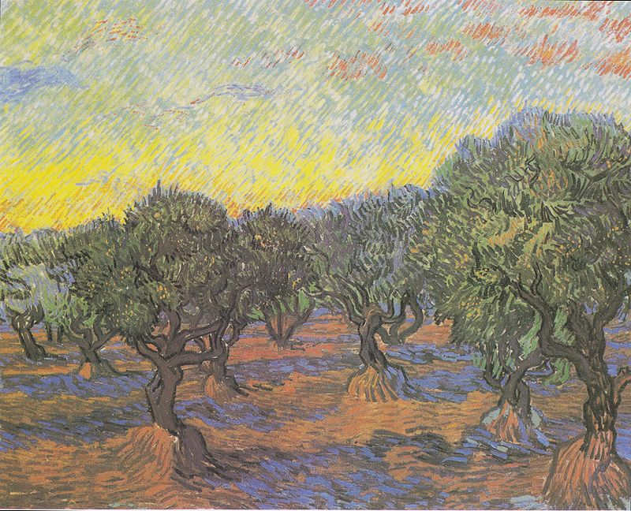
Olive Grove: Orange Sky, November 1889, oil on canvas, 74 x 93 cm,
Göteborgs Museum of Art, Gõteborg, Sweden

