Slide 1
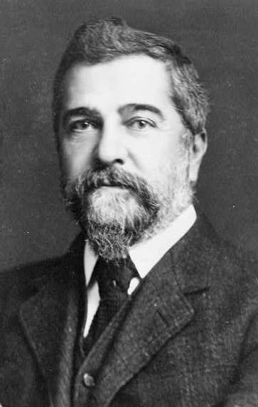
Louis Comfort Tiffany,
1848-1933

Slide 2
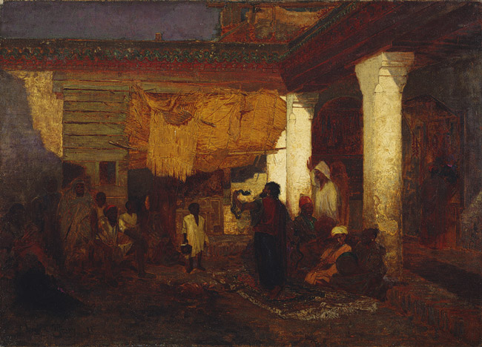
Snake Charmer at Tangier, Africa, 1872, Oil on canvas, The MET, NY

Slide 3
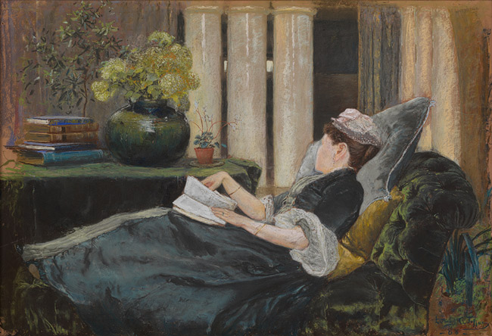
Louise Tiffany, Reading, 1888, Pastel on buff–colored wove paper, The MET, NY

Slide 4
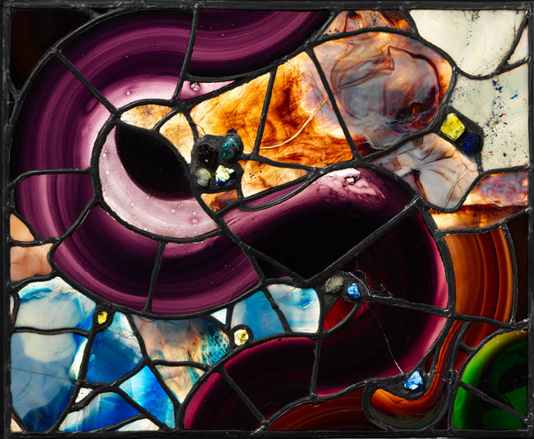
Bella Apartment Window, ca. 1880, Leaded glass, The MET, NY

Slide 5
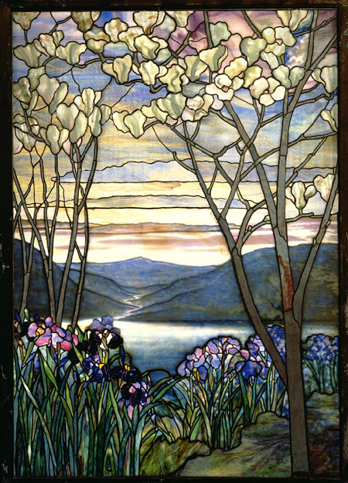
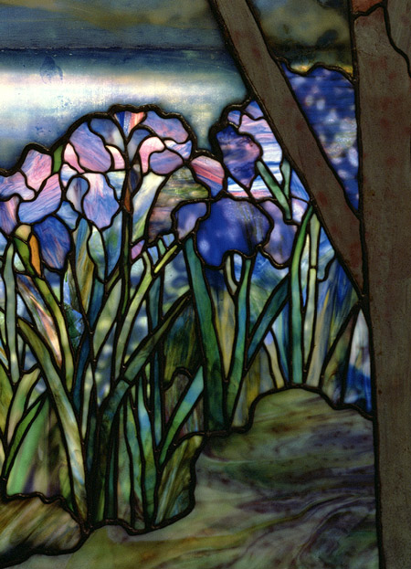
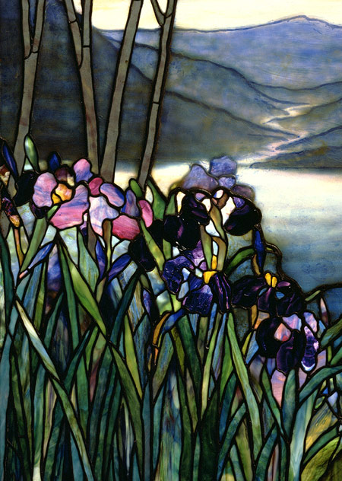
Magnolia and Irises, ca. 1908, Leaded Favrile glass, The MET, NY

Slide 6
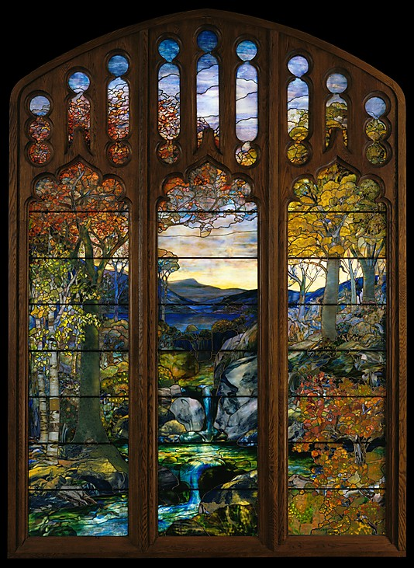
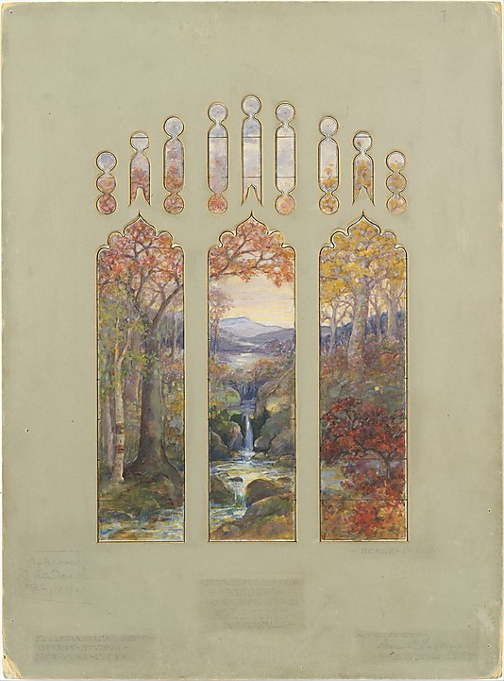
Autumn Landscape, 1923–24, Leaded Favrile glass, The MET, NY
Design for Autumn Landscape window, 1923, Watercolor, ink, and gouache on paper, The MET, NY

Slide 7
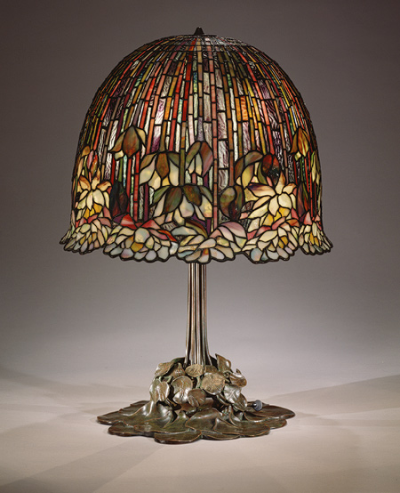
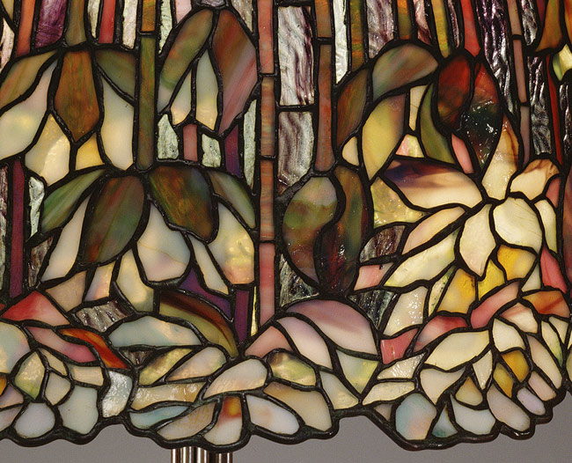
Lamp, 1904–15, Leaded Favrile glass, bronze, The MET, NY

Slide 8
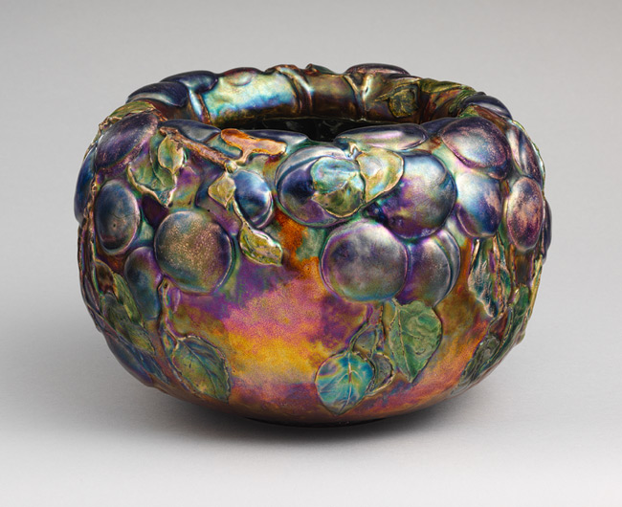
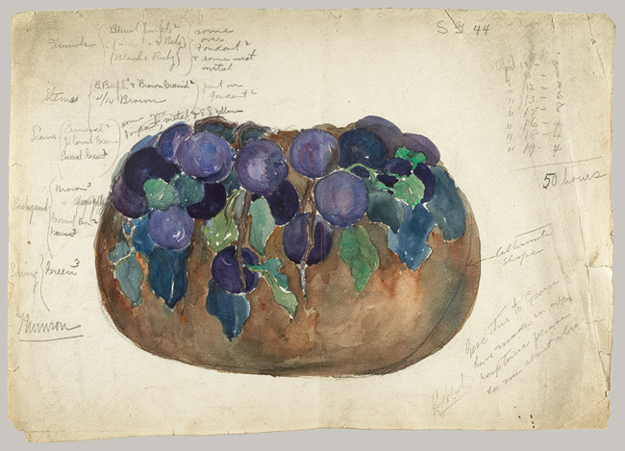
Bowl, 1899, Enamel on copper, The MET, NY
Sketch of enamel bowl, ca. 1898–99, Watercolour and graphite on paper, The MET, NY

Slide 9
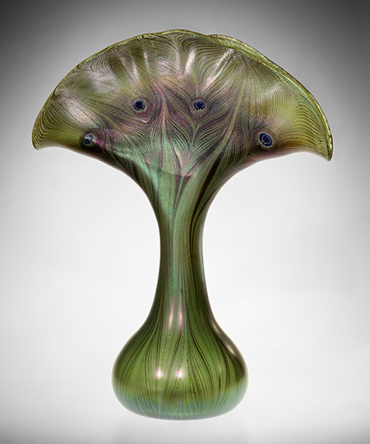
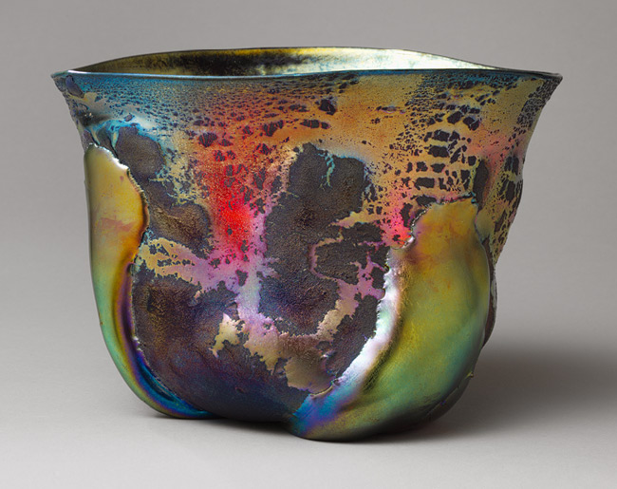
Vase, 1893–96, Favrile glass, The MET, NY
Bowl, ca. 1908, Favrile glass, The MET, NY

Slide 10
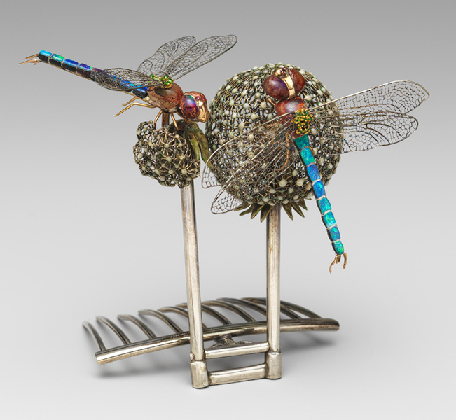
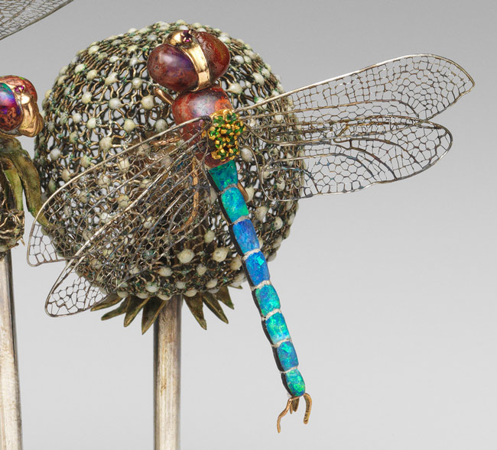
Hair ornament, ca. 1904, Silver, enamel, black and pink opals, demantoid garnets, The MET, NY

Slide 11
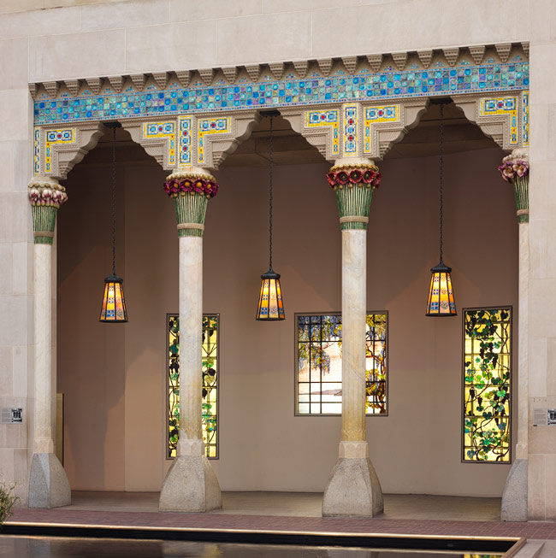
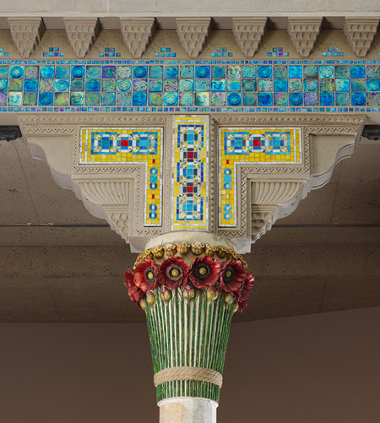
Loggia from Laurelton Hall, Oyster Bay, New York, ca. 1905, Limestone, ceramic, glass, The MET, NY

Slide 12
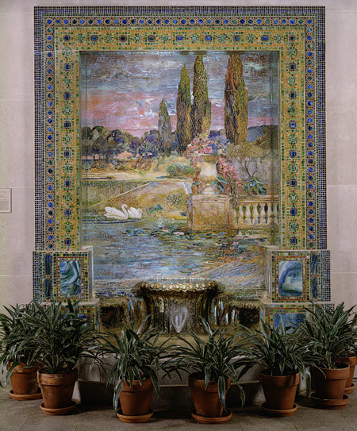
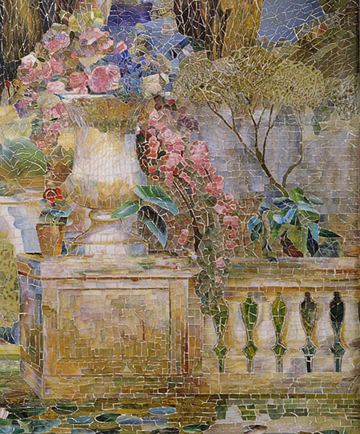
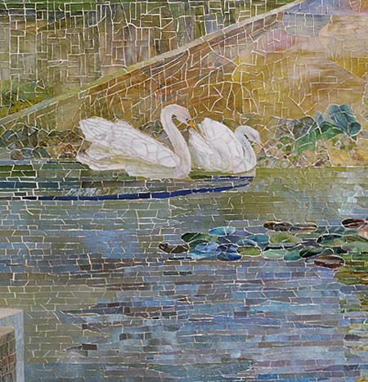
Garden Landscape and Fountain, ca. 1905–15, Favrile glass, cement, The MET,
NY

