Slide 1
Back to Aigai
Photos by Kostas Papantoniou

Slide 2
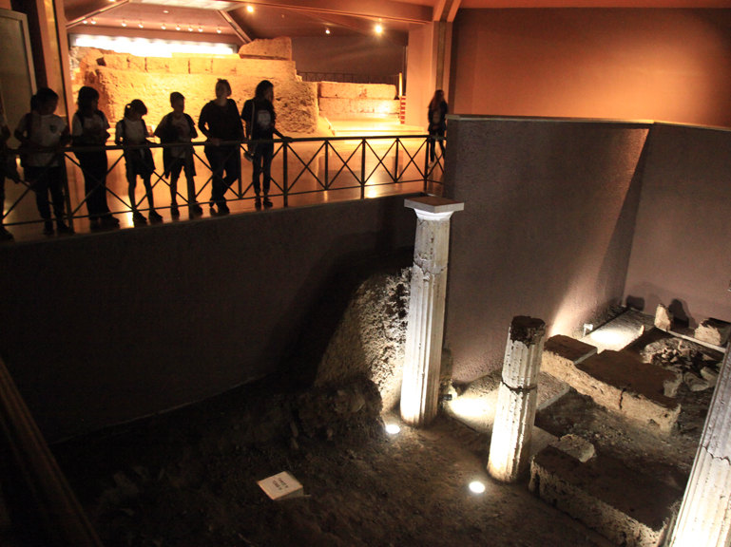
The tomb with the free-standing column façade, The royal burial cluster of Philip II, Aigai

Slide 3
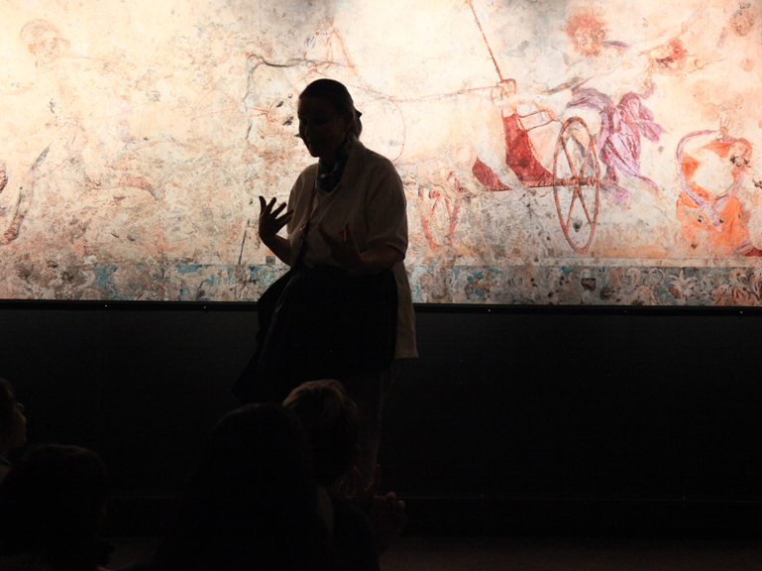
Guiding students in front of the mural reproduction depicting the Abduction of Persephone by Hades.
From the cist tomb of probably Nikissipoli, a wife of Philip II, father of Alexander the Great

Slide 4
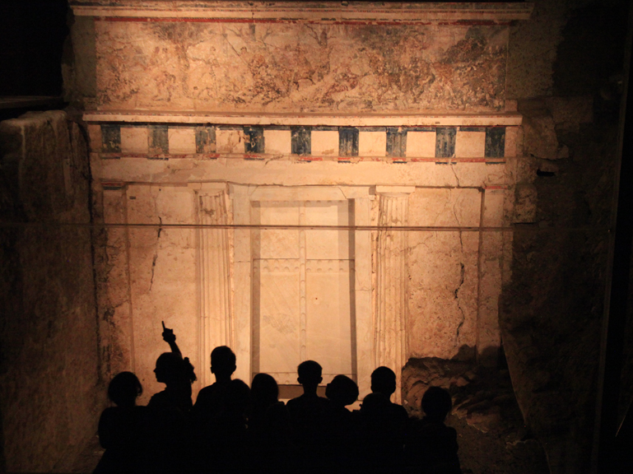
The Macedonian Tomb of King Philip II, father of Alexander the Great, 336 BC

Slide 5
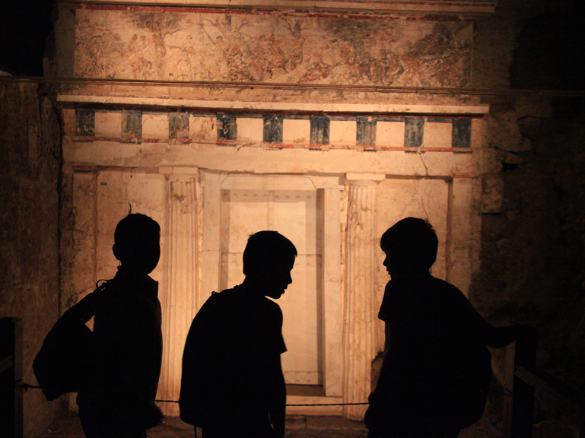

Slide 6
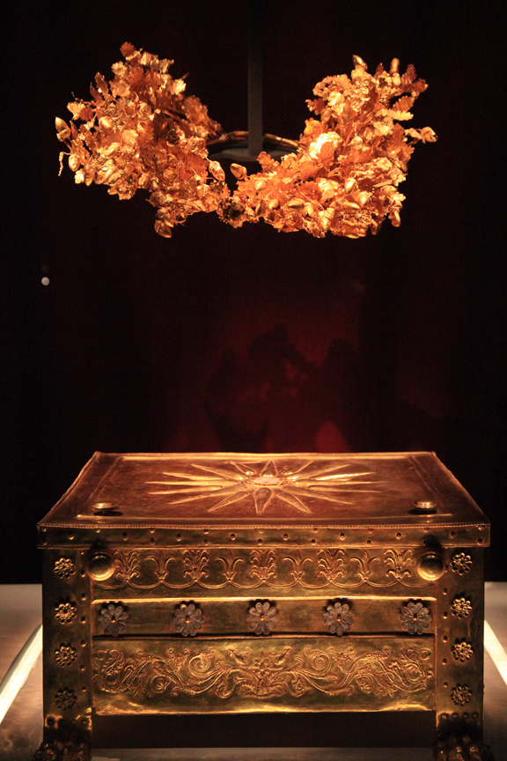
The golden larnax (ash-chest) of Philip II and his spectacular oak-leaf Wreath

Slide 7
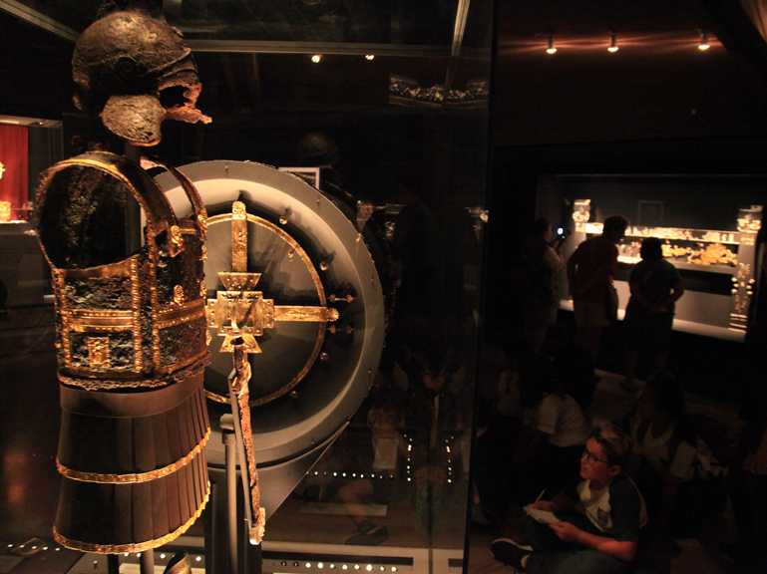
The gold-encrusted armor found in the Burial Chamber of Philip’s Tomb

Slide 8
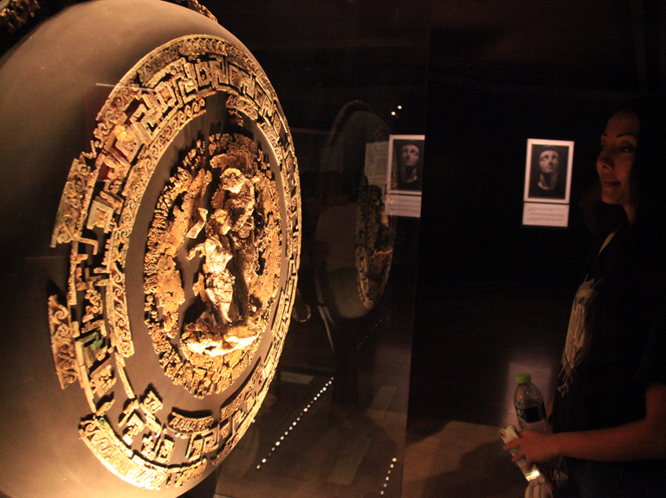
The gold and ivory shield of Philip II

Slide 9
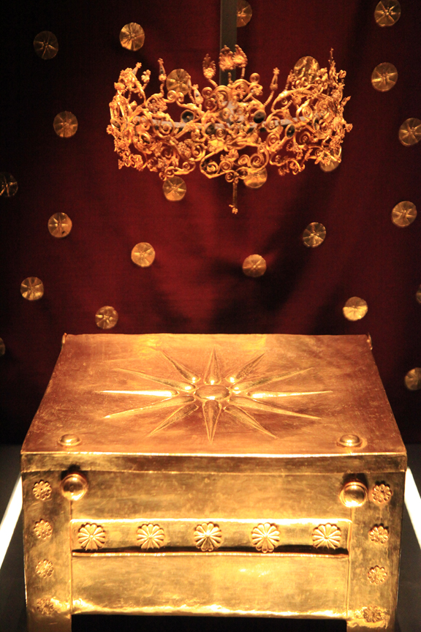
The golden larnax (ash-chest) of Philip’s Thracian wife, Meda and her spectacular crown

Slide 10
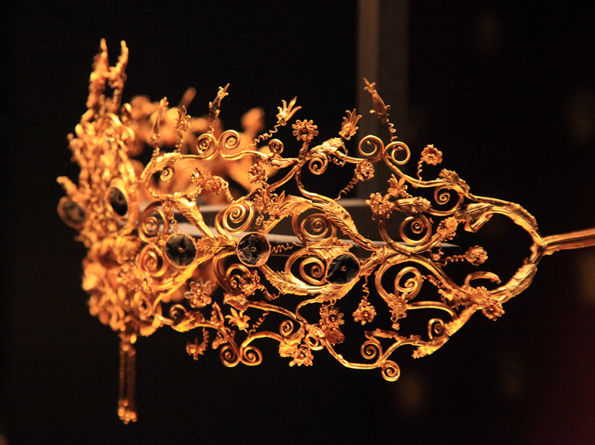

Slide 11
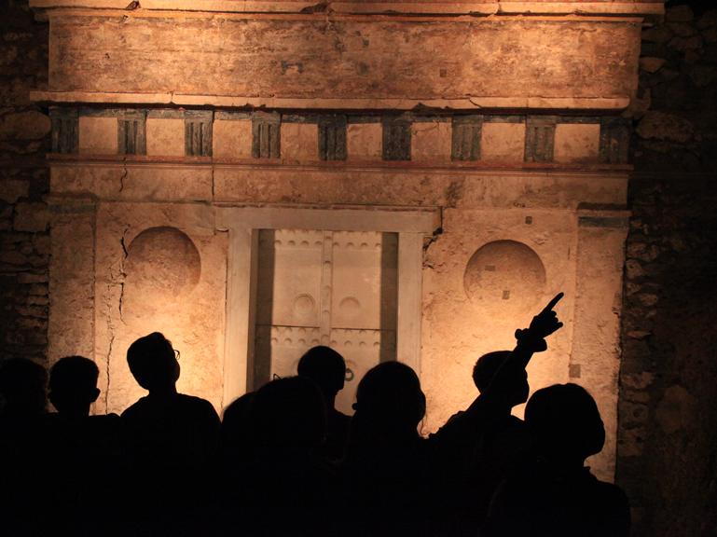
The Tomb of Alexander IV, son of Alexander the Great and Roxanne, 311 BC

Slide 12
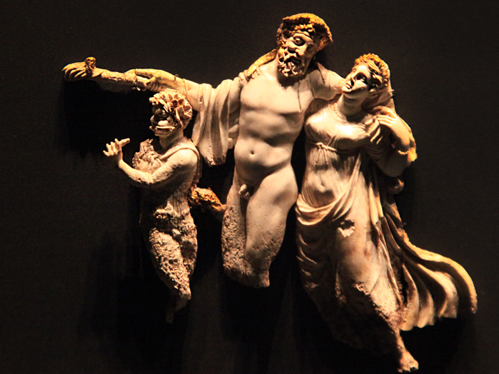
Ivory representation of Dionysus, a maenad and a young satyr, from the Tomb of Alexander IV, son of Alexander the Great and Roxanne, 311 BC

