Slide 1
Tick-Tock,
Bedroom
Clock

Slide 2
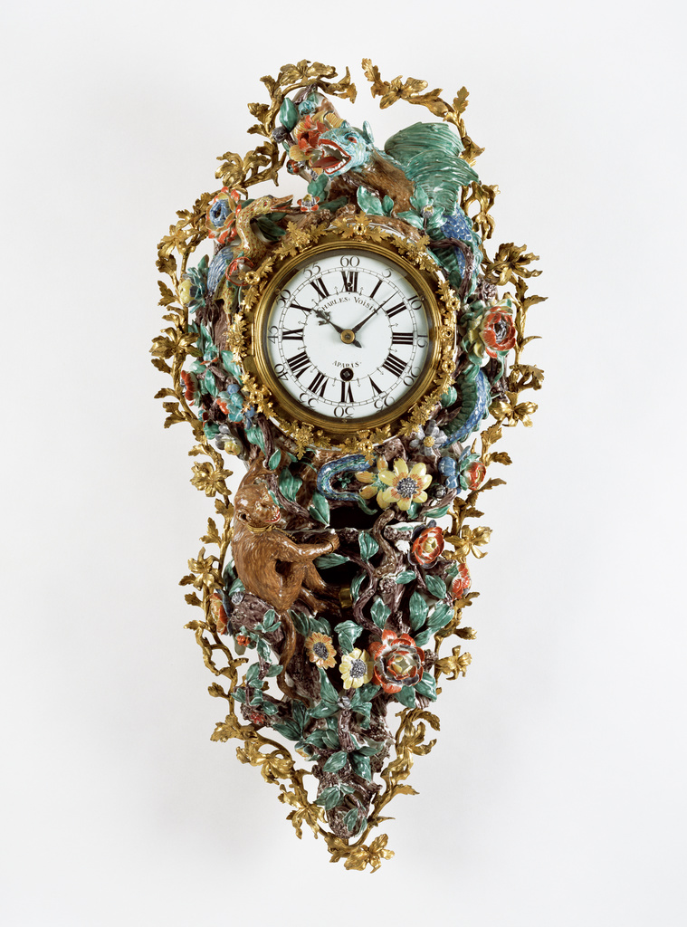
Wall Clock (Pendule d'alcove), Movement by Charles Voisin (French, 1685–1761), clockmaker; clock case made at the Chantilly Porcelain Manufactory French, Paris and Chantilly, about 1740, Soft-paste porcelain; gilt bronze; enameled metal; glass, The Getty Museum

Slide 3
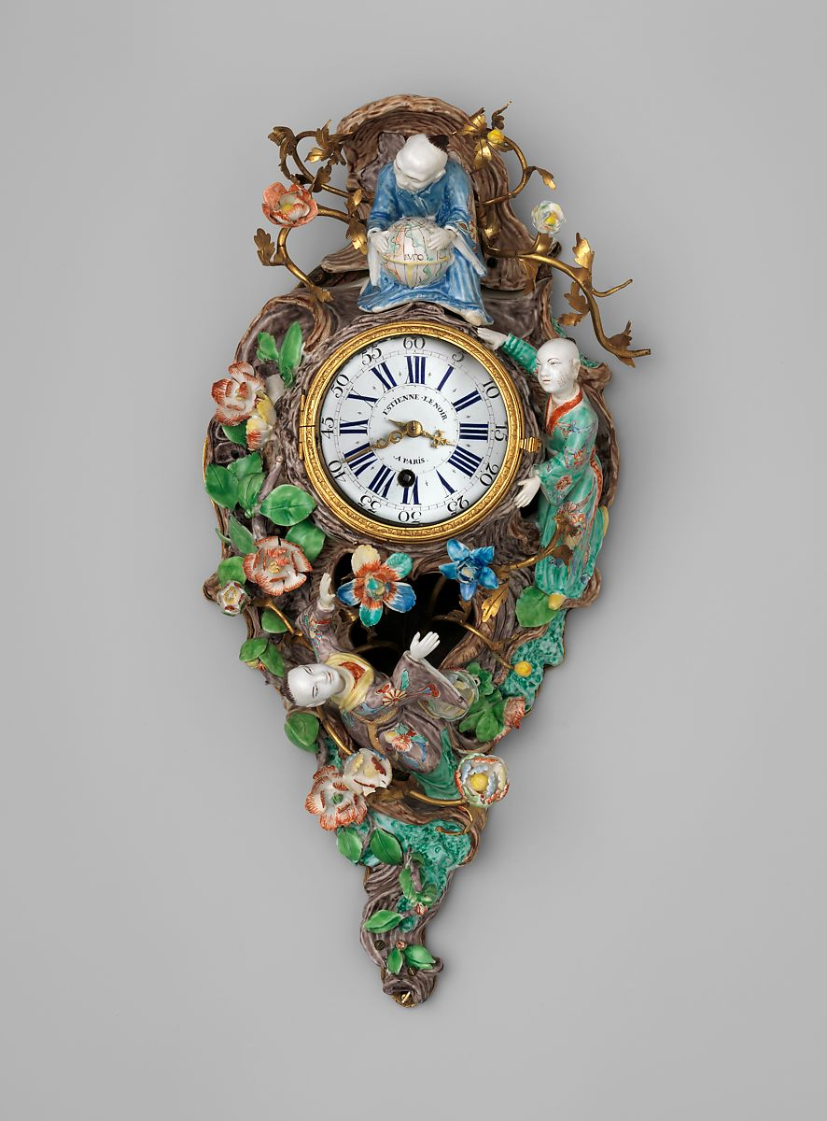
Wall clock (cartel) ca. 1735–40
Clockmaker: Etienne LeNoir, Case: soft-paste porcelain and partly gilded brass; Dial: white enamel; Movement: brass and steel, the MET,NY

Slide 4
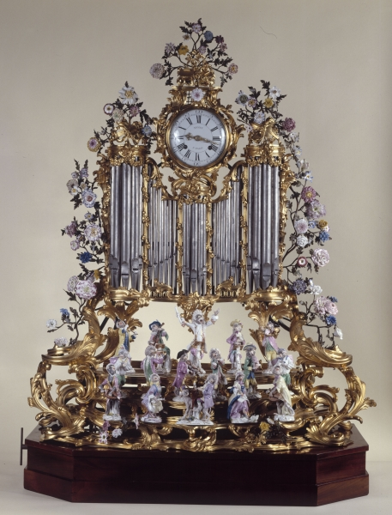
Organ Pipe Clock with Monkey Orchestra, Porcelain figures based on models by Johann-Joachim
Kändler and Peter Reinicke, 1755-1760, bronze work, Vincennes soft-paste porcelain flowers, hard-paste Meissen porcelain figurines, 130 x 85 cm, Petit Palais, Paris

Slide 5
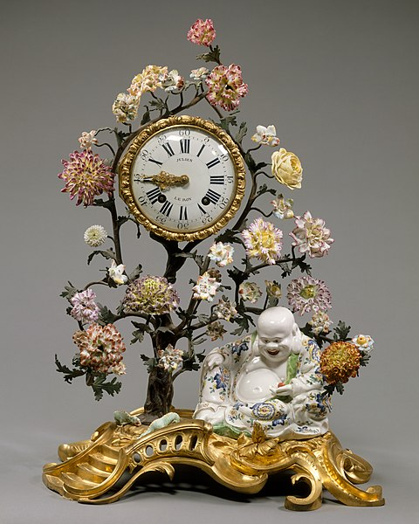
Mantel clock, circa 1745 –49, Chantilly soft-paste porcelain mounted on gilt bronz, flowers of soft- and hard-paste porcelain; clock face of white enameled meta, Height: 54.6 cm, the MET, NY

