Slide 1
The Myth of Theseus, the
Minotaur, Ariadne and Dionysus

Slide 2
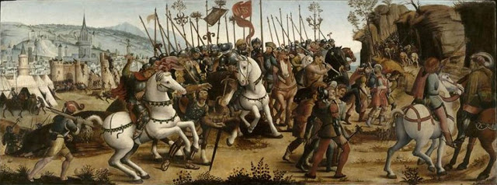
Master of the Cassoni Campana, active 1500-1525 in Florence,
The Taking of Athens by Minos, King of Crete, c. 1510s, oil on poplar panel, Musée du Petit Palais, Avignon

Slide 3
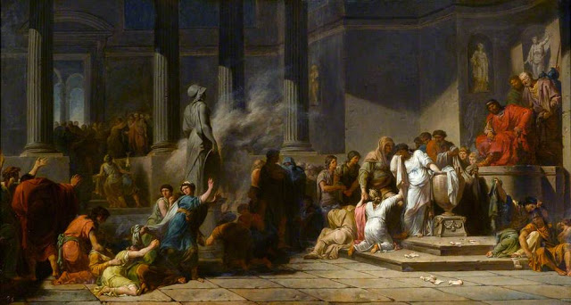
Jean-François-Pierre Peyron, 1744–1814
Athenian Girls Drawing Lots to Determine which among them Shall Be Sent to Crete for Sacrifice to the Minotaur, 1778, oil on paper laid on canvas, the Wellington Collection, Apsley House

Slide 4
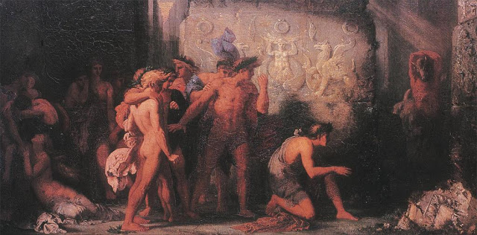
Gustave Moreau, 1826-1898
Athenians Delivered to the Minotaur, 1855, oil on canvas, Musée de Brou - Bourg-en-Bresse

Slide 5
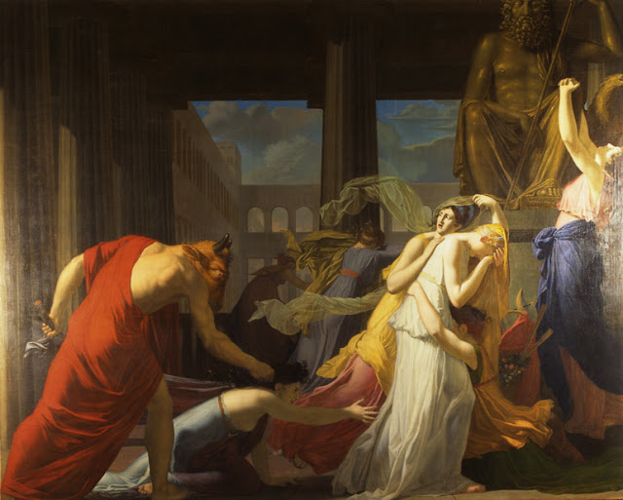
Jean-Baptiste Peytavin, 1767-1855
Seven Athenians Delivered from the Minotaur, 1808, oil on canvas,
Museum of Fine Arts of Chambéry

Slide 6
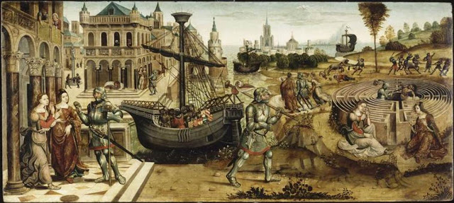
Master of the Campana Cassoni, 1500-1525
Theseus and the Minotaur, c. 1500 and 1525, oil on panel, Musee du Petit Palais, Avignon

Slide 7
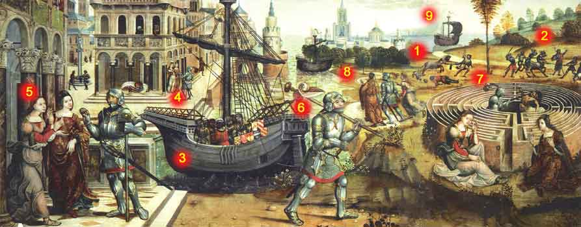
1) Minotaur, the son of the white Bull and Pasiphae, attacks and kills Cretans 2) The Minotaur is captured with the help of Poseidon. 3) The ship with Theseus arrives. 4) Theseus meets Ariadne and her sister Phaedra. 5) Ariadne gives a ball of thread to Theseusa to be able to return from the Labyrinth 6). Theseus goes to the Labyrinth 7) He kills inside the Labyrinth the Minotaur, Ariadne and her sister are waiting in front of the Labyrinth 8) Theseus with Ariadne and her sister leave Crete. 9) Their ship with the black sail leaves Crete.

Slide 8
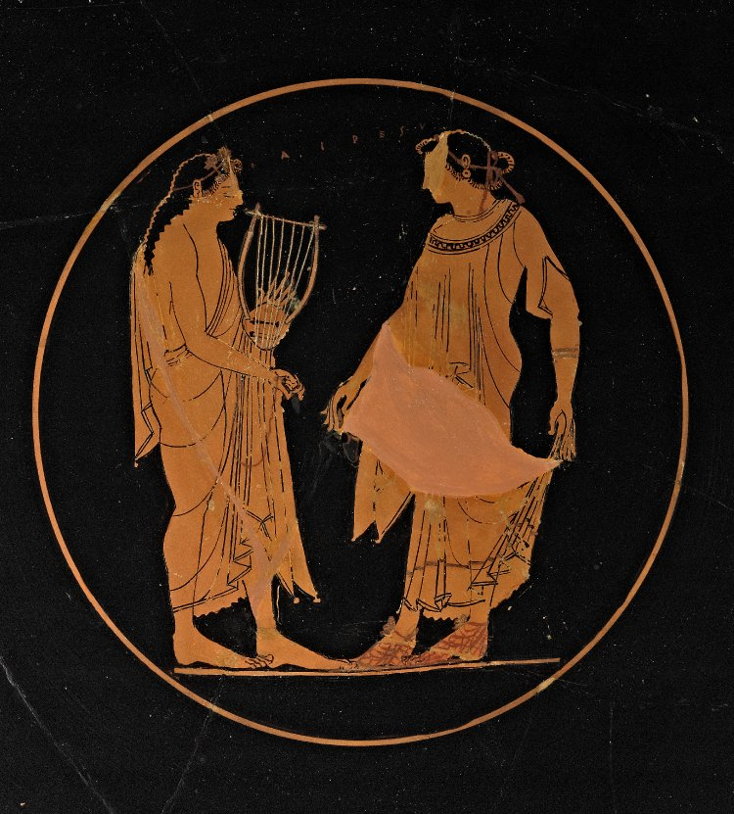
The Protagonists
Theseus, prince of Athens and
Ariadne, princess of Crete
Theseus and Ariadne, attributed to Euphronios, c. 500 BC, red figure kylix, the British Museum

Slide 9
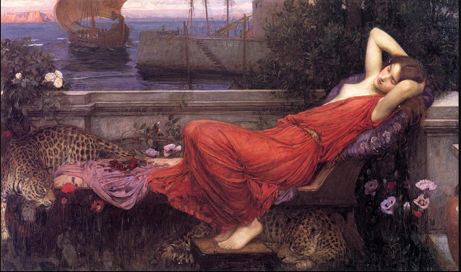
John William Waterhouse, 1849-1898
Ariadne, c. 1898, oil, canvas, private collection

Slide 10
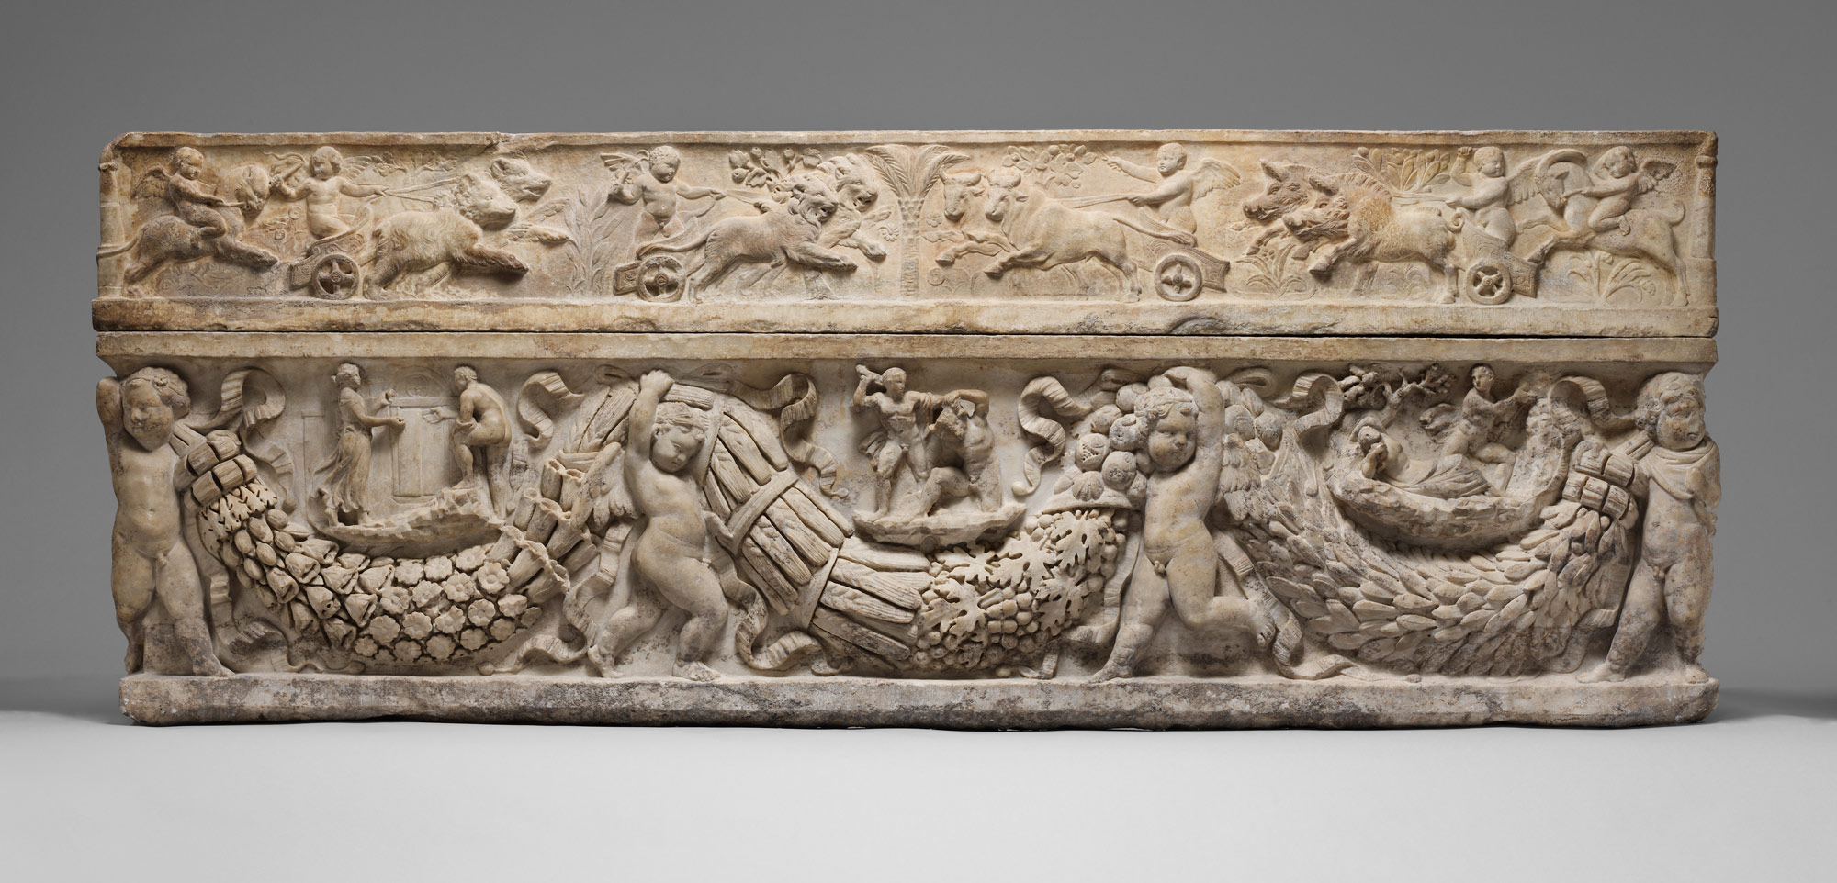
Marble sarcophagus with garlands and the myth of Theseus and Ariadne, 130–150 AD, marble, the MET, NY

Slide 11
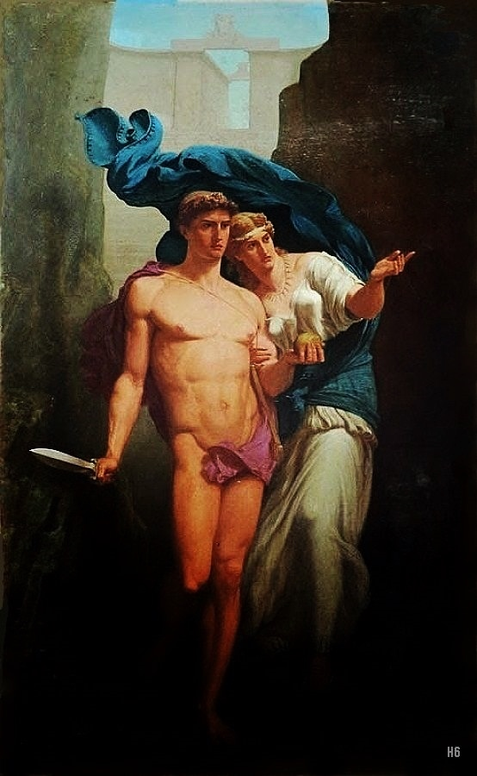
Charles de La Fosse, 1829-1910
Theseus and Ariadne, 19th.century, oil on canvas, private collection

Slide 12
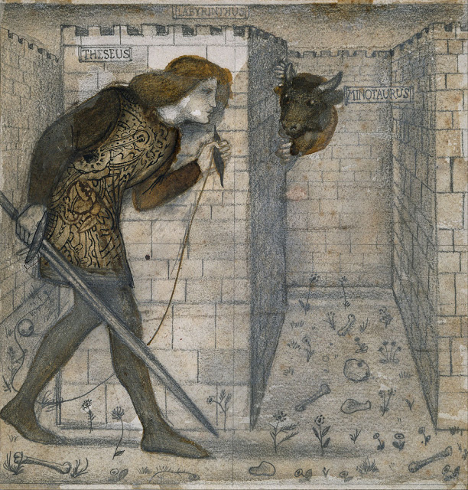
Edward Burne-Jones,
1833–1898
Theseus and the Minotaur in the Labyrinth, c. 1861, pencil, brown wash, pen and ink on paper, Birmingham Museum and Art Gallery

Slide 13
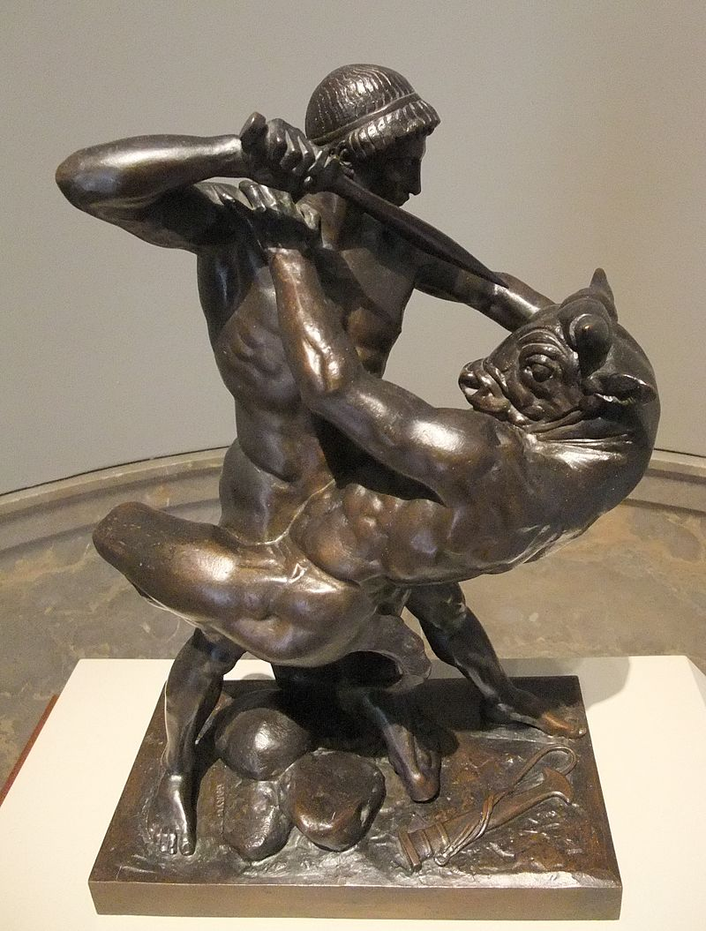
Antoine-Louis Barye, 1796-1875
Theseus Slaying Minotaur, 1843, bronze sculpture, Baltimore Museum of Art

Slide 14
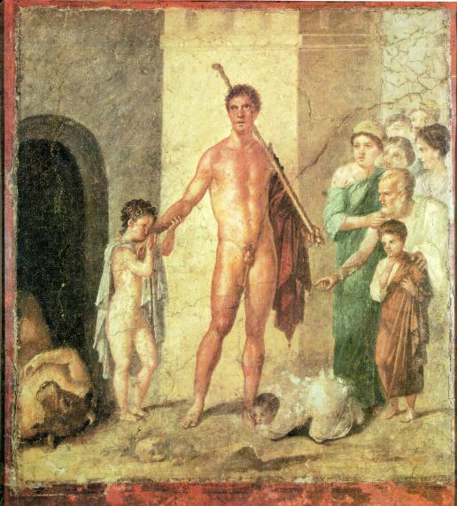
Victorious Theseus, 1st century AD, fresco, the painting is now hanging on a wall in the Museo Nazionale (National Museum) in Naples, but once it was part of a wall in a Pompeian house, the House of Gavius Rufus

Slide 15
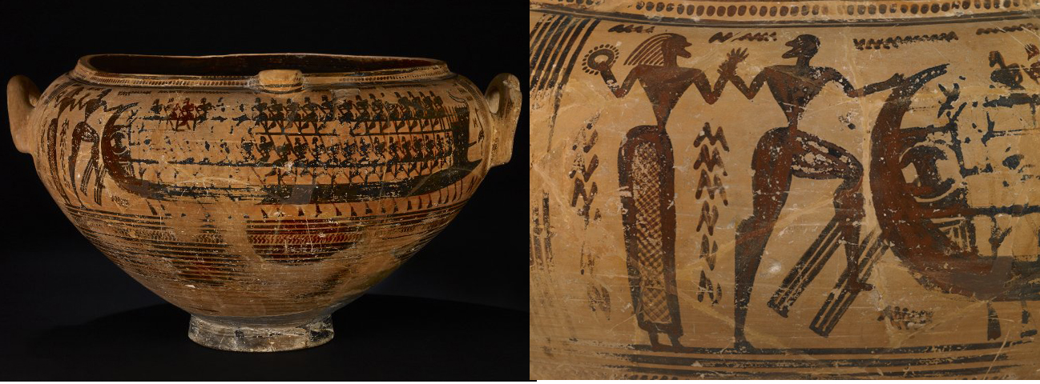
Ariadne and Theseus departing from Crete, c. 735 BC, Attic krater, the British Museum

Slide 16
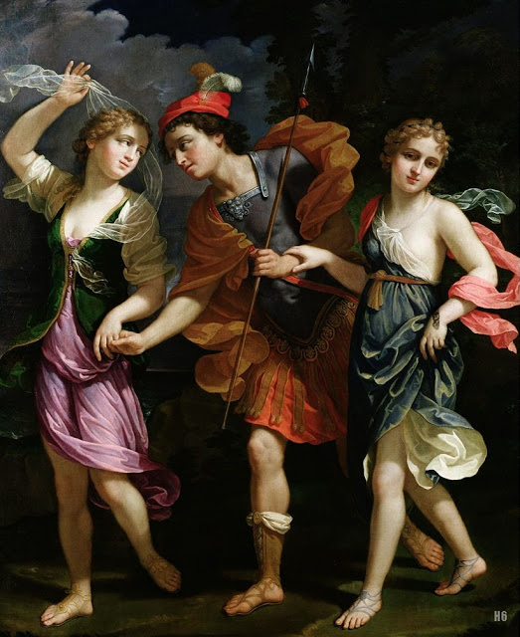
Benedetto Gennari II, 1635-1715
Theseus with Ariadne and Phaedra the daughters of King Minos, c. 1702, oil on canvas, Kunsthistorisches Museum in Vienna

Slide 17
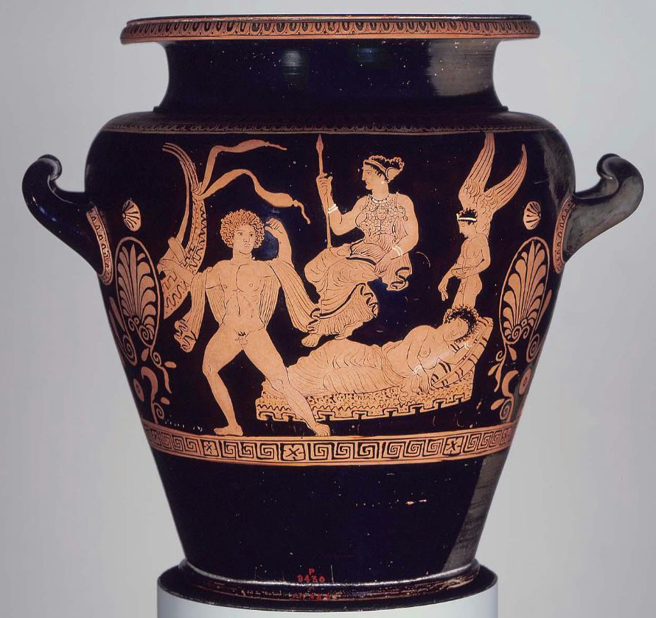
Theseus departing from the island of Naxos leaving Ariadne behind, c. 400 BC, red figure stamnos, MFA, Boston

Slide 18
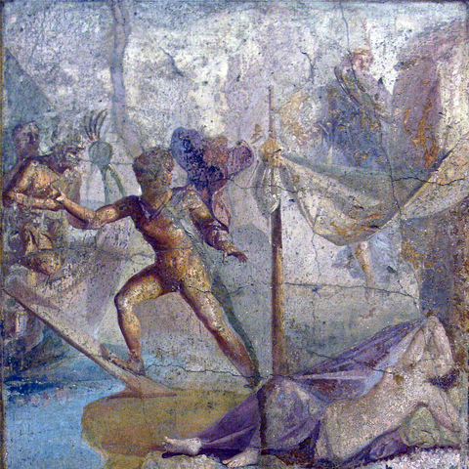
Theseus departing from the island of Naxos leaving Ariadne behind, 1st century AD, fresco from Pompeii, National Archaeological Museum, Naples

Slide 19
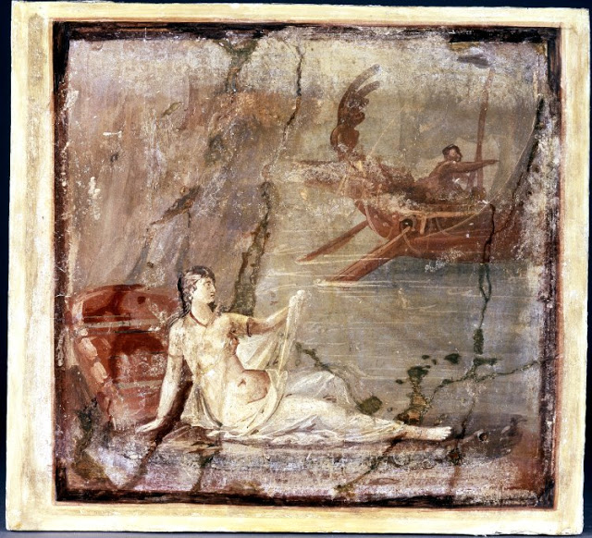
Theseus departing from the island of Naxos leaving Ariadne behind, 1st century AD, fresco from Pompeii, National Archaeological Museum, Naples

Slide 20
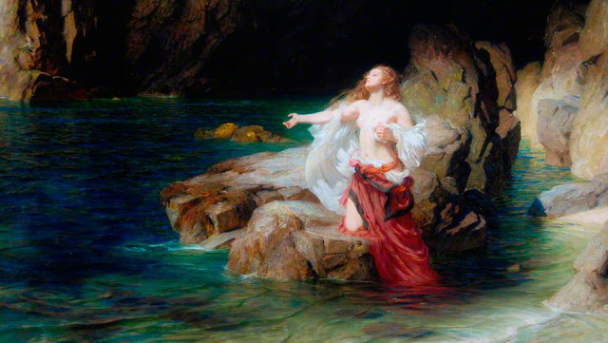
Herbert James Draper, 1864–1920
Ariadne Deserted by Theseus, 1905, oil on canvas, Middlesbrough Institute of Modern Art

Slide 21
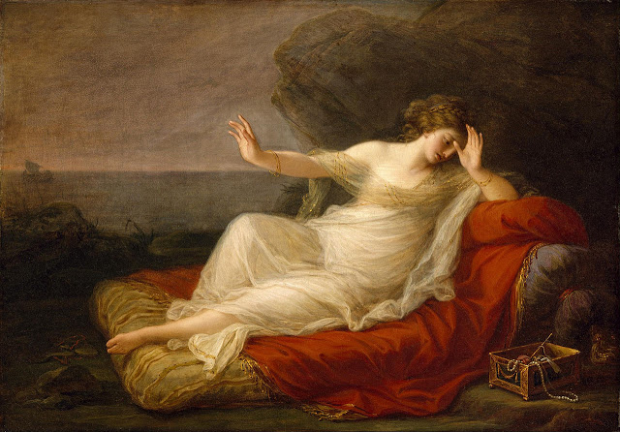
Angelica Kauffman,
1741–1807
Ariadne Abandoned by Theseus, c. 1774, oil on canvas, MFA, Houston

Slide 22
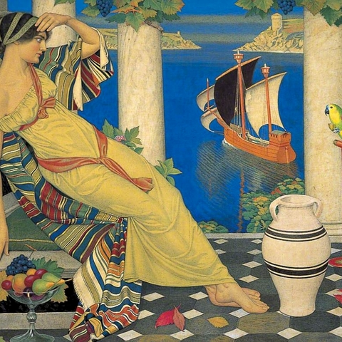
Joseph Edward, 1933-2000
Ariadne in Naxos, 1925,oil on canvas, Birmingham Museums Trust

Slide 23
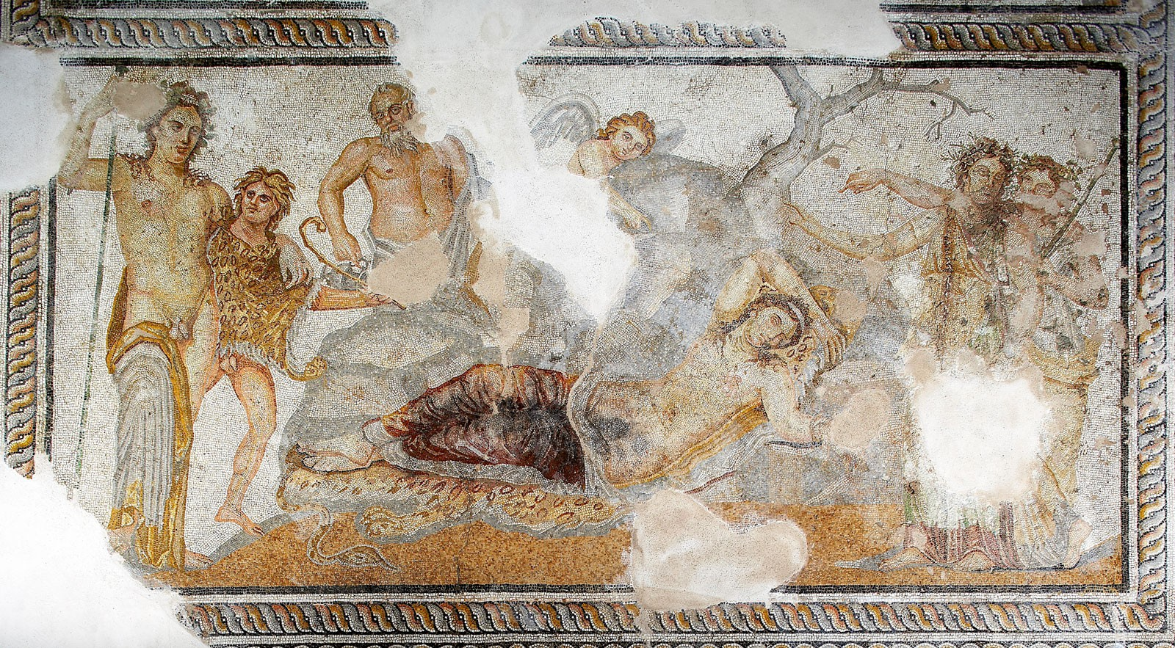
Mosaic Floor with Dionysos and Ariadne, 200-250 AD, mosaic floor, Archaeological Museum, Thessaloniki, Greece

Slide 24
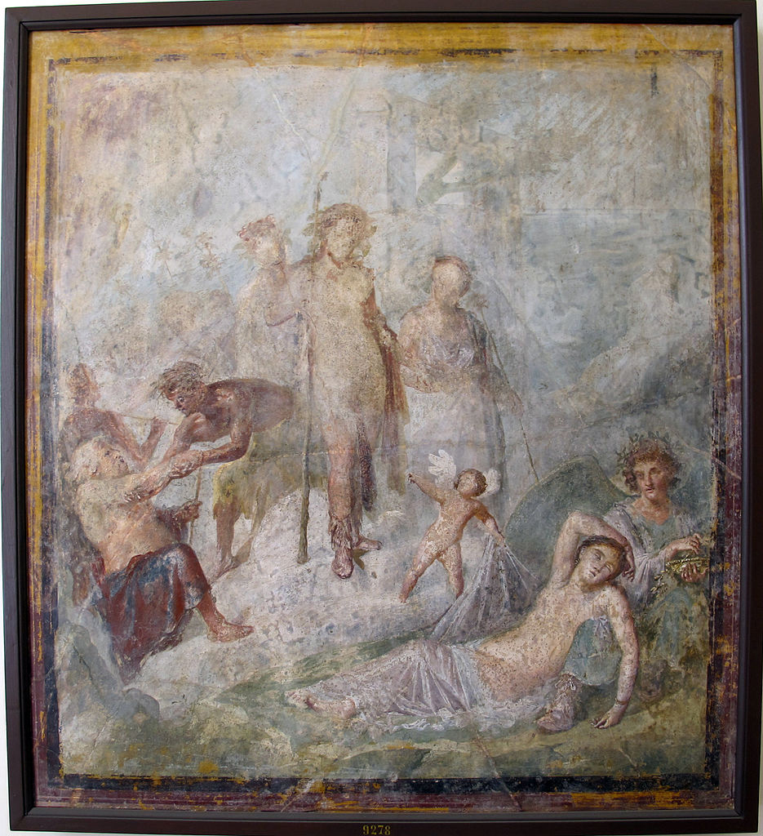
Dionysos and Ariadne, 1st century AD, Pompeii, from the House of Capitelli Colorati, now in the National Archaeological Museum of Naples

Slide 25
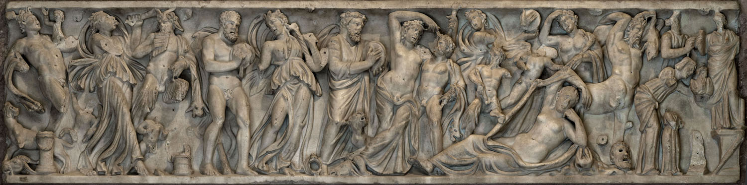
Dionysos and Ariadne, 3rd century AD, marble sarcophagus, The State Hermitage Museum

Slide 26
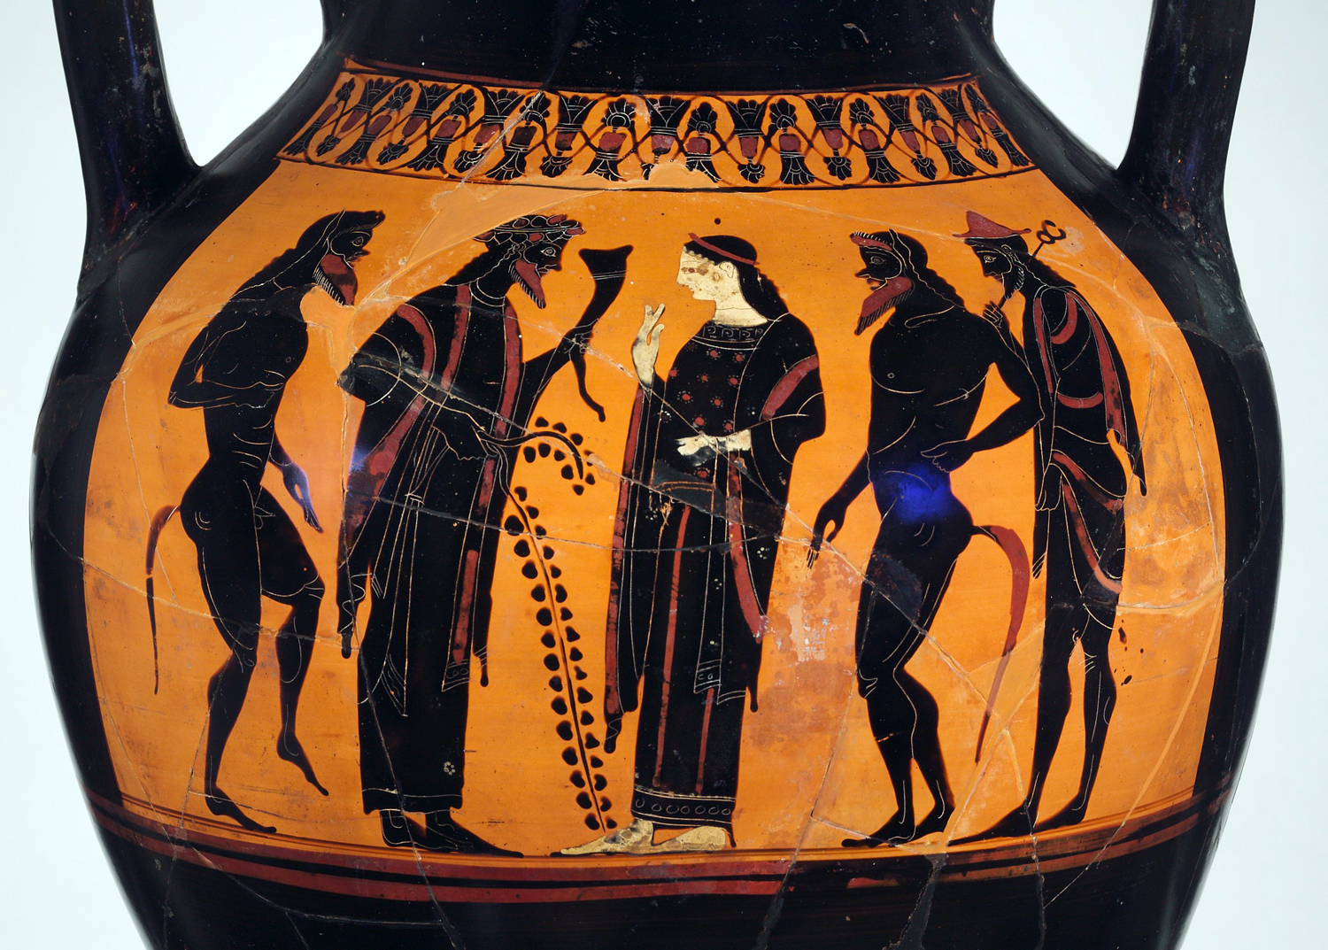
Dionysos, Ariadne, Satyrs and Hermes, 530-20 BC, black figure amphora attributed to the Bateman team, the MET, NY

Slide 27
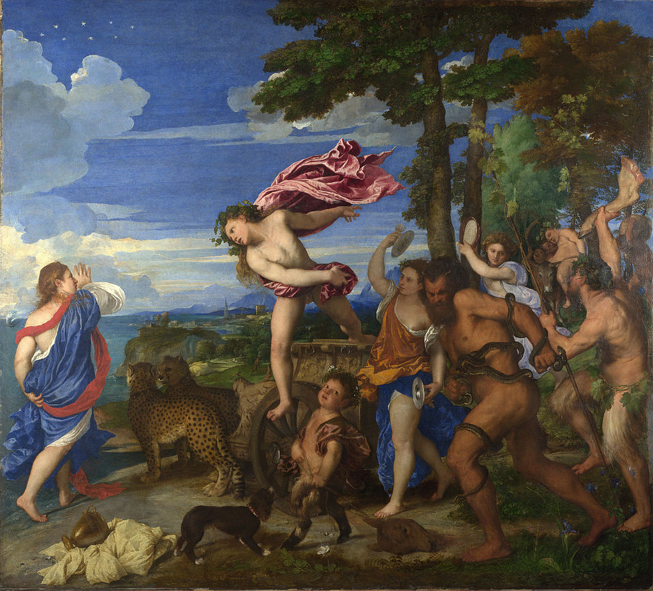
Titian, 1490-1576
Bacchus and Ariadne, 1522-23, oil on canvas, the National Gallery, London

Slide 28
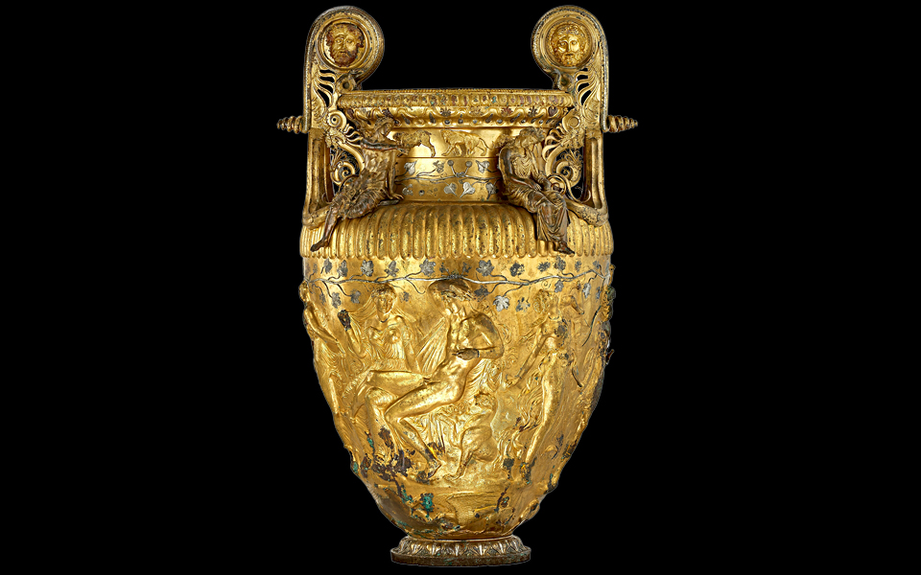
Wedding of Dionysos and Ariadne, the Derveni Krater, bronze, 4th century BC, Archaeological Museum of Thessaloniki

