Slide 1
Hercules at the Crossroads

Slide 2
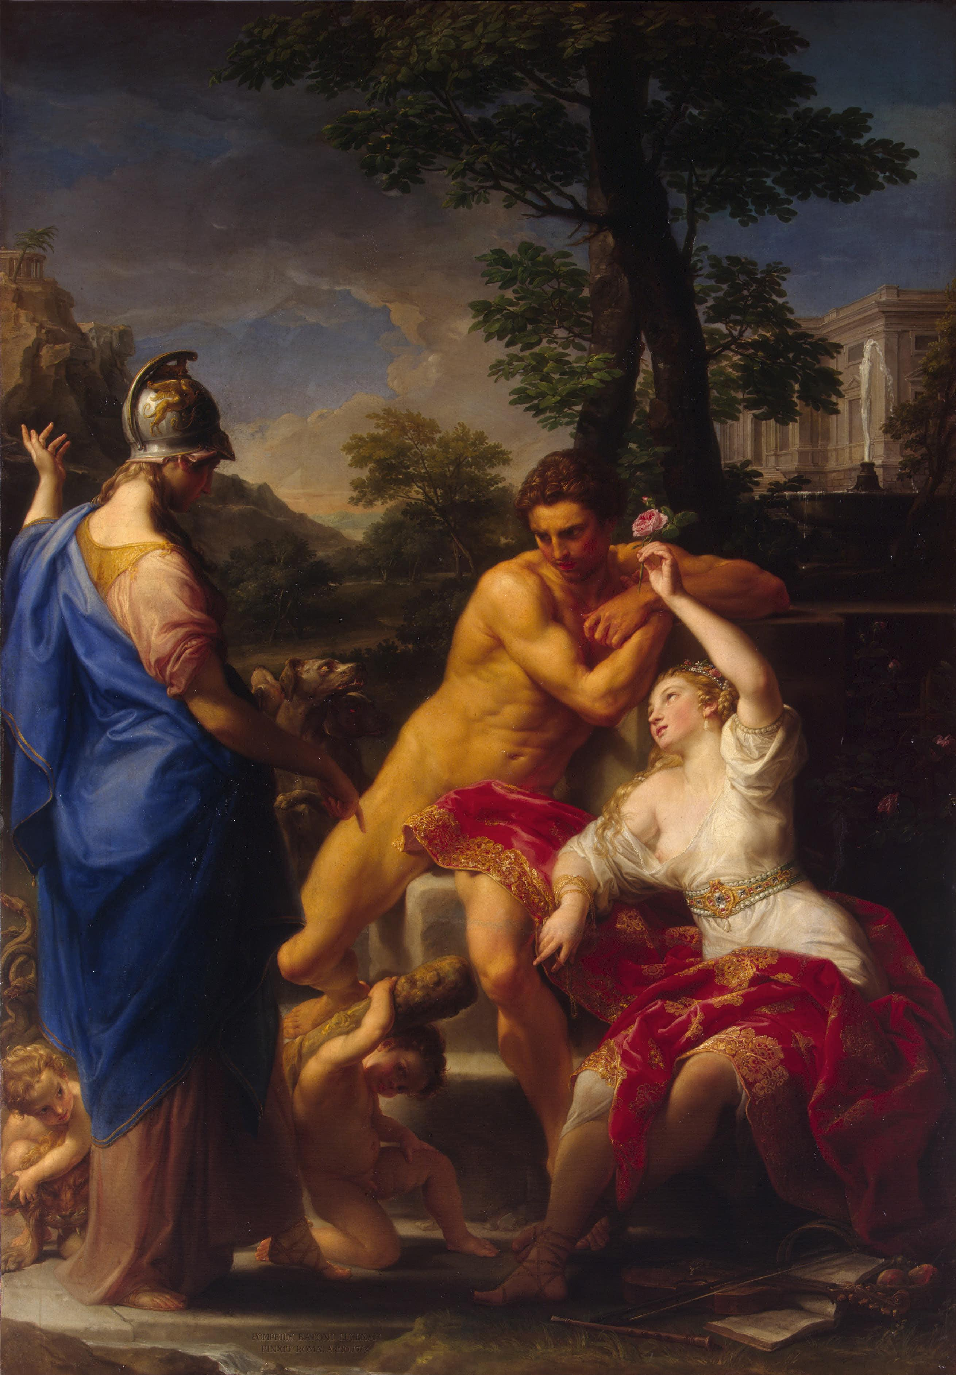
Hercules was trained in all the warlike arts, music and letters.
But knowledge does not always confer wisdom, so Hercules took himself deep into the forest to think.
To his surprise, two ladies appeared in front of him. Both were beautiful. One stood before him, richly dressed in colours and jewellery, but the other, in simple white.
The first was Vice, and she said: “Choose me, and your life shall be a pleasure, and no effort of mind or body will be demanded of you.”
The other was Virtue, and she said: “Choose me, and you will have the honour of your countrymen, but I cannot promise a life without labour, for no man may reap where he does not sow.”
And Heracles chose the path of Virtue — both the sweet, and the bitter.
Pompeo Batoni, 1708-1787
Hercules at the Crossroads, 1765, oil on canvas, 245x172 cm, Hermitage Museum

Slide 3
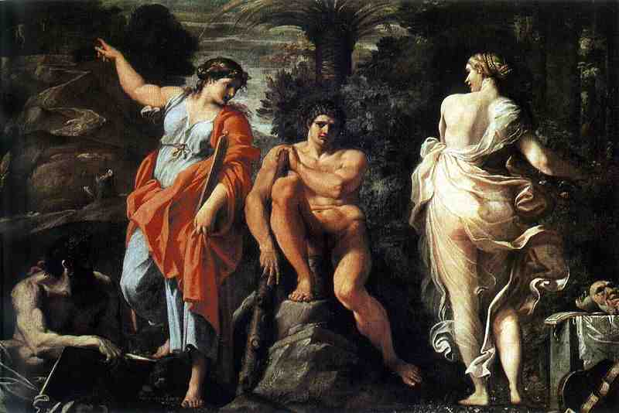
Annibale Carracci, 1560-1609
Heracles with Pleasure and Virtue, 1596, oil on canvas, 166 cm × 237 cm, Capodimonte Gallery, Naples

Slide 4
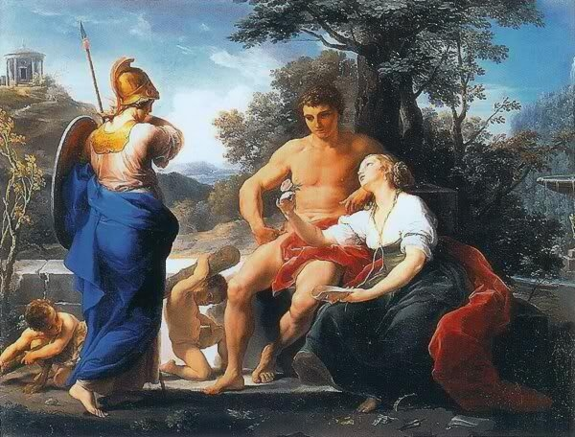
Pompeo Batoni, 1708 – 1787
Hercules at the Crossroads, 1753, oil on canvas, 245x172 cm, the Hermitage, St. Petersburg

Slide 5
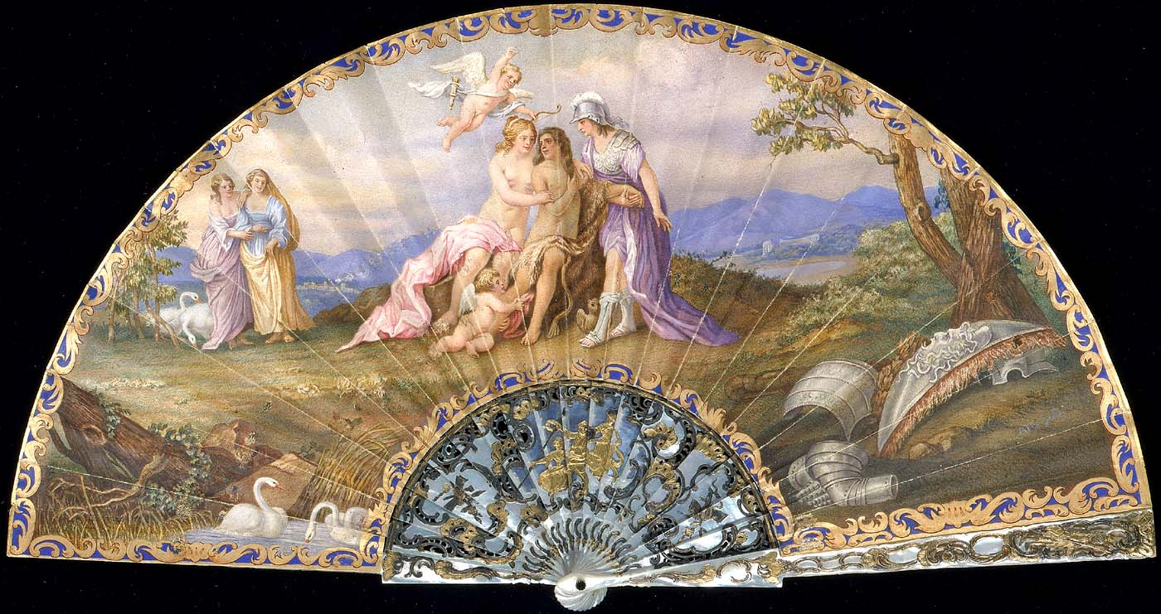
J. Naque, Hercules at the Crossroads, c. 1912, carved mother of pearl, gouache on vellum, and green stone fan, Smithsonian American Art Museum, Washington, DC

