Slide 1
Byzantine Chalices

Slide 2
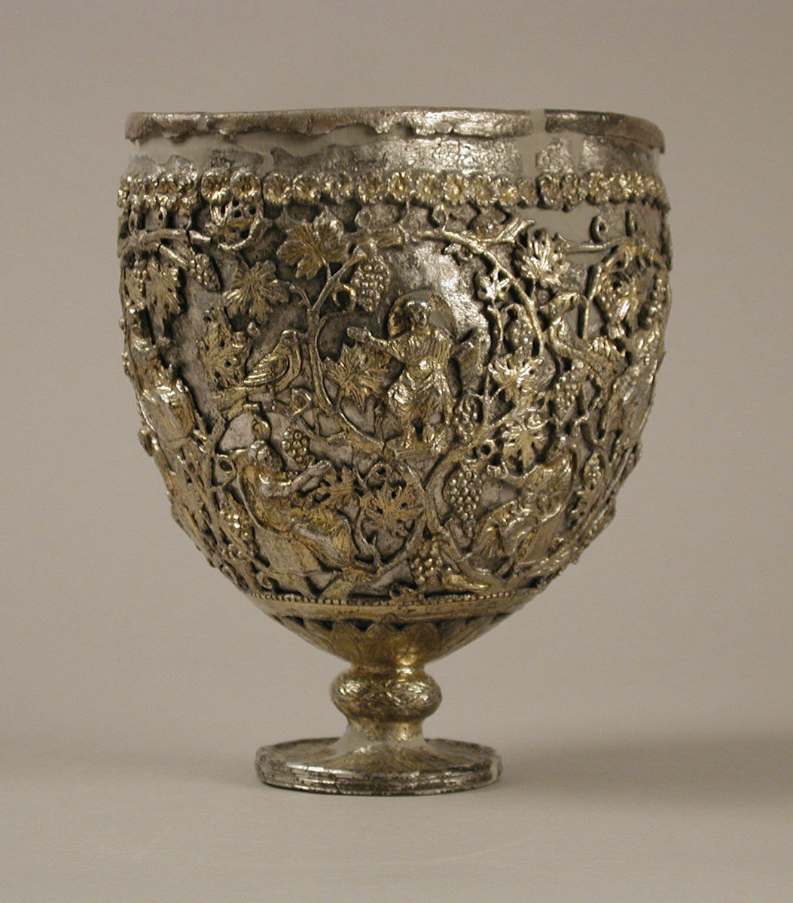
The Antioch "Chalice,” 500–550, Metalwork-Silver, 19.6 x 18 x 15.2 cm, the MET, NY

Slide 3
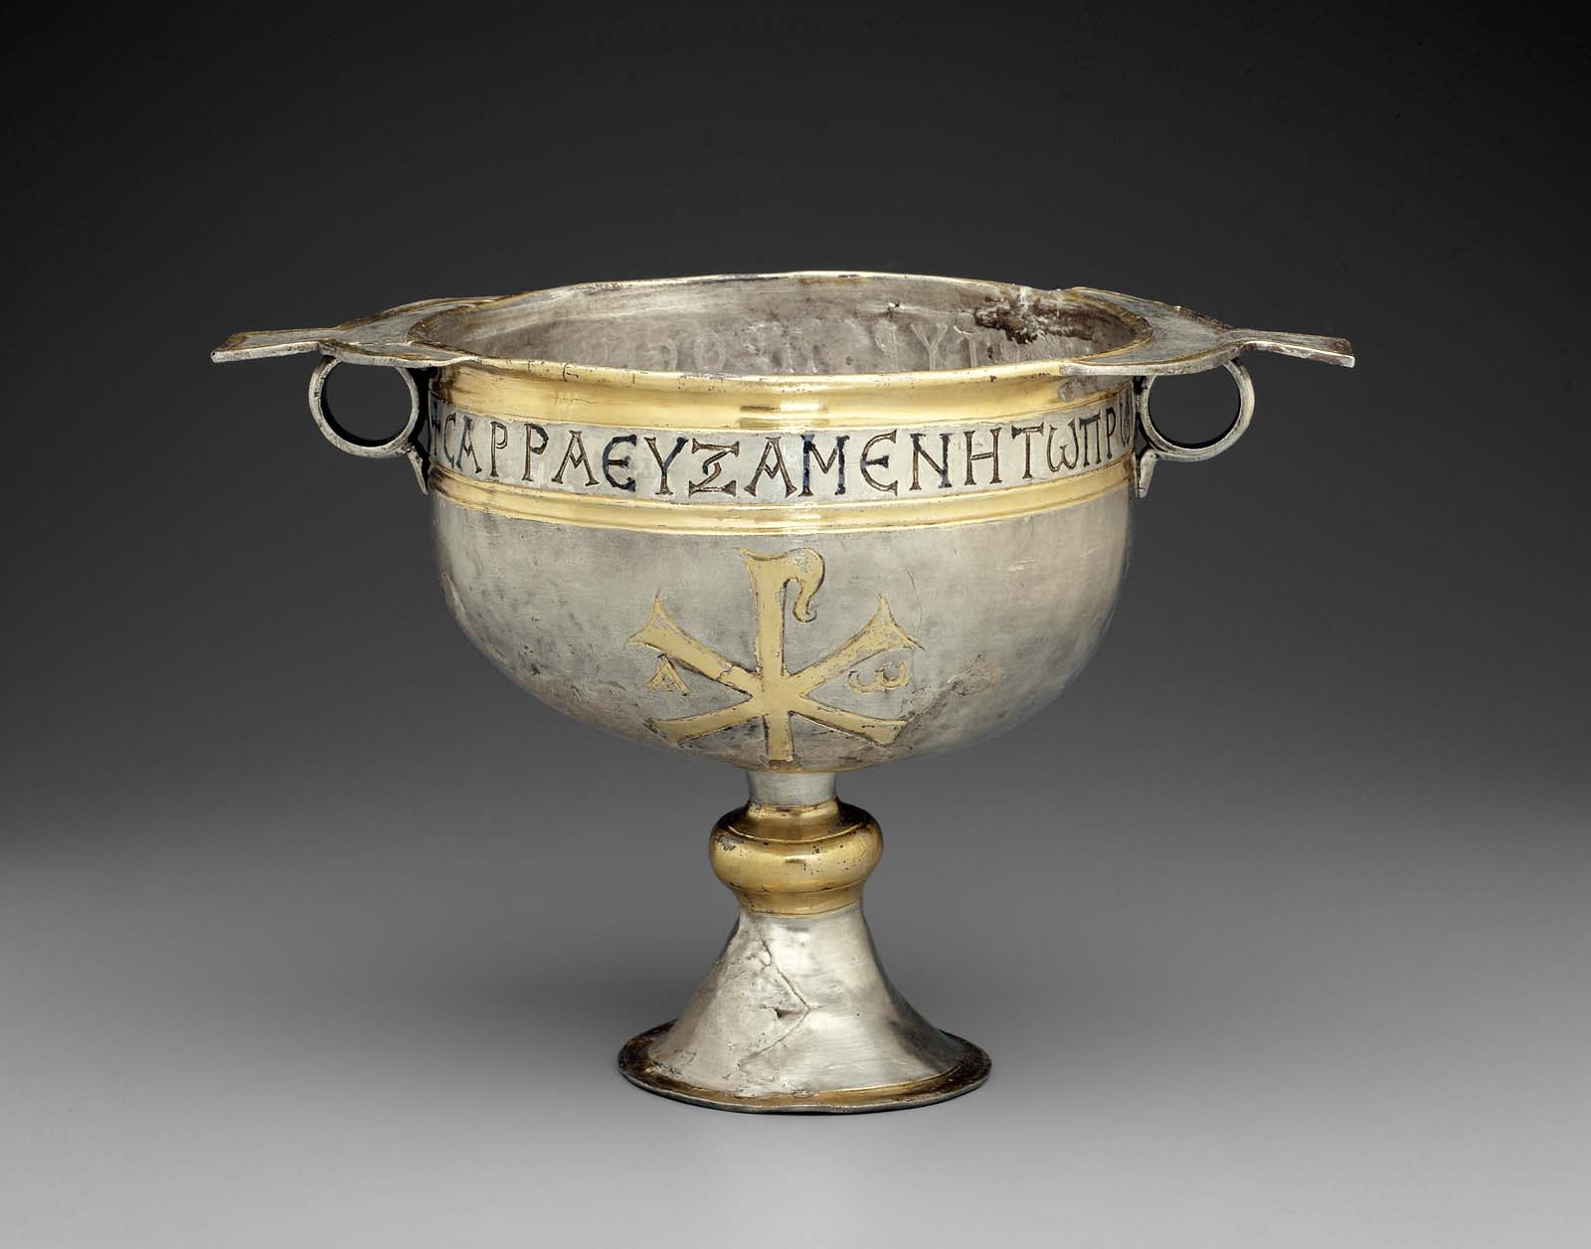
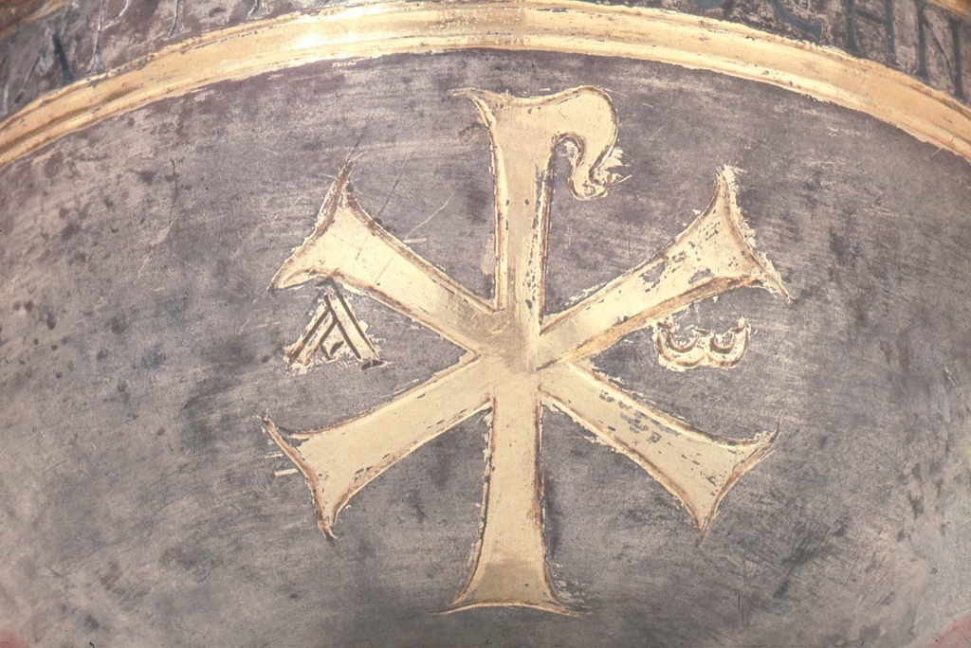
Byzantine Chalice, 6th century , silver, MFA, Boston

Slide 4
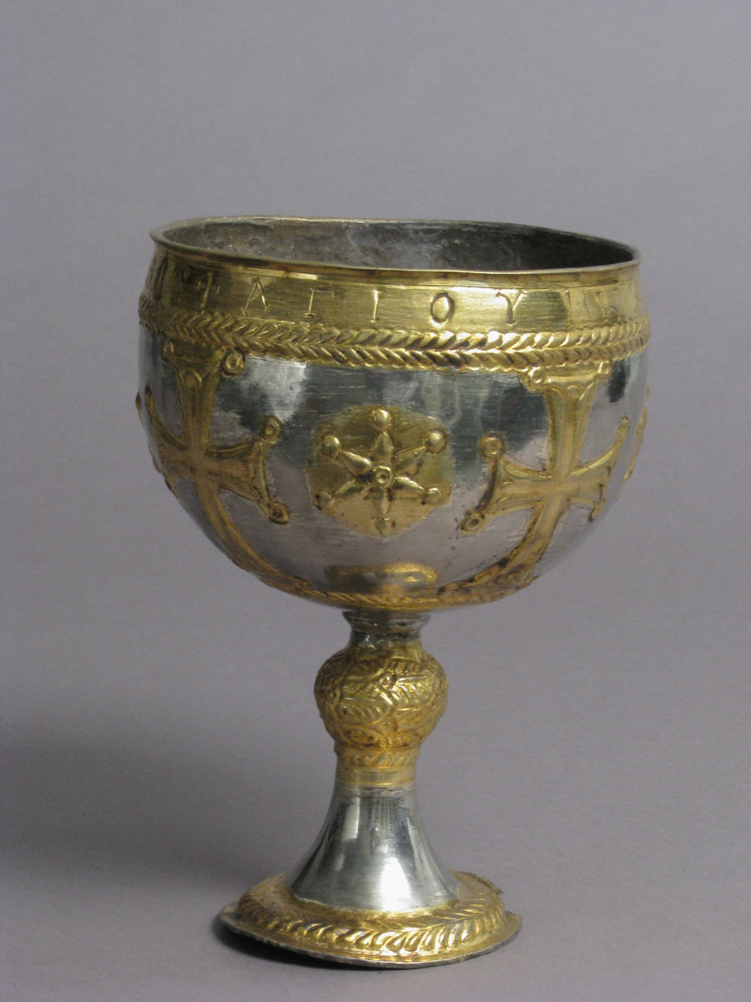
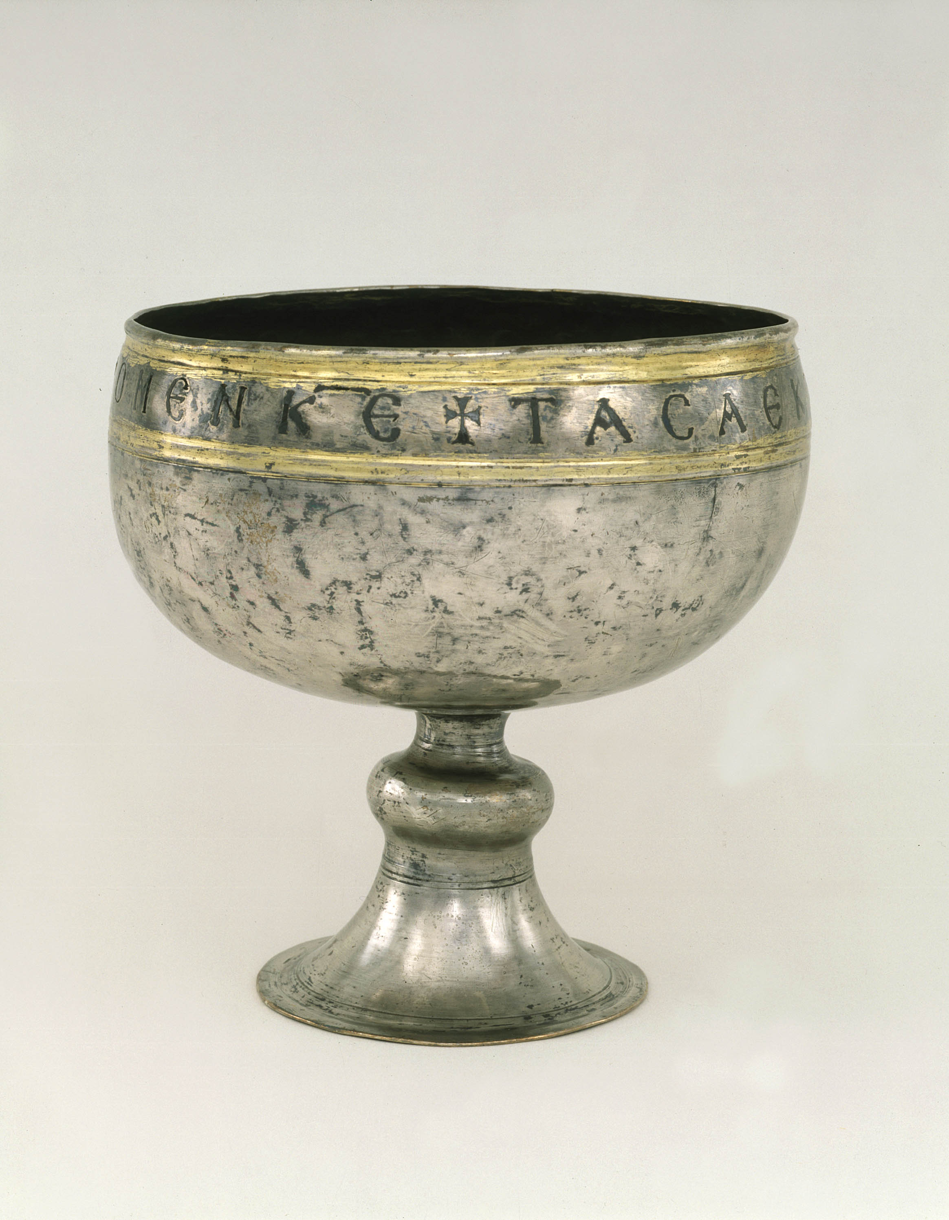
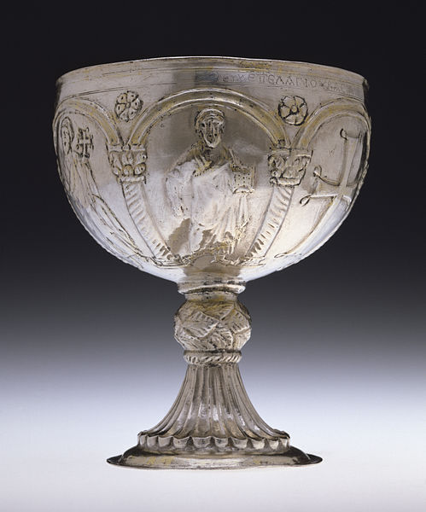
The Attarouthi Treasure – Chalice, 500–650, Silver and gilded silver, 20.7 × 14.9 cm, 360g, the MET NY
Chalice, Early Byzantine, 527–565, silver with gold and niello, Dumbarton Oaks Collection
Chalice with Apostles Venerating the Cross, 8th century, silver repoussé, partial gilt, Walters Art Museum

Slide 5
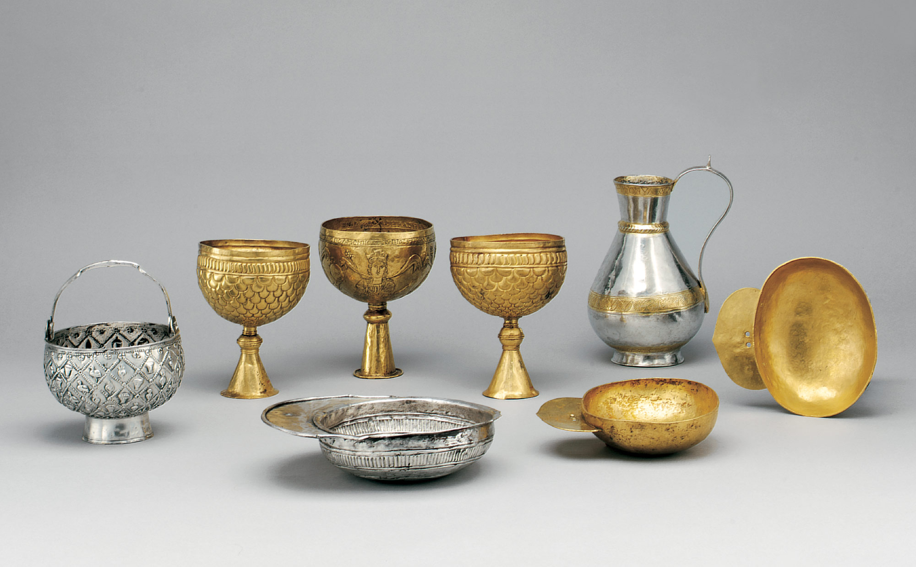
The Avar Treasure, 600s–700s, gold and silver, the MET, NY

Slide 6
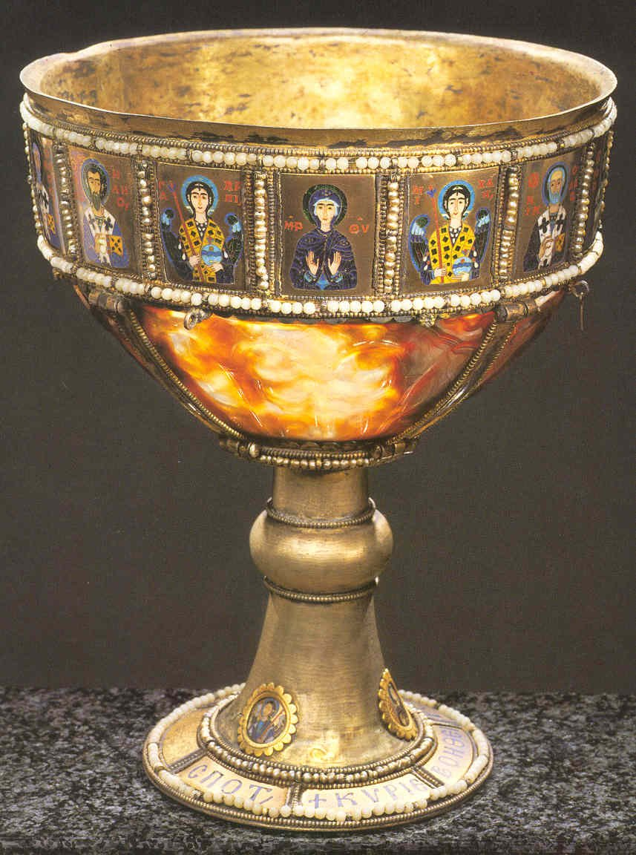
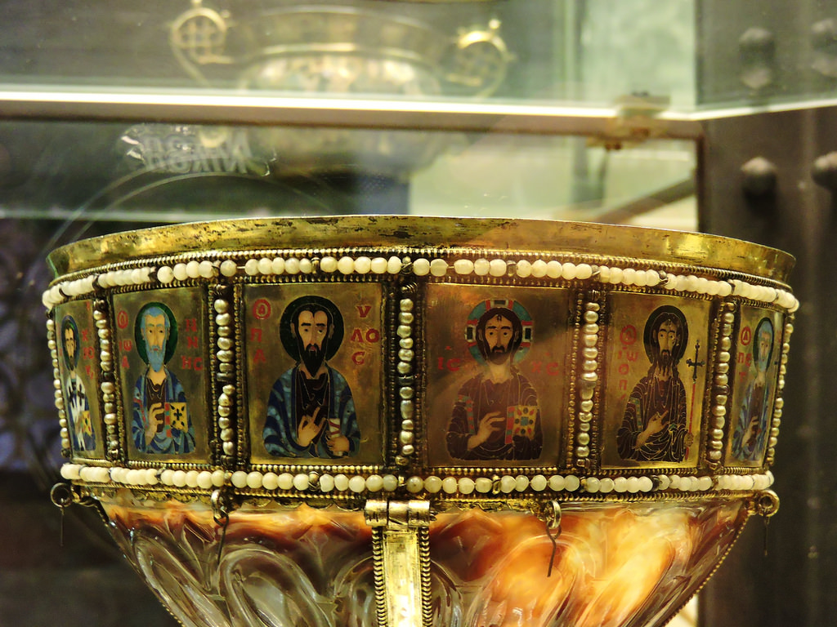
The sardonyx gilt, enamel, and pearl Chalice of the Emperor Romanos II, 10th century, possibly from HagiaSophia in Constantinople and looted in 1204, Treasury of Saint Mark’s, Venice

Slide 7
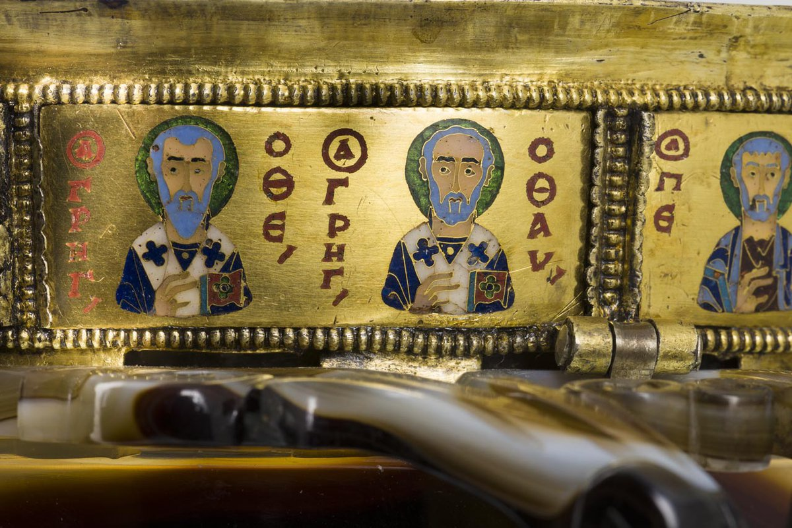
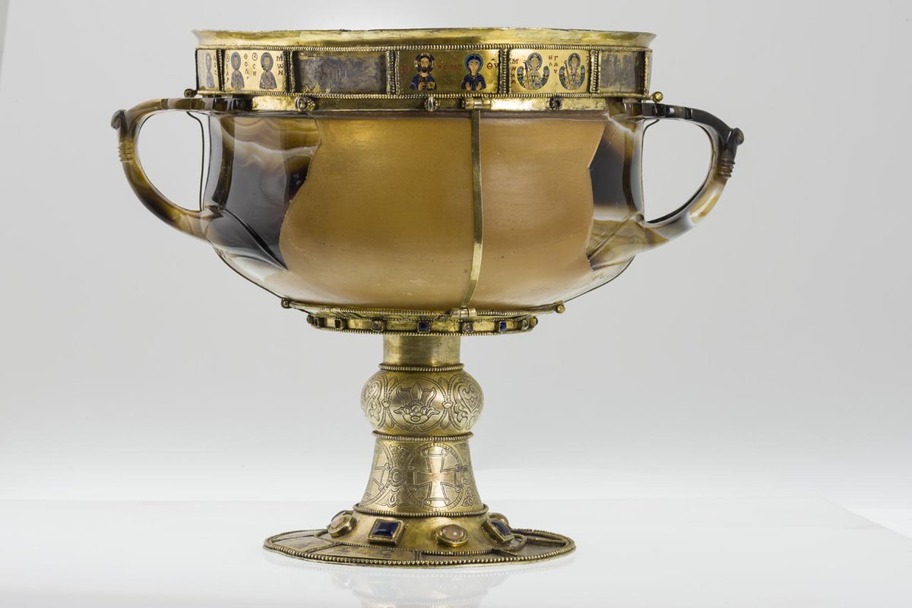
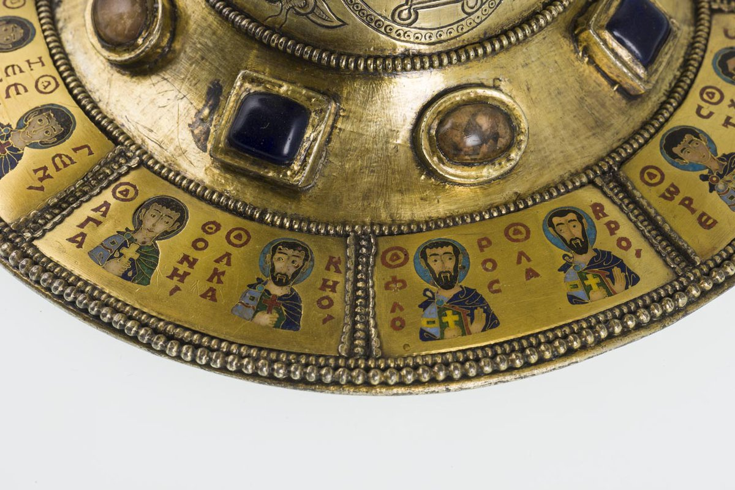
Chalice of Emperor Romanos, Sardonyx stone cup, dated to 1st BC-1st AD reused in the marvelous 10thC two-handled chalice of the Byzantine Emperor Romanus, Saint Mark’s Treasury, Venice

Slide 8
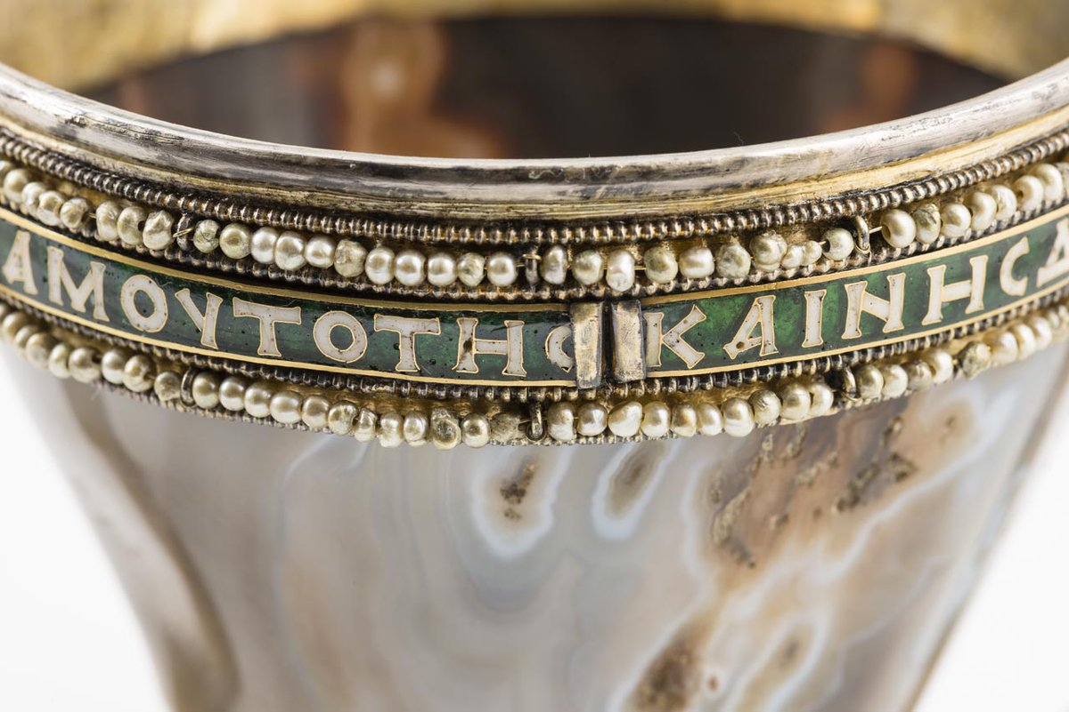
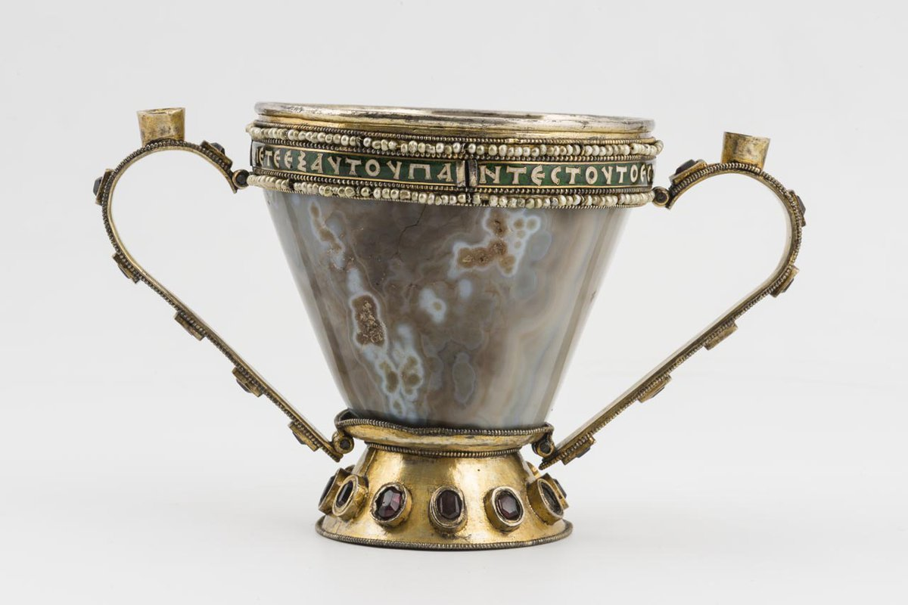
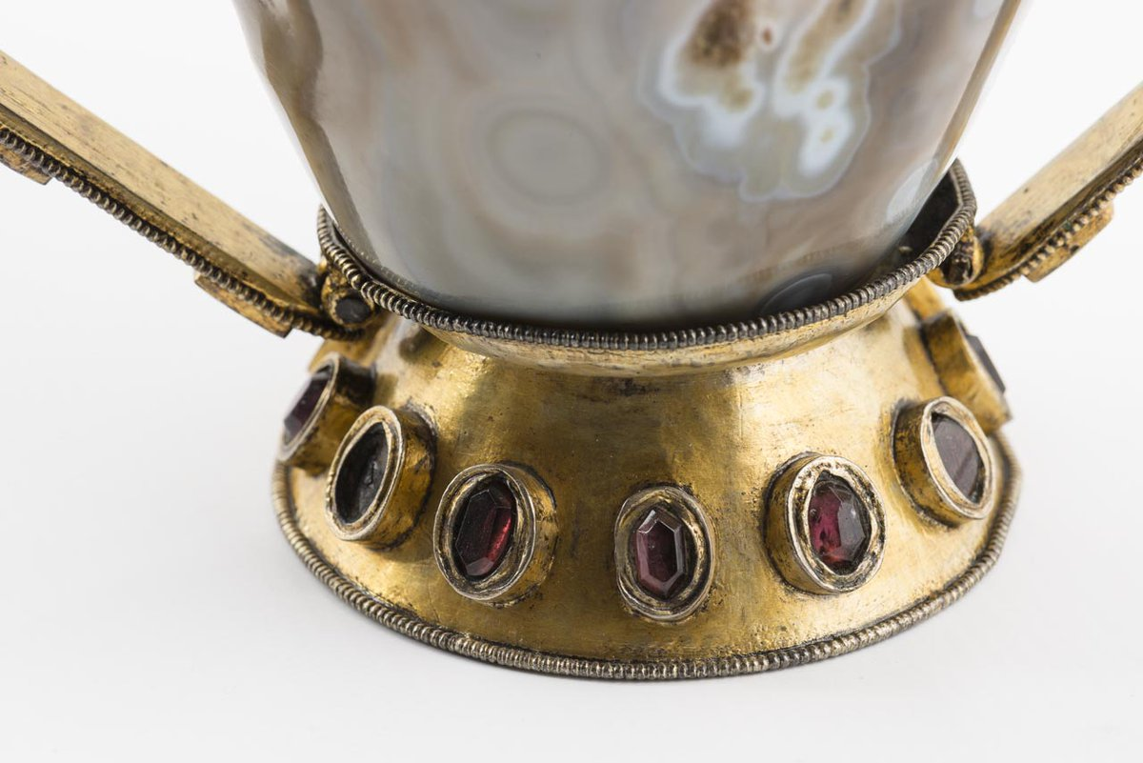
Chalice with Eucharistic Inscription, 10th century, sardonyx, gold, silver-gilt, enamel, stones and pearls, Saint Mark’s Treasury, Venice

Slide 9
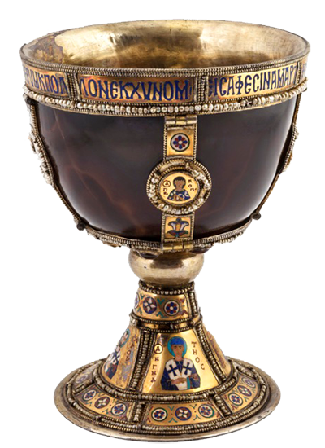
Chalice of the Patriarchs, 10th century, sardonyx, silver-gilt, enamel, stones and pearls, Saint Mark’s Treasury, Venice

Slide 10
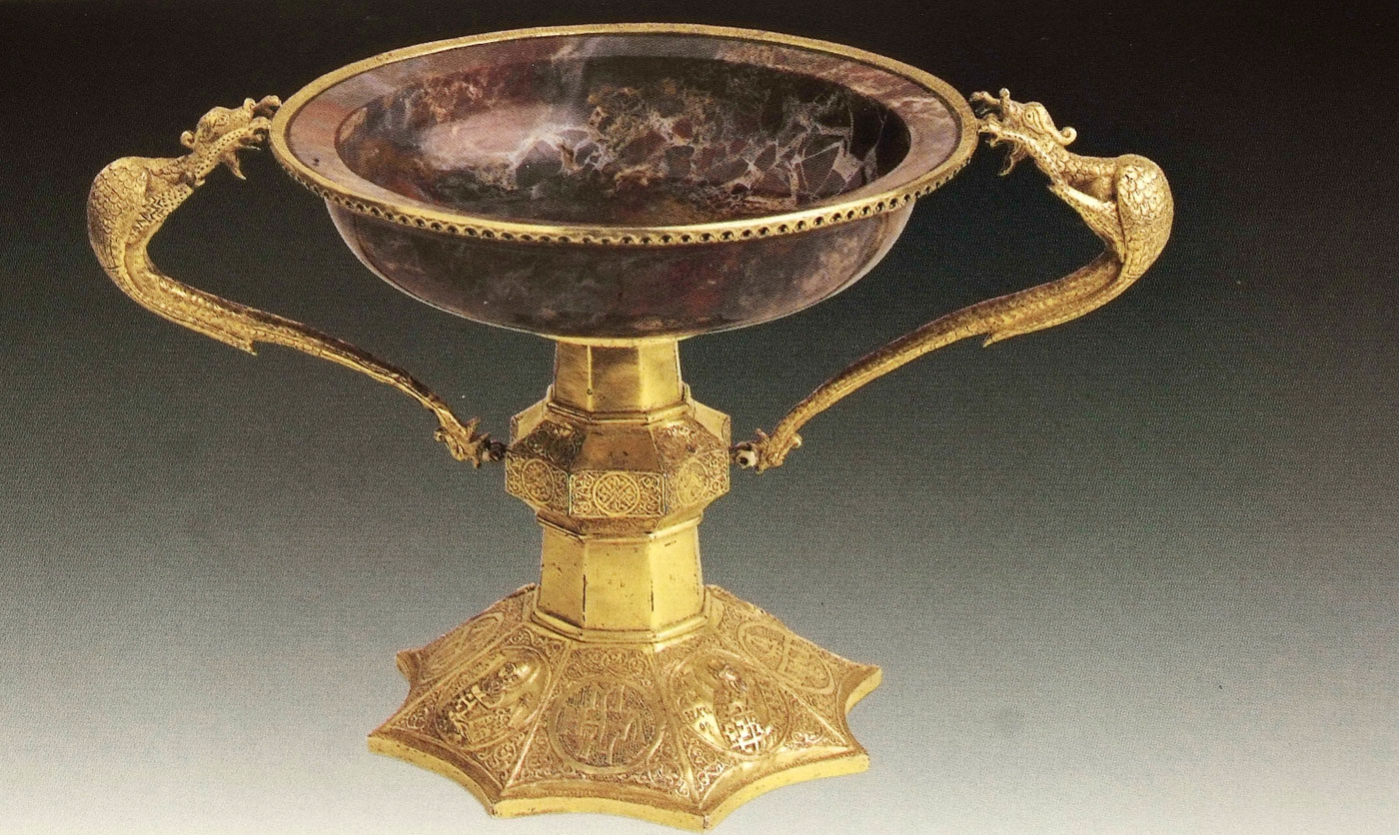
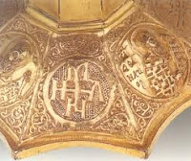
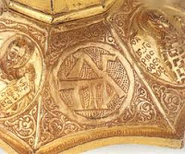
The Jasper Cup of Vatopedi, 14th century, belonged to Manuel Cantacuzenos Palaeologos (1349-80), Despot of Mystra, carved jasper, gilded silver relief work, H. 19.5 cm, Vatopedi Monastery, Mount Athos, Greece

