Slide 1
Ancient Greek Pottery
The François Vase

Slide 2
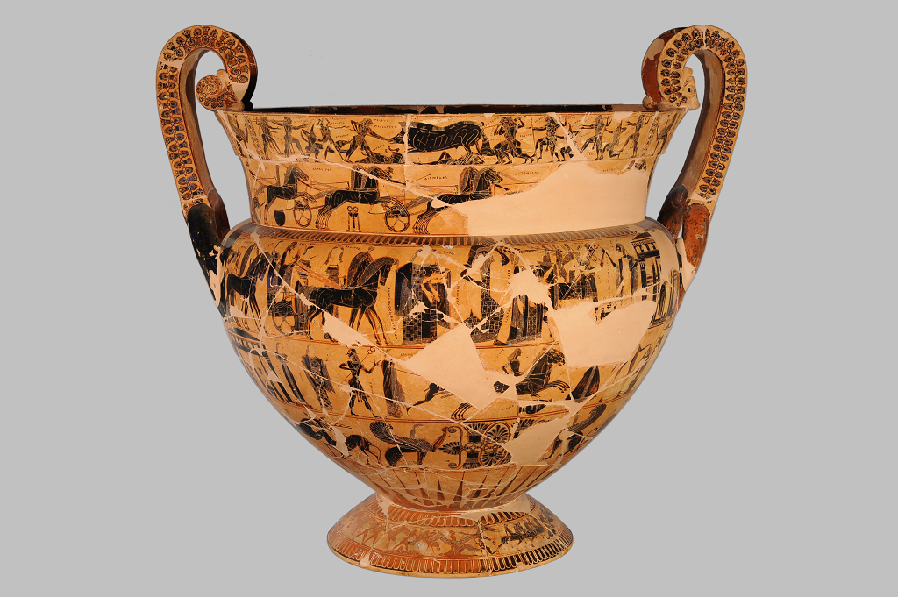
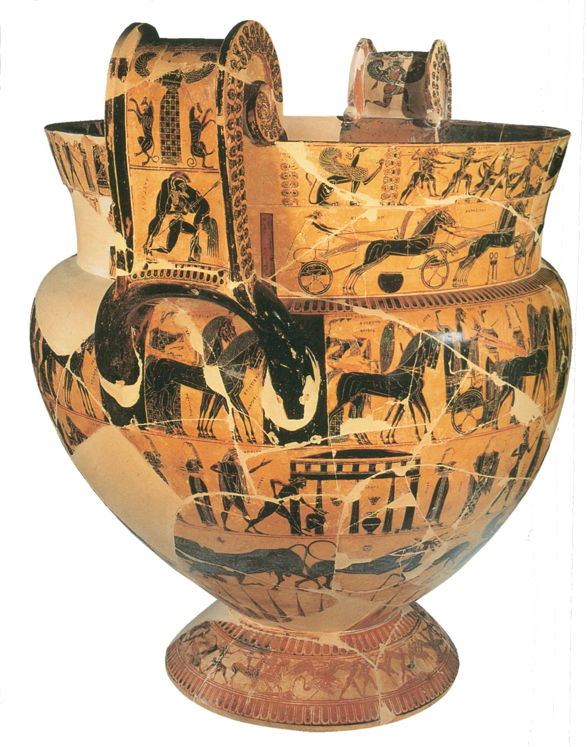
François Vase, Volute Krater, black figure, 570-560 BC, painter Kleitias and potter Ergotimos, Florence Archaeological Museum
François Vase is richly decorated in seven registers with additional scenes on handles.

Slide 3
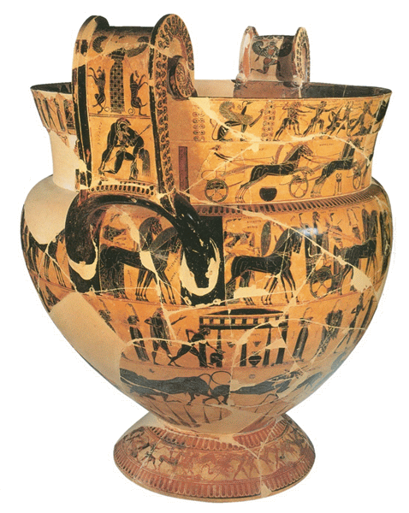
Location: Museo Archeologico, Florence
Date: c.570 B.C.E. (archaic period)
Painter: Kleitias
Potter: Ergotimos
Shape: volute krater
Size: 66cm
Technique: Black-Figure
Function: mixing bowl for wine and water.

Slide 4
The François Vase – Basic Characteristics
1. Shape and decoration revolutionary for time
2. Painted decoration inspired by Corinthian miniaturist style in vogue during the Orientalizing period
3. Division into seven friezes or bands
4. 270 human and animal figurines and 121 of them inscribed with names
5. Boustrophedon writing: the writing goes in either direction,
6. Features of the Orientalizing period like
mythological animals such as griffins and sphinxes as well as exotic vegetable motifs like the lotus and palmettos, evident in the decoration of the vase.

Slide 5
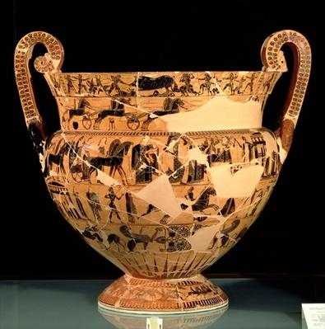
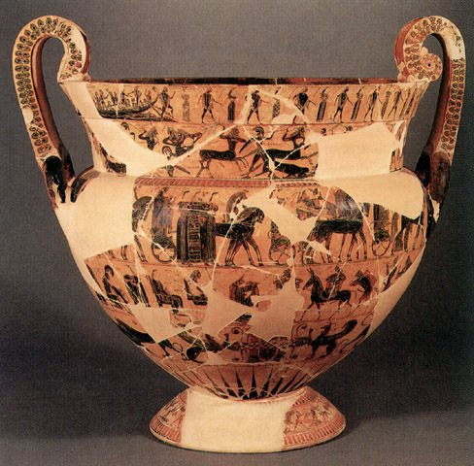
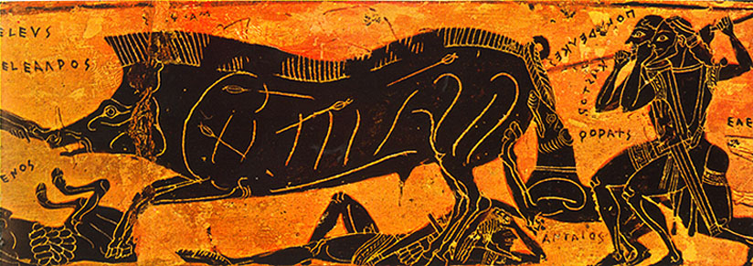
Side A top – Side B bottom
Two friezes on the neck: above, the hunt for the Calydonian Boar (A), and the dance of Theseus and the Athenian youths on their escape from Crete (B), and below, chariot race in the funeral games for Patroklos (A), and the battle between Lapiths and Centaurs (B).
On the shoulder, continuous around the whole vase, the wedding of Peleus and Thetis and a procession of deities.
On the lower body, Achilles chasing Troilos (A) and the return of Hephaistos to Olympus (B).
Lower register: sphinxes, animal battles, and palmette decoration.
On the foot, the battle between pygmies and cranes.
On the handles, Ajax carrying the dead Achilles, and Artemis or the Mistress of Beasts.

Slide 6
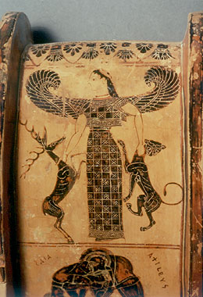
Conventions of Black Figure Style Pottery
1. All silhouettes are filled in with clay slip
2. Colour is added to identify: female flesh, drapery, a couple of horses and the dog (now almost entirely worn away) on the back of the Kalydonian boar
3. Incision are used for hair, internal details of anatomy and ornate patterns on some clothing.

Slide 7
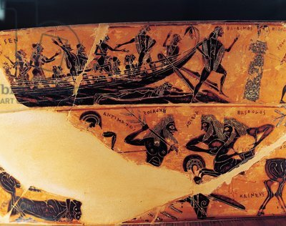
The François Vase – The depicted figures
1. Small-scale, silhouette figures
2. Figures depicted in profile head (but with frontal eye); frontal torso and profile legs and feet
3. Incisions of anatomical detail are delicate and precise, showing an accurate knowledge of major muscle groups.
4. Attempts to suggest texture show the smooth human hair and the spiky bristles of the boar.
5. Attempts to suggest movement show one foot in front of the other; raised and outstretched legs suggest running; joined hands for dancers.
6. Emotion are suggested by gestures such as raised hands.
7. Movement and gestures are lively and active in most scenes, bur restrained and dignified in the wedding procession.

