Slide 1
Archaeological Excavation Records
from the American School of Classical Studies at Athens
Picture Copyright: https://www.lifo.gr/articles/archaeology_articles/251926/selides-apo-ta-imerologia-ton-amerikanon-arxaiologon-poy-eskapsan-stin-korintho?fbclid=IwAR0-2mUehuUQV4hxkmD2C_lThSsCFq7uA5LAh9jUPWkLL3gKeBYfNWoFIi0

Slide 2
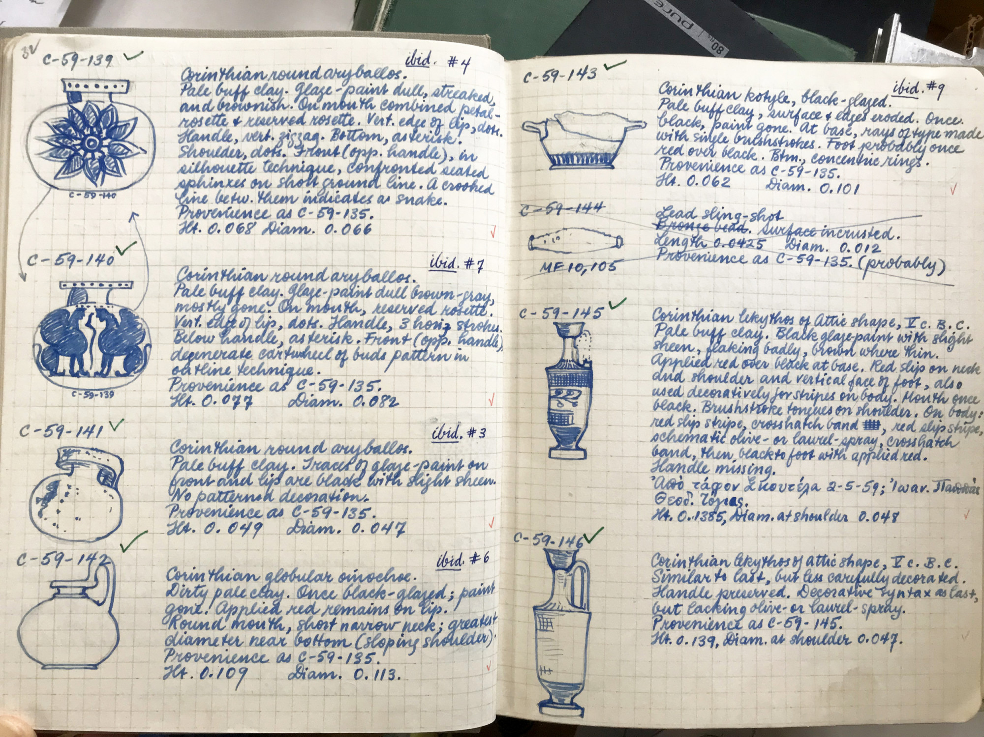

Slide 3
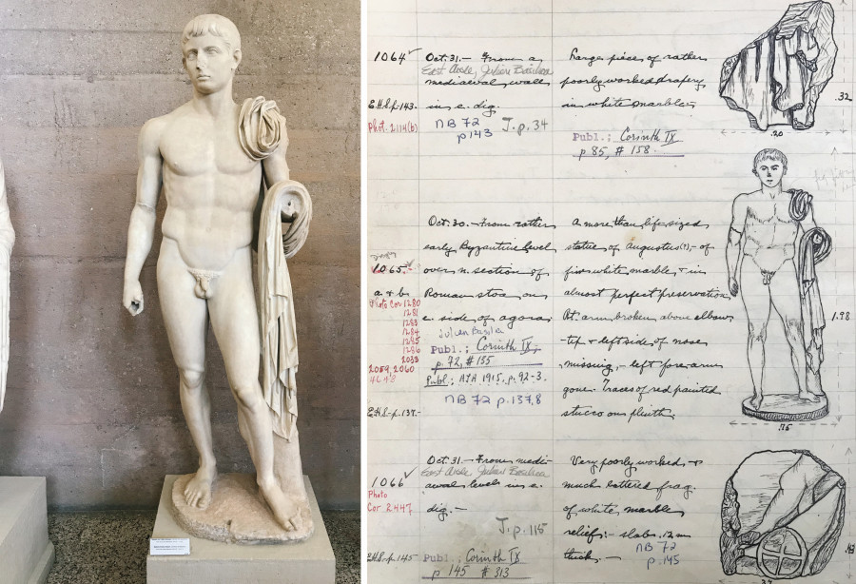

Slide 4
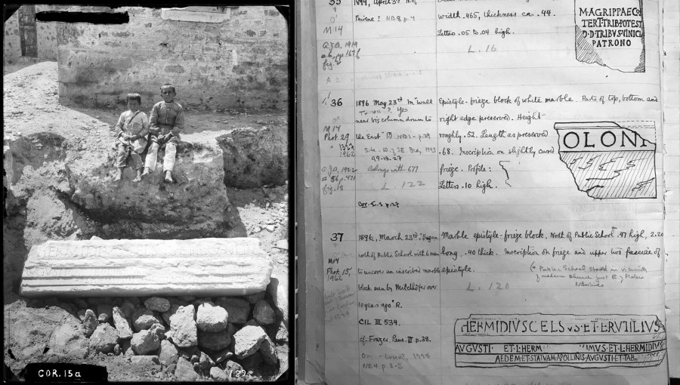

Slide 5
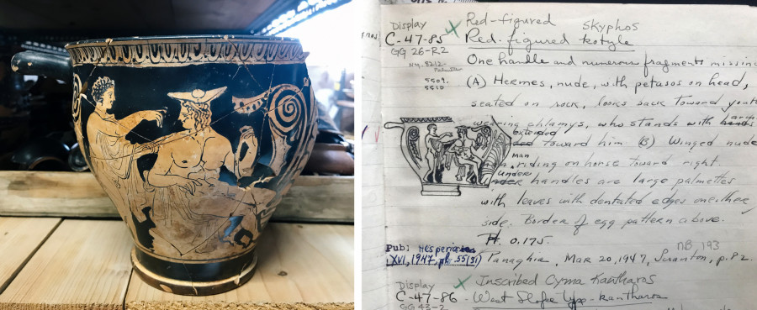
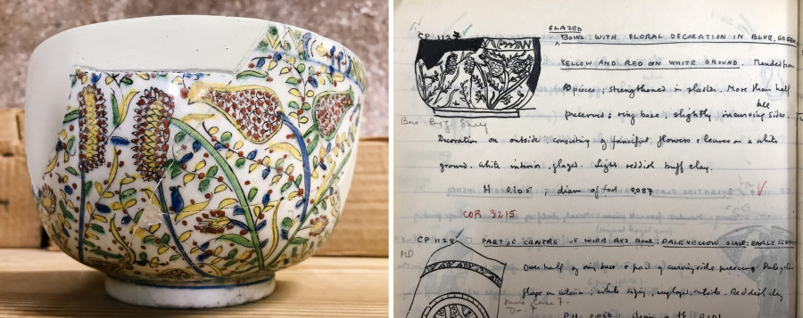

Slide 6
