Slide 1
September 6, 2019
Grade 1 – “Pencils” Activity

Slide 2
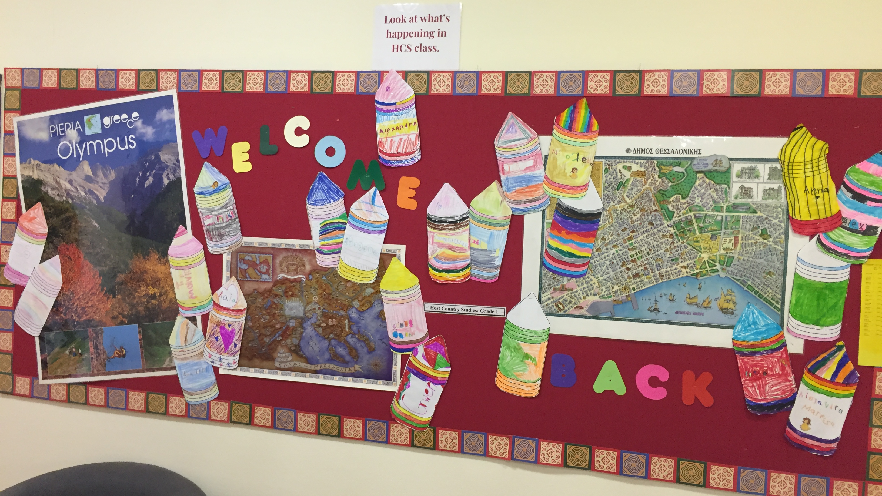

Slide 3
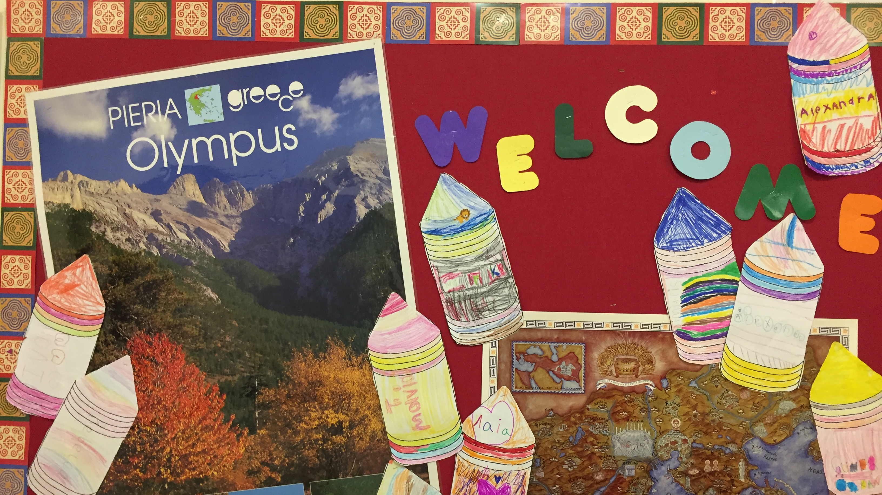

Slide 4
