Slide 1
Learning from Ancient Greek Pottery

Slide 2
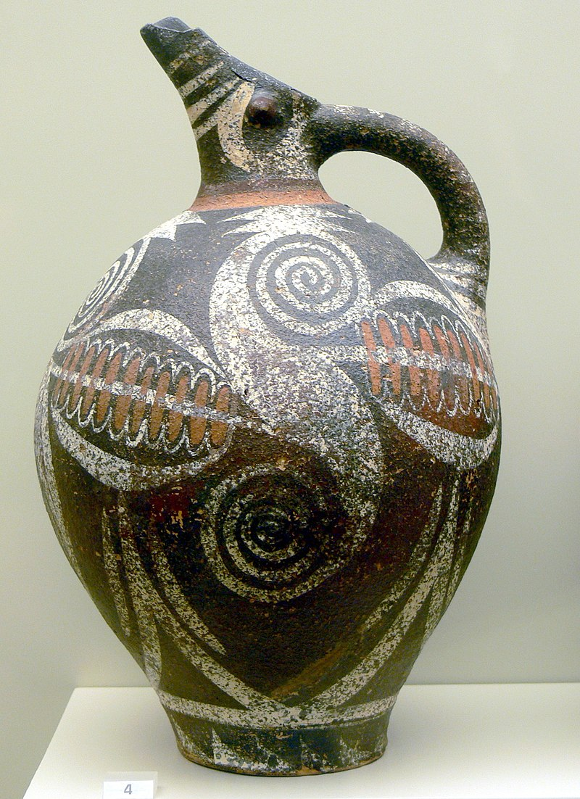
Kamares-style pottery, old palatial period, 2100-1700 BC, Archaeological Museum of Herakleion https://commons.wikimedia.org/wiki/Category:Kamares_style_pottery_in_AM_Herakleion#/media/File:AMI_-_Kamaresvase_1.jpg

Slide 3
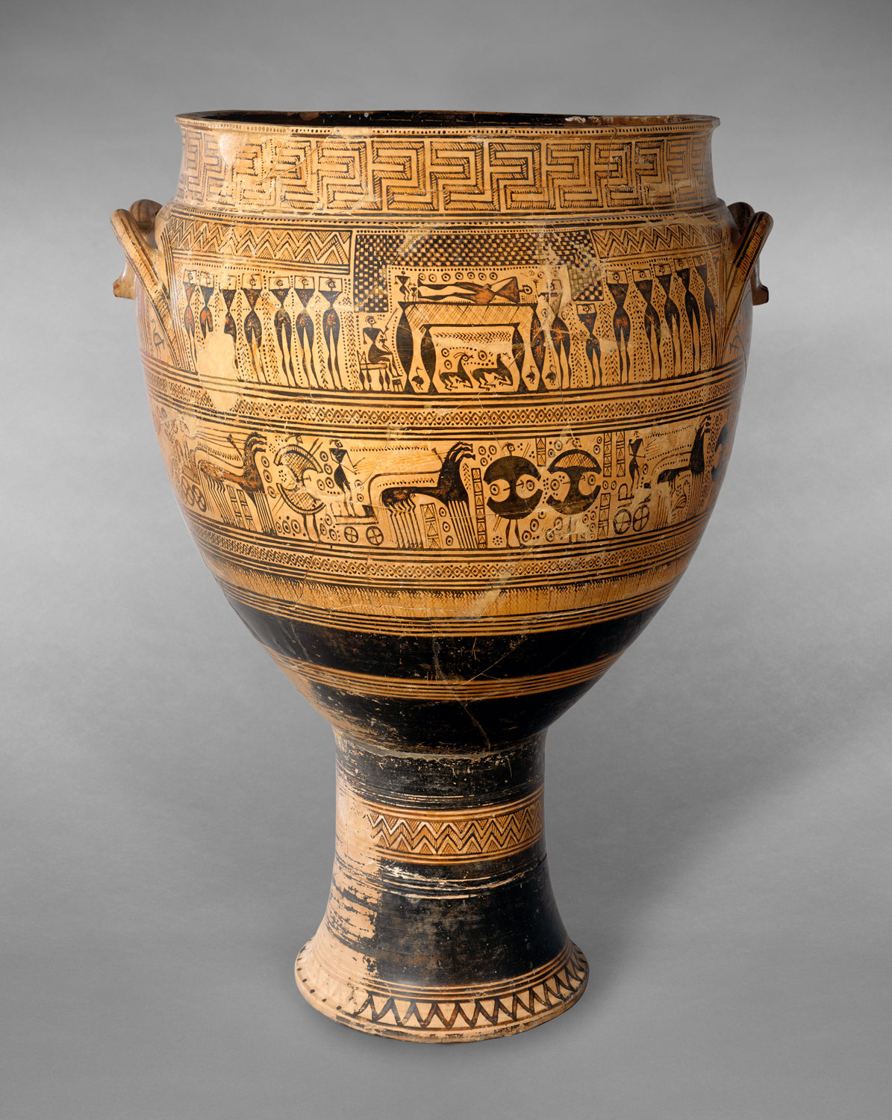
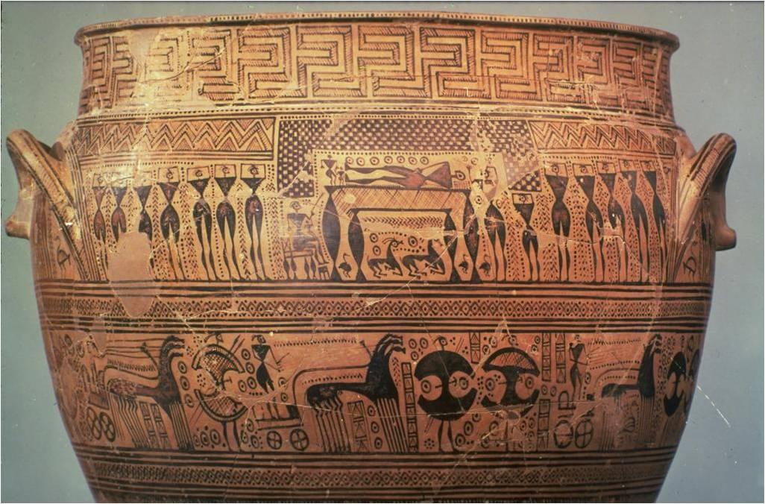
Terracotta krater, attributed to the Hirschfeld Workshop, Geometric, ca. 750–735 BC, the MET, NY https://www.metmuseum.org/toah/works-of-art/14.130.14/

Slide 4
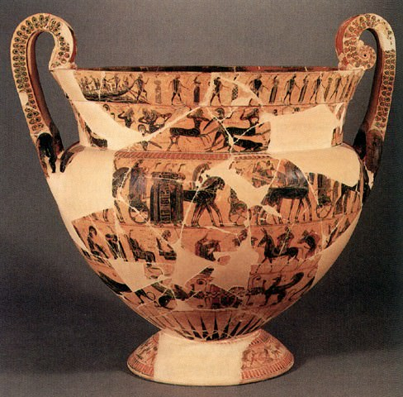
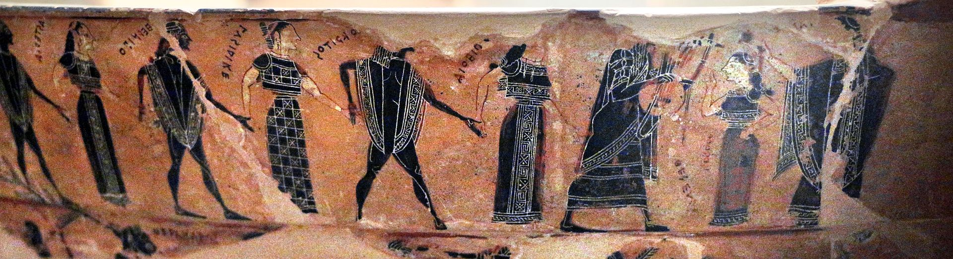
François Vase,Volute Krater, black figure, 570-560 BC, painter Kleitias and potter Ergotimos, Florence Archaeological Museum
Volute krater elaborately decorated in seven registers with additional scenes on handles https://commons.wikimedia.org/wiki/Category:Fran%C3%A7ois_vase#/media/File:Attic_Black-Figure_Volute-Krater,_known_as_the_Francois_vase,_ca._570-565_BCE.jpg https://commons.wikimedia.org/wiki/Category:Fran%C3%A7ois_vase#/media/File:Kleitias,_decorazione_del_vaso_fran%C3%A7ois,_570_ac_ca.,_ateniesi_inviati_a_creta_come_sacrificio_per_il_minotauro_06.jpg

Slide 5
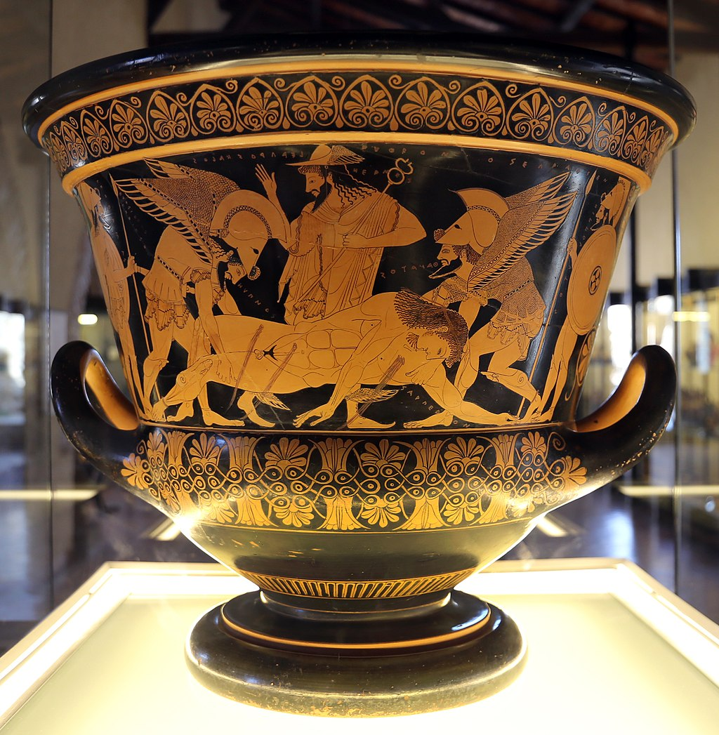
Euphronios Krater or Sarpedon krater, 515 BC, painted by the renowned Euphronios , the National Etruscan Museum, in the Villa Giulia in Rome.
The Euphronios Krater is considered one of the finest Greek vase artefacts in existence. https://commons.wikimedia.org/wiki/Category:Euphronios_krater_in_the_National_Archaeological_Museum_of_Cerveteri#/media/File:Eufronio,_cratere_modellato_da_euxitheos_con_morte_di_sarpedone,_520-510_ac_ca.,_dalla_necropoli_di_greppe_sant'angelo_01.jpg

