Slide 1
Tomb of Nebamun, 18th Dynasty, c. 1350 BC, Official of
Tuthmosis IV, and Amenhotep III, Western Thebes, British Museum

Slide 2
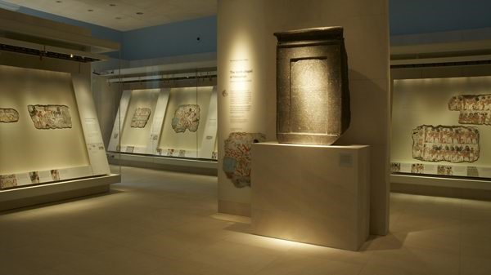
British Museum, Room 61, Nebamun Tomb-Chapel display http://www.artinsociety.com/lost-masterpieces-of-ancient-egyptian-art-from-the-nebamun-tomb-chapel.html

Slide 3
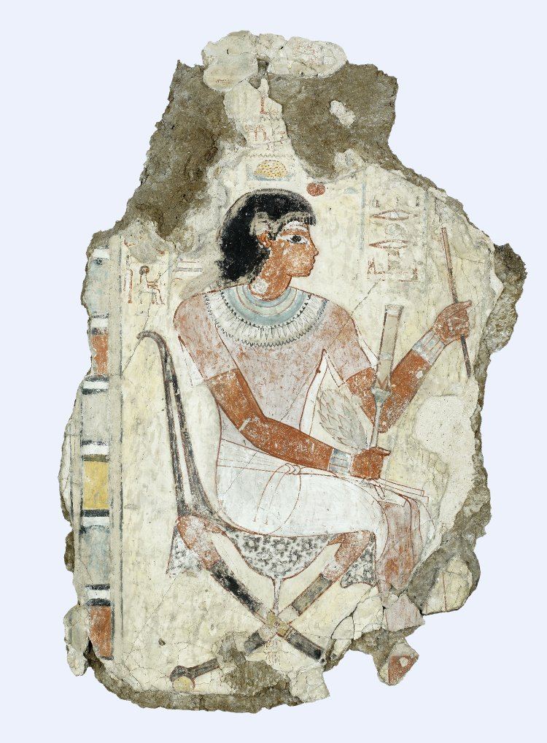
Well-dressed and impressive, Nebamun is depicted inspecting his geese and cattle, from the Outer Roome of Nebamun’s Tomb-Shrine

Slide 4
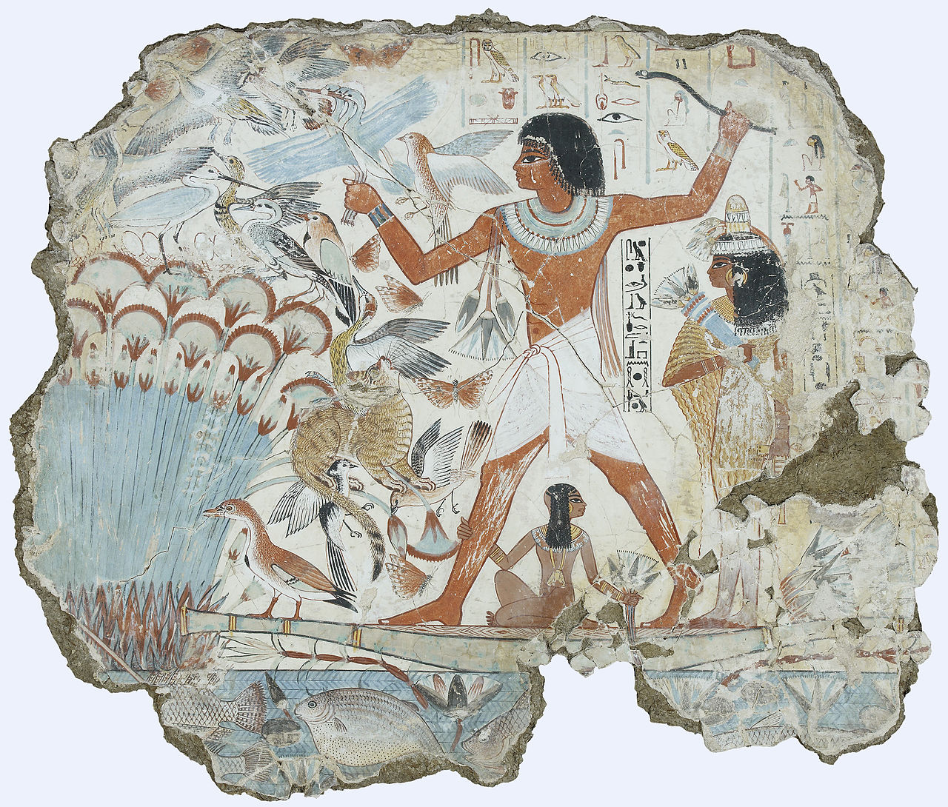
Nebamun fowling in the marshes, Tomb of Nebamun, 18th Dynasty, c. 1350 BC, Official of Tuthmosis IV, and Amenhotep III, Western Thebes, British Museum

Slide 5
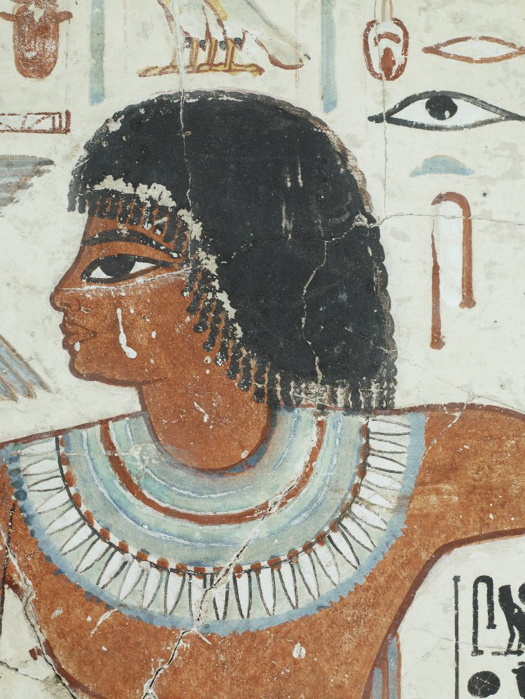
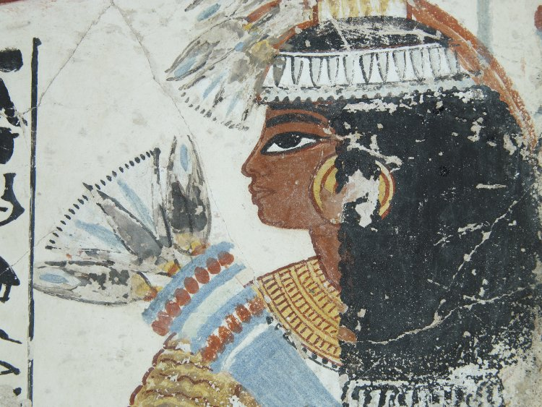
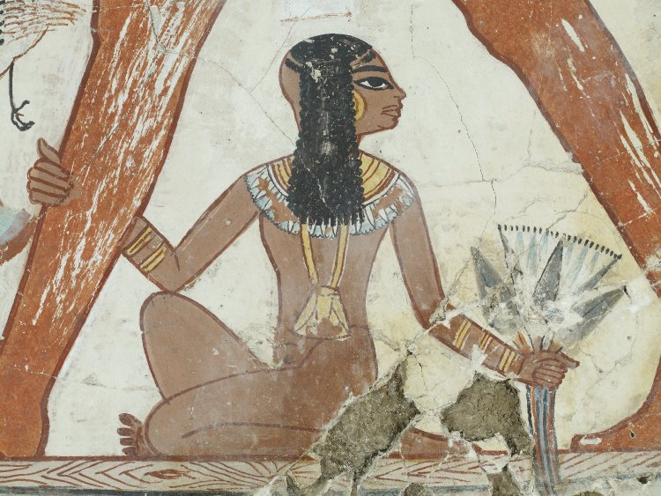

Slide 6
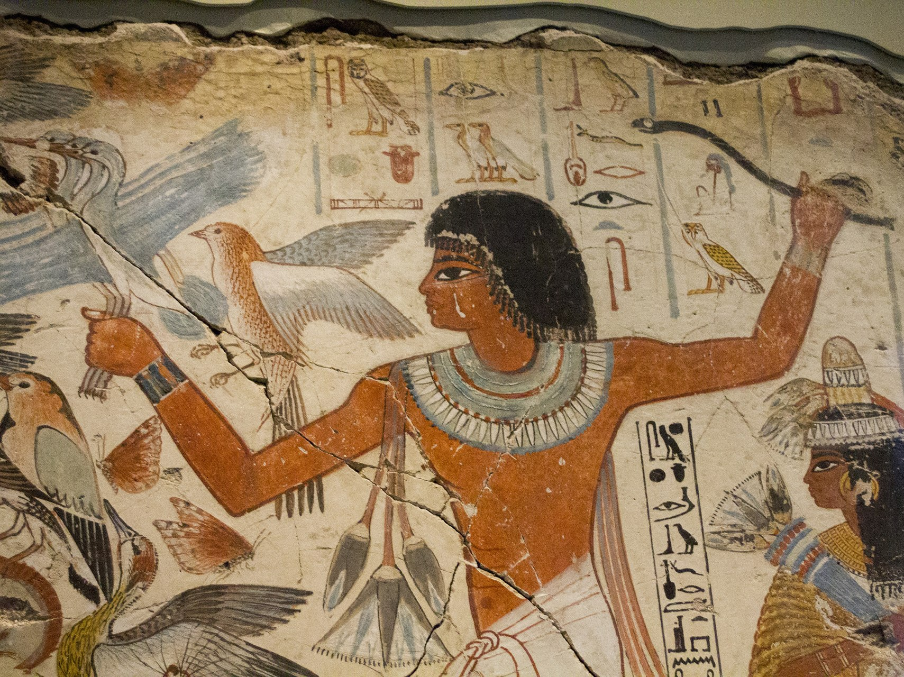

Slide 7
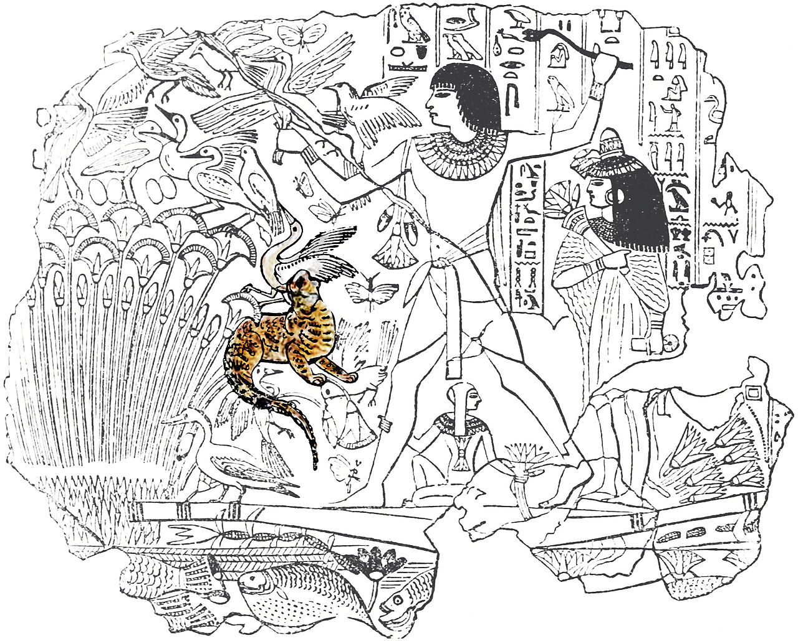
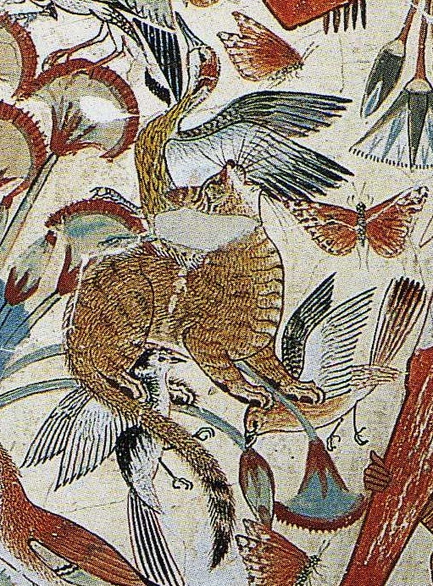
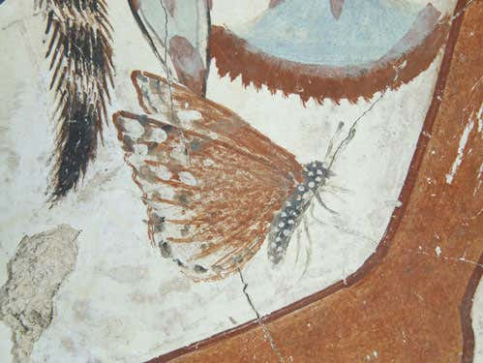
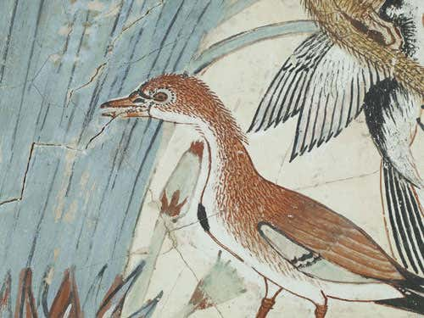

Slide 8
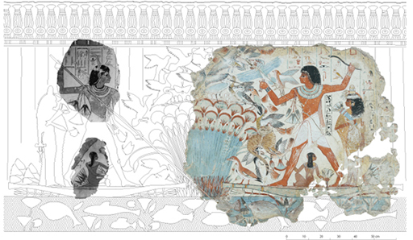
Reconstruction drawing by C. Thorne and R. B. Parkinson.© Trustees of the British Museum. Photographs of other fragments courtesy of the Association Egyptologique Reine Elizabeth, Brussel

Slide 9
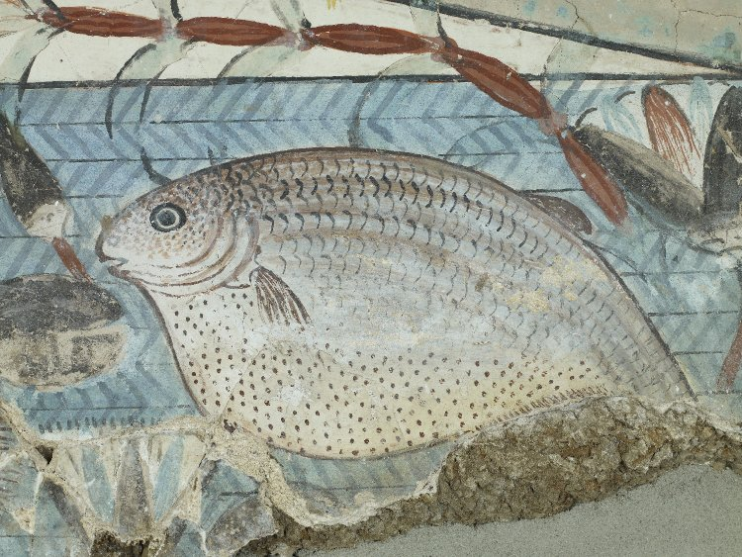

Slide 10
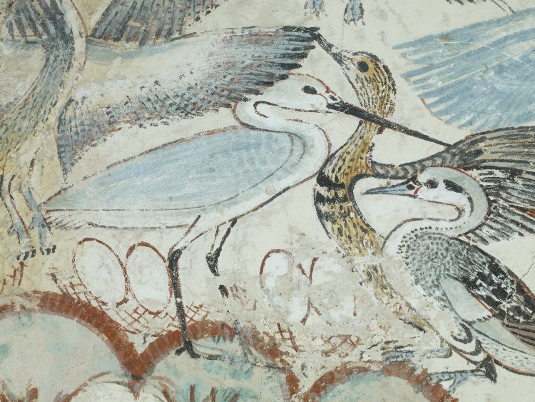

Slide 11
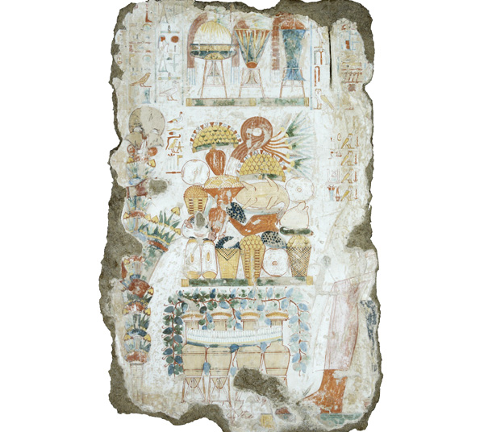
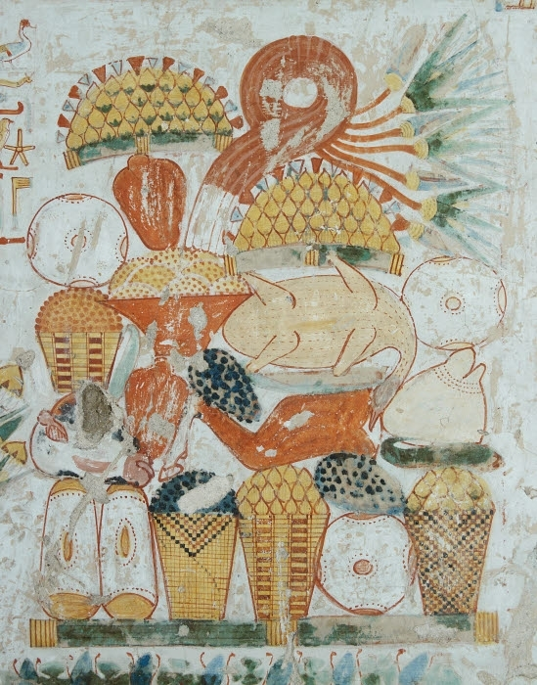
From the Outer Room of the Tomb-Chapel of Nebamun, a scene of Offerings

Slide 12
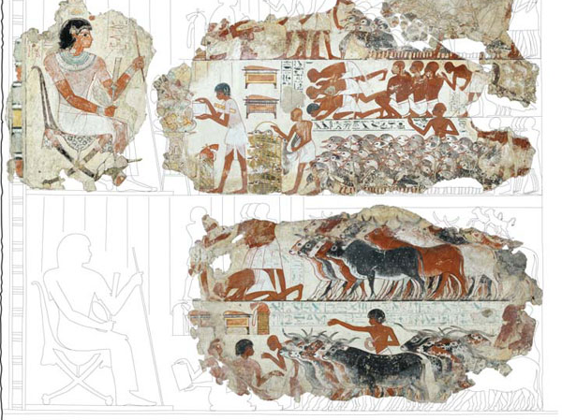
From the Outer Room of the Tomb-Chapel of Nebamun, an inspection scene

Slide 13
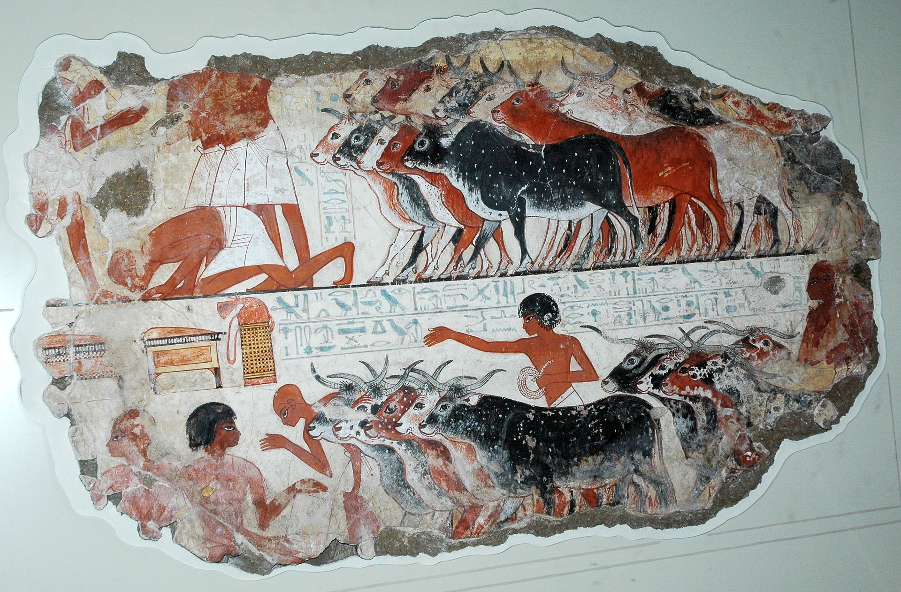
From the Outer Room of Nebamun’s Tomb-Shrine, a fragment of polychrome tomb-painting depicting in the upper register a herd of cattle brought to Nebamun for inspection.

Slide 14
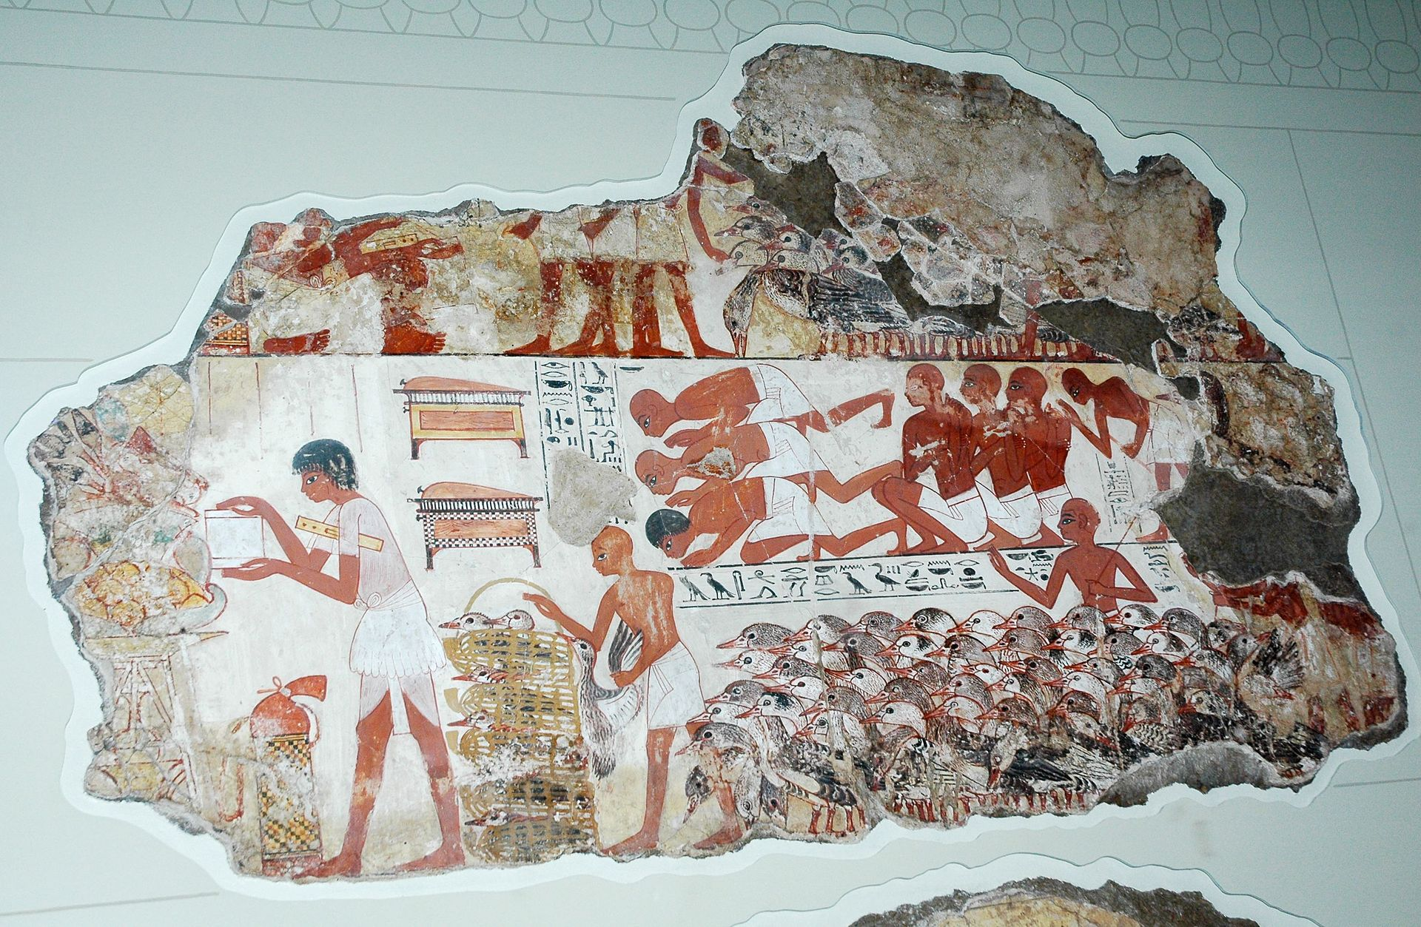
From the Outer Room of Nebamun’s Tomb-Shrine, a fragment of polychrome tomb-painting depicting in the lower register the inspection of Nebamun’s geese.

Slide 15
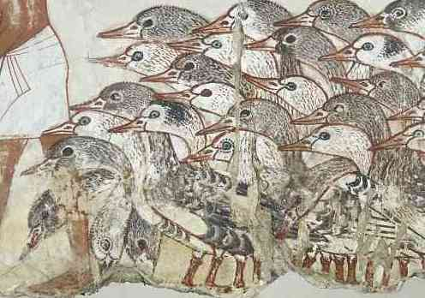
Geese (detail), from the Presentation of the Geese, Tomb chapel of Nebamun, c. 1350 B.C.E., paint on plaster, whole fragment: 71 x 115.5 cm, Thebes © Trustees of the British Museum

Slide 16
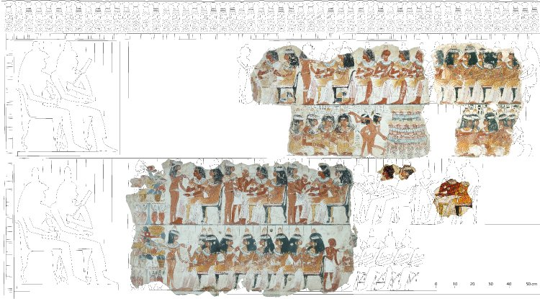
A Feast for Nebamun

Slide 17
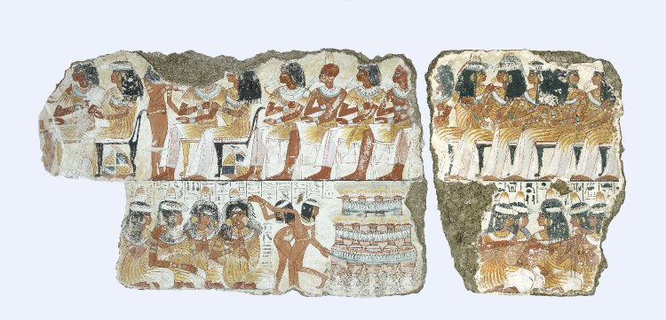
A Feast for Nebamun

Slide 18
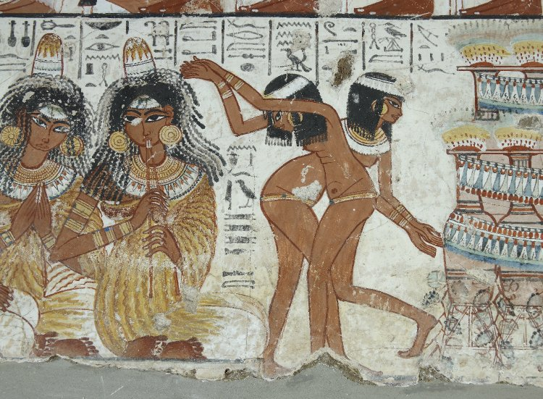

Slide 19
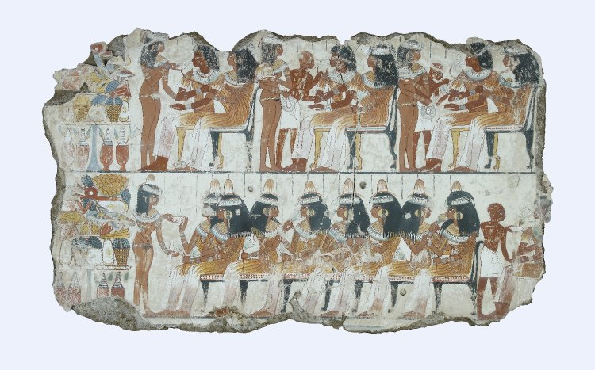

Slide 20
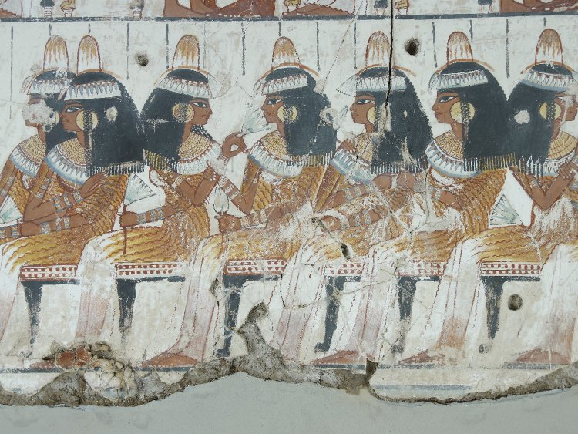

Slide 21
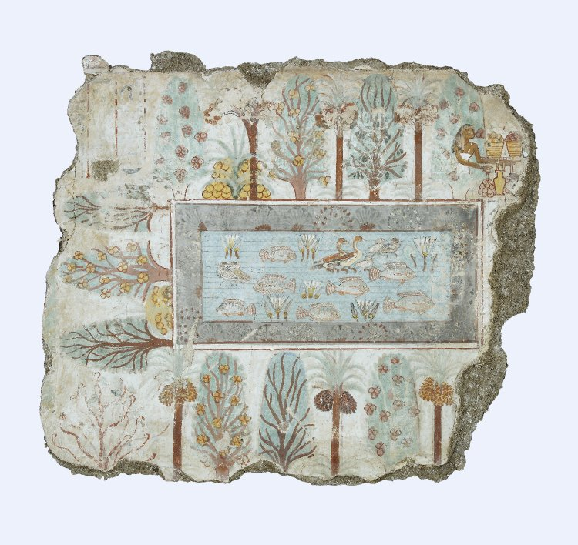
Nebamun’s Garden

Slide 22
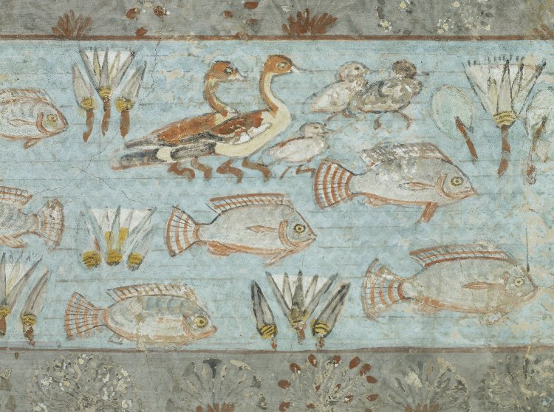

Slide 23
Copyrights http://www.artinsociety.com/lost-masterpieces-of-ancient-egyptian-art-from-the-nebamun-tomb-chapel.html https://www.britishmuseum.org/research/collection_online/collection_object_details.aspx?objectId=124907&partId=1&searchText=tomb+of+nebamun&page=1 https://commons.wikimedia.org/wiki/Category:Tomb_of_Nebamun#/media/File:Tomb_of_Nebamun.jpg https://www.britishmuseum.org/research/collection_online/collection_object_details/collection_image_gallery.aspx?partid=1&assetid=228278001&objectid=119661#more-views https://commons.wikimedia.org/wiki/Category:Tomb_of_Nebamun#/media/File:Tomb_Of_Nebamun_Painting_1_(221570977).jpeg https://www.newscientist.com/gallery/dn16421-nebamun-tomb-paintings/ https://www.newscientist.com/gallery/dn16421-nebamun-tomb-paintings/ https://commons.wikimedia.org/wiki/Category:Tomb_of_Nebamun#/media/File:PSM_V37_D104_An_egyptian_fowling_scene_(part-painted).jpg https://www.open.edu/openlearn/ocw/mod/oucontent/view.php?id=51847&section=5.2 https://www.britishmuseum.org/research/collection_online/collection_object_details/collection_image_gallery.aspx?partid=1&assetid=228201001&objectid=119661 https://www.britishmuseum.org/research/collection_online/collection_object_details/collection_image_gallery.aspx?partid=1&assetid=228278001&objectid=119661 https://www.britishmuseum.org/research/collection_online/collection_object_details.aspx?objectId=117386&partId=1&searchText=tomb+of+nebamun&page=1 https://nosycrowbritishmuseum.com/this-or-that/pages/fragment-from-funerary-offering-scene-from-the-tomb-of-nebamun https://www.britishmuseum.org/visiting/galleries/ancient_egypt/room_61_tomb-chapel_nebamun/nebamun_animation.aspx https://commons.wikimedia.org/wiki/Category:Tomb_of_Nebamun#/media/File:Nebamun-ViewingTheProduceOfTheEstates-3.JPG https://commons.wikimedia.org/wiki/Category:Tomb_of_Nebamun#/media/File:Nebamun-ViewingTheProduceOfTheEstates-2.JPG
Geese (detail), from the Presentation of the Geese, Tomb chapel of Nebamun, c. 1350 B.C.E., paint on plaster, whole fragment: 71 x 115.5 cm, Thebes © Trustees of the British Museum https://www.britishmuseum.org/research/collection_online/collection_object_details/collection_image_gallery.aspx?partid=1&assetid=435931001&objectid=119660 https://www.britishmuseum.org/research/collection_online/collection_object_details/collection_image_gallery.aspx?partid=1&assetid=244310001&objectid=119660 https://www.britishmuseum.org/research/collection_online/collection_object_details/collection_image_gallery.aspx?assetId=244318001&objectId=117387&partId=1 https://www.britishmuseum.org/research/collection_online/collection_object_details/collection_image_gallery.aspx?partid=1&assetid=226894001&objectid=117387 https://www.britishmuseum.org/research/collection_online/collection_object_details/collection_image_gallery.aspx?assetId=244326001&objectId=112655&partId=1 https://www.britishmuseum.org/research/collection_online/collection_object_details/collection_image_gallery.aspx?partid=1&assetid=237635001&objectid=112655

