Slide 1
Near East, 3rd millennium BC,
Chlorite Vessels and Weights

Slide 2
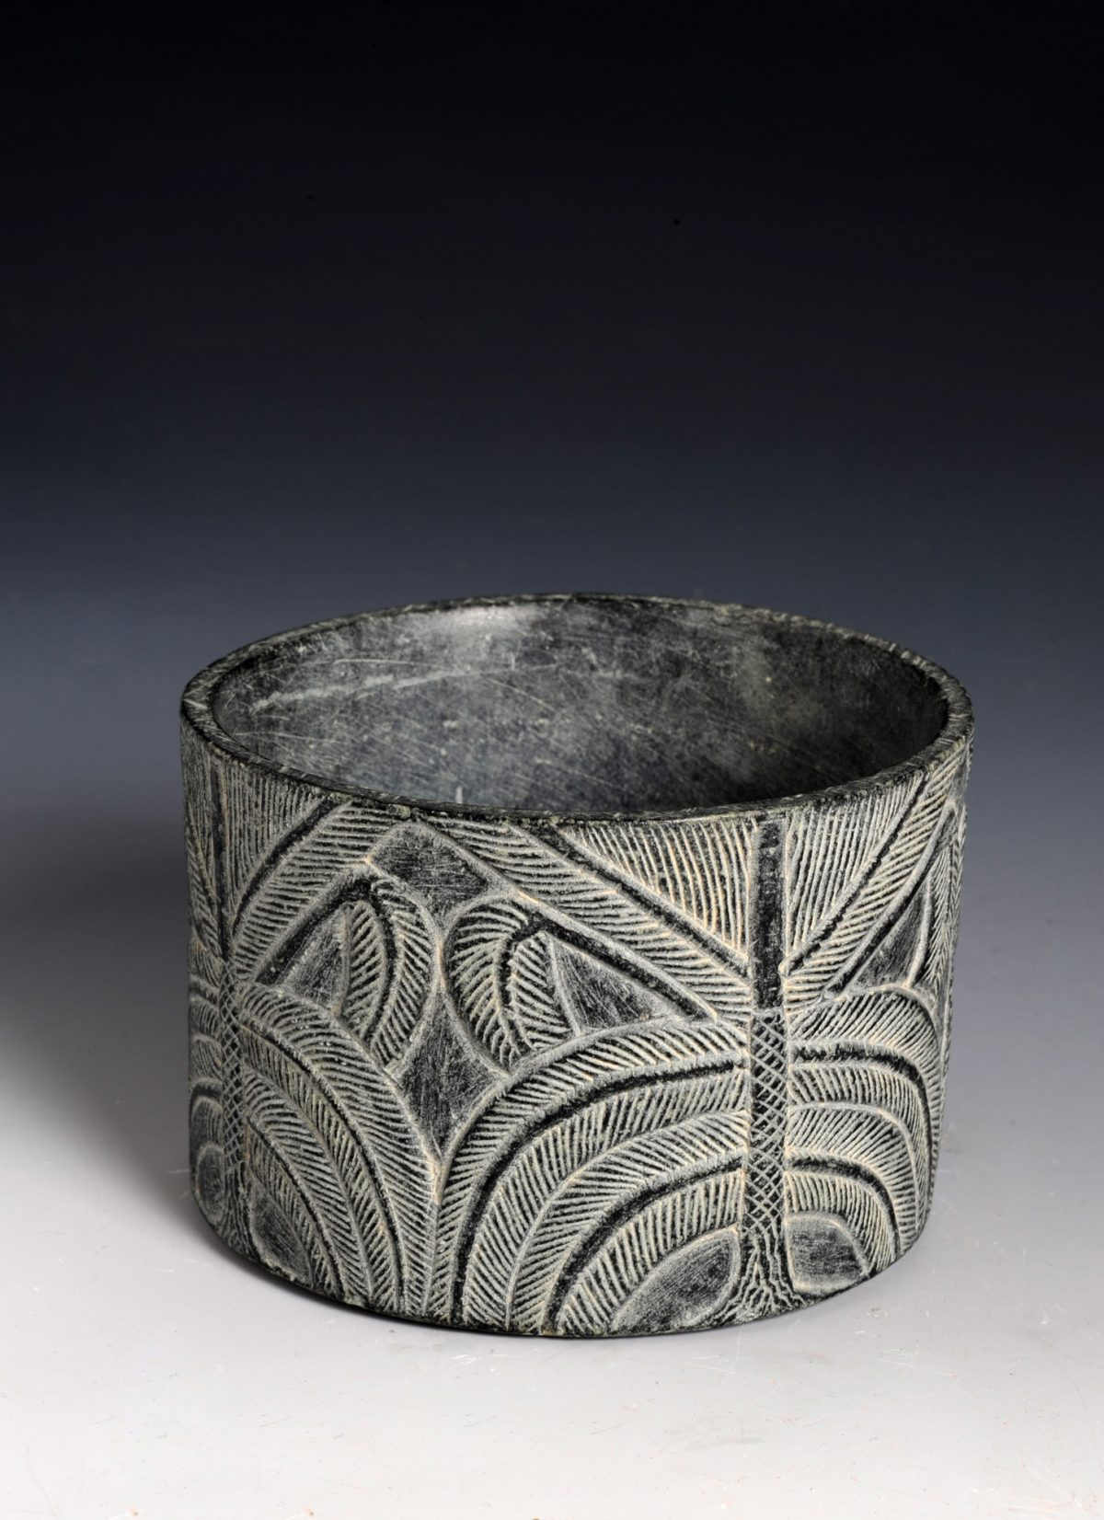
1st Slide: Cylindrical vessel with palm tree, approx. 2250–2000 BC, Saudi Arabia, Tarut island, al-Rufayah village, Chlorite, National Museum of Saudi Arabia, Riyadh

Slide 3
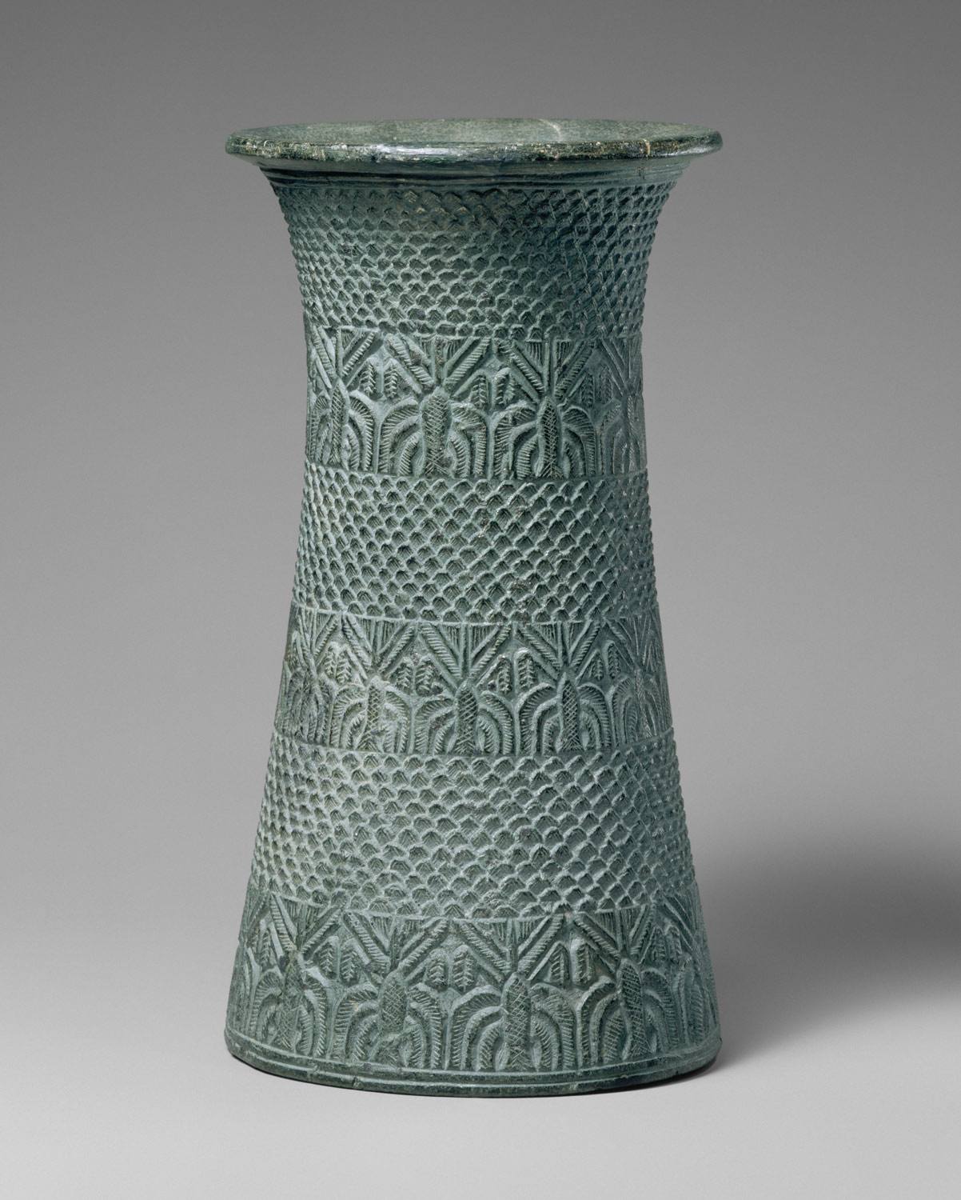
2nd Slide: Vase with overlapping pattern and three bands of palm trees, Early Bronze Age, ca. mid- to late 3rd millennium BC, Persian Gulf region or southern Iran, Chlorite, H. 23.5 cm, the MET, NY

Slide 4
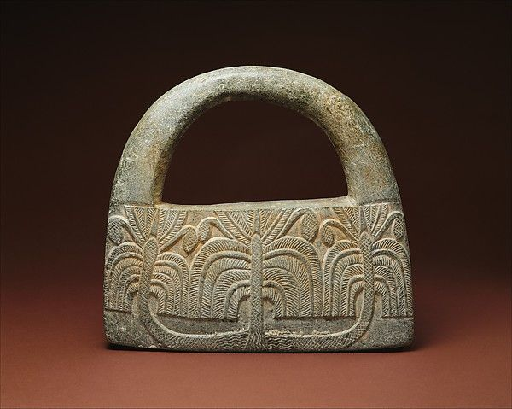
^{3rd} Slide: Carved Stone with Handle decorated with Palm Trees in guilloche (braided ornament), Persian Gulf or southern Iran. chlorite schist. 9.8" wide, the MET, NY

Slide 5
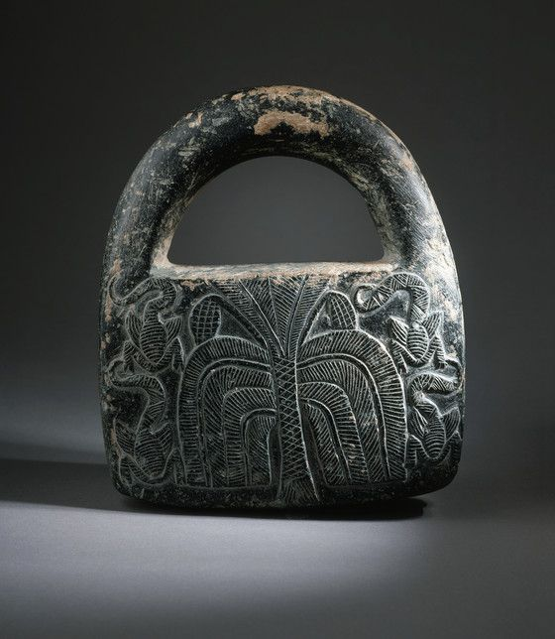
4th Slide: Chlorite handled weight. Northern Afghanistan. Bactria. Late 3rd - early 2nd century B.C. | Los Angeles County Museum of Arts Collections

Slide 6
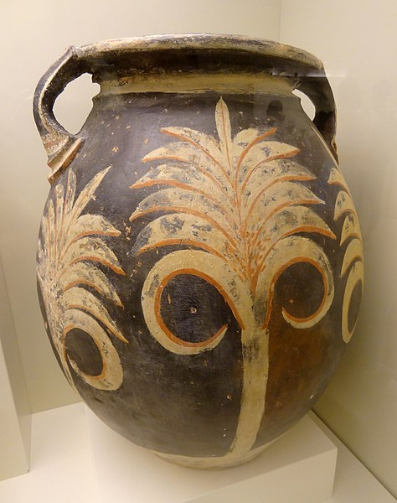
5th Slide: Small Kamares type pithos with a row of white palm trees against a black background, 1700-1650 B.C., Heraklion Archaeological Museum, Crete

Slide 7
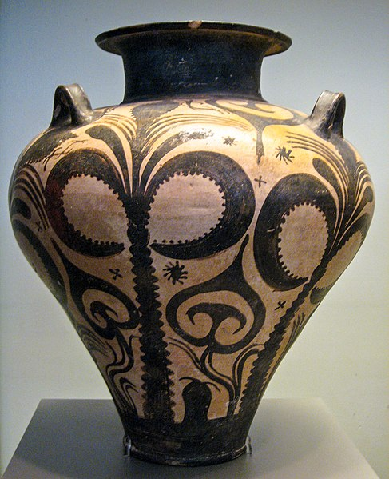
6th Slide: Three handled Mycenaean Palace-Style amphora with large palm trees symmetrically placed on the sides and smaller palm trees with floral motifs in between, 15th century BC, from the cemetery of Deiras in Argos, National Archaeological Museum of Athens

Slide 8
Copyrights
1st Slide https://alaintruong2014.files.wordpress.com/2014/10/725.jpg
2nd Slide https://www.metmuseum.org/toah/works-of-art/17.190.106/
3rd Slide https://www.metmuseum.org/art/collection/search/329071?=&imgNo=0&tabName=related-objects
4th Slide https://collections.lacma.org/node/202399
5th Slide https://commons.wikimedia.org/wiki/File:Pithos_Kamares-Stil_02.jpg
6th slide https://commons.wikimedia.org/wiki/File:Mycenaean_palace_amphora,_found_in_the_Argolid,_in_the_National_Archaeological_Museum_in_Athens.jpg
7th Slide

