Slide 1
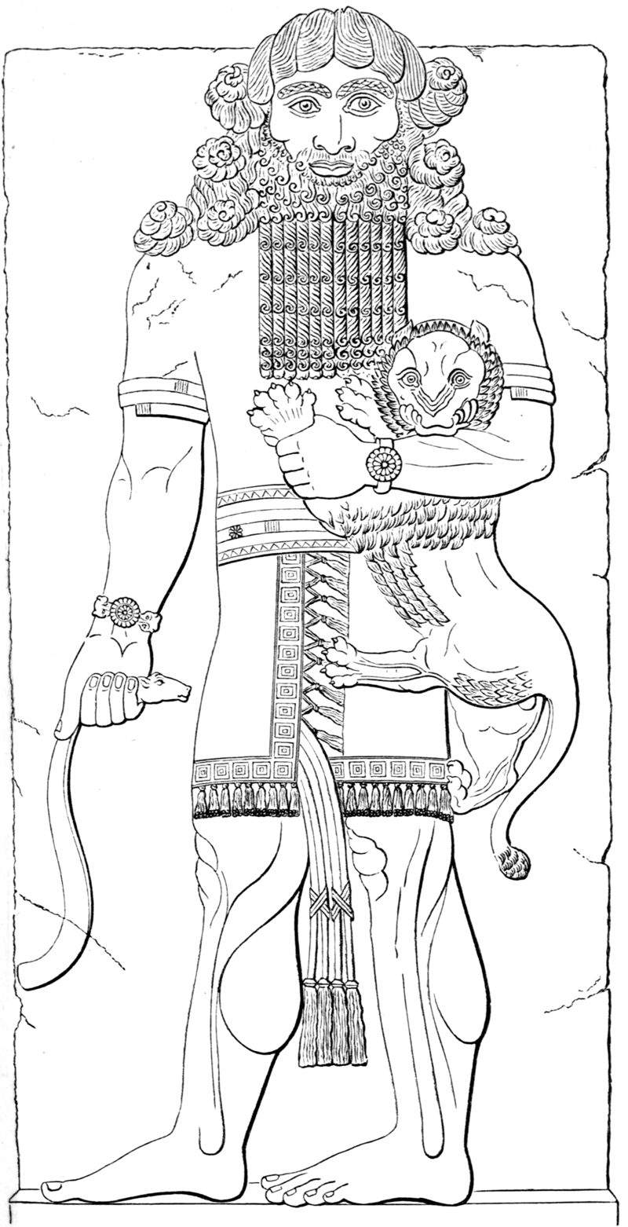
Gilgamesh

Slide 2
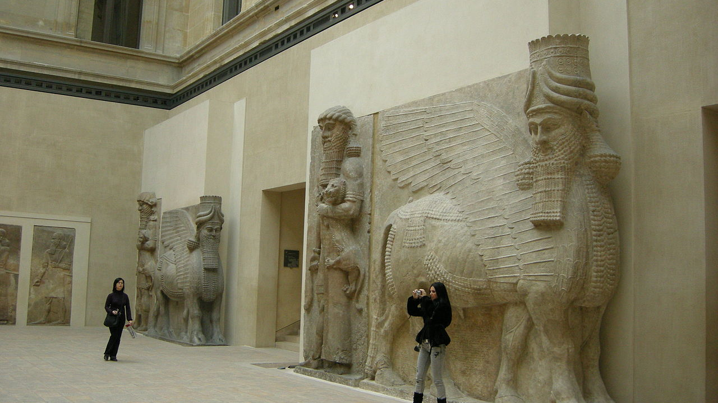
Slide 2: Hero mastering a lion-Eastern Antiquities in the Louvre

Slide 3
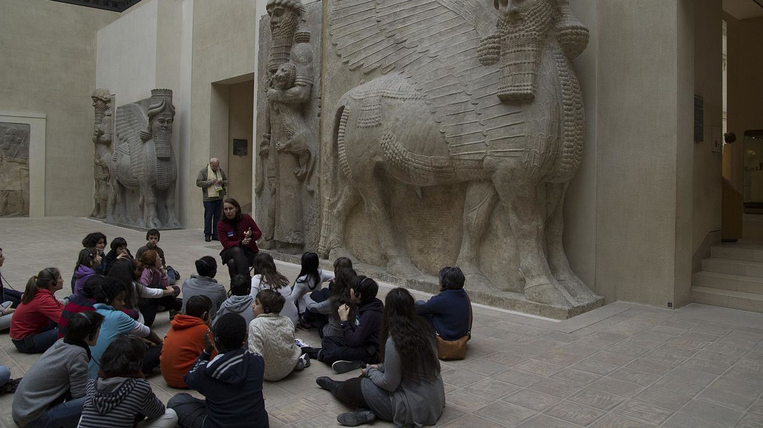
Slide 3: Hero mastering a lion-Eastern Antiquities in the Louvre

Slide 4
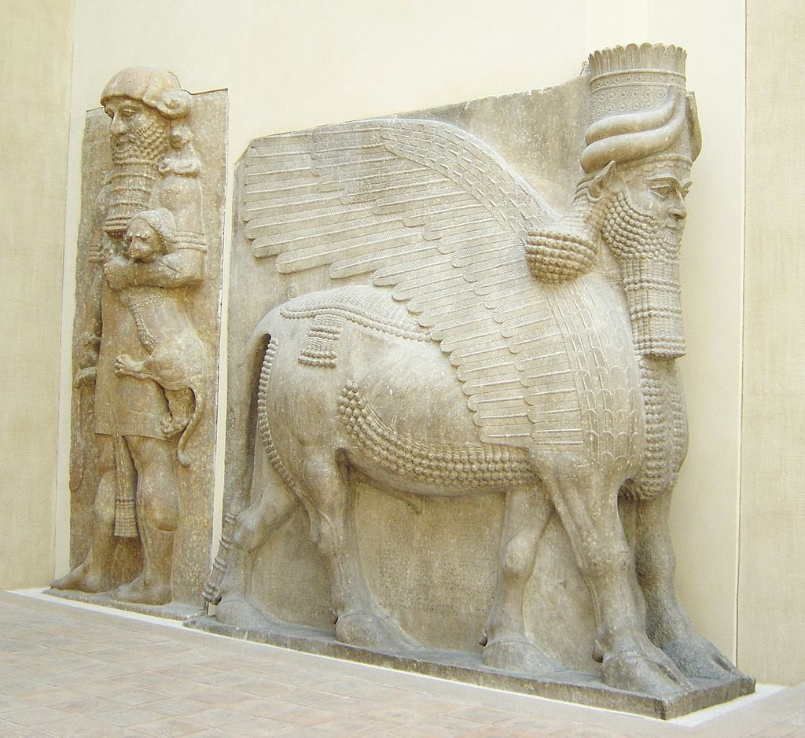
Slide 4: Hero mastering a Lion and Winged bull with human head, 8th century BC, stone, Height: 4.2 m, Louvre Museum, Paris

Slide 5
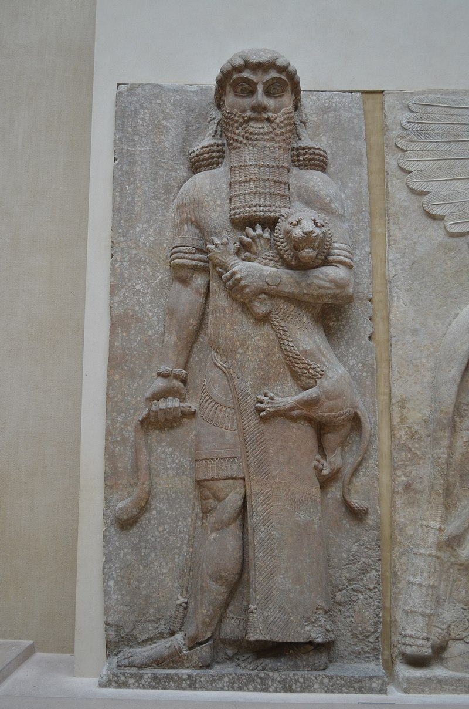
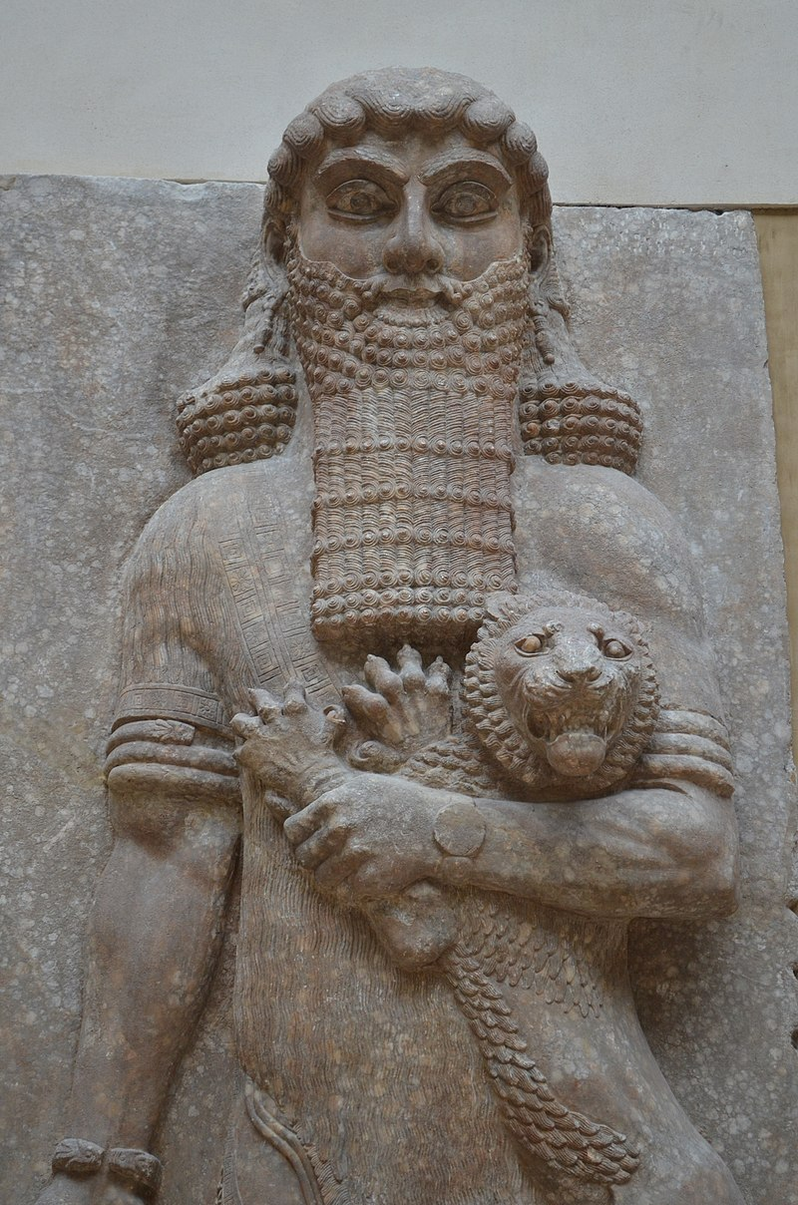
Slide 5: Hero mastering a lion, between 713 and 706 BC, stone, Height: 5.5 m, Louvre Museum, Paris

Slide 6
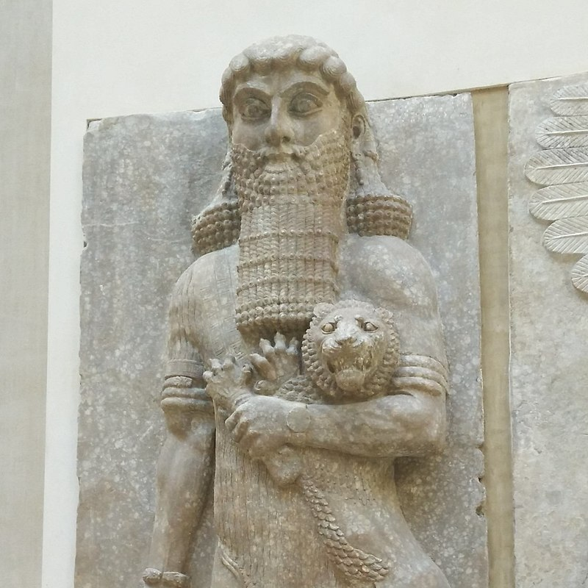
Slide 6: Hero mastering a lion, between 713 and 706 BC, stone, Height: 5.5 m, Louvre Museum, Paris

Slide 7
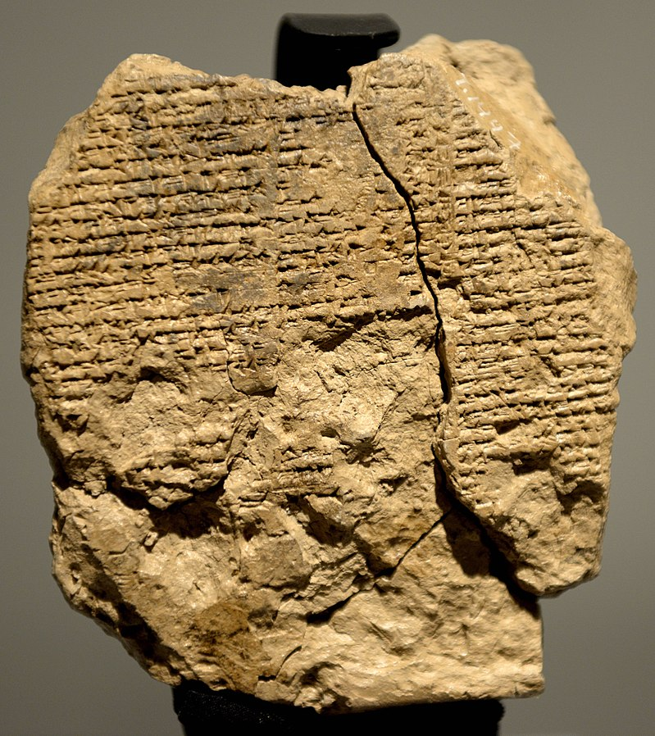
Slide 7: Reverse side of the newly discovered tablet V of the Epic of Gilgamesh. It dates back to the old Babylonian period, 2003-1595 BCE and is currently housed in the Sulaymaniyah Museum, Iraq. It narrates how Gilgamesh and Enkidu entered into cedar forest and how they dealt with Humbaba.

Slide 8
Copyrights
Slide 1 https://commons.wikimedia.org/wiki/Category:Gilgamesh#/media/File:Izdubar.png
Slide 2 https://commons.wikimedia.org/wiki/Category:Hero_mastering_a_lion-AO19861#/media/File:Eastern_Antiquities_in_the_Louvre_-_Room_4,_04.JPG
Slide 3 https://commons.wikimedia.org/wiki/Category:Hero_mastering_a_lion-AO19861#/media/File:Louvre_(8511684550).jpg
Slide 4 https://commons.wikimedia.org/wiki/Category:Hero_mastering_a_lion-AO19861#/media/File:Louvre_assyrian_gate_DSC00911.jpg
Slide 5 https://commons.wikimedia.org/wiki/Category:Hero_mastering_a_lion-AO19862#/media/File:Mus%C3%A9e_du_Louvre_Darafsh_(1817).jpg https://commons.wikimedia.org/wiki/Category:Hero_mastering_a_lion-AO19862#/media/File:Mus%C3%A9e_du_Louvre_Darafsh_(1818).jpg
Slide 6 https://commons.wikimedia.org/wiki/Category:Hero_mastering_a_lion-AO19862#/media/File:Hero_maitrisant_un_lion_D141107_a_(cropped).jpg
Slide 7 https://commons.wikimedia.org/wiki/Category:Gilgamesh#/media/File:Reverse_side_of_the_newly_discovered_tablet_V_of_the_Epic_of_Gilgamesh._It_dates_back_to_the_old_Babylonian_period,_2003-1595_BCE_and_is_currently_housed_in_the_Sulaymaniyah_Museum,_Iraq.jpg

