Slide 1
Cultural Geography of Greece
In-Class Activity for the Region of Epirus
A Pindos Mountain Wild Life Poster Project

Slide 2
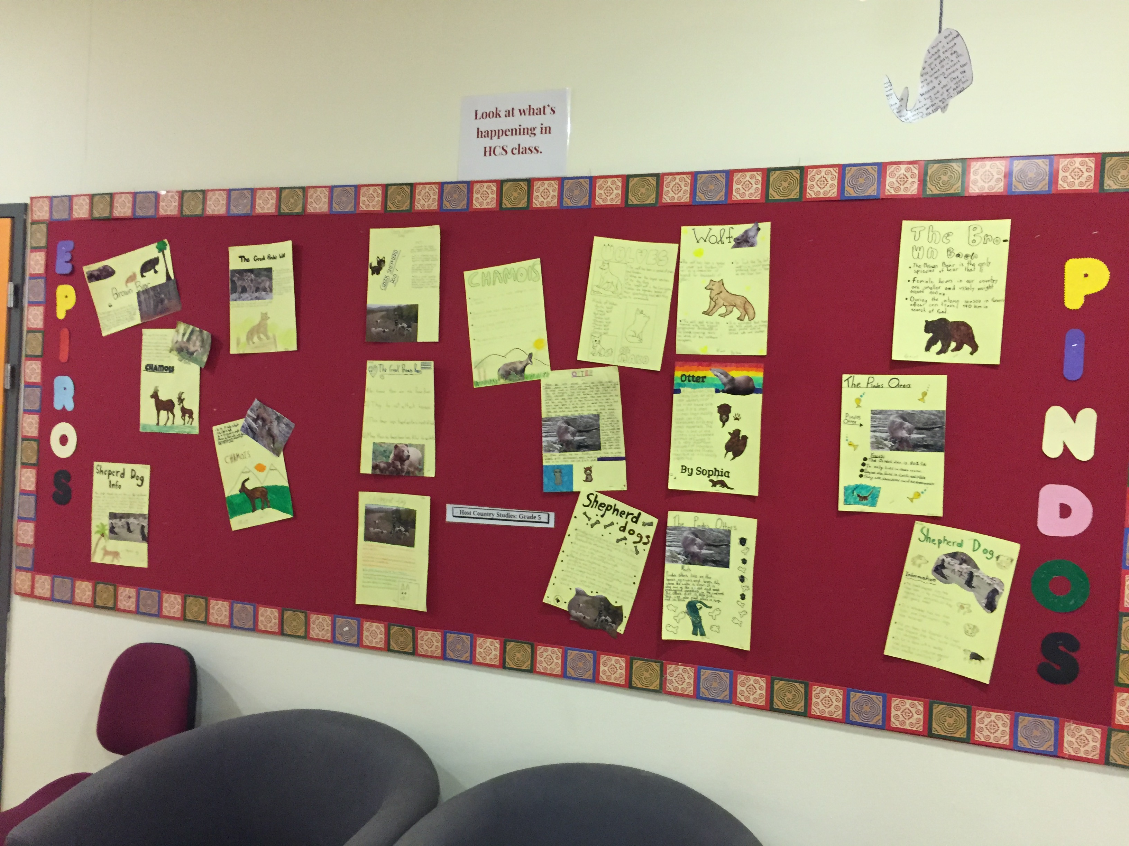

Slide 3
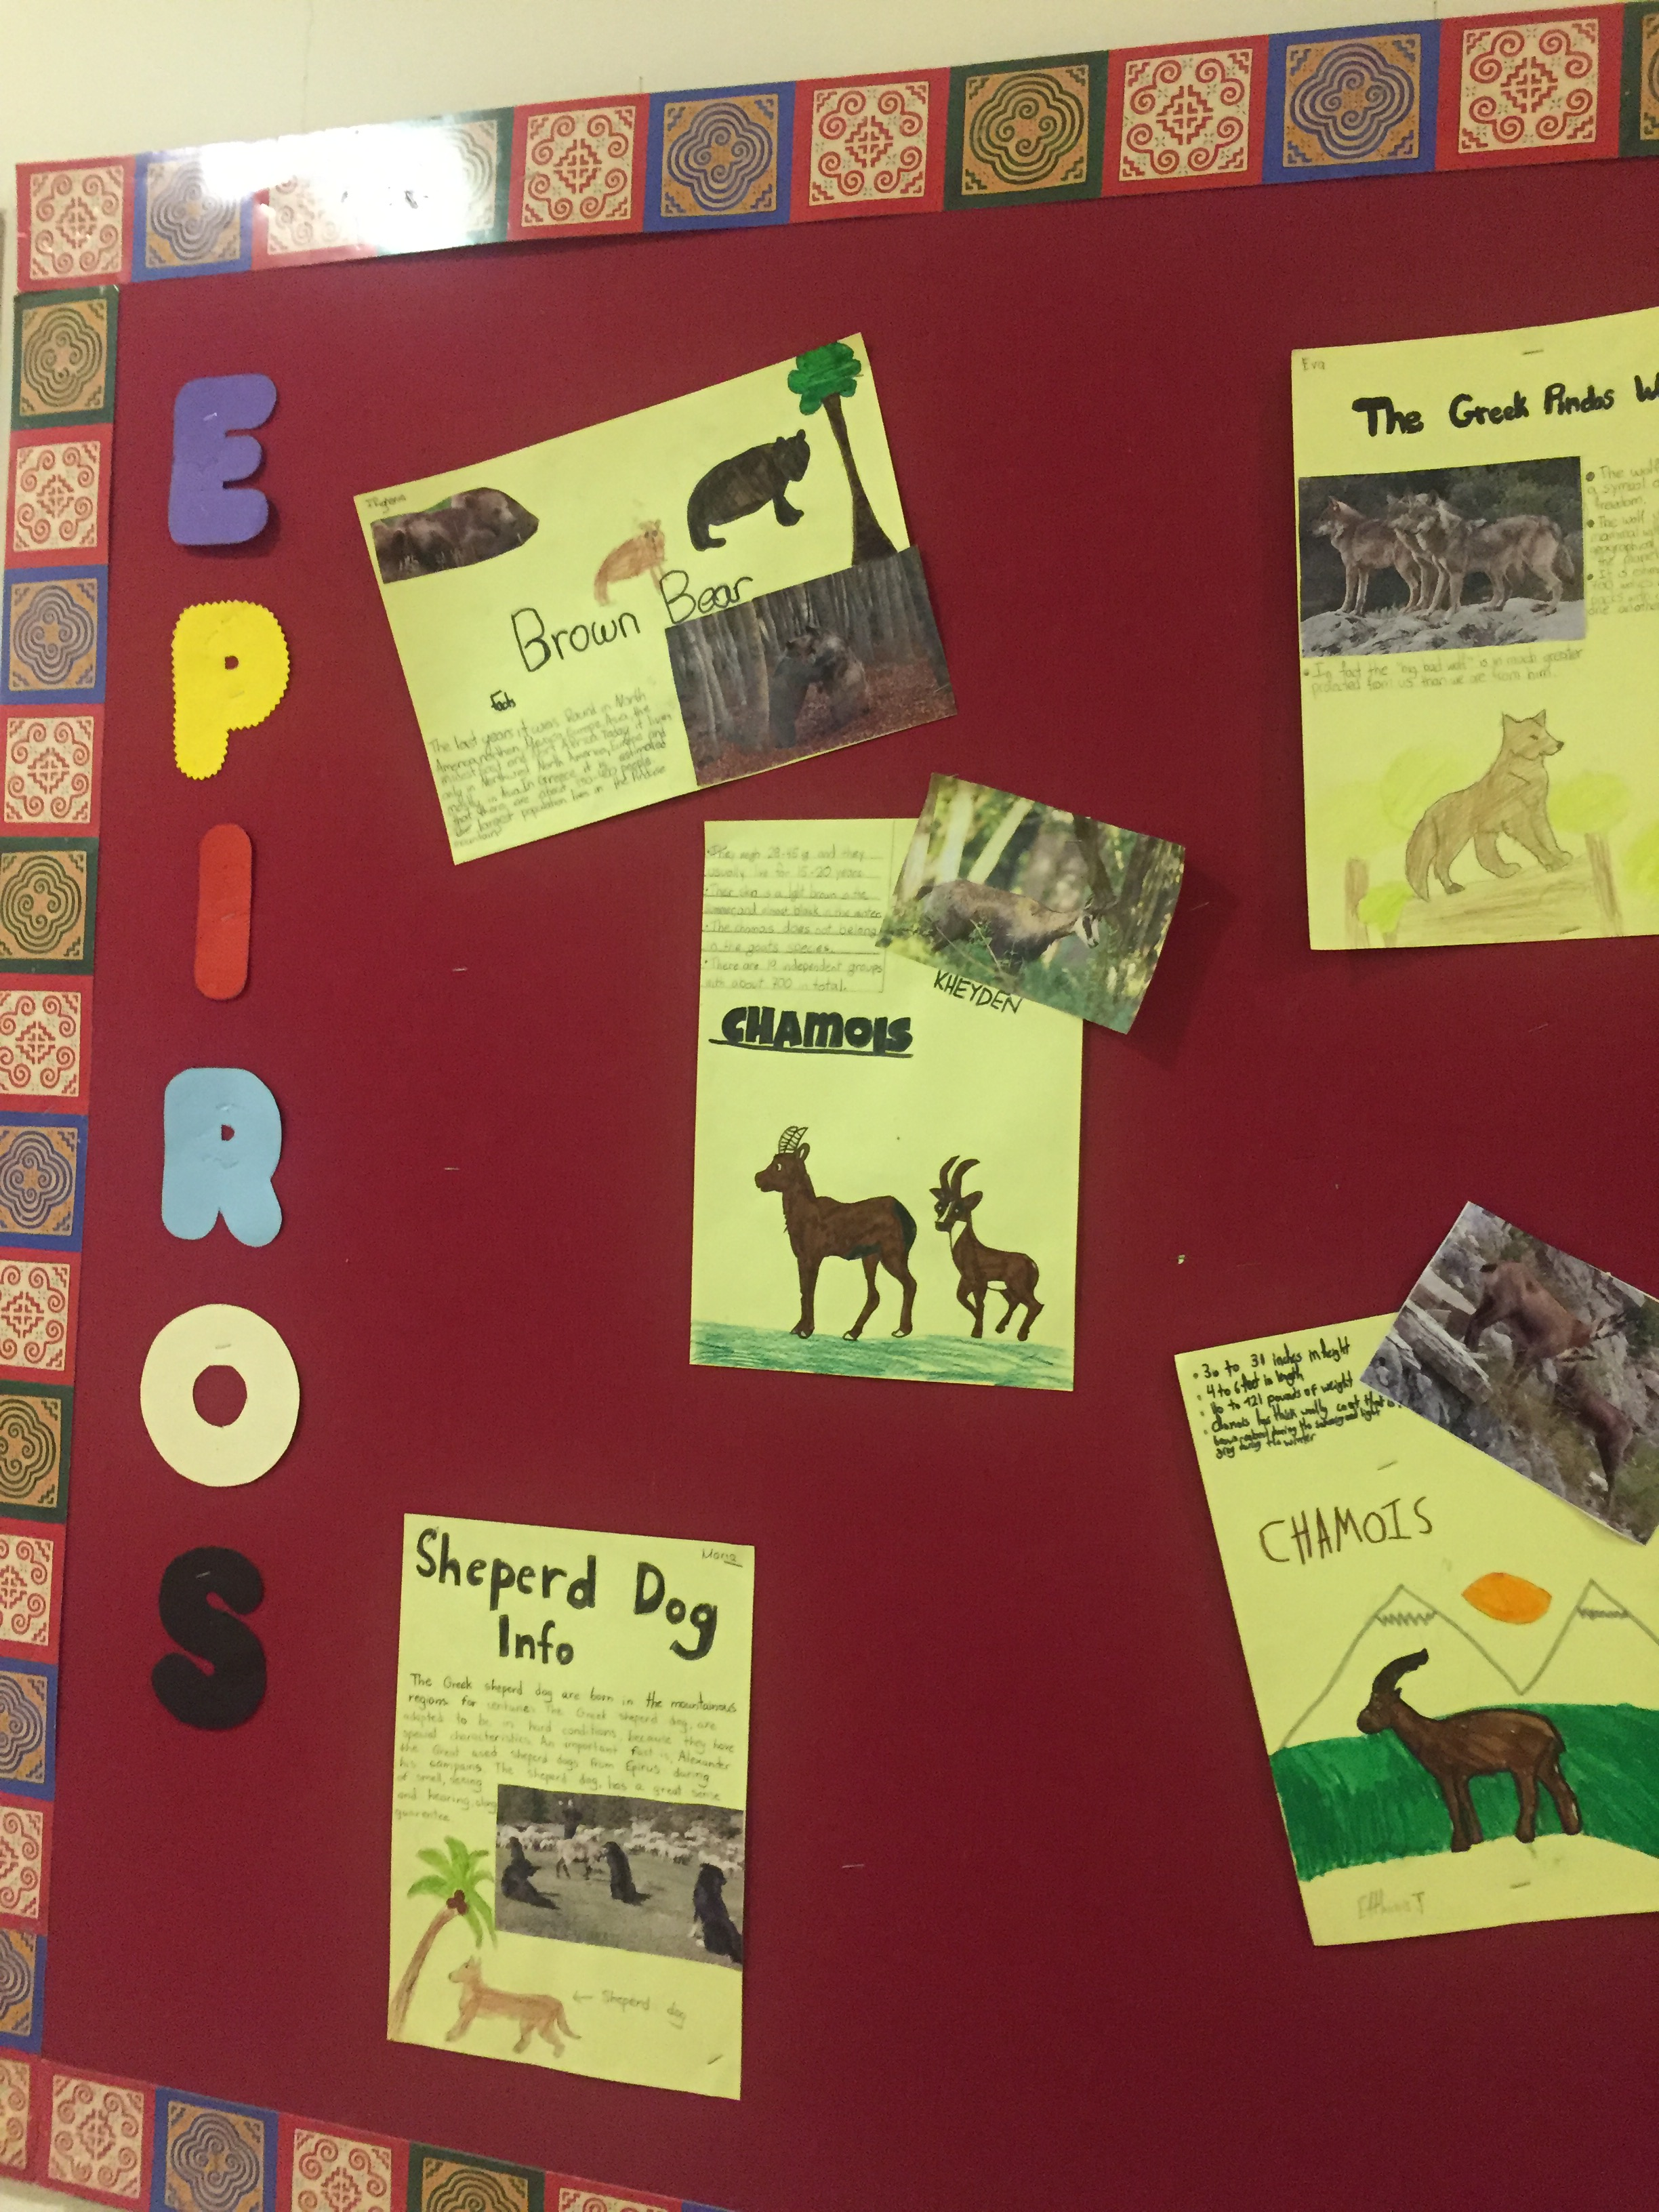
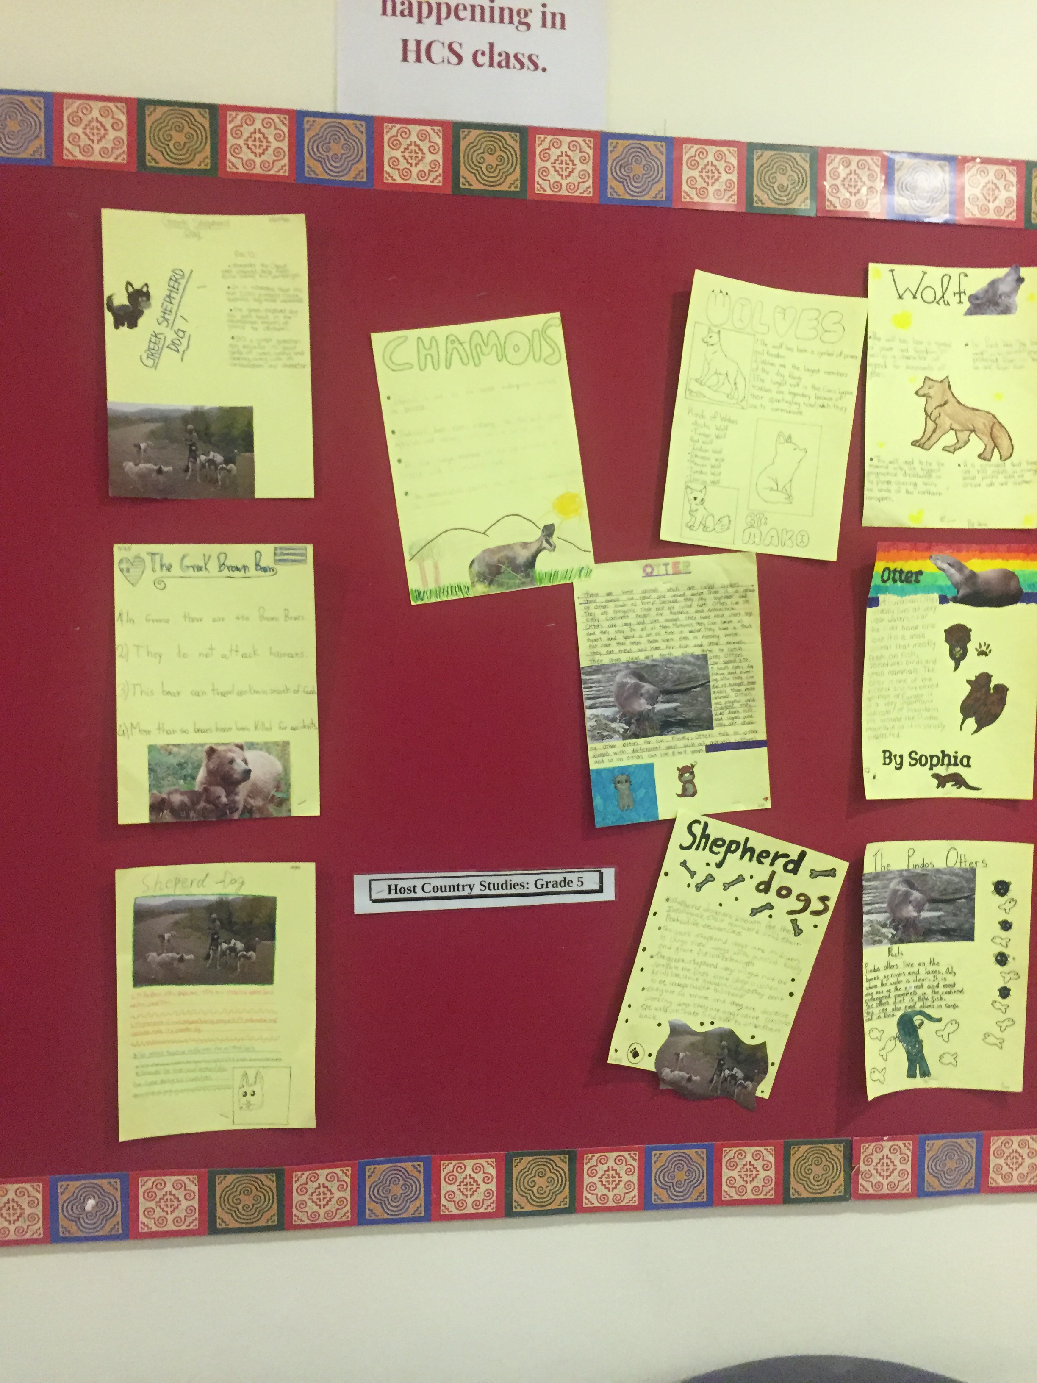

Slide 4
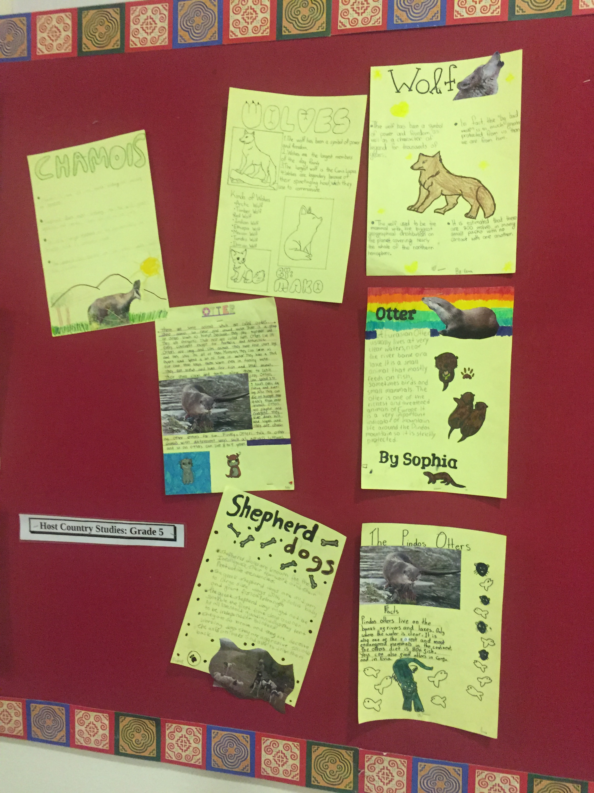
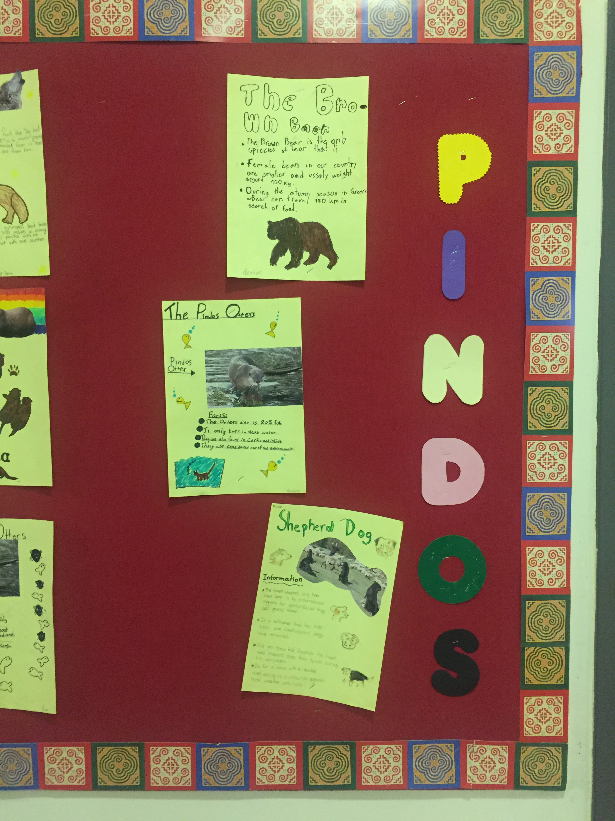

Slide 5
