Slide 1
Epirus
Pindos National Park Center
Lake Aoos

Slide 2
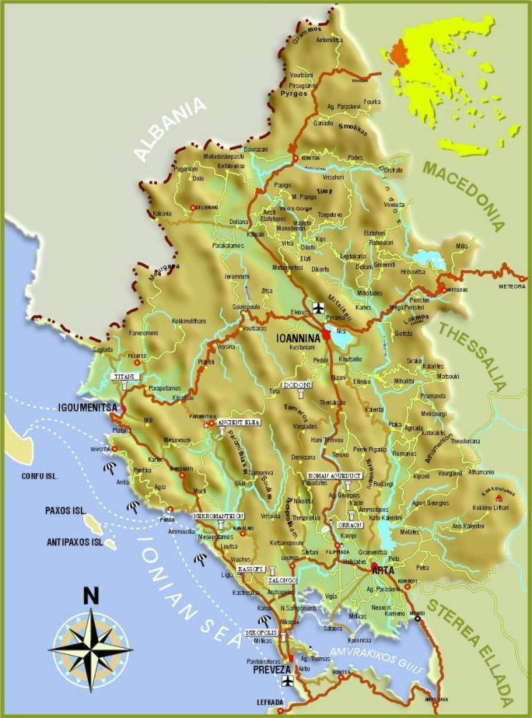
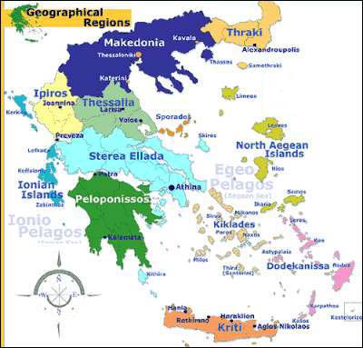
Epirus

Slide 3


Slide 4
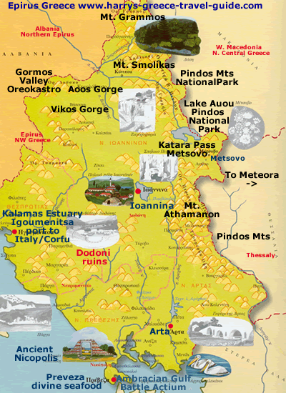
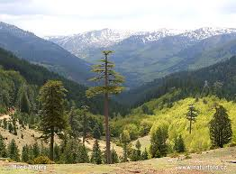
The Northwest Pindos Mts. National Park
“The park is, for the most part, a large wooded valley encircled by peaks, all over 2000 meters. Almost eighty species of birds live in the Pindos area, including the Imperial, golden, and short-toed eagles, the lanner falcons, the Egyptian vulture, and quite a few species of breeding woodpeckers. This is also one of the areas where bears, wolves, and wild cats are found, as well as red squirrels, wild boar, roe deer, beech martens, and otters (along the streams). A large variety of reptiles, amphibians, and insects, complete the picture.” http://pindosnationalpark.gr/en/

Slide 5
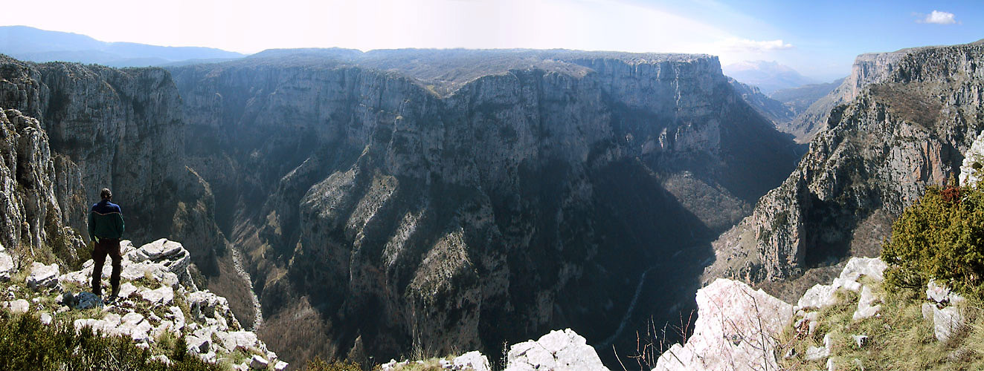
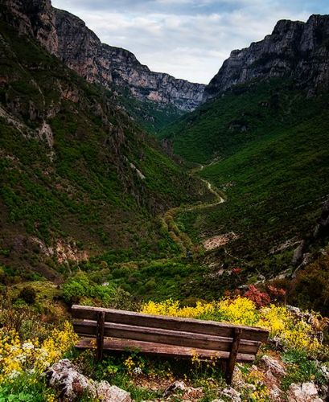
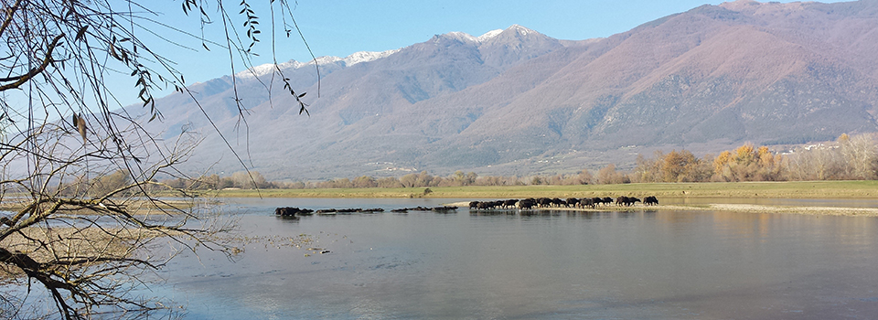

Slide 6
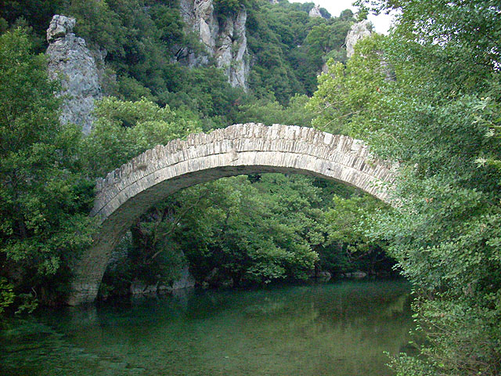
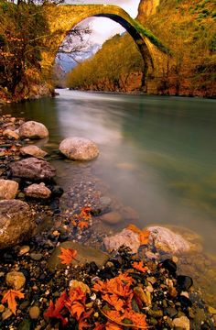
Aoos River Bridges

Slide 7
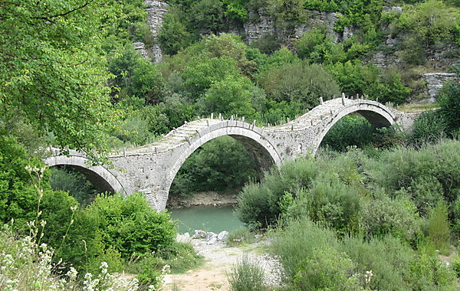
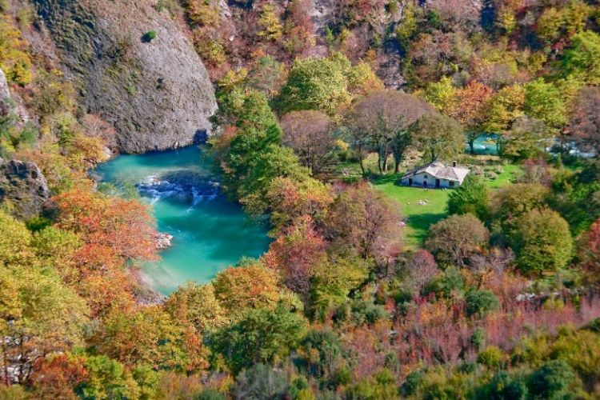

Slide 8
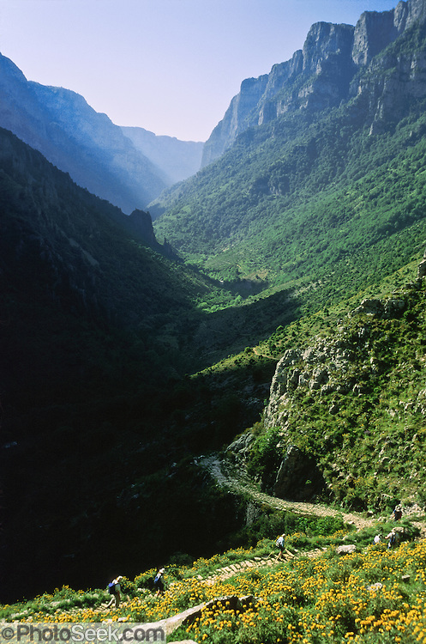
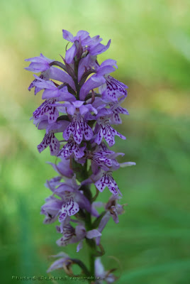
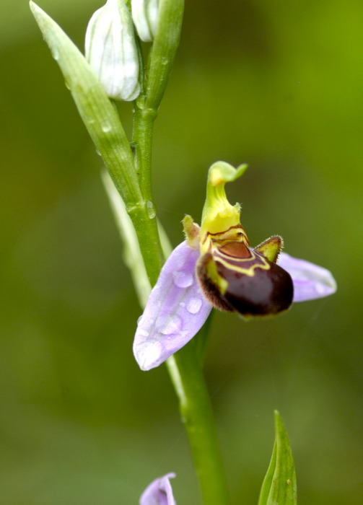
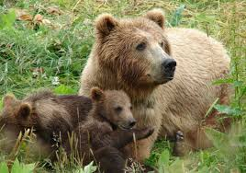

Slide 9
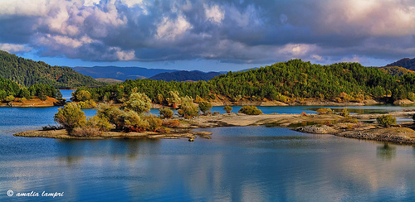
Aoos River Lake

Slide 10
