Slide 1
American Art
Colonial Period,
1600-1776

Slide 2
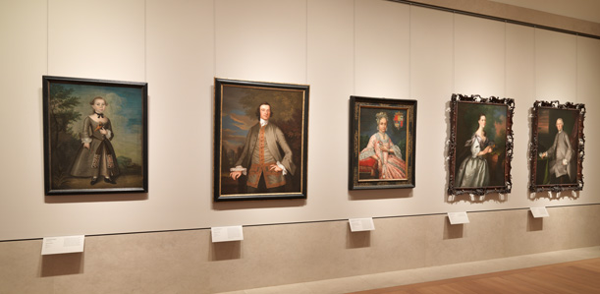
Colonial Portraiture at the MET, NY

Slide 3
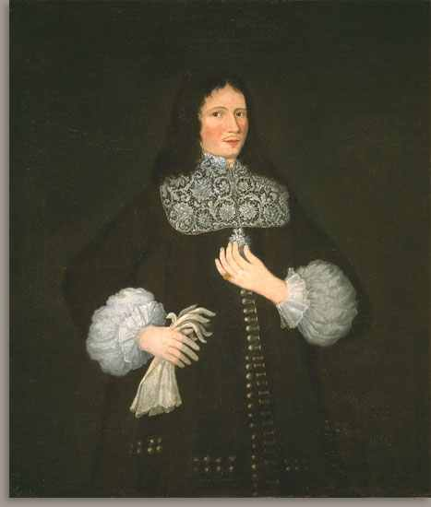
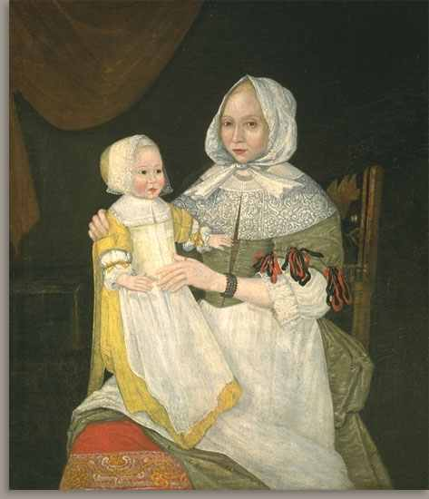
1st Slide: Unidentified artist, 17th cent., John Freake, ca. 1671-74, oil on canvas, 108 x 93.3 cm, Worcester Art Museum
Unidentified artist, 17th century, Elizabeth Clarke Freake, Mrs. John Freake and Baby Mary, ca. 1671-74, oil on canvas, 108 x 93.3 cm, Worcester Art Museum

Slide 4
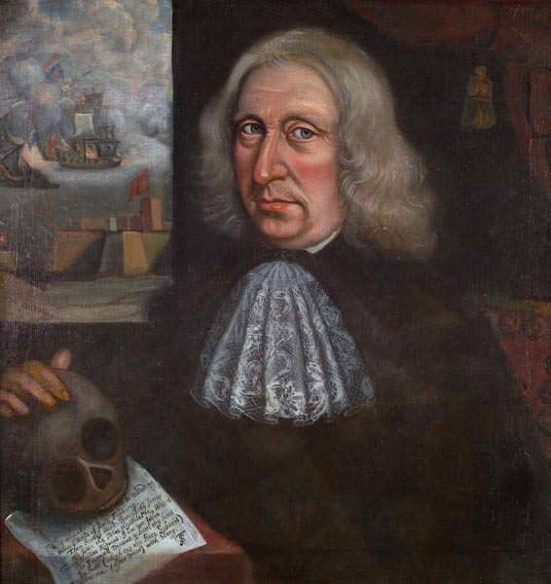
2nd Slide: Thomas Smith, Self-Portrait, about 1680, oil on canvas, 62.8 x 60 cm, Worcester Art Museum

Slide 5
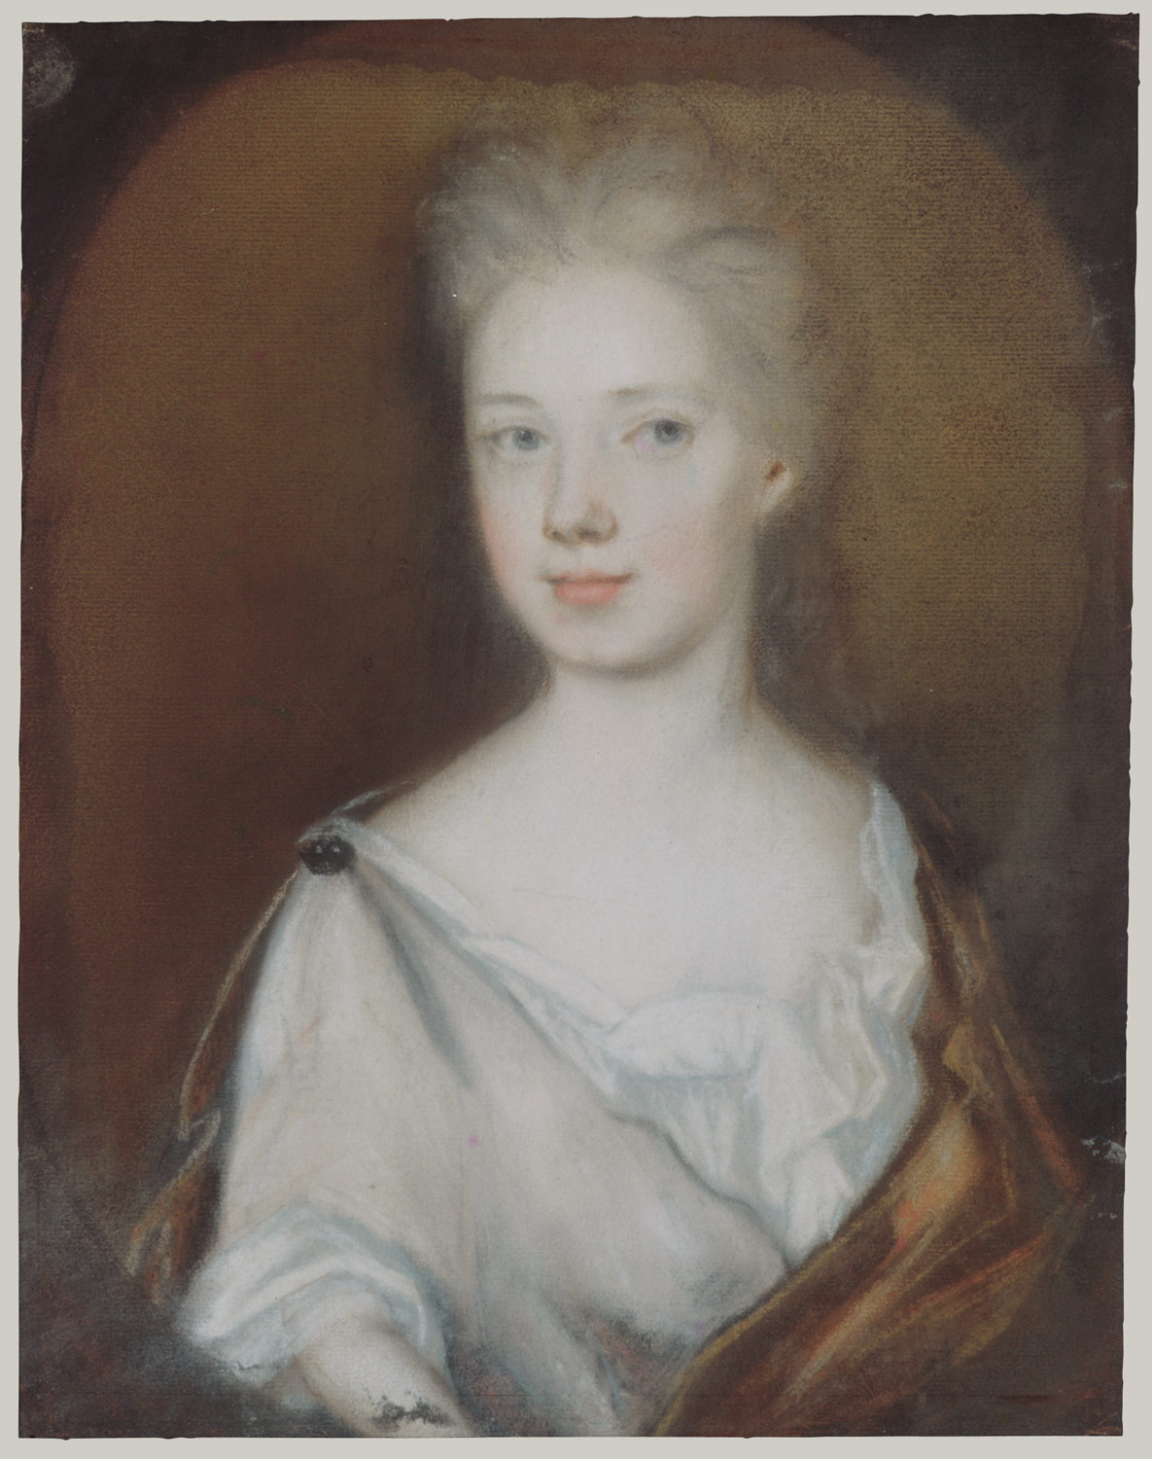
3rd Slide: Henrietta Johnston, 1674–1729
Mrs. Pierre Bacot Marianne Fleur Du Gue, ca. 1708–10, pastel, red and black chalk on toned laid paper, 27.9 x 21.7 cm, the MET, NY

Slide 6
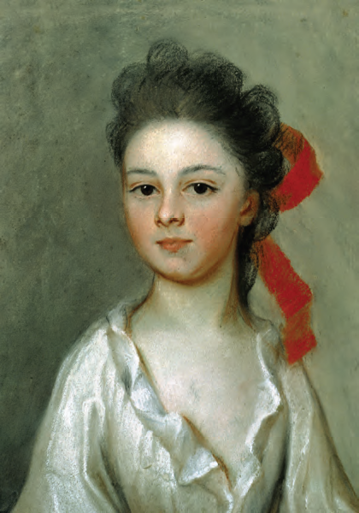
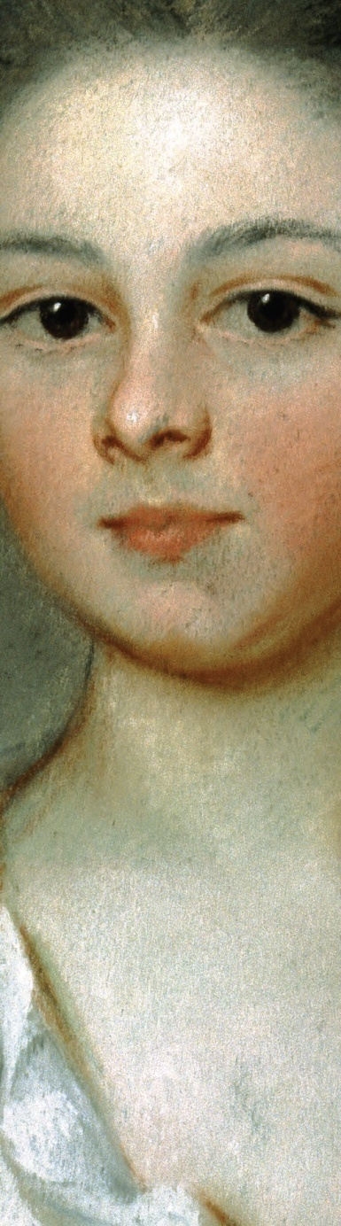
4th Slide: Henrietta De Beaulieu Dering Johnston, ca. 1674 – 1729
Henriette Charlotte Chastaigner (Mrs. Nathaniel Broughton, 1700 –1754), 1711, pastel on paper, 36.58x29.47 cm, the Gibbes Museum of Art, Charleston, SC

Slide 7
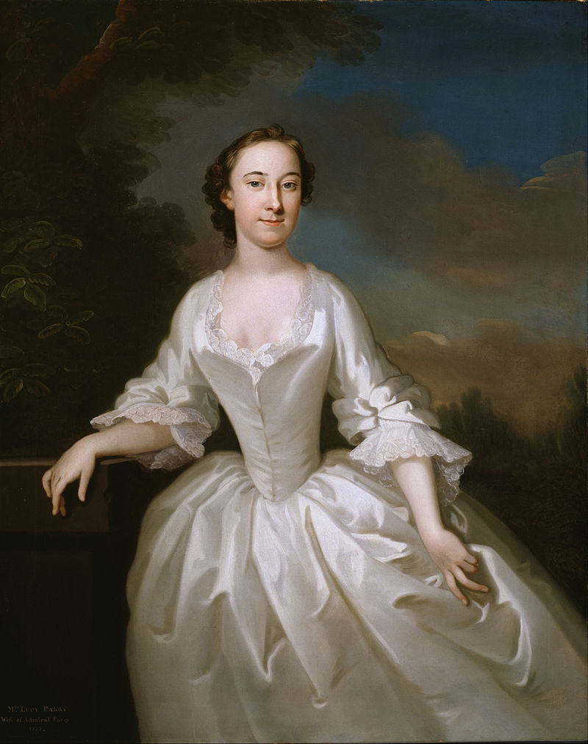
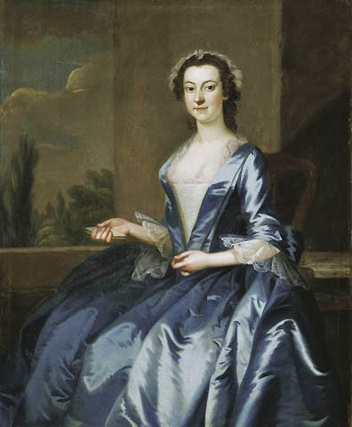
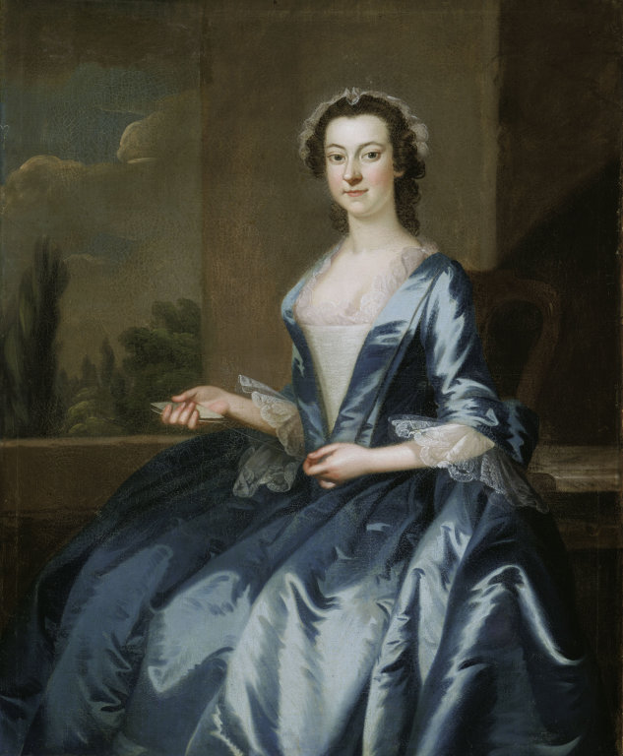
5th Slide: John Wollaston ,
1710-1775
Portrait of Lucy Parry,
Wife of Admiral Parrya ,
1749, oil on canvas,
Smithsonian American Art
Museum
Portrait of a Woman,
1749-52, oil on canvas,
132.6 x 107.2 cm, Art
Institute of Chicago
Wollaston's rococo portraits were a hit in
Maryland’s capital of
Annapolis. The March 15,
1753, Maryland Gazette carried the following poem honoring
Wollaston.
"On Seeing Mr. Wollaston’s Pictures, in Annapolis," by a Dr. T. T.
Behold the wond’rous Power of Art!
That mocks devouring Time and Death,
Can Nature’s ev’ry Charm impart;
And make the lifeless Canvas breathe.

Slide 8
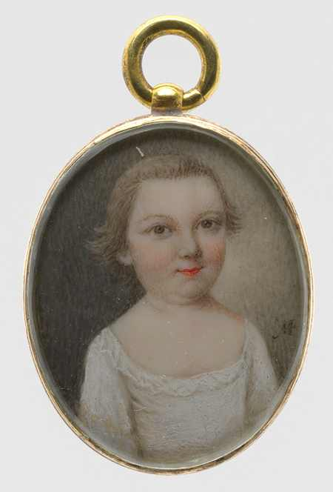
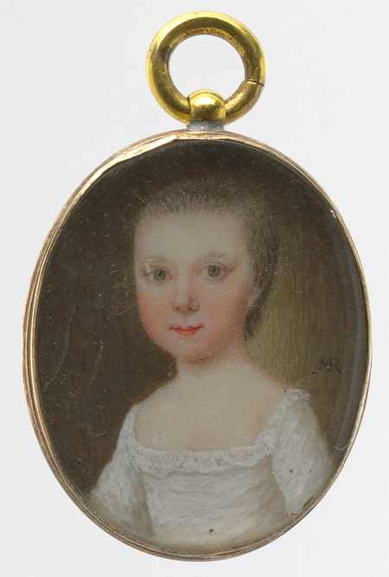
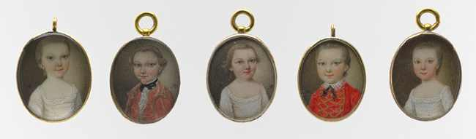
6th Slide: Mary Roberts died 1761
The Middleton Cousins, early 1750s
Watercolor on ivory, each 3.8 x 2.5 cm,
The MET, NY

Slide 9
Copyrights for American Art – Colonial Period PP
1st Slide: Unidentified artist, 17th cent., John Freake, ca. 1671-74, oil on canvas, 108 x 93.3 cm,
Worcester Art Museum
Unidentified artist, 17th century, Elizabeth Clarke Freake, Mrs. John Freake and Baby Mary, ca. 1671-74, oil on canvas, 108 x 93.3 cm, Worcester Art Museum https://commons.wikimedia.org/wiki/File:John_freake_1674.jpg https://www.worcesterart.org/collection/American/1963.134.html https://commons.wikimedia.org/wiki/File:Elizabeth_and_Mary_Freake.jpg https://www.worcesterart.org/collection/American/1963.135.html
Public Domain
2nd Slide: Thomas Smith, Self-Portrait, about 1680, oil on canvas, 62.8 x 60 cm, Worcester Art Museum https://commons.wikimedia.org/wiki/File:Self-Portrait_by_Thomas_Smith_circa_1680.jpg https://www.worcesterart.org/collection/American/1948.19.html
Public Domain
3rd Slide: Henrietta Johnston, 1674–1729
Mrs. Pierre Bacot Marianne Fleur Du Gue, ca. 1708–10, pastel, red and black chalk on toned laid paper, 27.9 x 21.7 cm, the MET, NY https://commons.wikimedia.org/wiki/File:Mrs._Pierre_Bacot_(Marianne_Fleur_Du_Gue.jpg
Public Domain
4th Slide: Henrietta De Beaulieu Dering Johnston, ca. 1674 – 1729
Henriette Charlotte Chastaigner (Mrs. Nathaniel Broughton, 1700 –1754), 1711, pastel on paper, 36.58x29.47 cm, the Gibbes Museum of Art, Charleston, SC https://commons.wikimedia.org/wiki/File:Henrietta_De_Beaulieu_Dering_Johnston_-_Henriette_Charlotte_Chastaigner_(Mrs._Nathaniel_Broughton)_-_Google_Art_Project.jpg https://artsandculture.google.com/asset/YQEoyJ7Nrh9EBQ
Public Domain
5th Slide: John Wollaston , 1710-1775
Portrait of Lucy Parry, Wife of Admiral Parrya, 1749, oil on canvas, Smithsonian American Art Museum
Portrait of a Woman, 1749-52, oil on canvas, 132.6 x 107.2 cm, Art Institute of Chicago https://commons.wikimedia.org/wiki/File:John_Wollaston_-_Portrait_of_Lucy_Parry,_Wife_of_Admiral_Parry_-_Google_Art_Project.jpg https://commons.wikimedia.org/wiki/Category:John_Wollaston_(painter)#/media/File:John_Wollaston_-_Portrait_of_a_Woman_-_1953.462_-_Art_Institute_of_Chicago.jpg
Public Domain
6th Slide: Mary Roberts, died 1761
The Middleton Cousins, early 1750s, watercolor on ivory, each 3.8 x 2.5 cm, the MET, NY https://www.metmuseum.org/art/collection/search/19430
Public Domain

