Slide 1
Vincent Van Gogh and the Roulin Family

Slide 2
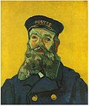
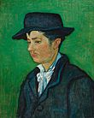
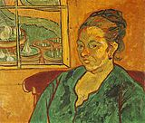
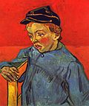
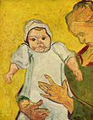
In the very first days of December 1888 Vincent told his brother Theo:
I have made portraits of a whole family, that of the postman whose head I had done previously – the man, his wife, the baby, the young boy, and the son of sixteen, all of them real characters and very French, though they look like Russians. Size 15 canvases. You know how I feel about this, how I feel in my element, and that it consoles me up to a certain point for not being a doctor. I hope to get on with this and to be able to get more careful posing, paid for by portraits. And if I manage to do this whole family better still, at least I shall have done something to my liking and something individual. Just now I am completely swamped with studies, studies, studies, and this will go on for quite a while – it makes such a mess that it breaks my heart, and yet it will provide me with some property when I'm forty.

Slide 3
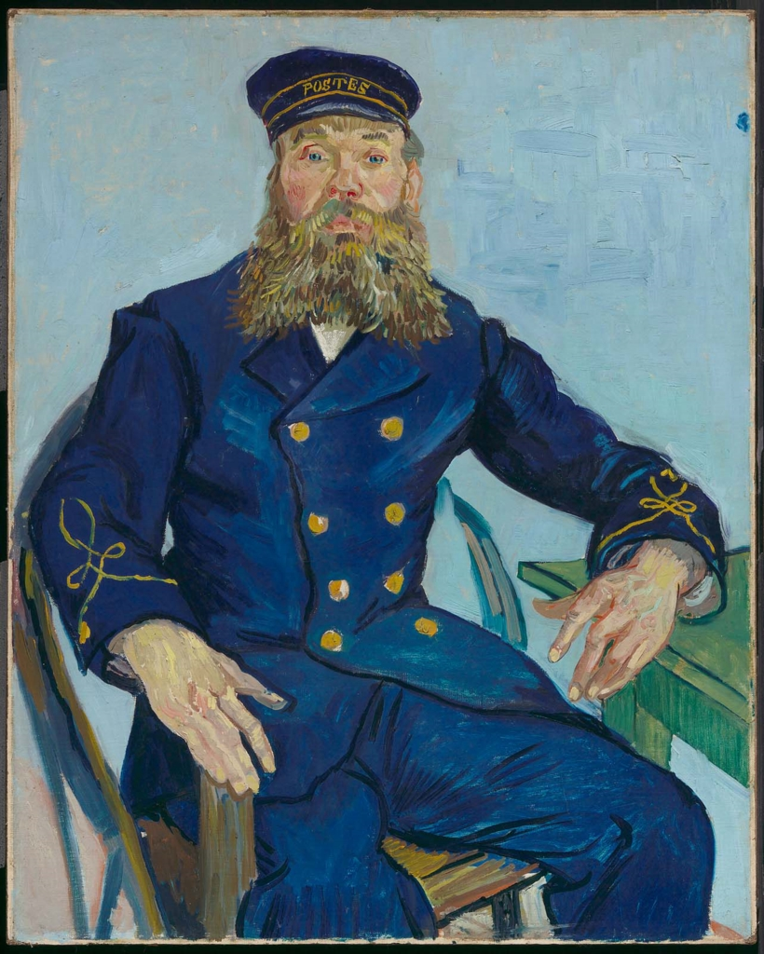
1st Slide: Postman Joseph Roulin, 1888, oil on canvas, MFA, Boston
Joseph Roulin, born on 4 April 1841 in Lambesc, worked at the railroad station as an Entreposeur des Postes. Van Gogh compared Roulin to Socrates and described him as "such a good soul and so wise and so full of feeling and so trustful." Roulin saw Van Gogh through the good and the most difficult times, being at his side during and following the hospital stay in Arles.

Slide 4
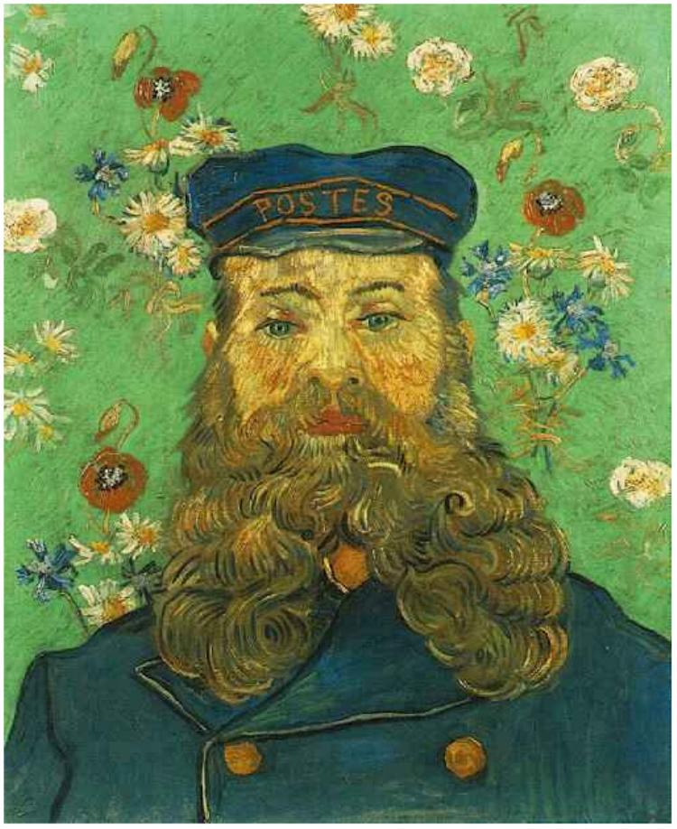
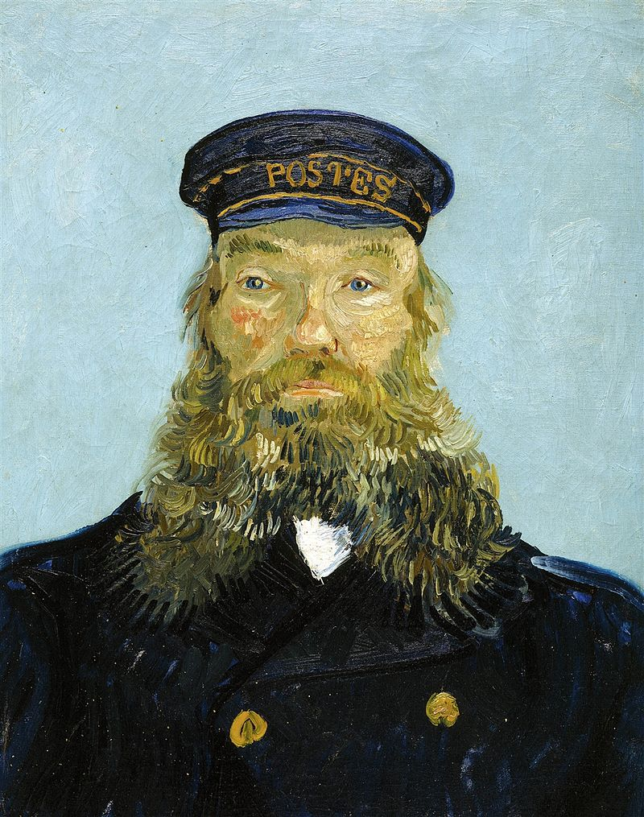
2nd Slide: Portrait of the Postman Joseph Roulin, early August, 1888, oil on canvas, Detroit Institute of Arts
Portrait of the Postman Joseph Roulin, April 1888, Kröller-Müller Museum, Otterlo, Netherlands

Slide 5

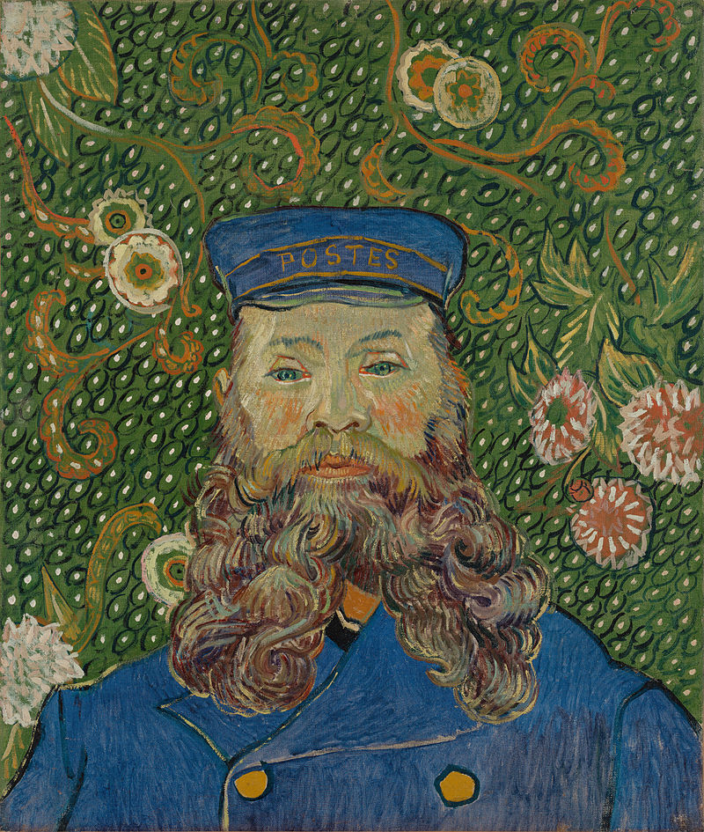
3rd Slide: Portrait of the Postman Joseph Roulin, April 1889, oil on canvas, MOMA, NY
The Father or Portrait of the Postman Joseph Roulin, Nov–Dec 1888, oil on canvas, Kunstmuseum Winterthur, Switzerland

Slide 6
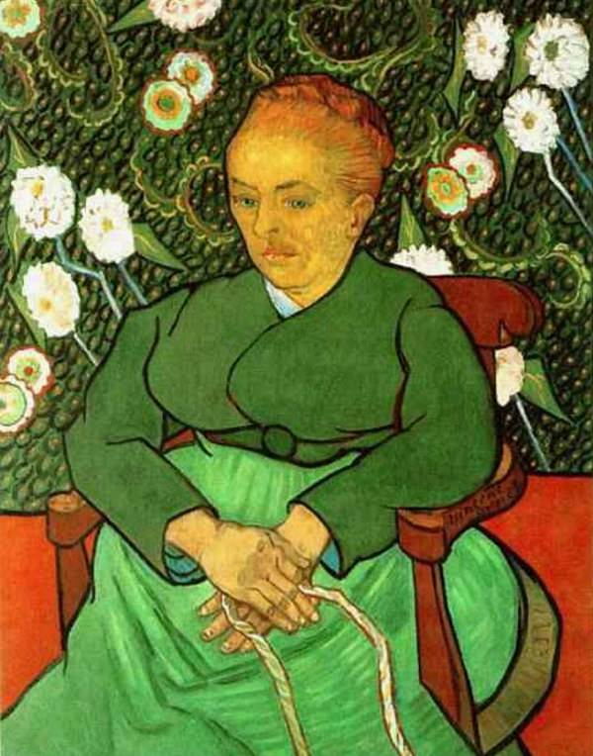
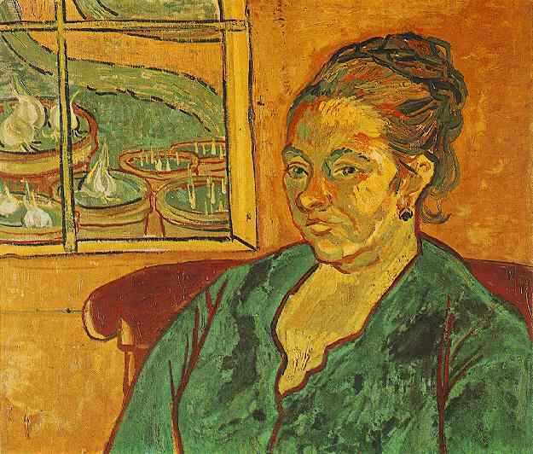
4th Slide: La Berceuse, Augustine Roulin, 1888-1889, oil on canvas, Kröller-Müller Museum, Otterlo, Netherlands
Portrait of Madame Augustine Roulin, 1888, Winterthur, Oskar Reinhart Collection 'Am Römerholz'

Slide 7
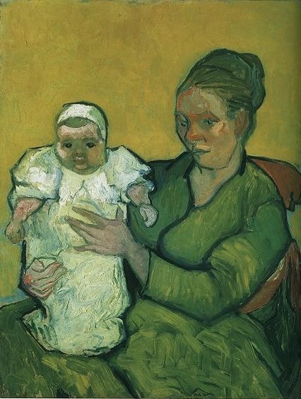
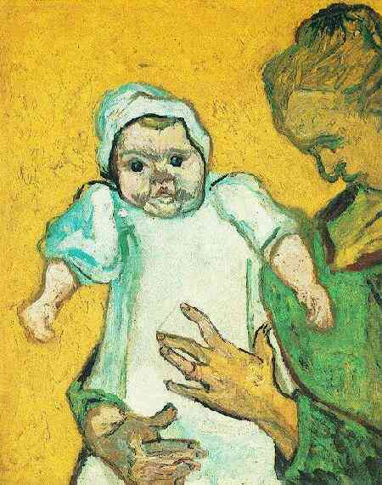
5th Slide:
Mother Roulin with Her Baby, 1888, oil on canvas, the MET, NY
Mother Roulin with Her Baby, 1888, oil on canvas, The Philadelphia Museum of Art

Slide 8
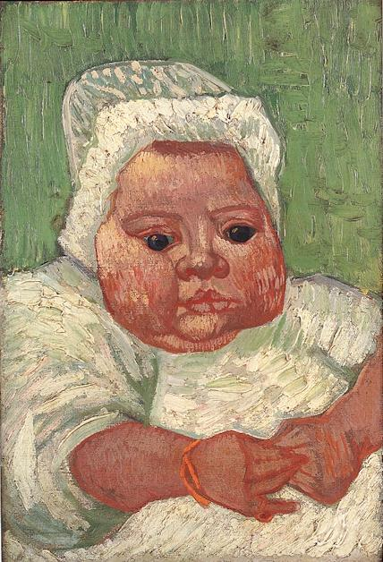
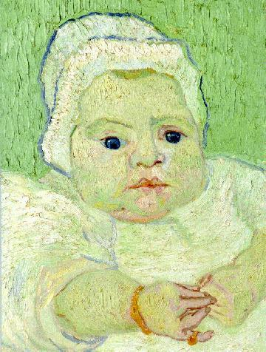
6th Slide:
Baby Marcelle Roulin, 1888, oil on canvas, private collection
Baby Marcelle Roulin, 1888, oil on canvas, NGA, Washington, DC

Slide 9
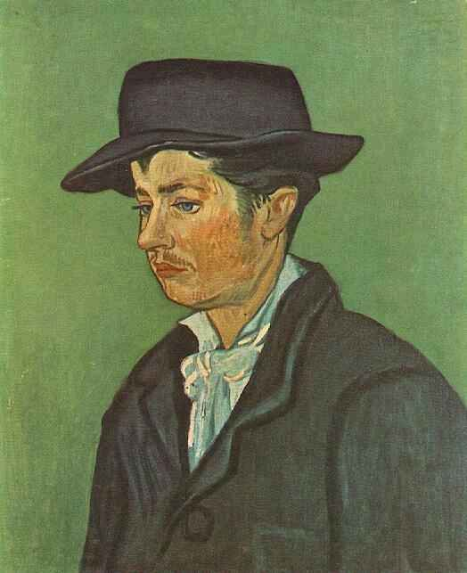
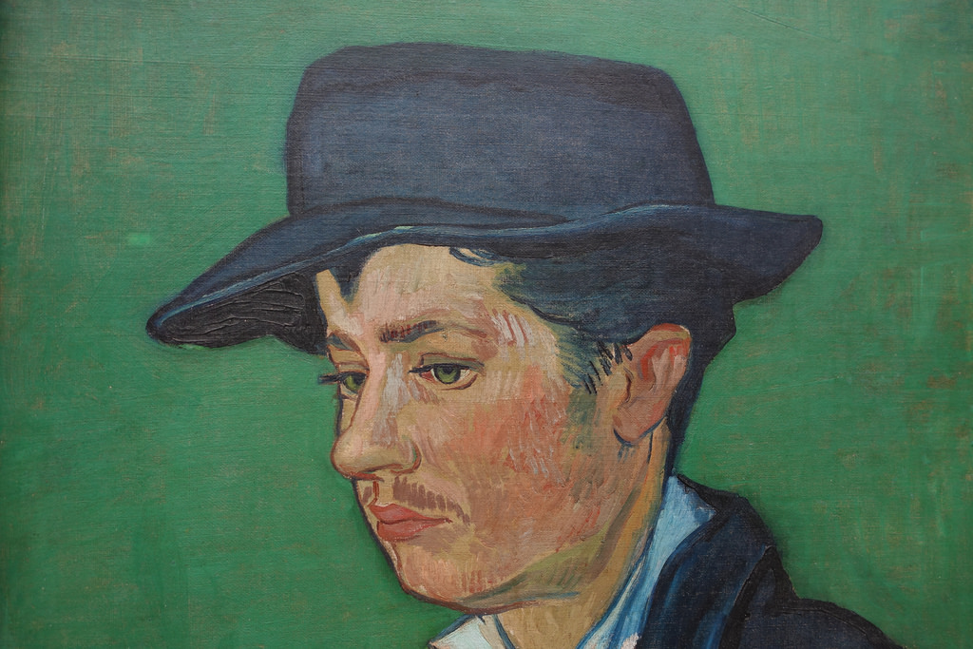
7th Slide: Portrait of Armand Roulin, 1888, oil on canvas, Museum Boijmans-van Beuningen, Rotterdan

Slide 10
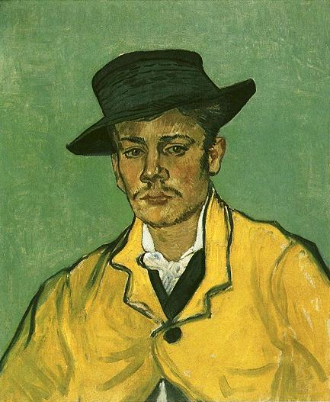
8th Slide: Portrait of Armand Roulin, 1888, oil on canvas, Museum Folkwang, Essen

Slide 11
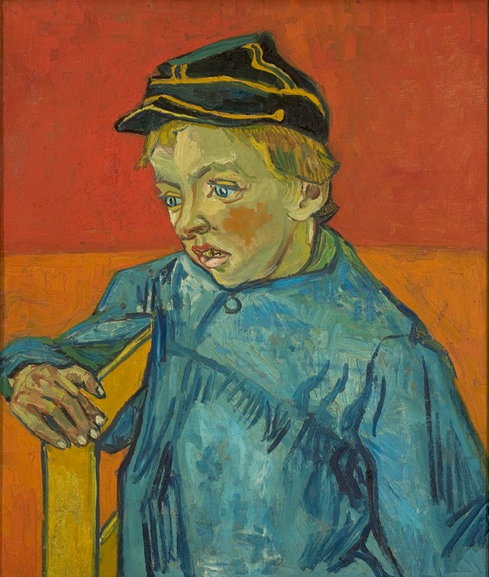
9th Slide: Portrait of Camille Roulin, 1888, oil on canvas, Museu de Arte de São Paulo, Brasil

Slide 12
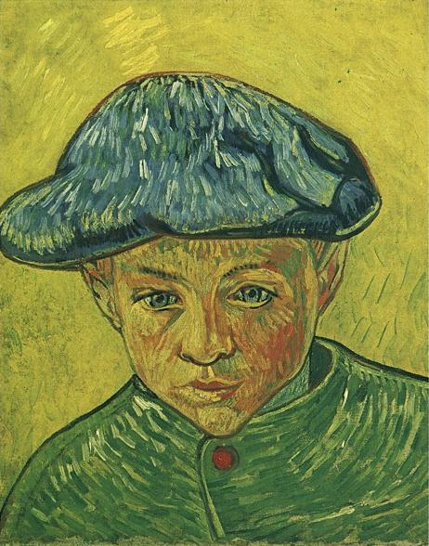
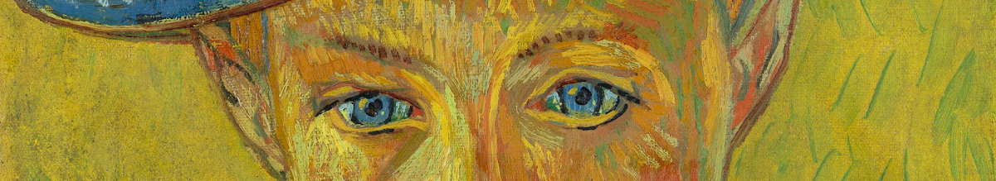
10th Slide: Portrait of Camille Roulin, 1888, oil on canvas, Van Gogh Museum, Amsterdam

Slide 13
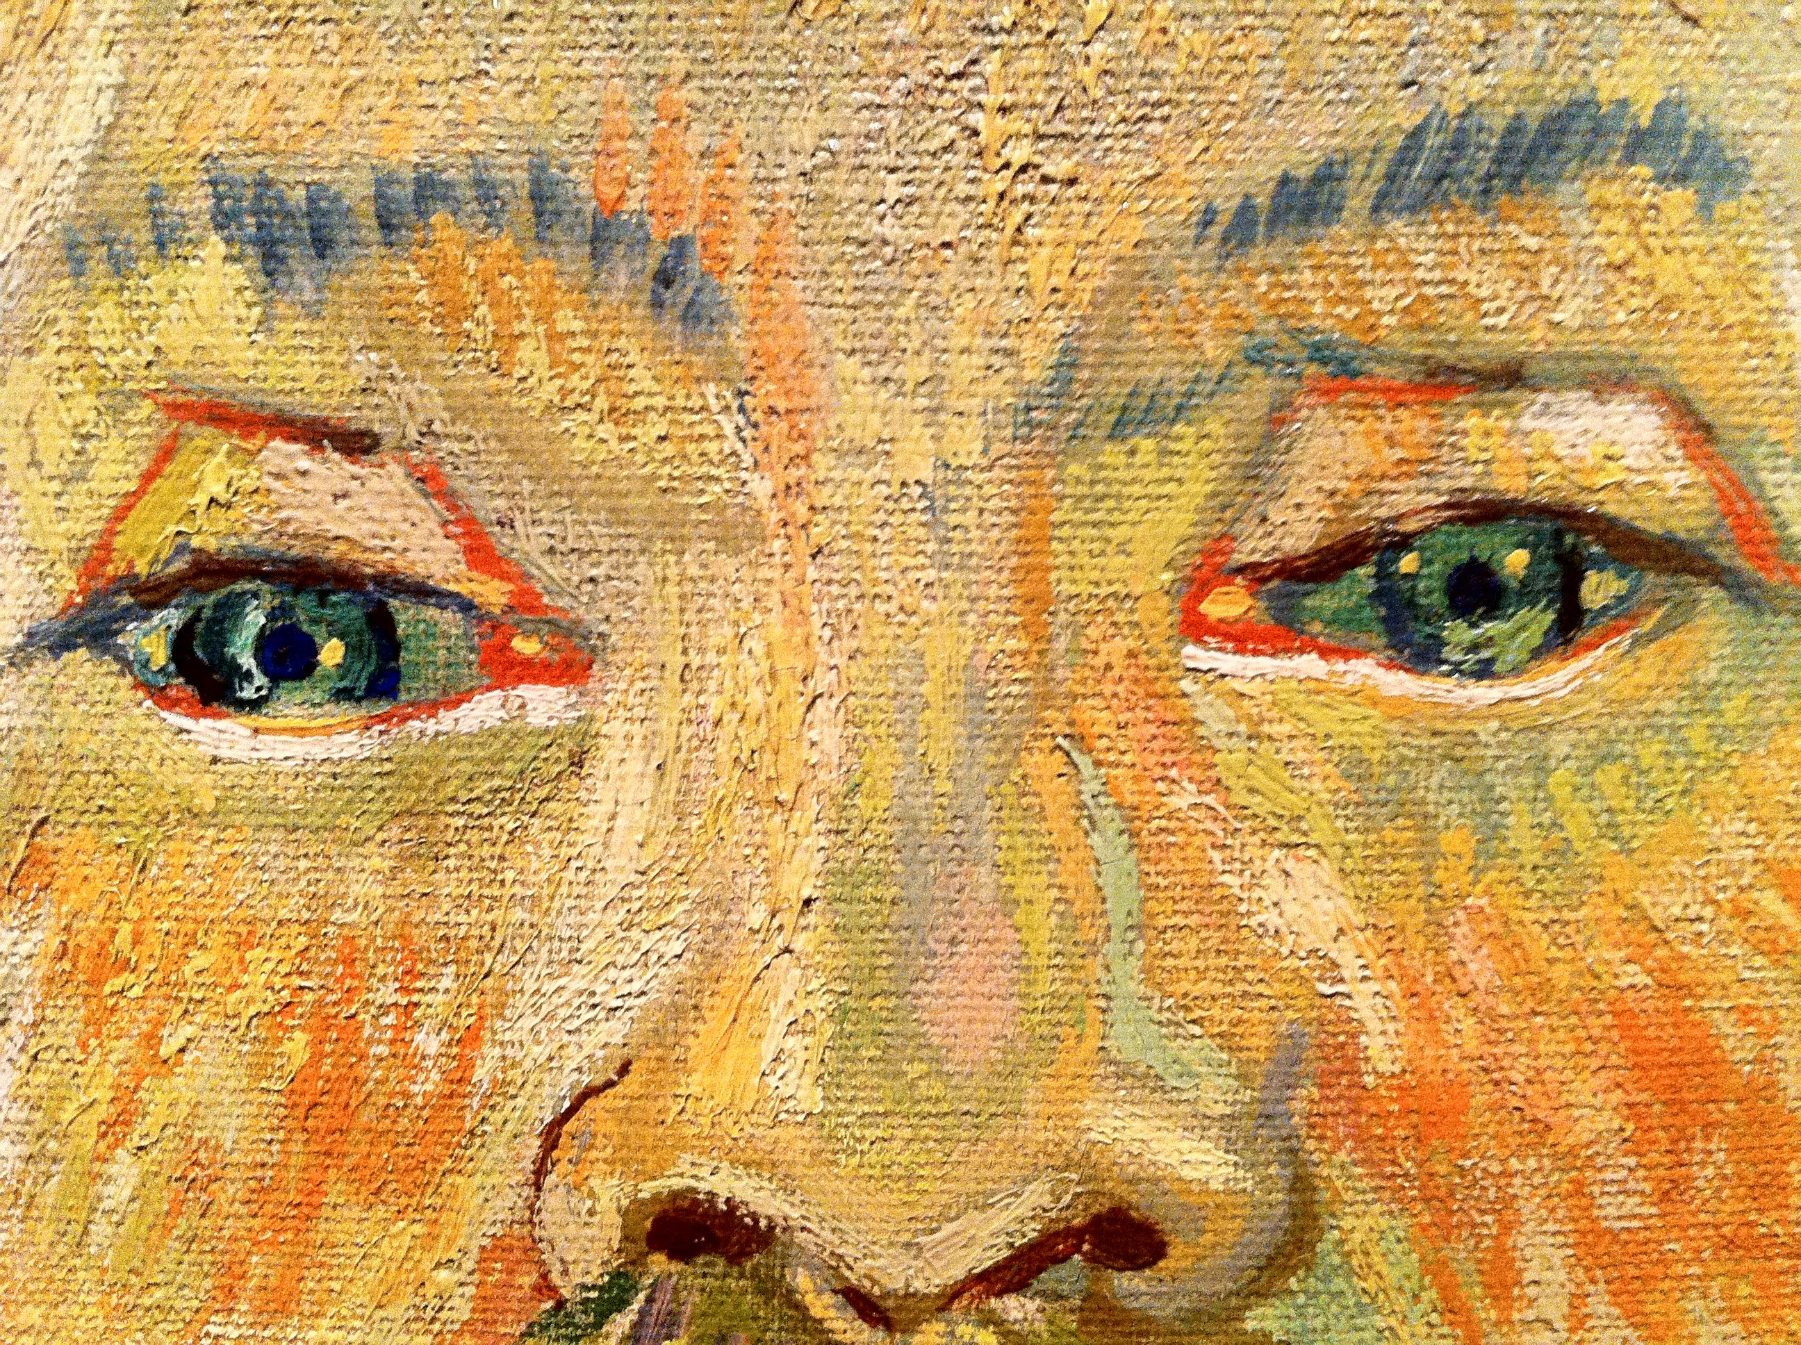

Slide 14
Copyright for “Van Gogh – Roulin Family” PP
1st Slide
Postman Joseph Roulin, 1888, oil on canvas, MFA, Boston https://commons.wikimedia.org/wiki/Category:Portraits_of_Joseph_Roulin
Public Domain
2nd Slide
Portrait of the Postman Joseph Roulin, early August, 1888, oil on canvas, Detroit Institute of Arts
Portrait of the Postman Joseph Roulin, April 1888, Kröller-Müller Museum, Otterlo, Netherlands https://commons.wikimedia.org/wiki/Category:Portraits_of_Joseph_Roulin
Public Domain
3rd Slide
Portrait of the Postman Joseph Roulin, 1889, oil on canvas, MOMA, NY
The Father or Portrait of the Postman Joseph Roulin, Nov–Dec 1888, oil on canvas, Kunstmuseum Winterthur, Switzerland https://commons.wikimedia.org/wiki/Category:Portraits_of_Joseph_Roulin
Public Domain
4th Slide
La Berceuse, Augustine Roulin, 1888-1889, oil on canvas, Kröller-Müller Museum, Otterlo, Netherlands
Portrait of Madame Augustine Roulin, 1888, Winterthur, Oskar Reinhart Collection 'Am Römerholz' https://commons.wikimedia.org/wiki/Category:Portraits_of_Augustine_Roulin
Public Domain
5th Slide
Mother Roulin with Her Baby, 1888, oil on canvas, the MET, NY
Mother Roulin with Her Baby, 1888, oil on canvas, The Philadelphia Museum of Art https://commons.wikimedia.org/wiki/Category:Portraits_of_Augustine_Roulin
Public Domain
6th Slide
Baby Marcelle Roulin, 1888, oil on canvas, private collection,
Baby Marcelle Roulin, 1888, oil on canvas, NGA, Washington, DC https://commons.wikimedia.org/wiki/Category:Portraits_of_Marcelle_Roulin
Public Domain
7th Slide
Portrait of Armand Roulin, 1888, oil on canvas, Museum Boijmans-van Beuningen, Rotterdan https://commons.wikimedia.org/wiki/Category:Portraits_of_Armand_Roulin
Public Domain
8th Slide
Portrait of Armand Roulin, 1888, oil on canvas, Museum Boijmans-van Beuningen, Rotterdan https://commons.wikimedia.org/wiki/Category:Portraits_of_Armand_Roulin
Public Domain
9th Slide
Portrait of Camille Roulin, 1888, oil on canvas, Museu de Arte de São Paulo, Brasil https://commons.wikimedia.org/wiki/Category:Portraits_of_Camille_Roulin
Public Domain
10th Slide
Portrait of Camille Roulin, 1888, oil on canvas, Van Gogh Museum, Amsterdam https://commons.wikimedia.org/wiki/Category:Portraits_of_Camille_Roulin
Public Domain

