Slide 1
?

Slide 2
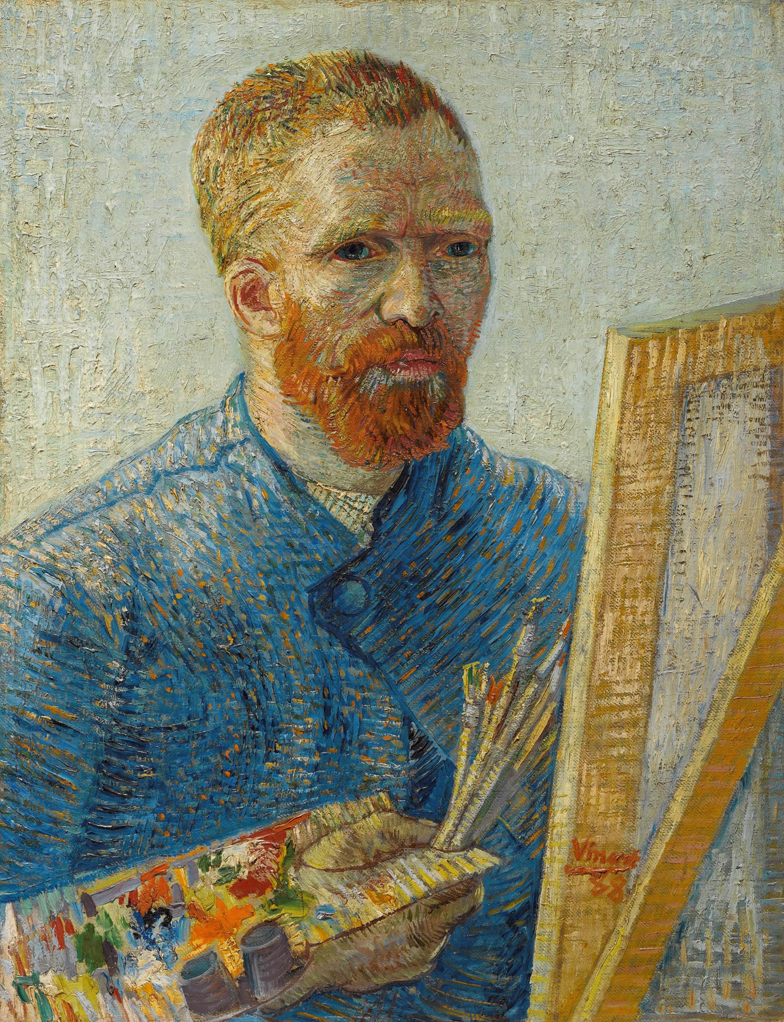
Do you know who this person is?
Can you Guess?
Is it:
Rembrandt van Rijn
Piet Mondrian
Vincent Van Gogh
Hans Brinker

Slide 3
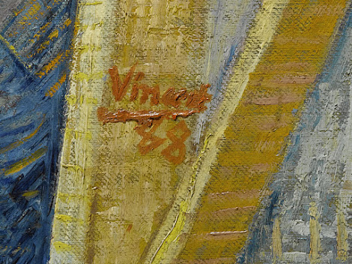
Look at the painting more closely.
Do you see at the painting any clues that tell us it was made by Vincent Van Gogh?

Slide 4
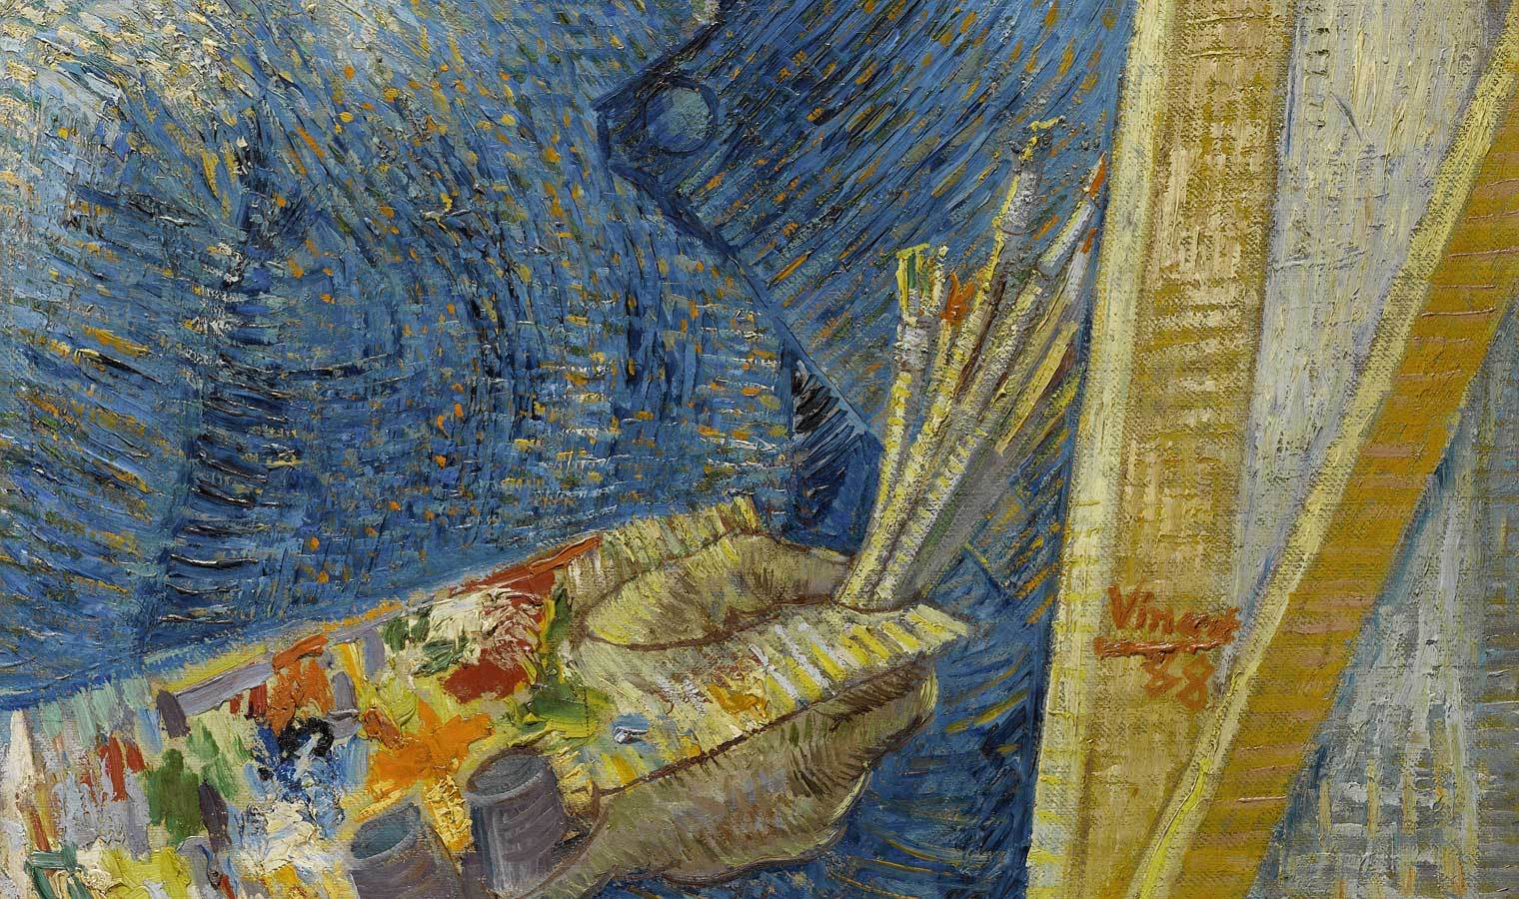
What painting material do you see?
What do you think he might be painting?

Slide 5
Use the “best” adjective that describes Van Gog’s brushwork: soft, nervous, smooth, flat, flowing

Slide 6
Identify the colours the artist used

Slide 7
Vincent Van Gogh, 1853 – 1890
Self-Portrait, Paris, December 1887-February 1888, oil on canvas, 65.1 cm x 50 cm, Van Gogh Museum, Amsterdam

Slide 8
Vincent Van Gogh
https://commons.wikimedia.org/wiki/Vincent_van_Gogh#/media/File:Zelfportret_als_schilder_-_s0022V1962_-_Van_Gogh_Museum.jpg
Public Domain

