Slide 1
Vincent Van Gogh

Slide 2
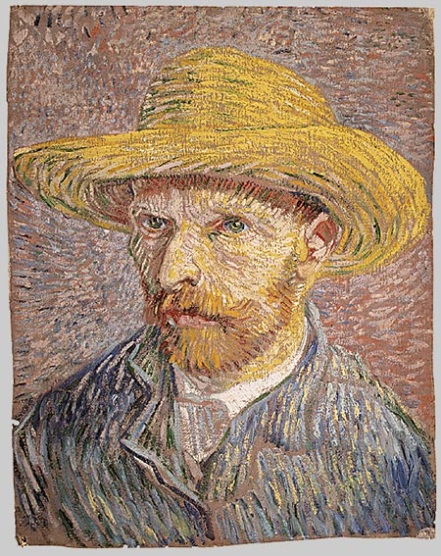
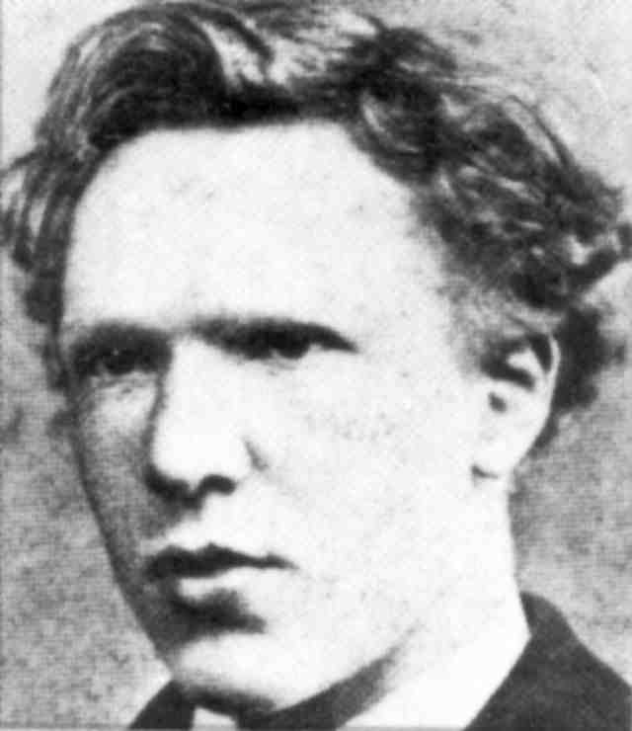
Slide 1:Vincent Willem van Gogh, 1853-1890
Self-Portrait with Straw Hat, Paris, Winter 1887/88, oil on canvas, 40.6 x 31.8 cm, Metropolitan Museum of Art, NY

Slide 3
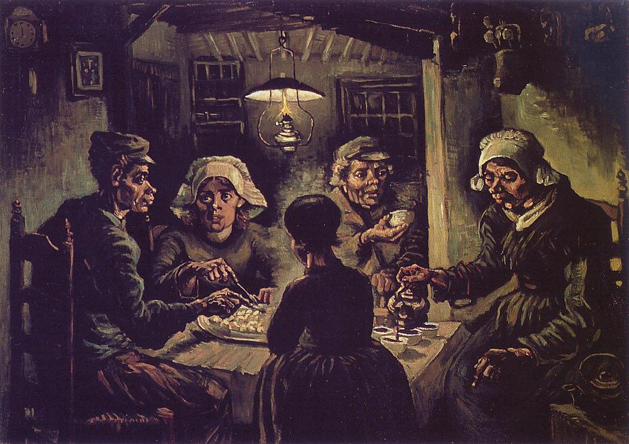
Slide 2: The Potato Eaters, 1885, oil on canvas, 82 cm x 114 cm, Van Gogh Museum, Amsterdam

Slide 4
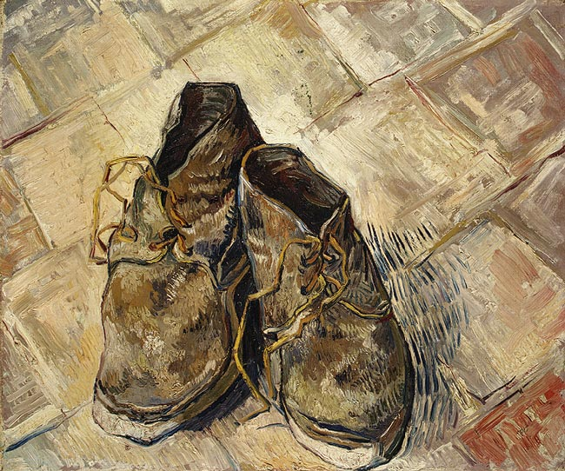
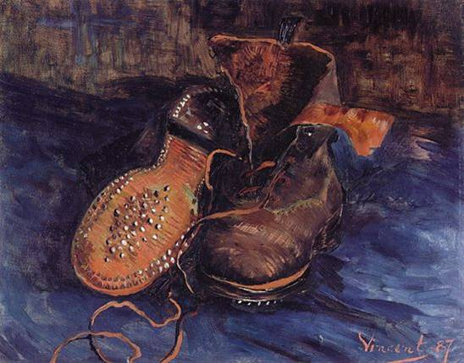
Slide 3:
A Pair of Shoes, 1887, oil on canvas, 73 × 45.1 cm, the Baltimore Museum of Art
A Pair of Shoes, 1888, oil on canvas, 44 x 53 cm, the MET, NY

Slide 5
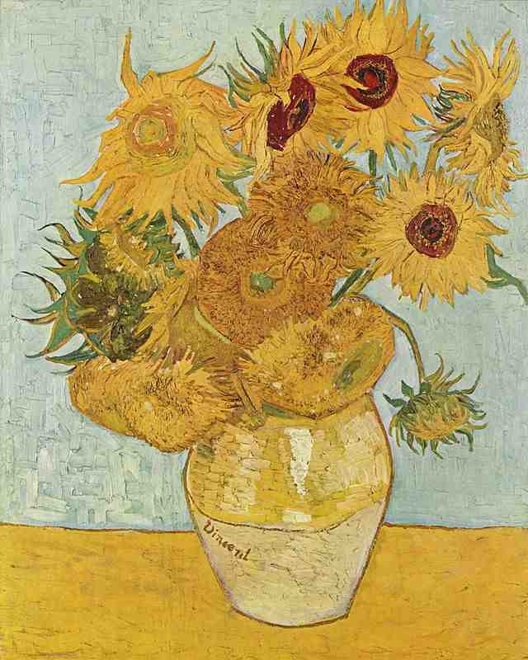
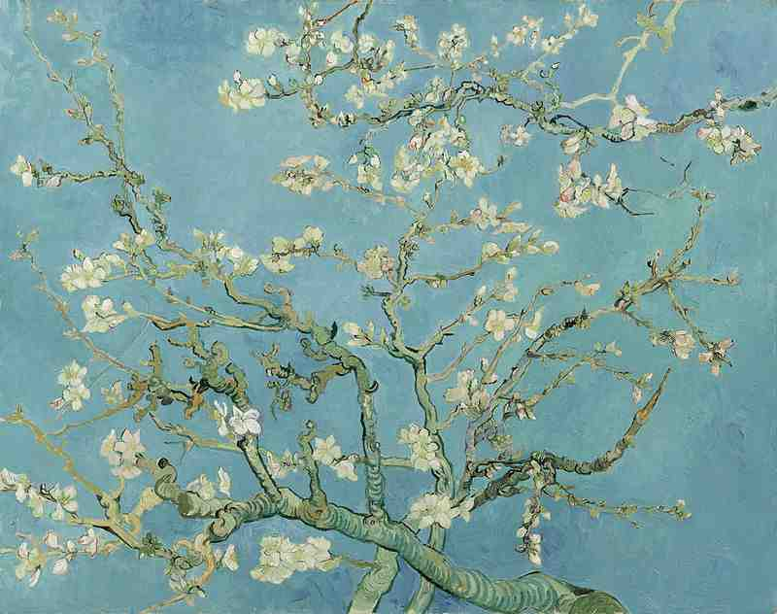
Still Life: Vase with Twelve Sunflowers, August 1888, oil on canvas, 91.0 x 72.0 cm, Neue Pinakothek, Munich
Almond Blossoms , 1890, oil on canvas, 73.3 cm x 92.4 cm, Van Gogh Museum, Amsterdam

Slide 6
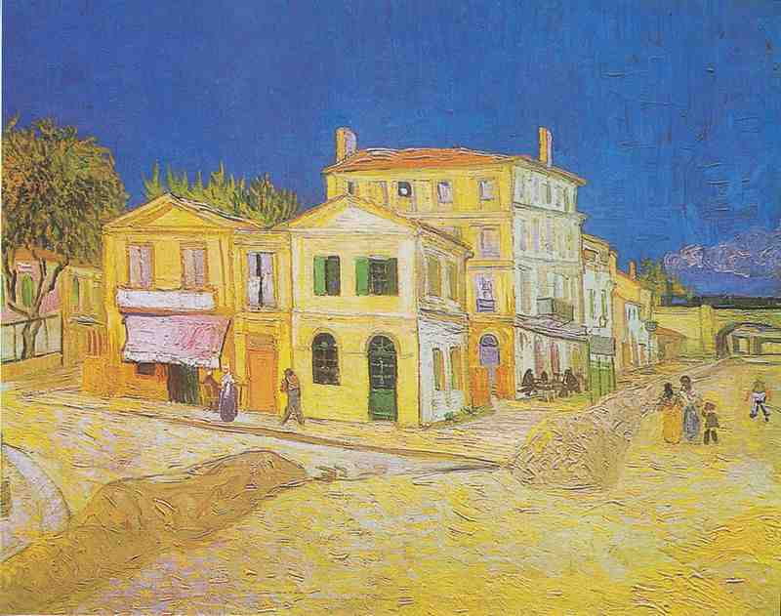
The Yellow House, 1888, oil on canvas, 72 cm x 91.5 cm, Van Gogh Museum, Amsterdam

Slide 7
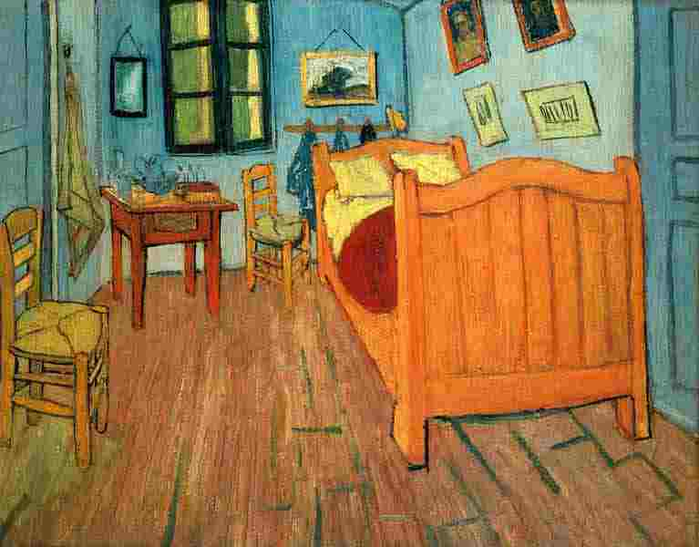
Bedroom in Arles, 1888, oil on canvas, 72.4 cm x 91.3 cm, Van Gogh Museum, Amsterdam

Slide 8
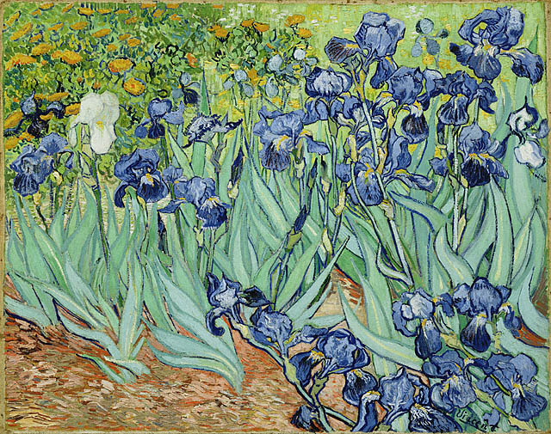
Irises, 1889, oil on canvas, 74.3 × 94.3 cm, Getty Museum, Los Angeles

Slide 9
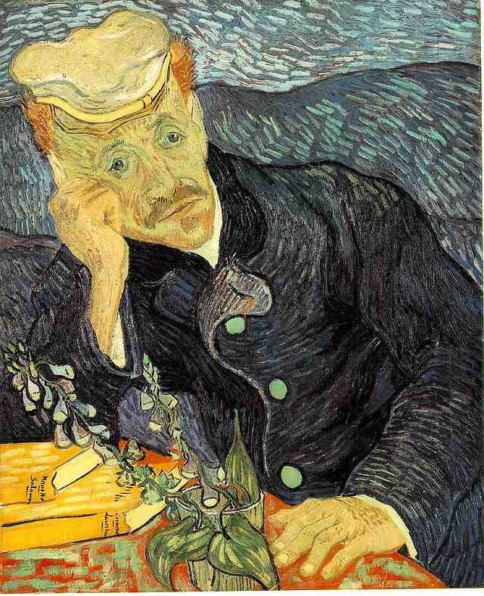
Portrait of Dr. Gachet, 1890 (oil on canvas, 67 cm × 56 cm) was sold for US$ 82.5 million in 1990 to a private collector

Slide 10
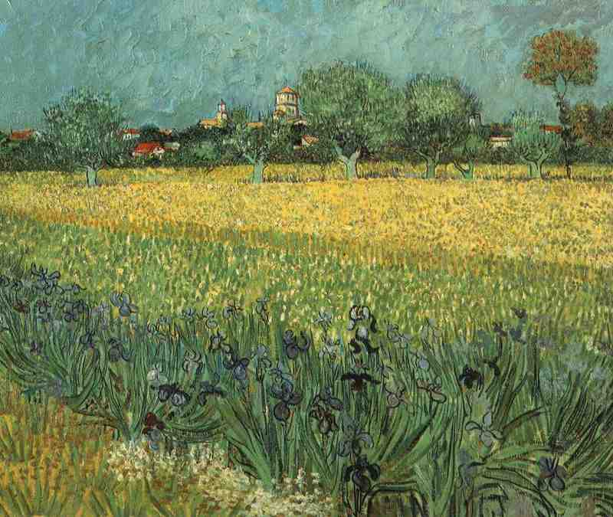
View of Arles with Irises, 1888, oil on canvas, 54 cm x 65 cm, Van Gogh Museum, Amsterdam

Slide 11
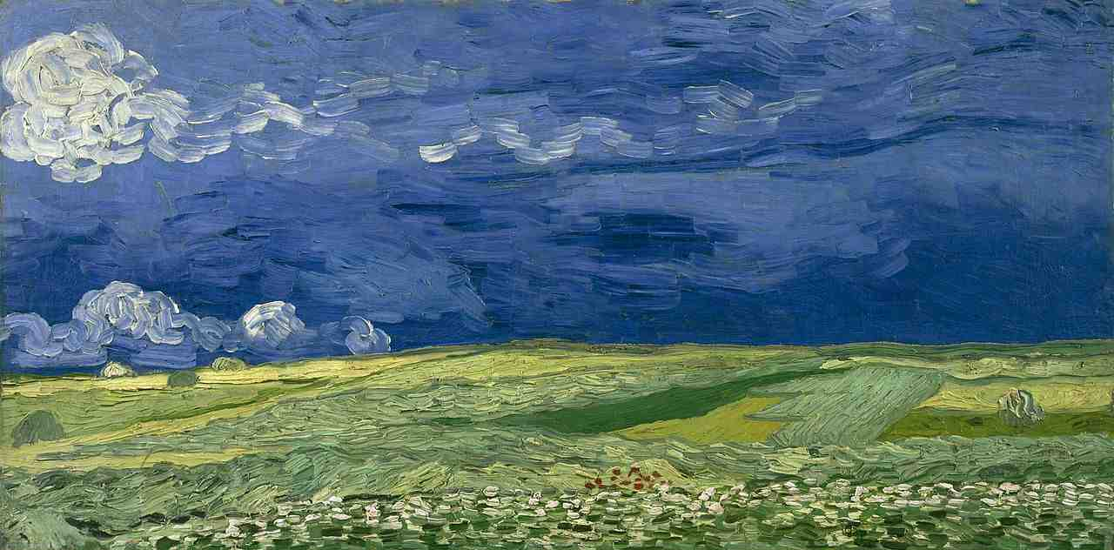
Wheatfield Under Thunderclouds, July 1890, oil on canvas, 50.4 cm x 101.3 cm Van Gogh Museum, Amsterdam

Slide 12
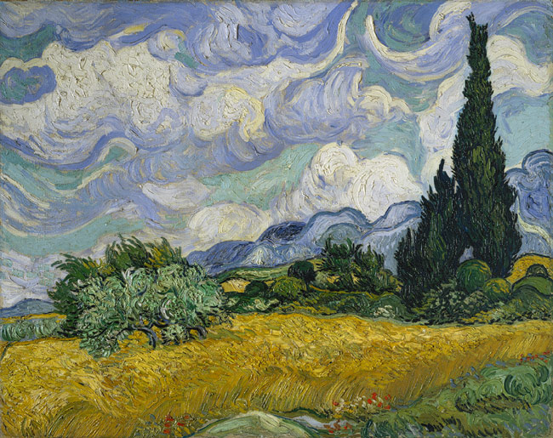
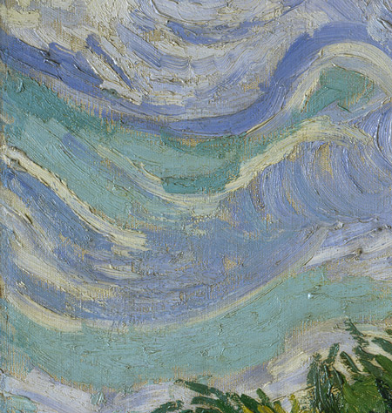
Wheat Field with Cypresses, 1889, oil on canvas, 72.1 × 90.9 cm, National Gallery, London

Slide 13
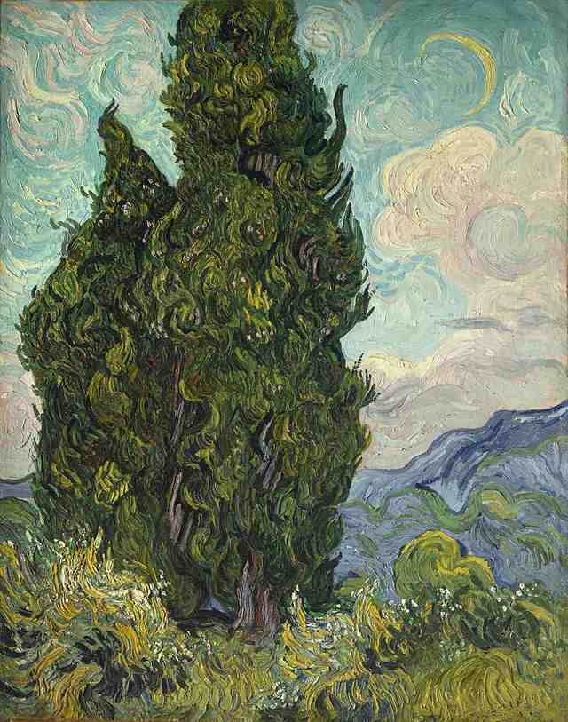
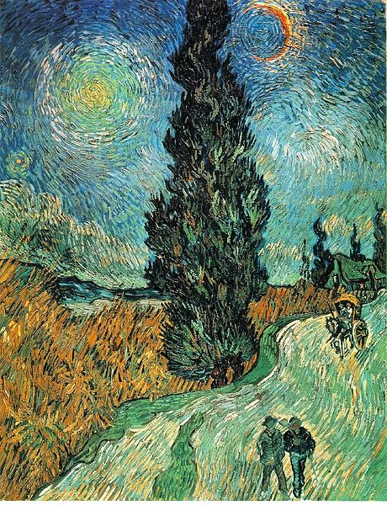
Cypresses, 1889, oil on canvas, 93.4 x 74 cm, the MET, NY
Road with Cypress and Star, May 1890,oil on canvas,
92.0x73.0 cm, Kröller-Müller Museum

Slide 14
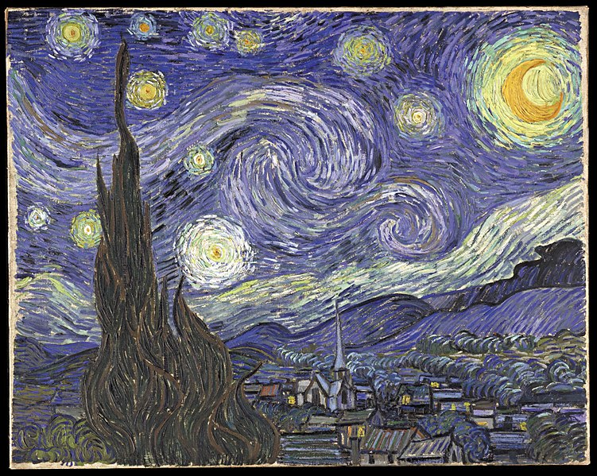
The Starry Night, June 1889, oil on canvas, 73.7 x 92.1 cm, MOMA, New York

Slide 15
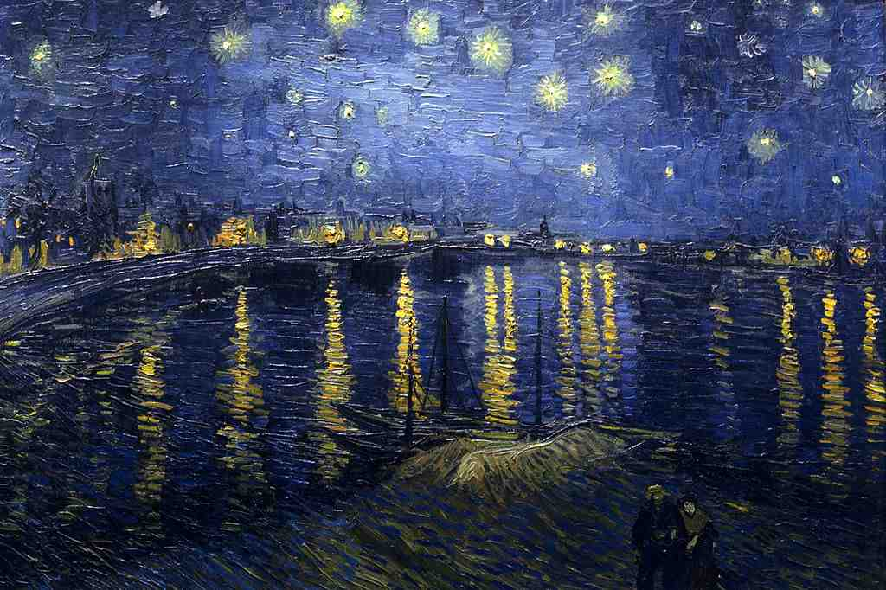
Starry Night Over the Rhone, 1888, oil on canvas, 73,0x92,0 cm, Musée d'Orsay, Paris

Slide 16
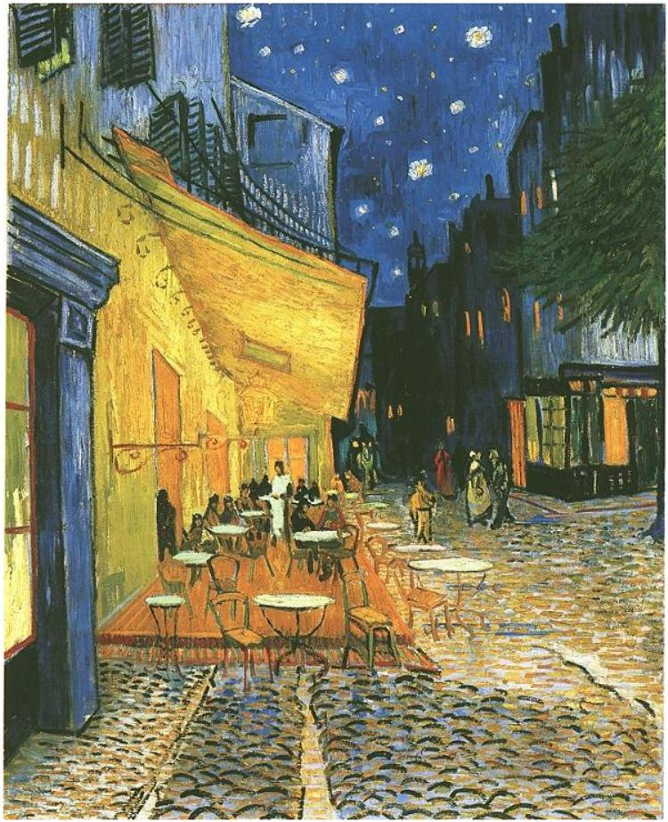
The Café Terrace on the Place du Forum, Arles, at Night, September 1888, oil on canvas, 81.0 x 65.5 cm, Kröller-Müller Museum,Otterlo, The Netherlands

Slide 17
Copyrights for “Van Gogh” PP
1st Slide
Self-Portrait with Straw Hat, Paris, Winter 1887/88, oil on canvas, 40.6 x 31.8 cm, Metropolitan Museum of Art, NY https://www.metmuseum.org/art/collection/search/436532
Public Domain
2nd Slide and 3rd Slides
The Potato Eaters, 1885, oil on canvas, 82 cm x 114 cm, Van Gogh Museum, Amsterdam https://commons.wikimedia.org/wiki/File:Vincent_van_Gogh_-_The_potato_eaters_-_Google_Art_Project_(5776925).jpg
Public Domain
3rd Slide
A Pair of Shoes, 1887, oil on canvas, 73 × 45.1 cm, the Baltimore Museum of Art
A Pair of Shoes, 1888, oil on canvas, 44 x 53 cm, the MET, NY https://commons.wikimedia.org/wiki/File:Vincent_van_Gogh_-_A_Pair_of_Boots,_1887_(Baltimore_Museum_of_Art).jpg https://www.metmuseum.org/art/collection/search/436533
Public Domain
4th Slide
Still Life: Vase with Twelve Sunflowers, August 1888, oil on canvas, 91.0 x 72.0 cm, Neue Pinakothek, Munich
Almond Blossoms , 1890, oil on canvas, 73.3 cm x 92.4 cm, Van Gogh Museum, Amsterdam https://commons.wikimedia.org/wiki/File:Van_Gogh_Sunflowers_Neue_Pinakothek_8672.jpg https://commons.wikimedia.org/wiki/File:Van_Gogh_Almond_blossom.jpg
Public Domain
5th Slide
The Yellow House, 1888, oil on canvas, 72 cm x 91.5 cm, Van Gogh Museum, Amsterdam https://commons.wikimedia.org/wiki/Category:The_Yellow_House_(Van_Gogh_painting)#/media/File:Vincent_van_Gogh_-_The_yellow_house_(%60The_street%27)_-_Google_Art_Project.jpg
Public Domain
6th Slide
Bedroom in Arles, 1888, oil on canvas, 72.4 cm x 91.3 cm, Van Gogh Museum, Amsterdam https://commons.wikimedia.org/wiki/File:VanGogh_Bedroom_Arles.jpg
Public Domain
7th Slide
Irises, 1889, oil on canvas, 74.3 × 94.3 cm, Getty Museum, Los Angeles https://commons.wikimedia.org/wiki/Category:Irises_by_Vincent_van_Gogh_(Saint-R%C3%A9my,_1889)#/media/File:Irises-Vincent_van_Gogh.jpg
Public Domain
8th Slide
Portrait of Dr. Gachet, 1890 (oil on canvas, 67 cm × 56 cm) was sold for US$ 82.5 million in 1990 to a private collector https://commons.wikimedia.org/wiki/File:Portrait_of_Dr._Gachet.jpg
Public Domain

Slide 18
9th Slide
View of Arles with Irises, 1888, oil on canvas, 54 cm x 65 cm, Van Gogh Museum, Amsterdam https://commons.wikimedia.org/wiki/File:VanGogh-View_of_Arles_with_Irises.jpg
Public Domain
10th Slide
Wheatfield Under Thunderclouds, July 1890, oil on canvas, 50.4 cm x 101.3 cm Van Gogh Museum, Amsterdam https://commons.wikimedia.org/wiki/File:Vincent_van_Gogh_-_Wheatfield_under_thunderclouds_-_Google_Art_Project.jpg
Public Domain
11th Slide
Wheat Field with Cypresses, 1889, oil on canvas, 72.1 × 90.9 cm, National Gallery, London https://commons.wikimedia.org/wiki/File:Vincent_van_Gogh_-_Wheat_Field_with_Cypresses_-_Google_Art_Project.jpg
Public Domain
12th Slide
Cypresses, 1889, oil on canvas, 93.4 x 74 cm, the MET, NY
Road with Cypress and Star, May 1890,oil on canvas, 92.0x73.0 cm, Kröller-Müller Museum https://commons.wikimedia.org/wiki/File:Vincent_van_Gogh_Cypresses.jpg https://commons.wikimedia.org/wiki/File:Vincent_van_Gogh_-_Road_with_Cypress_and_Star.JPG
Public Domain
13th Slide
The Starry Night, June 1889, oil on canvas, 73.7 x 92.1 cm, MOMA, New York https://commons.wikimedia.org/wiki/File:VanGogh-starry_night.jpg
Public Domain
14th Slide
Starry Night Over the Rhone, 1888, oil on canvas, 73,0x92,0 cm, Musée d'Orsay, Paris https://commons.wikimedia.org/wiki/File:Starry_Night_Over_the_Rhone.jpg
Public Domain
15th Slide
The Café Terrace on the Place du Forum, Arles, at Night, September 1888, oil on canvas, 81.0 x 65.5 cm, Kröller-Müller Museum,Otterlo, The Netherlands https://commons.wikimedia.org/wiki/Category:Cafe_Terrace_at_Night_(F467)#/media/File:Gogh4.jpg
Public Domain

