Slide 1
Heracles
The Lion of Nemea

Slide 2
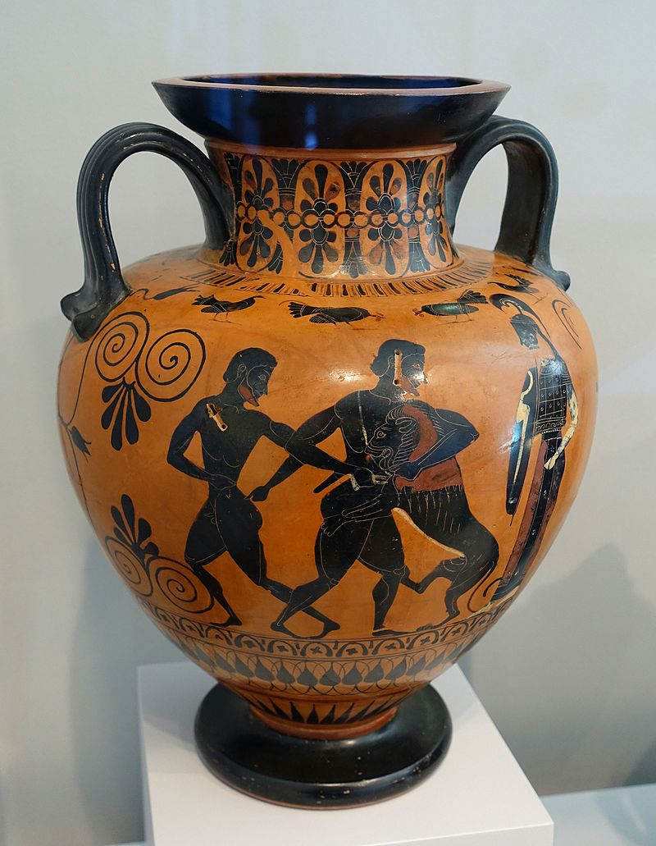
1st Slide: The Lion of Nemea was a large beast, whose hide, unaffected to weapons, plagued the district of Nemea in the Argolis area of Greece. This is the 1st of the 12 Labours, Heracles was commanded to accomplish by King Eurystheas. The fight between Heracles and the Lion was epic. At the end, Heracles managed to trap the lion in its cave and grabbing it by the neck, wrestled it to death. He then skinned its hide to make a lion-skin cape, one of his most distinctive attributes. Today, the Lion of Nemea is remembered as the constellation Leo.
Heracles and the Nemean Lion, neck amphora, 540-530 BC, terracotta, black-figure technique, Arthur M. Sackler Museum, Harvard University

Slide 3
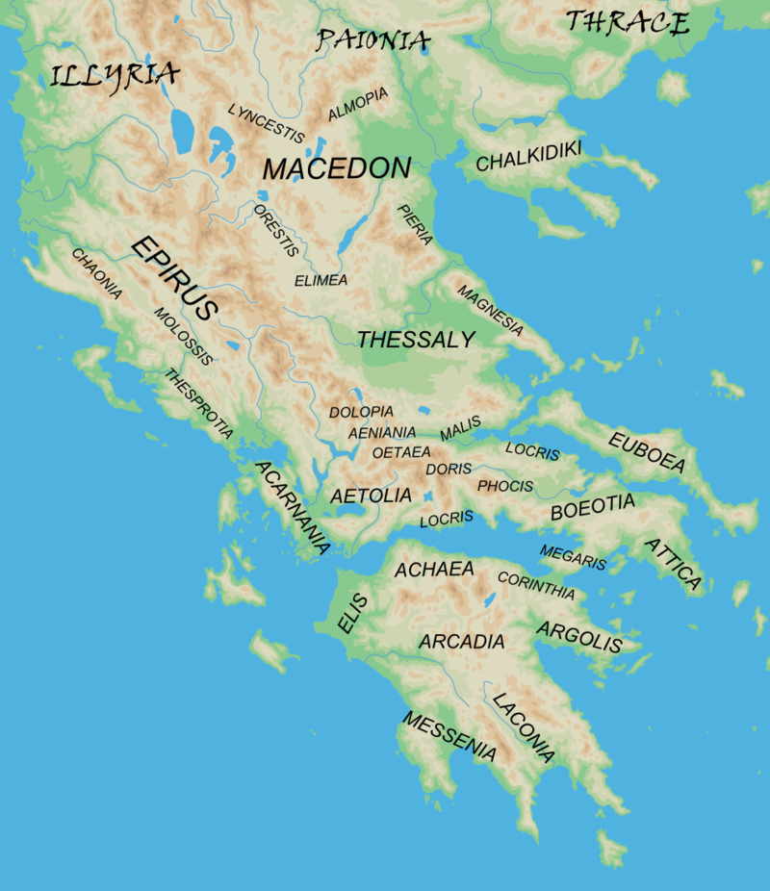

2nd Slide: Locations across Greece that Heracles visited during his Adventures and a Map of the World

Slide 4
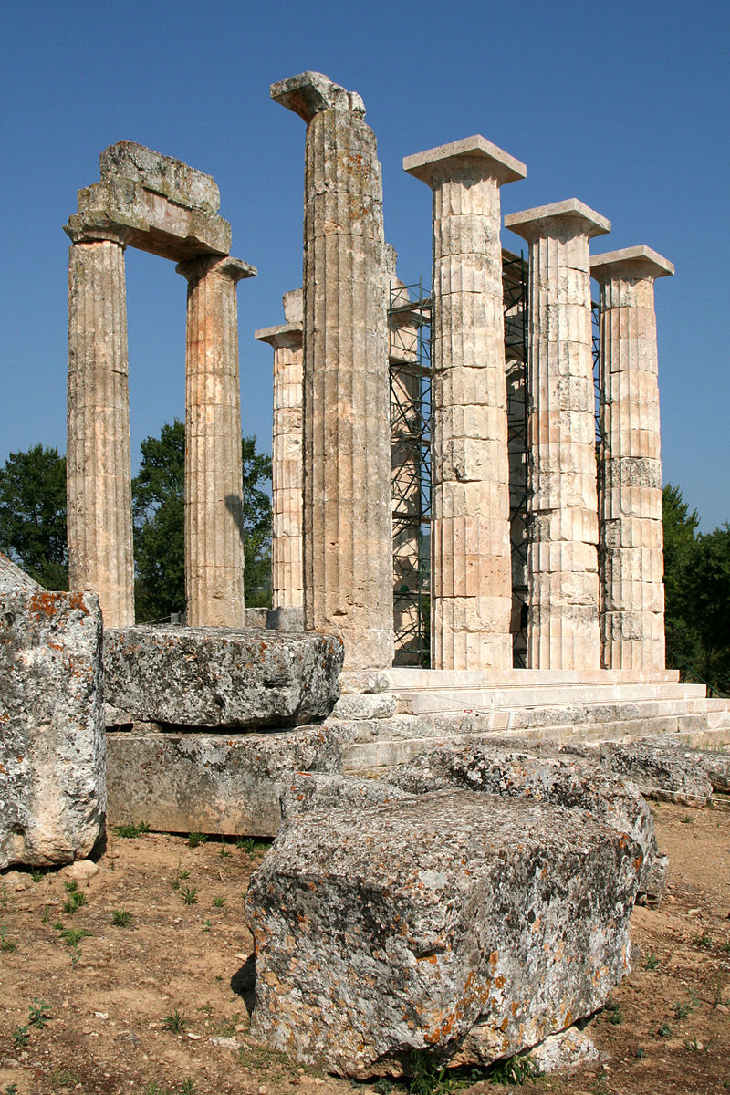
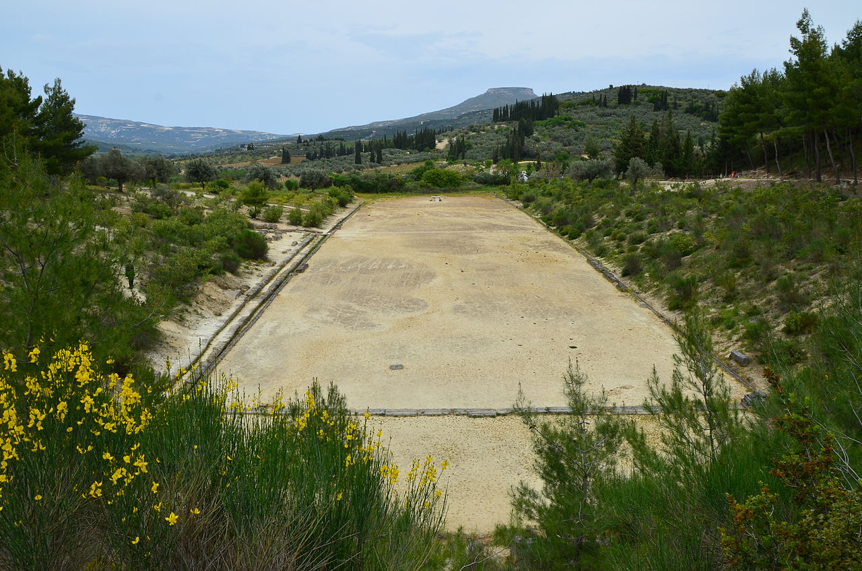
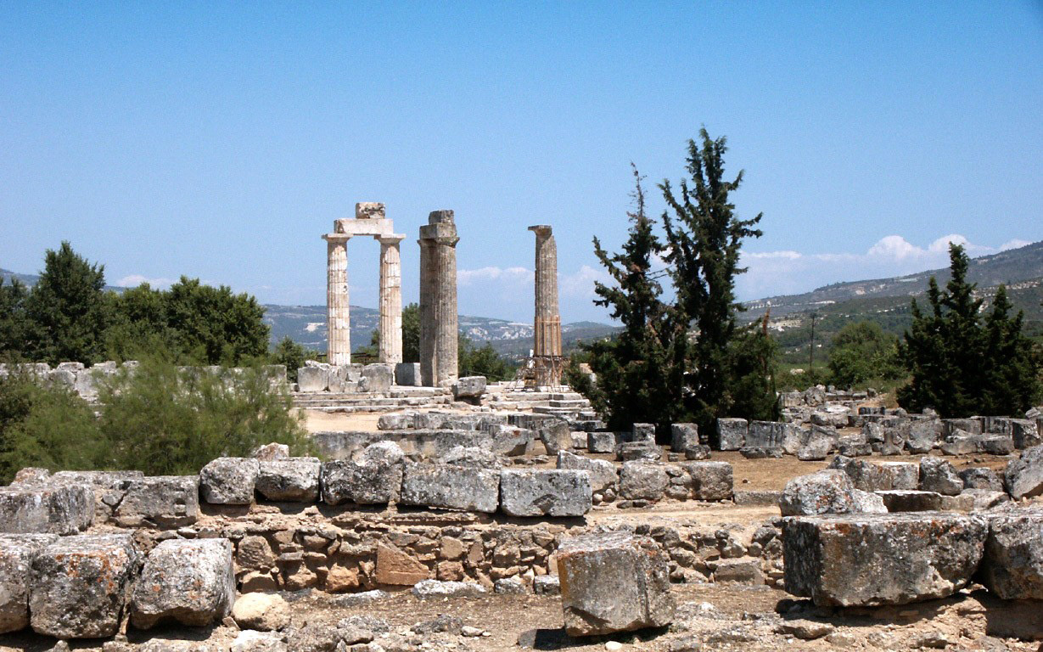
3rd Slide: The Archaeological Site of Nemea

Slide 5
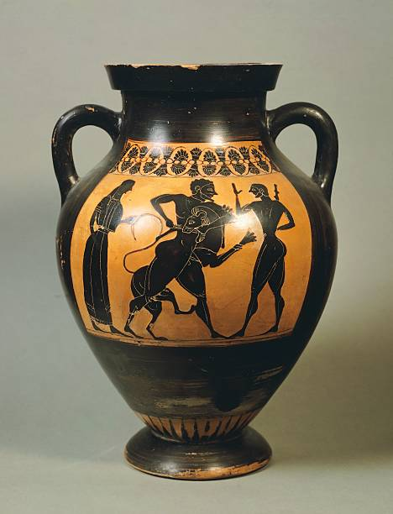
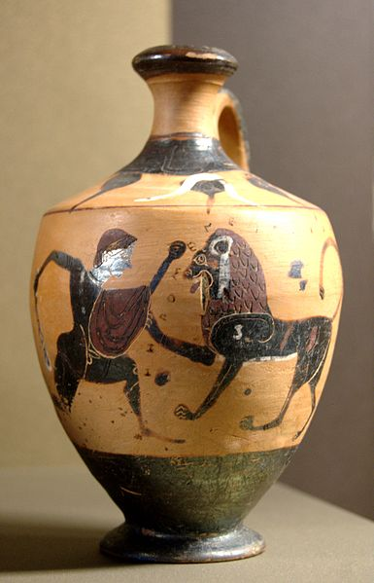
4th Slide: Attic amphora showing Heracles and the lion of Nemea, 6th Century BC , black-figure pottery, Portland Museum
Lekythos showing Hercles and the Lion of Nemea, c.540 BC , black-figure Boetian pottery, the Louvre, Paris, France

Slide 6
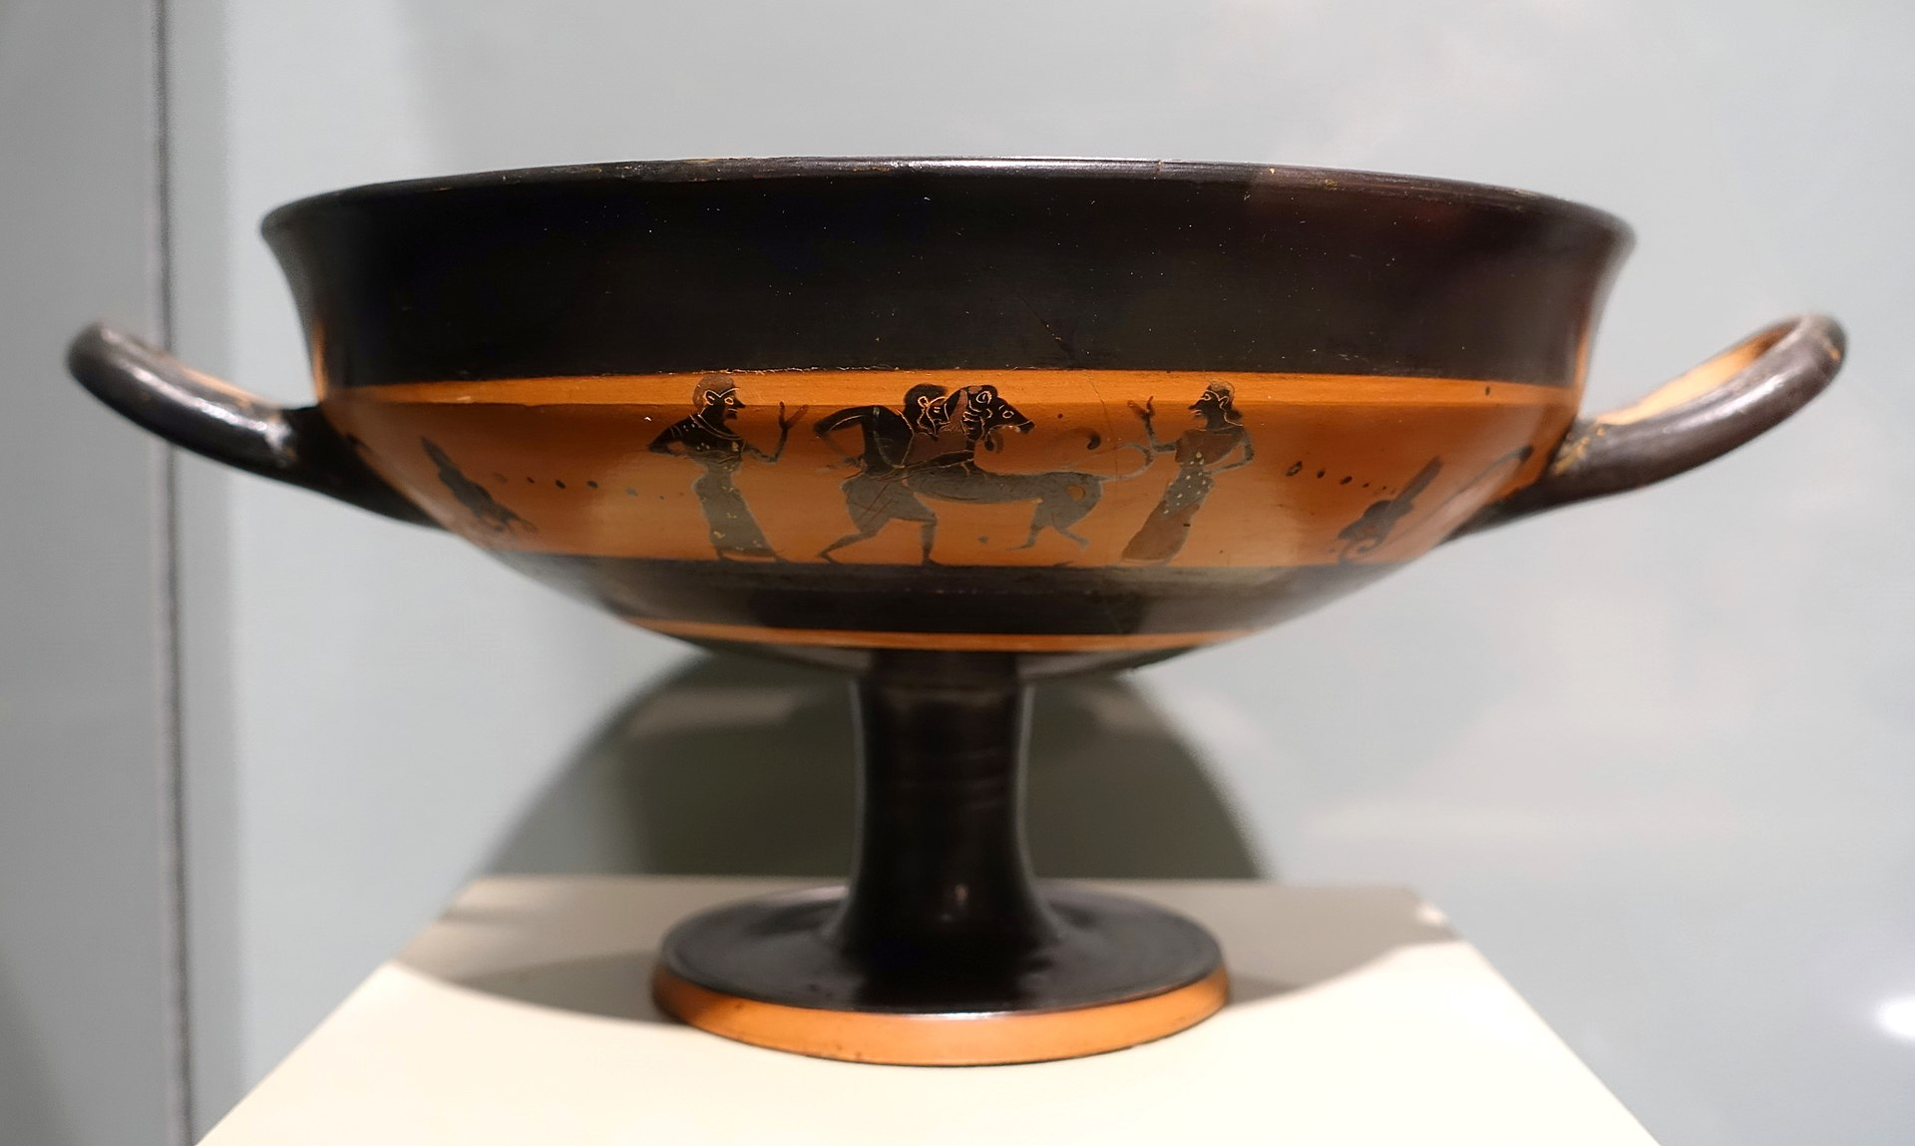
"I seized him by the scruff of his iron neck, having thrown my bow to the ground with my broidered quiver. Then I throttled him mightily with my stout hands, reaching round from behind lest he lacerate my flesh with his claws." - Theocritus, Idylls 25.150
5th Slide: Kylix cup with Heracles and the Nemean Lion, c. 560-530 BC, by the Little Masters, Attic black-figure vase, Middlebury College Museum of Art, Middlebury, VT, USA

Slide 7
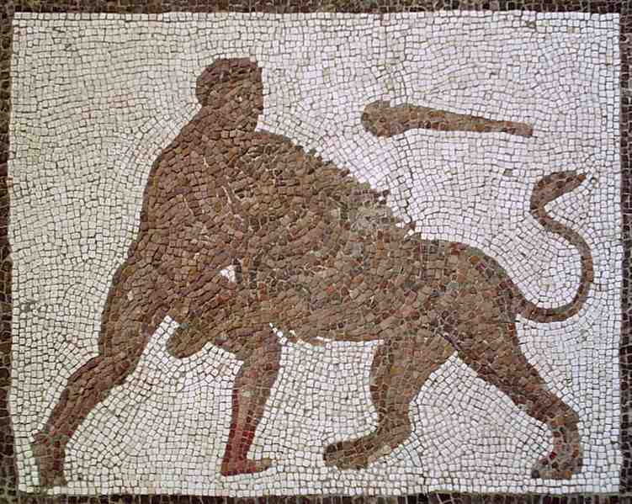
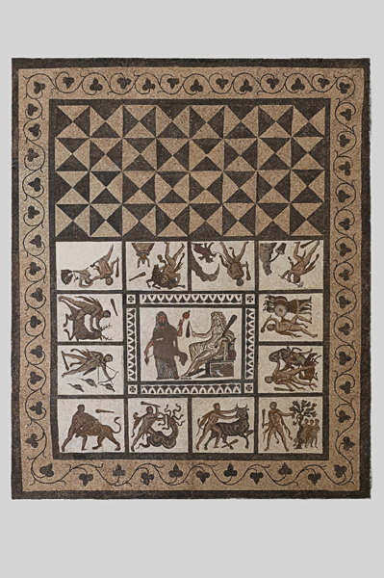
6th Slide: Heracles fighting the Nemean Lion. Detail of The Twelve Labours Roman mosaic from Llíria, Valencia, Spain, between 201 and 250 AD, National Archaeological Museum of Spain

Slide 8
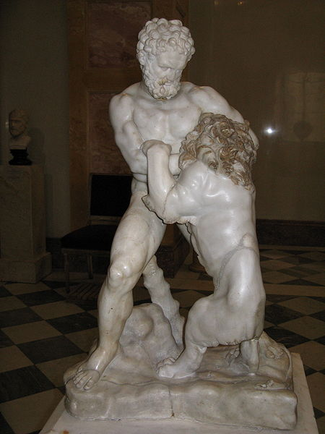
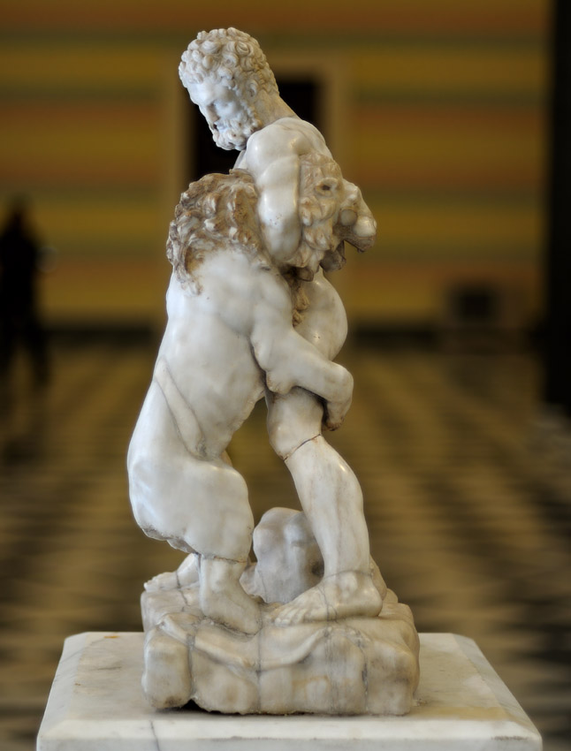
7th Slide: Roman copy of Heracles and the Lion of Nemea, a 1st to 2nd century Roman copy ofan original 4th century BC statue by Lysippus, Hermitage Museum, St. Petersburg

Slide 9
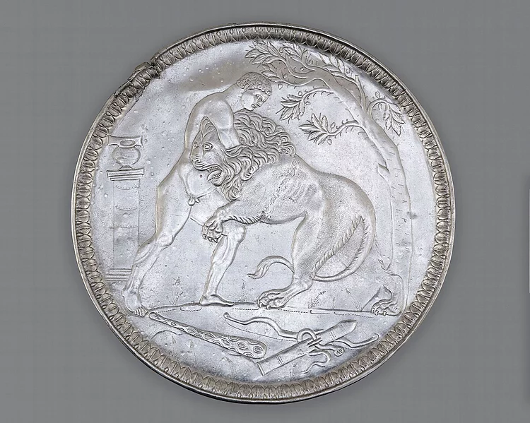
8th Slide: Heracles and the Lion of Nemea, 6thcentury Byzantine silver plate, 60 cm in diameter, National Library of France

Slide 10
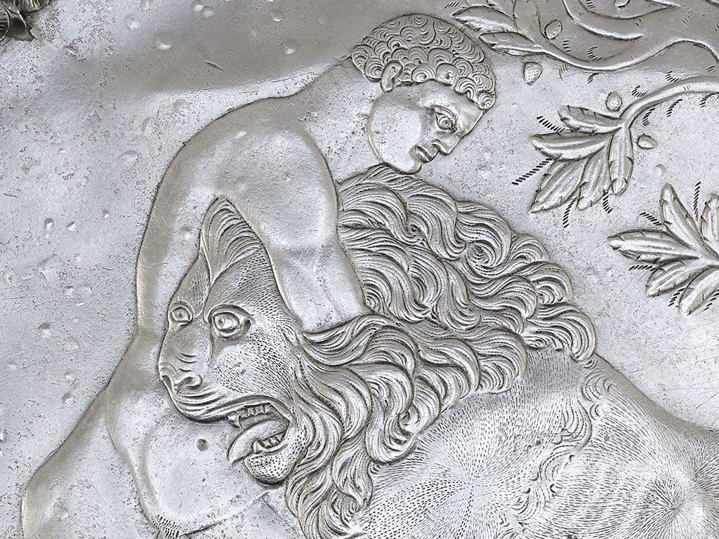

Slide 11
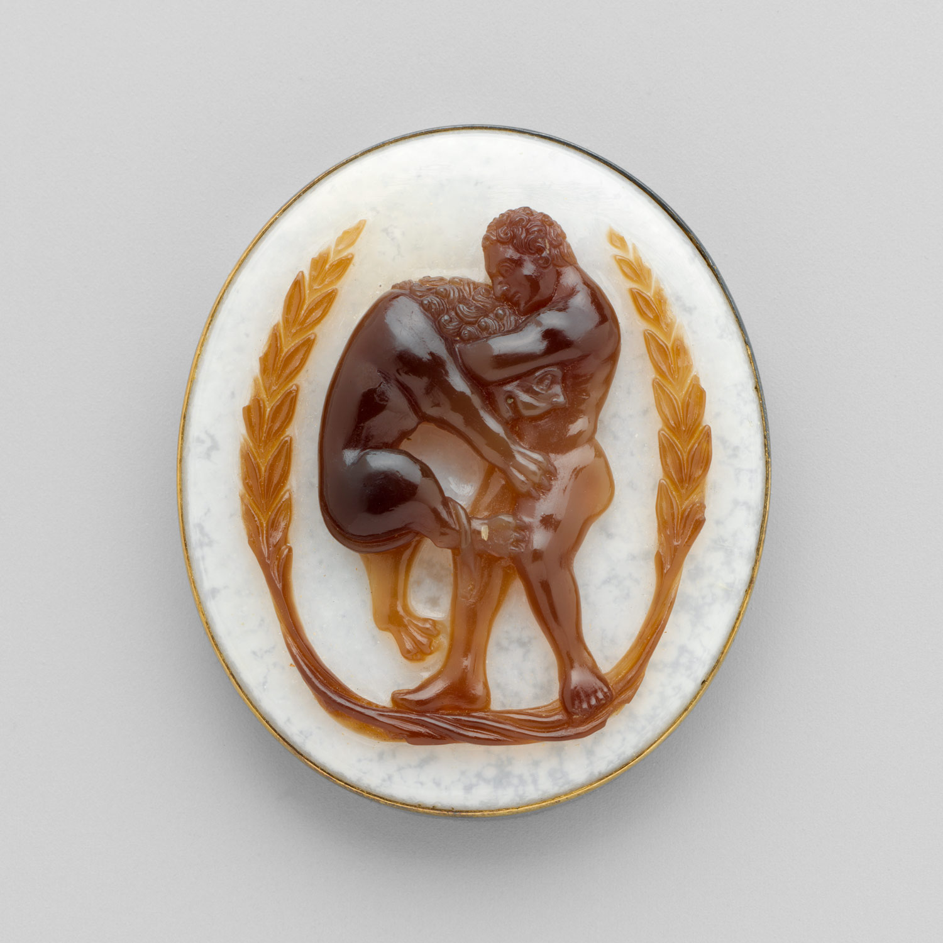
10th Slide: Cameo with Heracles and the Nemean Lion within a Garland, Date: ca. 1220–40, South Italian, Sardonyx with modern gold frame, 4.2 x 3.6 x 0.8cm, the MET, NY

Slide 12
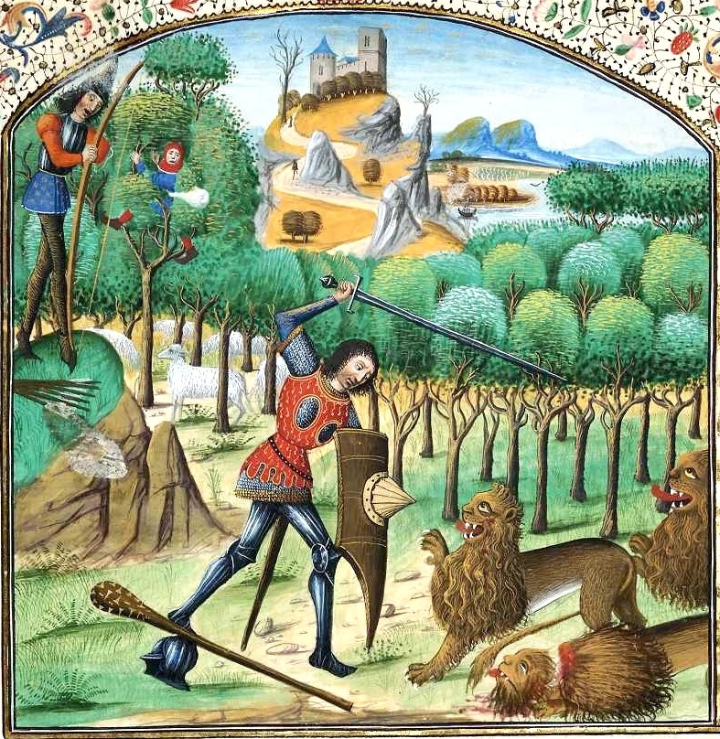
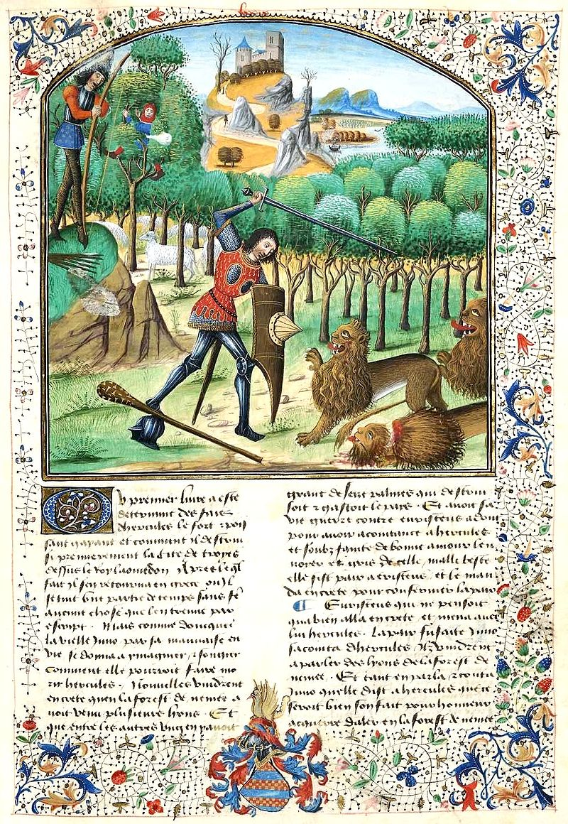
11th Slide: Heracles and the Lion of Nemea, 1470-80, Manuscript Illumination in Raoul Lefèvre’s book « History of Troy », paper and parchement, Royal Library of Belgium

Slide 13
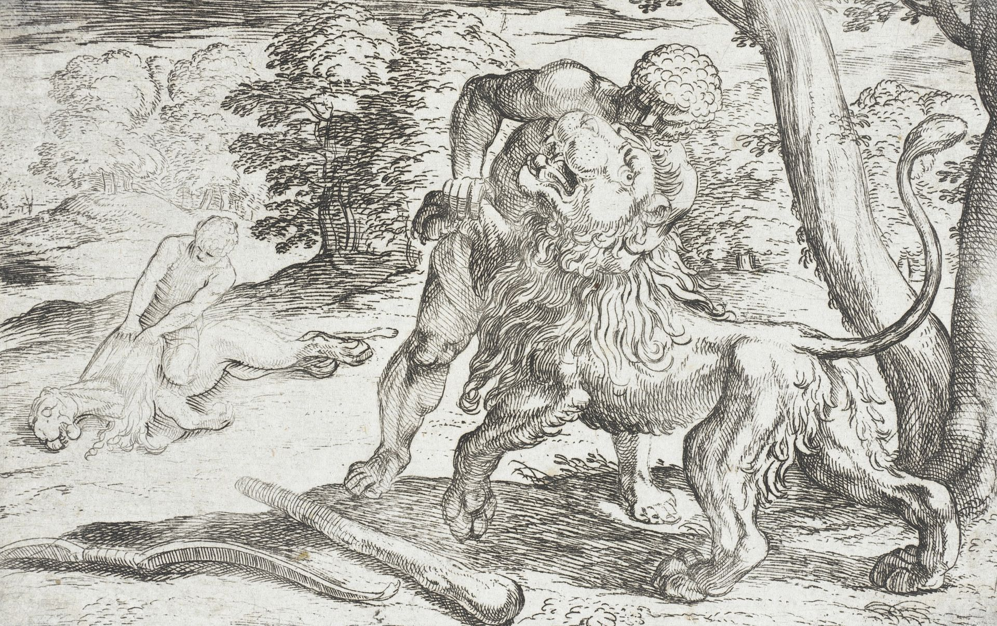
12th Slide: Antonio Tempesta, Italian,1555-1630 and Nicolo Van Aelst, Flemish, 1527-1612
Heracles and the Lion of Nemea, c. 1608, print, LACMA, CA, USA

Slide 14
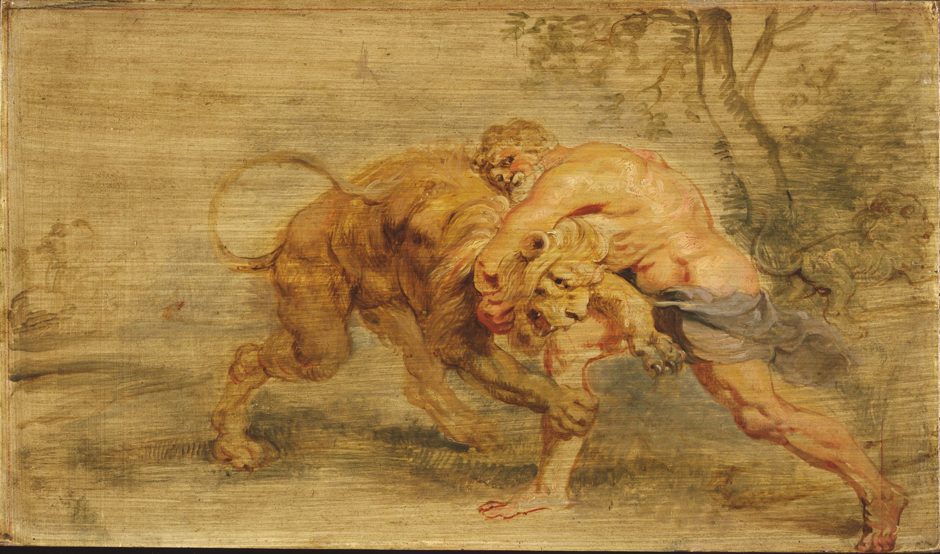
13th Slide: Peter Paul Rubens, 1577 - 1640
Heracles Strangling the Nemean Lion, 1639, Oil on cradled panel, with traces of red chalk, Harvard Art Museums/Busch-Reisinger Museum
https://www.nytimes.com/2019/04/15/world/europe/notre-dame-cathedral-facts.html

Slide 15
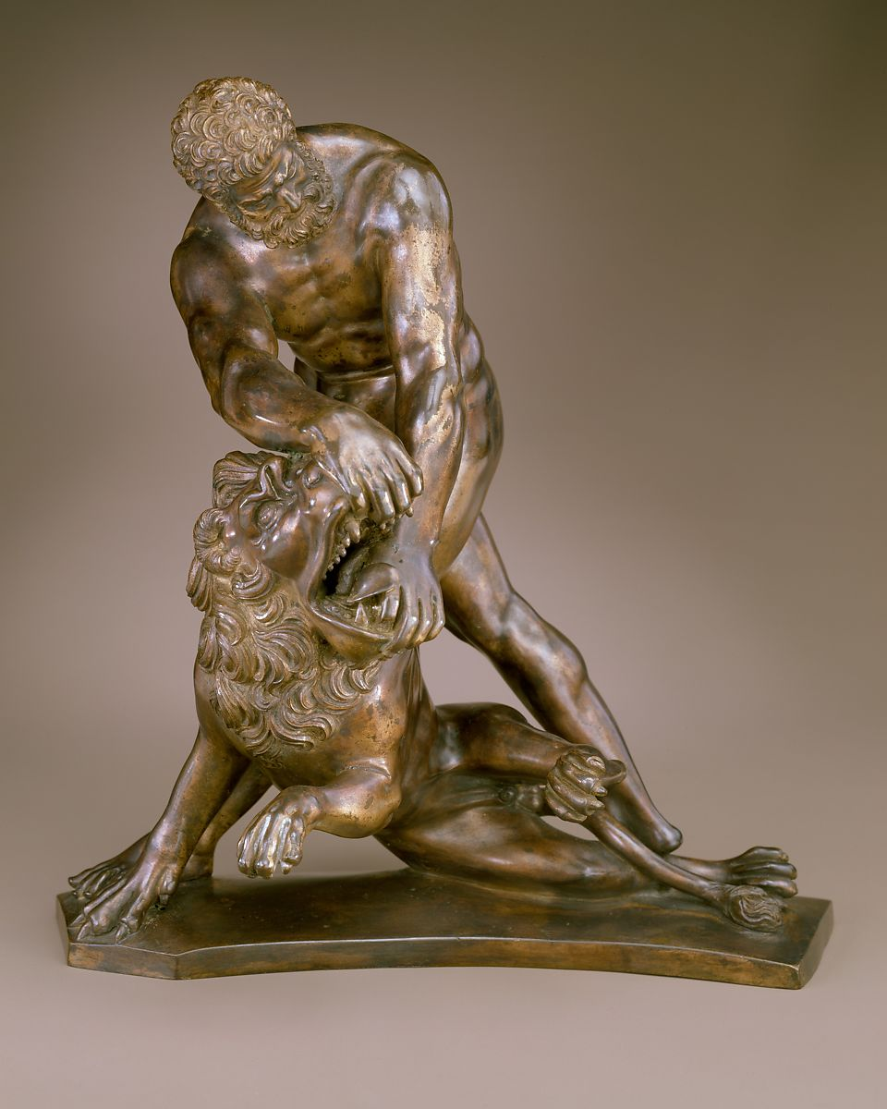
14th Slide: Heracles and the Lion of Nemea, early 17th century, possibly French, Bronze, with etched golden-brown surface, oxidized dark brown where rubbed, Height: 24.4 cm, the MET, NY

Slide 16
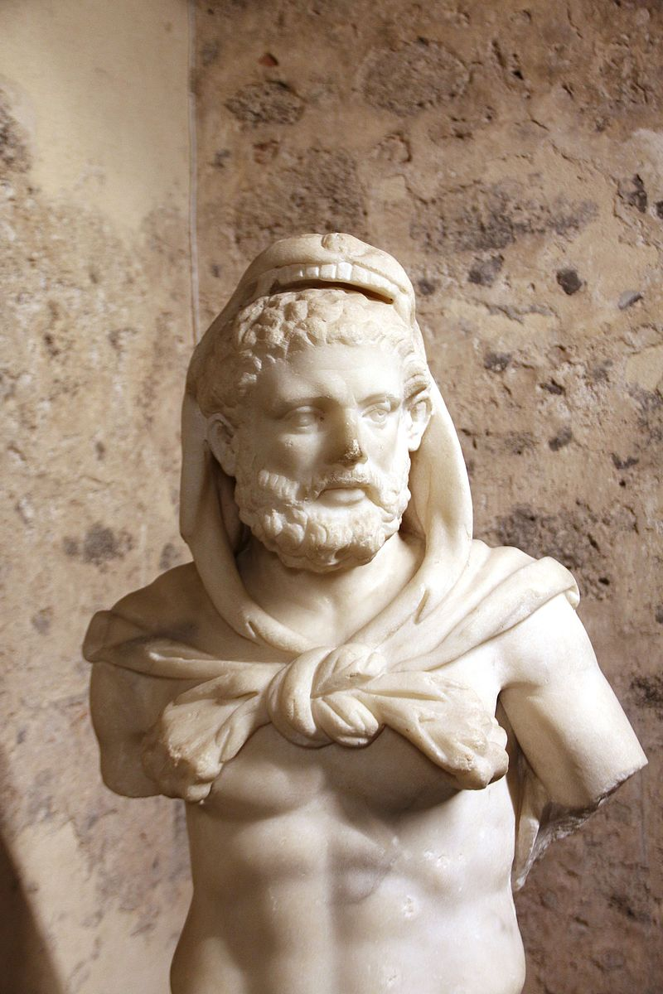
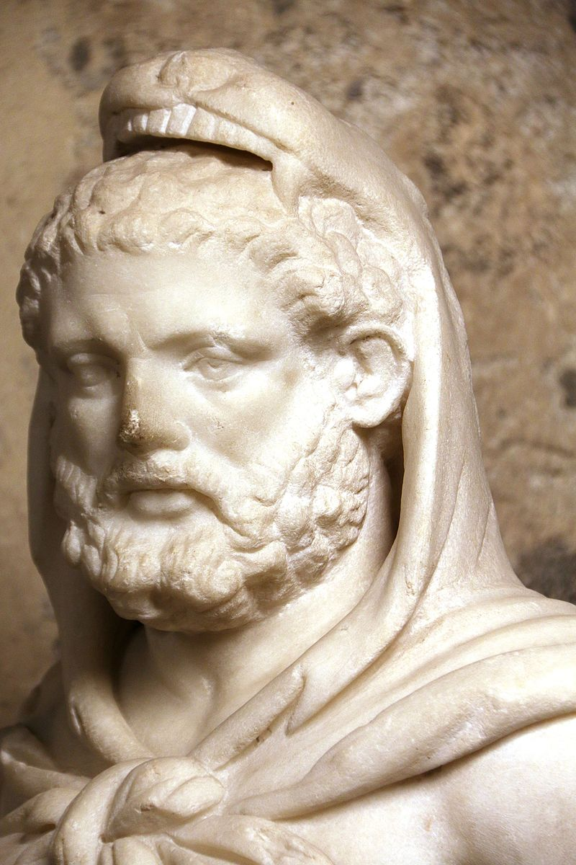
15th Slide: Ancient Roman statue of Heracles, 2nd century AD, Castello Ursino castle Museum in Catania, Italy

Slide 17
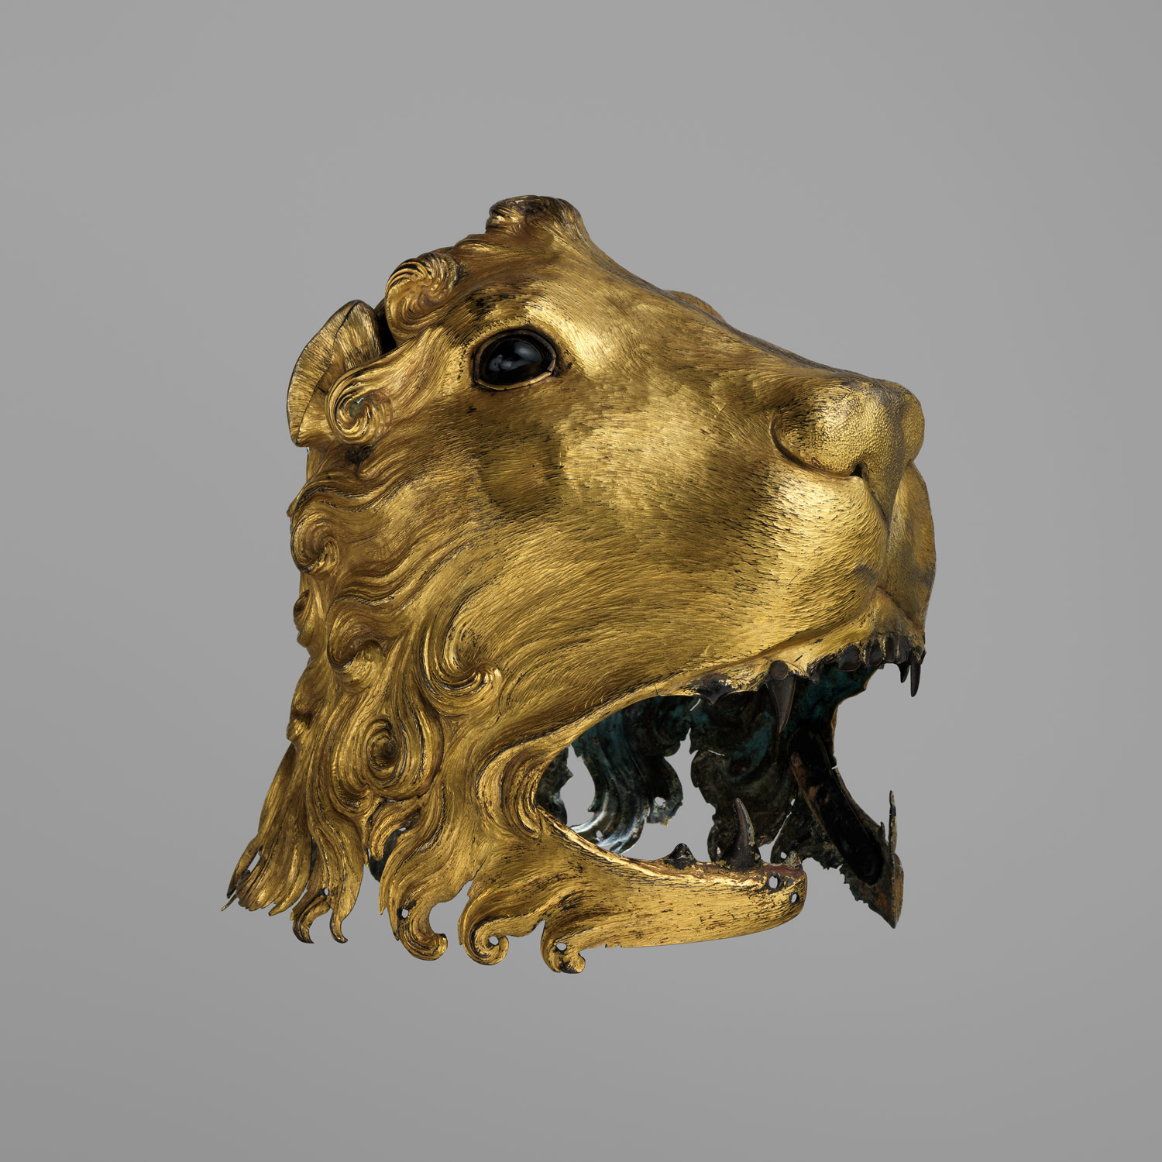
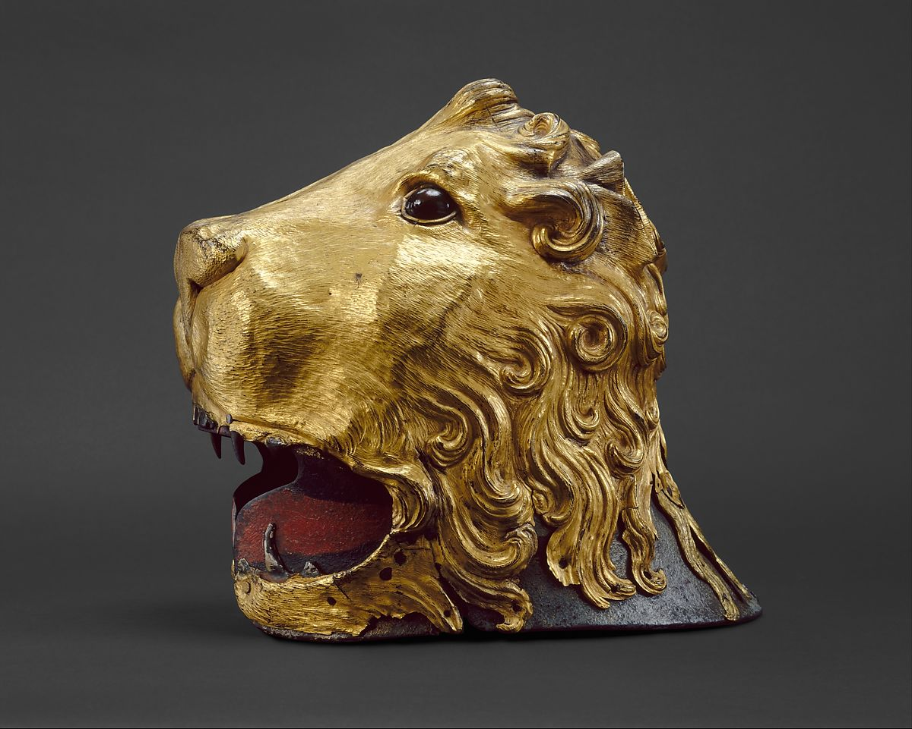
16th Slide: Helmet in the Shape of a Lion's Head, it represents the Lion of Nemea, ca. 1475–80, Italian, steel, copper, gold, glass, pigment, textile, the MET, NY

Slide 18
Copyrights
Heracles and the Nemean Lion, neck amphora, 540-530 BC, terracotta, black-figure technique, Arthur M. Sackler Museum, Harvard University https://www.harvardartmuseums.org/art/289262 https://commons.wikimedia.org/wiki/Category:Nemean_Lion_in_Ancient_Greek_pottery#/media/File:Herakles_and_the_Nemean_Lion,_with_Theseus_and_the_Minotaur,_neck_amphora_(storage_jar),_Greek,_Attic,_540-530_BC,_terracotta,_black-figure_technique_-_Arthur_M._Sackler_Museum,_Harvard_University_-_DSC01551.jpg
Public Domain - by Daderot
Locations across Greece that Heracles visited during his Adventures and a Map of the World https://commons.wikimedia.org/wiki/Category:Maps_of_ancient_Greece#/media/File:Ancient_Regions_Mainland_Greece.png https://commons.wikimedia.org/wiki/Maps_of_the_world#/media/File:Eckert4.jpg
Public Domain
The Archaeological site of Nemea https://commons.wikimedia.org/wiki/Category:Stadium_of_Nemea#/media/File:Nemea_Ancient_Stadium_with_the_starting_line_in_the_foreground,_built_ca._330_-_300_BC,_Ancient_Nemea,_Greece_(14114674713).jpg
Public Domain - by Carole Raddato from FRANKFURT, German https://commons.wikimedia.org/wiki/Category:Temple_of_Zeus_in_Nemea#/media/File:Nemea1.jpg
Public Domain - by Heinz Schmitz https://commons.wikimedia.org/wiki/Category:Temple_of_Zeus_in_Nemea#/media/File:Nemea_-_Temple_of_Zeus2.jpg
Public Domain – by Ophelia2
Attic amphora showing Heracles and the lion of Nemea, 6th Century BC , black-figure pottery, Portland Museum
Lycethos showing Heracles and the Lion of Nemea, c.540 BC , black-figure Boetian pottery, the Louvre, Paris, France http://portlandartmuseum.us/mwebcgi/mweb.exe?request=record;id=7443;type=101
Public Domain https://commons.wikimedia.org/wiki/File:Herakles_lion_Louvre_CA1340.jpg
Public Domain
"I seized him by the scruff of his iron neck, having thrown my bow to the ground with my broidered quiver. Then I throttled him mightily with my stout hands, reaching round from behind lest he lacerate my flesh with his claws." - Theocritus, Idylls 25.150
Kylix cup with Heracles and the Nemean Lion, c. 560-530 BC, by the Little Masters, Attic black-figure vase, Middlebury College Museum of Art, Middlebury, VT, USA https://commons.wikimedia.org/wiki/File:Band_cup_with_Herakles_and_the_Nemean_Lion,_by_the_Little_Masters,_Greek,_Attic,_c._560-530_BC,_terracotta_-_Middlebury_College_Museum_of_Art_-_Middlebury,_VT_-_DSC07971.jpg
Public Domain – by Daderot
Heracles fighting the Nemean Lion. Detail of The Twelve Labours Roman mosaic from Llíria, Valencia, Spain, between 201 and 250 AD, National Archaeological Museum of Spain https://en.wikipedia.org/wiki/Nemean_lion#/media/File:Mosaico_Trabajos_H%C3%A9rcules_(M.A.N._Madrid)_01.jpg by Luis García (photo) https://commons.wikimedia.org/wiki/Category:Twelve-Labours_Roman_mosaic_from_Ll%C3%ADria_(M.A.N.,_Madrid)#/media/File:Museo_Arqueol%C3%B3gico_Nacional_-_38315BIS_-_Mosaico_de_los_trabajos_de_H%C3%A9rcules_01.jpg
Public Domain – by Cases Ortega, Gonzalo (photo)
Roman copy of Heracles and the Lion of Nemea, a 1st to 2nd century Roman copy of an original 4th century BC statue by Lysippus, Hermitage Museum, St. Petersburg https://commons.wikimedia.org/wiki/Category:Statues_of_Heracles#/media/File:Heracles_Slaying_the_Lion_of_Nemea-2-Hermitage.jpg
Public Domain – by Yair Haklai

Slide 19
Heracles and the Lion of Nemea, 6thcentury Byzantine silver plate, 60 cm in diameter, National Library of France https://commons.wikimedia.org/wiki/Category:Missorium_of_Herakles
Public Domain
Detail
Cameo with Heracles and the Nemean Lion within a Garland, Date: ca. 1220–40, South Italian, Sardonyx with modern gold frame, 4.2 x 3.6 x 0.8cm, the MET, NY https://www.metmuseum.org/toah/works-of-art/38.150.23/
Public Domain
Heracles and the Lion of Nemea, 1470-80, Manuscript Illumination in Raoul Lefèvre’s book « History of Troy », paper and parchement, Royal Library of Belgium https://commons.wikimedia.org/wiki/Category:Heracles_and_the_Nemean_Lion#/media/File:Hercule-KBR-ms9254-f79-detail.jpg
Public Domain
Antonio Tempesta, Italian,1555-1630 and Nicolo Van Aelst, Flemish, 1527-1612
Heracles and the Lion of Nemea, c. 1608, print, LACMA, CA, USA https://commons.wikimedia.org/wiki/Category:Heracles_and_the_Nemean_Lion#/media/File:Hercules_and_the_Nemean_Lion_LACMA_65.37.8.jpg
Public Domain
Peter Paul Rubens, 1577 - 1640
Heracles Strangling the Nemean Lion, 1639, Oil on cradled panel, with traces of red chalk, Harvard Art Museums/Busch-Reisinger Museum https://commons.wikimedia.org/wiki/Category:Heracles_and_the_Nemean_Lion#/media/File:Lion_of_Nemea.jpg
Public Domain
Heracles and the Lion of Nemea, early 17th century, possibly French, Bronze, with etched golden-brown surface, oxidized dark brown where rubbed, Height: 24.4 cm, the MET, NY https://www.metmuseum.org/art/collection/search/207010
Public Domain
Ancient Roman statue of Heracles, 2nd century AD, Castello Ursino castle Museum in Catania, Italy https://commons.wikimedia.org/wiki/File:9827_-_Heracles_(2nd_centuy)._Castello_ursino,_Catania_-_Photo_by_Giovanni_Dall%27Orto,_October_28_2016.jpg
Public Domain
Helmet in the Shape of a Lion's Head, it represents the Lion of Nemea, ca. 1475–80, Italian, steel, copper, gold, glass, pigment, textile, the MET, NY https://www.metmuseum.org/toah/works-of-art/23.141/
Public Domain

