Slide 1
7
Roarsome Lion Facts

Slide 2
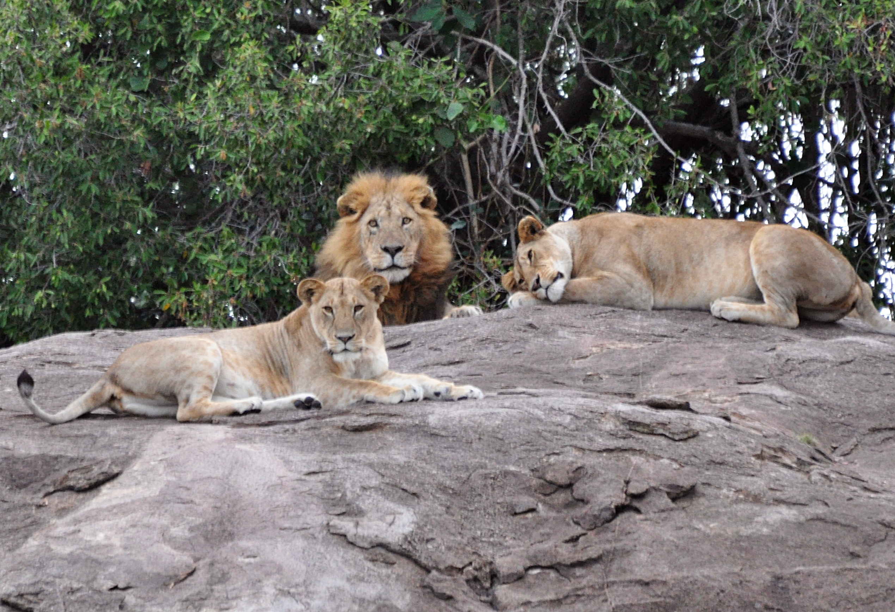
Fact 1: Lions live in prides, that is groups of 10 or 15 animals. https://www.youtube.com/watch?v=EVZFdJlzExQ

Slide 3
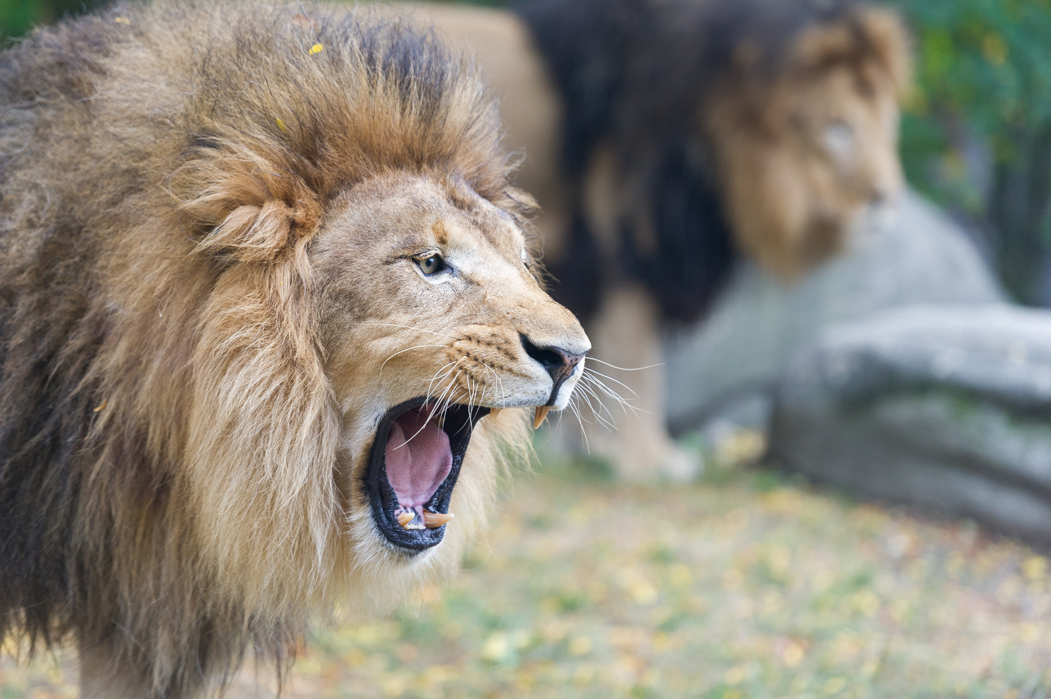
Fact 2:
Listen carefully!!!
Even if you are 8km away, you can hear a Lion’s ROAR. https://www.youtube.com/watch?v=pgTZBjwf3qM

Slide 4
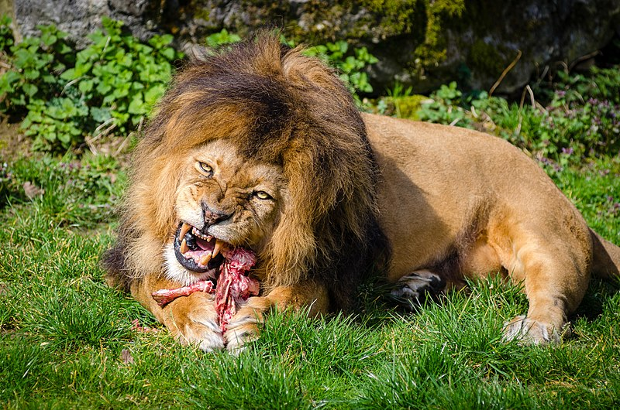
Fact 3: Watch out, from dusk to dawn, Lions go hunting! The male Lions are responsible for the pride’s safety, while the female lions do the actual hunting. A female lion needs 5kg of meat a day. A male needs 7kg or more a day.

Slide 5
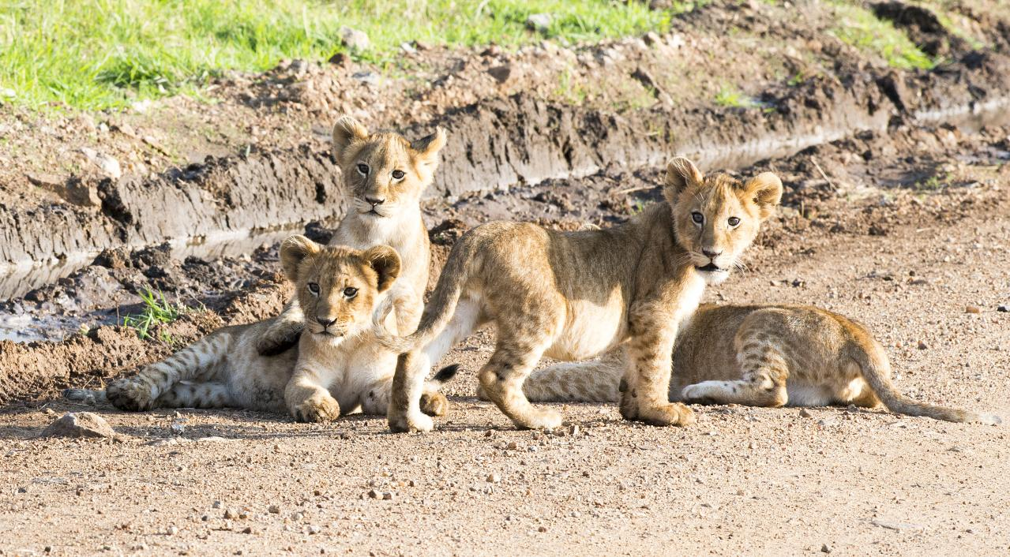
Fact 4: Do you know how baby lions are called? Check these words out: cubs, whelps or lionets. https://www.youtube.com/watch?v=UoN2qtdE1YI

Slide 6
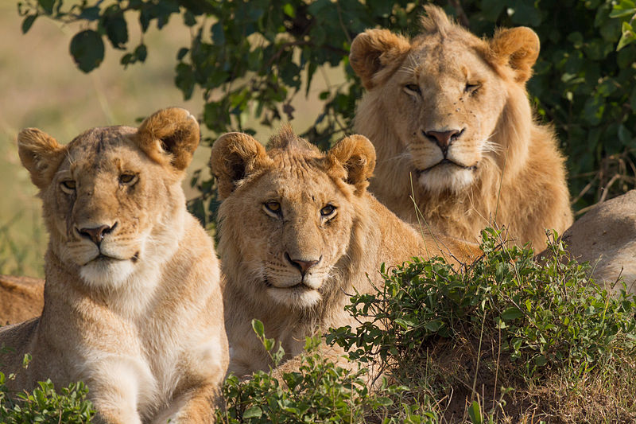
Fact 5: In their natural habitat, lions can live between 12 to 16 years. In captivity, they live up to 25 years.

Slide 7
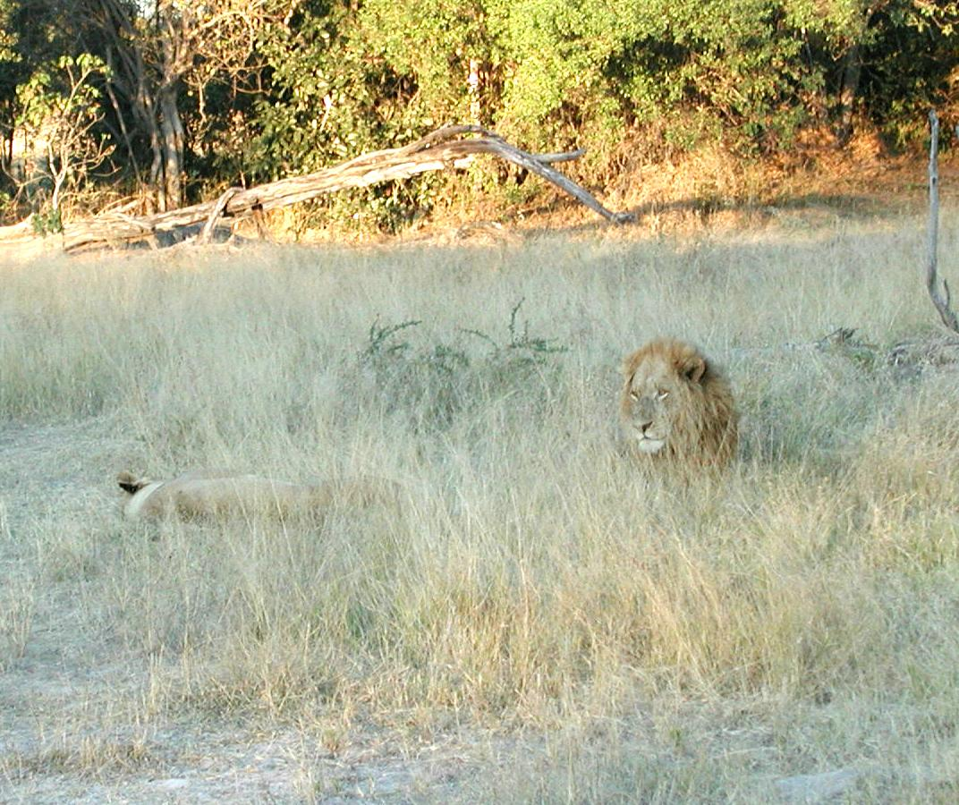
Fact 6: Lions are called ‘kings of the jungle’. In reality, they live in the savannah or grasslands. https://www.youtube.com/watch?v=Nh_9k9cqx4k

Slide 8
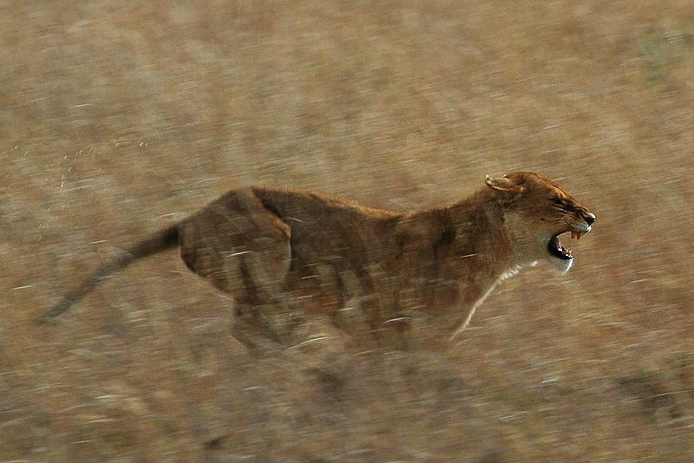
Fact 7: 81km per hour, this is how fast Lions can run! https://www.youtube.com/watch?v=HUW67ZUrdVM

Slide 9
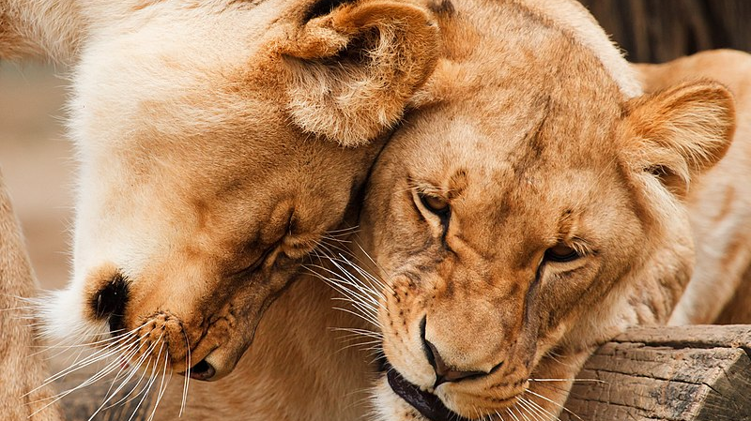

Slide 10
Copyrights – Facts about Lions
Fact 1: Lions live in prides, that is groups of 10 or 15 animals. https://commons.wikimedia.org/wiki/File:Pride_leader.jpg
Public Domain
Fact 2: Listen carefully!!! Even if you are 8km away, you can hear a Lion’s ROAR. https://commons.wikimedia.org/wiki/File:Two_Lions_Roaring_-_Closeup_(20842585554).jpg
Public Domain
Fact 3: Watch out, from dusk to dawn, Lions go hunting! Female lions do 85-90% of the pride’s hunting, whilst the male lions patrol the territory and protect the pride. A female lion needs 5kg of meat a day. A male needs 7kg or more a day. https://commons.wikimedia.org/wiki/File:Carnivore-lion.jpg
Public Domain
Fact 4: Lions are called ‘kings of the jungle’. In reality, they live in the savannah or grasslands. https://commons.wikimedia.org/wiki/File:Lion_cubs_on_the_Masai_Mara.jpg
Public Domain
Fact 5: In their natural habitat, lions can live between 12 to 16 years. In captivity, they live up to 25 years. https://sq.m.wikipedia.org/wiki/Skeda:Lions_Family_Portrait_Masai_Mara.jpg
Public Domain
Fact 6: Lions are called ‘kings of the jungle’. In reality, they live in the savannah or grasslands. https://commons.wikimedia.org/wiki/File:Lions_in_the_savannah.jpg
Public Domain
Fact 7: 81km per hour, this is how fast Lions can run! https://commons.wikimedia.org/wiki/File:Serengeti_Lion_Running_saturated.jpg
Public Domain https://commons.wikimedia.org/wiki/File:Africa-animal-big-carnivore-87410.jpeg
Public Domain

